Slide 1
IEEE802.11bn WLANs and WMANs
Date: 2024-05-13
Authors:

Slide 2
Abstract
TWI’s candidate Dynamic Polarization TGbn PHY incorporates radical new MIMO Multiplexing and Beamforming techniques to achieve its claimed 32x Rate/ 8x Range gains over WiFi-7. While representing WMAN manna from heaven (perhaps to a world-changing degree), DPWiFi seems to provide meagre, if any, WLAN benefit. And reconciling the two essentially mutually exclusive Polarization and Spatial MIMO (“PMX” and “SMX”) constructs within the one TGbn standard would appear a Herculean, if at all possible, endeavour. Therefore, TWI will propose herein an alternative TGbn methodology arguably better suited to such a novel “disjoint dual protocol suite” standard development.

Slide 3
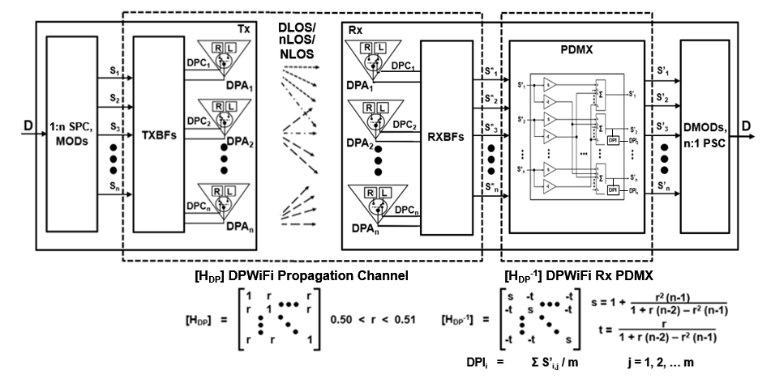
DPWiFi MIMO Multiplexing and Beamforming
AP
Client
32 EHT Streams
92.2 Gbps, Max
32 Element Tx Phased Array
25 – 38 dBi
32 Element Tx Phased Array
21 dBi
DPWiFi transports 32 EHT streams in an up to 92Gbps-in-320MHz pencilbeam at 5-7 GHz

Slide 4
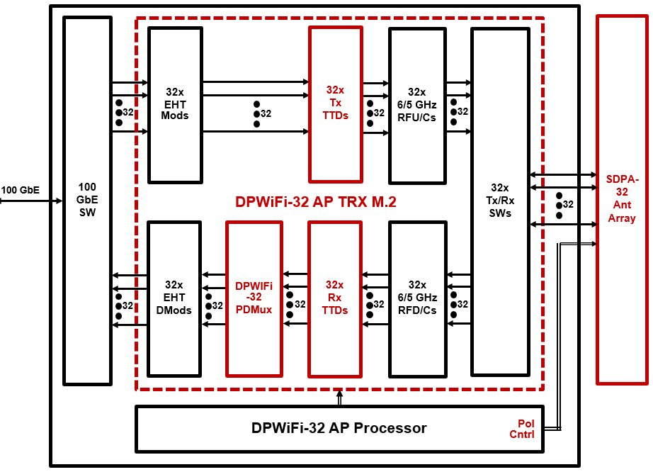
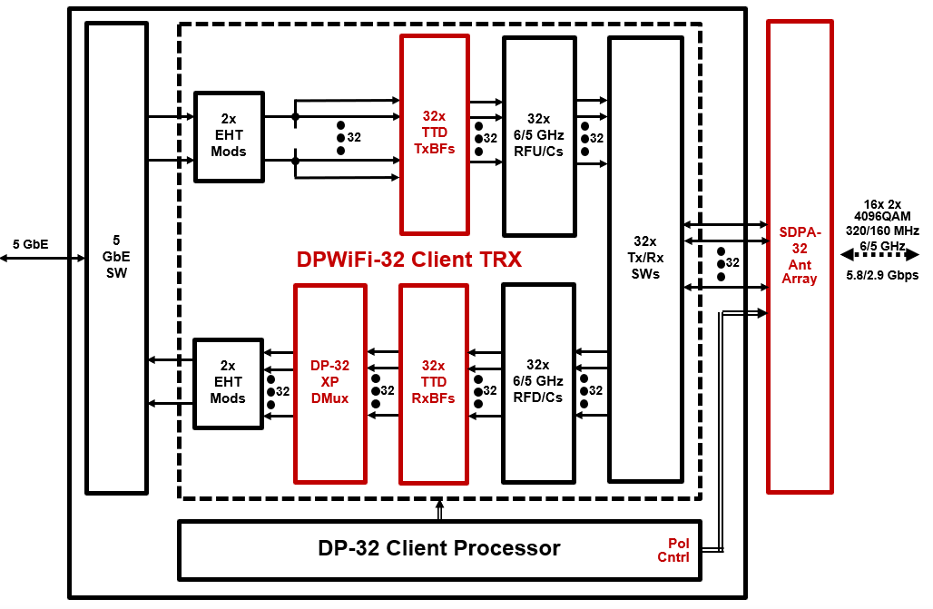
Breakthrough DPWiFi SoCs

Slide 5
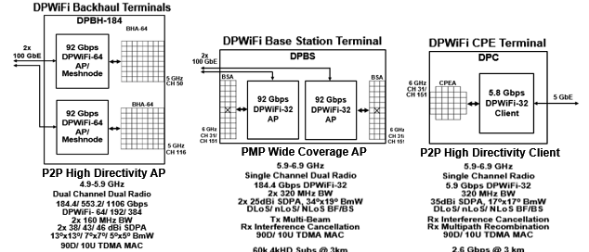
Disruptive DPWiFi APs and Clients

Slide 6
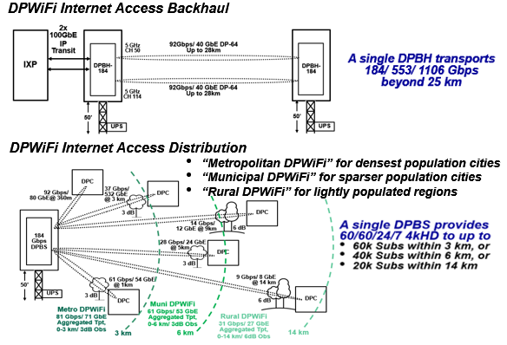
Revolutionary DPWiFi Networks

Slide 7
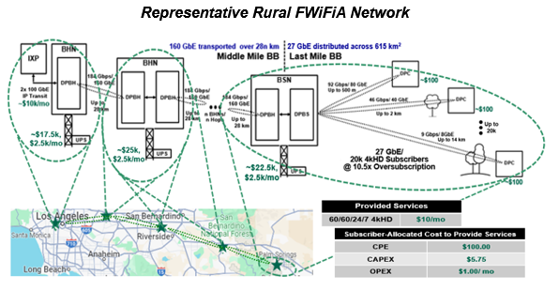
Transformative DPWiFi WMANs
DPWiFi could deliver $10/mo Home 4kHD Broadband to 2.5B global subscribers by 2030

Slide 8
DPWiFi UHR WMAN/WLAN Relevance
PMX UHR Protocol WMAN Benefit WLAN Benefit
32x32 MIMO Polarization Multiplexing Y N
32x32 MIMO True Time Delay Beamforming Y N
Open Loop Channel Sounding Y N
Open Loop Direction of Arrival Estimation Y N
Split Array Tx Multibeam Y N
MVDR/ LCMV Rx Nullsteering Y N
90DS/ 10US/ 32k ACL TDMA MAC Y N
TGbn-proposed DPWiFi PMX Protocols ONLY benefit IEEE WMANs

Slide 9
Legacy WiFi UHR WMAN/WLAN Relevance
SMX UHR Protocol WMAN Benefit WLAN Benefit
MAP N Y
DRU N Y
UEQM/ MCS N Y
Preamble N Y
Preemption N Y
Beamforming N Y
MIMO N Y
Power Save N Y
CCA N Y
Sounding N Y
Coexistence N Y
TGbn-proposed Legacy WiFi SMX Protocols ONLY benefit IEEE WLANs

Slide 10
Efficient Disjoint Dual Protocol Wireless Standard Development
Problem Statement: TGbn is ill-equipped to concurrently develop distinct (and practically mutually exclusive) UHR protocol suites for both IEEE802.11 WLANs and WMANs
Proposed Resolution Restructure TGbn by adding a 4th Ad Hoc subtask group and slightly restructuring the resulting 4 respective charters as follows:
Joint WLAN/WMAN Ad Hoc: Addresses common/cross WLAN/WMAN issues
WLAN MAC Ad Hoc develops SMX MAC UHR protocols, as it does now
WLAN PHY Ad Hoc develops SMX PHY UHR protocols, as it does now
WMAN Ad Hoc develops PMX MAC and PHY UHR protocols

Slide 11
References
1. 23/1606r1-UHRSG Dynamic Polarization Multiplexing and Beamforming WLANs Carlos A Rios (Terabit Wireless Internet), 13-Sep-2023
23/1756r3-TGbn MIMO Dynamic Polarization and Beamforming: Proposed IEEE802.11bn PHY Carlos A Rios (Terabit Wireless Internet), 16-Nov-2023
24/0041r12-TGbn DPWiFi MATLAB Validation Carlos A Rios (Terabit Wireless Internet), 02-Feb-2024
24/0440r6-TGbn DPWiFi for IEEE802.11bn WMANs Carlos A Rios (Terabit Wireless Internet), 22-Apr-2024

