Slide 1
Channel Switching Between Coordinating APs
Date: 2024-03-07
Authors:

Slide 2
Abstract
Several aspects of Multi-AP coordination has been actively discussed in 11bn.
  Coordinated TDMA [1]
  Coordinated Spatial Reuse [2]
  Coordinated Beamforming [3]
  Coordinated TWT [4]
Clearly, an AP may want to operate in a channel where it can coordinate with co-channel APs, rather than with APs that it cannot.
In this contribution, we discuss enhancements to AP channel switching to enable APs to operate in channels with other cooperative APs.

Slide 3
Extended Channel Switch
The Extended Channel Switch Announcement element is used by an AP in a BSS or a STA in an IBSS to advertise when it is changing to a new channel and the channel number of the new channel.
The element may be carried in management frames sent by APs, e.g. Beacon Frames
The reason for changing to a new channel can be due to a Hidden Node Interference Problem in the current channel. The extended channel switch element includes
  New Channel Number – The channel number of the new channel
  Channel Switch Count- the number of TBTTs (beacon intervals) before channel switching
The information New Channel Number and Channel Switch Count can also be carried in a standalone frame called Extended Channel Switch Announcement frame

Slide 4
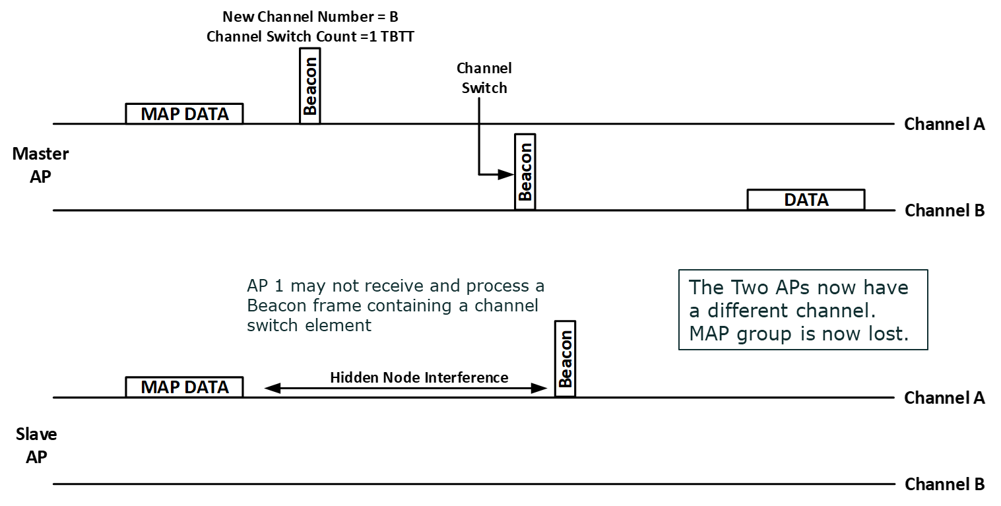
Motivation
When an AP belonging in a Multi-AP group switches channel (e.g. avoiding congestion on the current channel), it may lose the benefits of Multi-AP coordination.
- e.g. longer range when two APs can perform joint transmission.
While APs may know by receiving beacons of other APs whether the other AP is channel switching, it is not a reliable mechanism (APs not required to parse beacons of other APs).

Slide 5
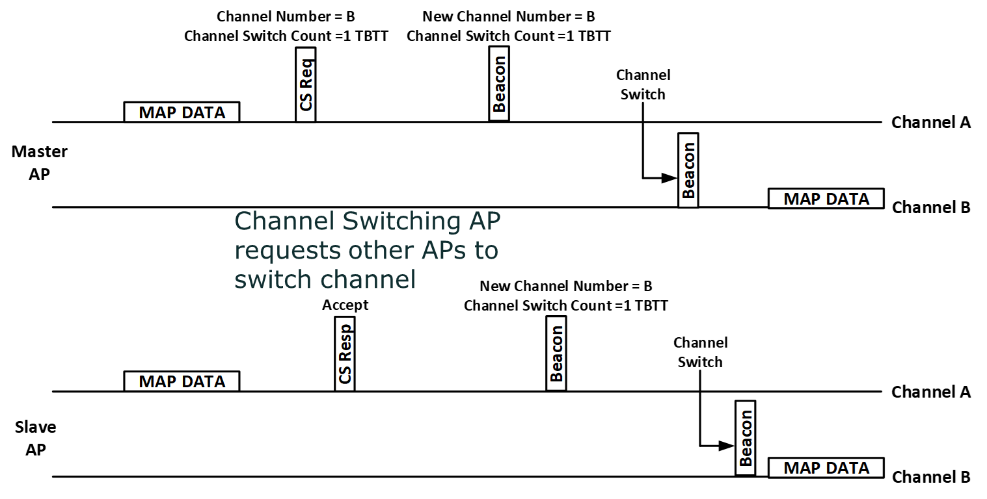
Proposal
Define a mechanism for robust notification of channel switch between APs.
  Channel Switch Notification from one AP to another AP
  Channel Switch Request/Response exchange
The new frames may include a list of channels that an AP may want to switch to.
Details of the mechanism is TBD.

Slide 6
Conclusion
We have presented a proposal to enhance channel switch mechanism between coordinating APs.
With this mechanism, an AP may be able to request another coordinating AP to switch to a channel together and maintain coordination.

Slide 7
References
[1] https://mentor.ieee.org/802.11/dcn/23/11-23-1895-00-00bn-c-tdma-frame-sequence.pptx
[2] https://mentor.ieee.org/802.11/dcn/23/11-23-1868-00-00bn-coordinated-spatial-reuse-design.pptx
[3] https://mentor.ieee.org/802.11/dcn/24/11-24-0009-00-00bn-coordinated-beamforming-coordinated-beamforming-for-802-11bn.pptx
[4] https://mentor.ieee.org/802.11/dcn/23/11-23-1916-00-00bn-r-twt-coordination-in-multi-bss.pptx

