Slide 1
Pre-allocation of sub-band for DSO – follow up
Date: 2024-03-08
Authors:

Slide 2
Abstract
This document proposes pre-allocation of sub-bands to devices operating in Dynamic Sub-band Operation (DSO) mode at the beginning of a TXOP, to minimize the need for padding. This solution was partly discussed before in 11-23-2027r2 [4]. Here we provide more details of the same.

Slide 3
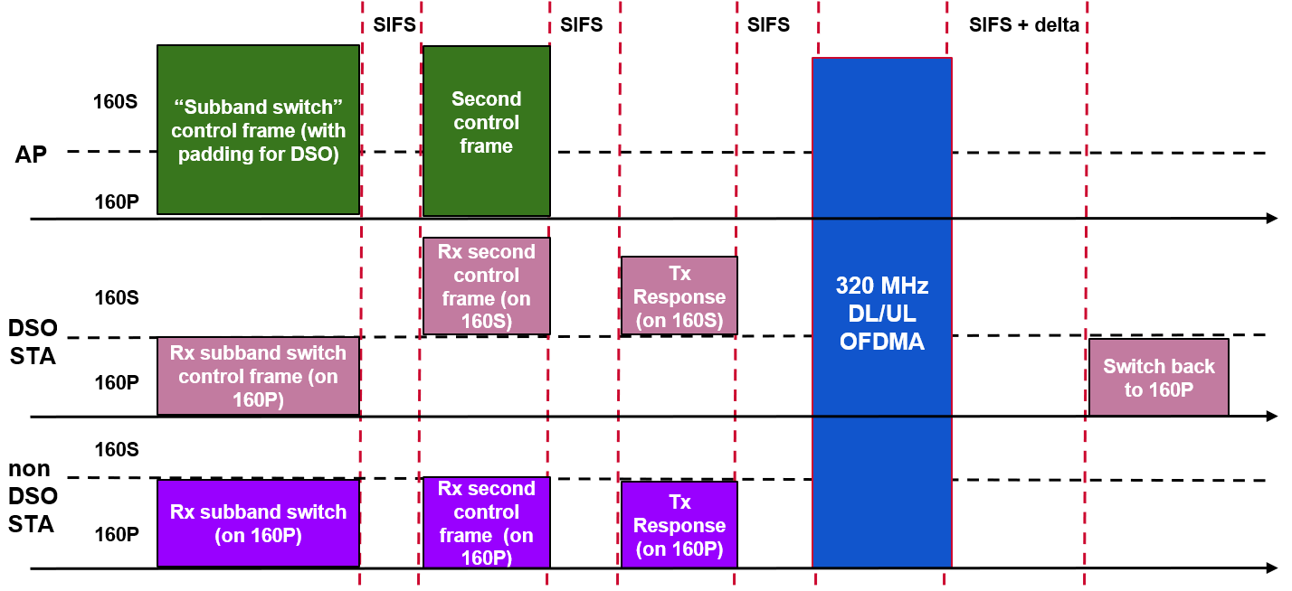
Dynamic Sub-band Operation - Recap
As the maximum supported bandwidth by WiFi rises, non-AP STAs may operate with a smaller supported bandwidth than the AP.
To exploit the full bandwidth supported by an AP efficiently, Dynamic Sub-band Operation (DSO) was proposed in 11-22-2204r0 [1].
In a TXOP, an AP can indicate to DSO-capable clients the sub-band on which they will be served within the TXOP.
The AP initiates transmission to the DSO STAs after sufficient delay to allow the DSO devices to perform the channel switch. The AP also ensures protection of the TXOP for the duration of this switch.
At the end of the TXOP the DSO STAs switch back to the primary channel.

Slide 4
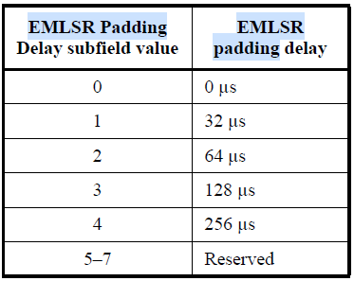
Problem: Padding overhead
Using padding to occupy the channel while DSO STAs perform a switch is a waste of resources.
Expected padding delay required for DSO STAs:
80MHz+ devices: 32-64 $μs$.
20MHz only devices: 500-1000 $μs$.
Note 1: In enterprise scenarios with 80MHz BSS BW, main benefactors of DSO are 20MHz only STAs.
Note 2: In multi-user transmission, the required padding may be the largest among all the DSO STAs served.
In a long TXOP or B-TWT SP, multiple STAs can be served sequentially. Providing separate padding each time, exacerbates the overhead.
The padding provided within a TXOP should be minimized, especially in a long TXOP that follows SIFS bursting or a broadcast target wake time (B-TWT) service period.

Slide 5
Pre-allocation of sub-band
A sub-band switch initial control (SBS IC) frame sent in the beginning of a TXOP may carry the sub-band indication for DSO STAs served later in the TXOP.
The main goal of pre-allocation is to reduce the padding overhead. See backup slides for overhead comparison from an example scenario.
Note: A separate trigger frame can be sent to the pre-allocated STAs before they are served, but without the need for padding.
Without pre-allocation
TXOP
Frequency
Data for STA2
Data for STA1
…
Data for STA4
Data for STA3
…
Data for STA6
Data for STA5
SBS IC
Padding
SBS IC
Padding
SBS IC
Padding
Time
Resp.
Resp.
Resp.
TXOP
Frequency
Data for STA2
Data for STA1
…
Data for STA4
Data for STA3
…
Data for STA6
Data for STA5
…
SBS IC
Padding
Time
Resp.
With pre-allocation

Slide 6
Indication of response from pre-allocated DSO STAs
The SBS ICF should carry an indication of whether a DSO STA is required to respond to the IC frame.
The STAs indicated to not respond may be a subset of the “pre-allocated” STAs.
Why is restricting the ICF response helpful?
There may be insufficient RUs to multiplex all served STAs within the ICF response.
E.g. CTS needs minimum 20MHz BW. For BSR/BQR, there may be a limit the RU allocation size per STA to manage residual CFO (see doc. 11-24/299r1).
If the ICF is an MU-RTS frame, CTS response should be from STAs served first. This helps AP determine (i) if these STAs have performed the switch, and (ii) the 20MHz sub-bands which have been detected as idle by these STAs.
Example: MU-RTS on 80MHz with 40MHz allocation to STA1 and STA 2 each.
TXOP
Frequency
Padding
Data for STA2
Data for STA1
…
Data for STA4
Data for STA3
…
MU-RTS
Time
From STA 2
CTS
From STA 1

Slide 7
Indication of response from pre-allocated DSO STAs contd.
Why is restricting the ICF response helpful? (contd.)
It can reduce the required padding in ICF, since padding need not account for DSO STAs that do not send a response.
Example: AP obtains 80MHz TXOP. STA 1-2 are 80 MHz STAs, STA 3-6 are 20 MHz-only STAs. All STAs allocated sub-bands in first MU-RTS, no response solicited from STA 3-6.
It can aid a DSO STA anticipate when it will be served. This can help a STA save power, and has beneficial effect when there are coexistence issues.
TXOP
Frequency
Data for STA2
Data for STA1
Data for STA 6
MU-RTS
…
MU-RTS
Data for STA 5
…
Data for STA 4
Time
Data for STA 3
From STA 2
From STA 5
From STA 6
From STA 1
CTS
From STA 3
CTS
From STA 4

Slide 8
Example – Using MU-RTS frame
Here we assume SBS IC frame is an MU-RTS frame.
The RU Allocation subfield of the User Info field corresponding to a DSO STA indicates the sub-band to be monitored by the DSO STA for the TXOP duration (can be a non-primary 20/40/80/160 MHz).
Small change required to the spec to allow indication of non-primary channels.
The Response Solicited field in the User Info field corresponding to a DSO STA is set to 0 to indicate that the DSO STA is not expected to send a CTS response frame.
If the Response Solicited field corresponding to a DSO STA is set to 1, the CTS response by the DSO STA is sent on the RUs indicated by the RU Allocation subfield corresponding to the STA.
Frame Control | Duration | RA | TA | Common Info | User Info List | Padding | FCS
User Info field 1 | … | User Info field N
AID12 | RU Allocation | Response Solicited | Reserved
Bits: 12 8 1 19

Slide 9
Conclusion
Using padding in SBS IC frame to reserve medium for the time required for DSO sub-band switch can be inefficient.
Enabling pre-allocation of sub-bands to DSO STAs in the beginning of a TXOP, minimizes the amount of padding required in long TXOPs serving multiple STAs.
Allowing the AP to indicate in the SBS IC, the DSO STAs which should send a response to the SBS IC has several benefits.

Slide 10
Straw polls
SP1: Do you agree to allow DSO Sub-band Switch initial control frame to provide sub-band indication for any DSO STA scheduled to be served within the TXOP?
Yes
No
Abstain
SP2: Do you agree to allow DSO Sub-band Switch initial control frame to indicate to an addressed DSO STA, if a response is solicited from the STA?
Yes
No
Abstain

Slide 11
References
11-22-2204-00-0uhr-dynamic-subband-operation.pptx
11-23-0843-01-0uhr-considerations-on-dynamic-subchannel-operation.pptx
11-23-1496-00-0uhr-emlsr-dynamic-subband-operation.pptx
11-23-2027-02-00bn-considerations-for-dso-sub-band-switch-delay.pptx
11-24-0299-00-00bn-initial-ctrl-frame-for-bw-switching-modes.pptx

Slide 12
Backup slides

Slide 13
Example – Using BSRP frame
Here we assume SBS IC frame is a BSRP frame.
The RU Allocation subfield of the User Info field corresponding to a DSO STA indicates the response frame RUs (if response is required to be transmitted by the STA).
The sub-band to be monitored by the DSO STA is either (i) indicated separately in a Sub-band Allocation subfield, or (ii) there is a unique mapping from the RU Allocation to the sub-band to be monitored (for a given STA operating BW).
The Response Solicited field in the User Info field corresponding to a DSO STA is set to 0 to indicate that the DSO STA is not expected to send a response frame.
Note: BSRP doesn’t have any reserved fields in User Info field. Expansion for such new fields can be accommodated by including a 2nd User Info field with same AID12.
Frame Control | Duration | RA | TA | Common Info | User Info List | Padding | FCS
User Info field 1 | … | User Info field N
AID 12 | RU Allocation |  |  |  |  |  | Response Solicited | Sub-band Allocation
Other fields
Bits: 12 8 1 8

Slide 14
Overhead comparison in an example scenario
Consider AP wins a TXOP of duration 2.5ms with the TXOP bandwidth being 160MHz.
Let us assume the AP intends to serve 6 DSO-capable 80MHz STAs within the TXOP in the secondary 80MHz channel as illustrated below. The primary 80MHz may be used to serve non-DSO devices within the TXOP.
We assume the STAs have Channel Switch Times of $\{0, 16, 256, 32, 64, 128\}μs$, respectively.
We assume the SBS IC frame is transmitted with a data rate of 6Mbps. We assume the fields of SBS IC can be comparable in size to MU-RTS frame.
MU-RTS frame components | Bits | Time ($μ$s)
PHY header | -- | 20
MAC header | 128 | 21.33
Common Info | 64 | 10.67
User Info/STA | 40 | 6.67
FCS | 32 | 5.33
Secondary 80MHz
Tx to STA1
Tx to STA3
Tx to STA5
Tx to STA2
Tx to STA4
Tx to STA6
Primary 80MHz
Non-DSO STAs
TXOP duration

Slide 15
Overhead comparison results
Baseline: 3 separate SBS ICs carry indication for DSO STAs just before transmission to them. ACK/CTS solicited from all the addressed DSO STAs.
Overhead = 3$×$[Duration of SBS IC (with Padding) + SIFS]: $660.01μ$s. (26.4% of TXOP)
Preallocation: SBS IC carries indication for all DSO STAs 1-6. ACK/CTS solicited from all DSO STAs. MAC padding of $256μ$s is used to reserve medium.
Overhead = Duration of SBS IC (with Padding) + SIFS: $369.35μ$s. (14.8% of TXOP)
Preallocation + noResponse: SBS IC carries indication for all DSO STAs 1-6. CTS solicited only from DSO STAs 1-2. MAC padding of $16μ$s is used to reserve medium.
Overhead = Duration of SBS IC (with Padding) + SIFS: $129.35μ$s. (5.2% of TXOP)
SBS IC1
Data to STA1-2
SBS IC2
Data to STA3-4
SBS IC3
Data to STA5-6
Resp.
Resp.
Resp.
SBS IC (padding)
Data to STA 1-6
Resp. from STAs 1-6
SBS IC (padding)
Data to STA 1-6
Resp. from STAs 1,2

