Slide 1
High Level Thoughts on LDPC Rate Matching for 11bn
Date: 2024-01-08
Authors:

Slide 2
Problem Statement
LDPC rate matching schemes are proposed in [2] based on the PSDU size statistics provided in [1].
Before putting efforts into the rate matching designs, it is worth to investigate whether the statistics represents traffic patterns of majority of the Wi-Fi devices on the market.
Are the PSDU size statistics in [1][3] showing the full picture for PSDU length used in most typical Wi-Fi scenarios?
How many members have evaluated and verified those statistics?
The impact of proposed LDPC rate matching schemes on rate adaptation may be undesirable.
Aggressive MCS assignment for short packets in proposed rate matching schemes [2] can lead to sharp throughput drops in the subsequent longer packets.
Rate matching may not bring any measurable RvR improvement even if SNR sensitivities are improved as shown in [2].

Slide 3
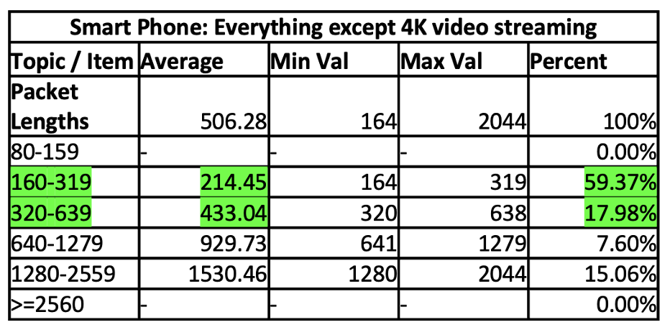
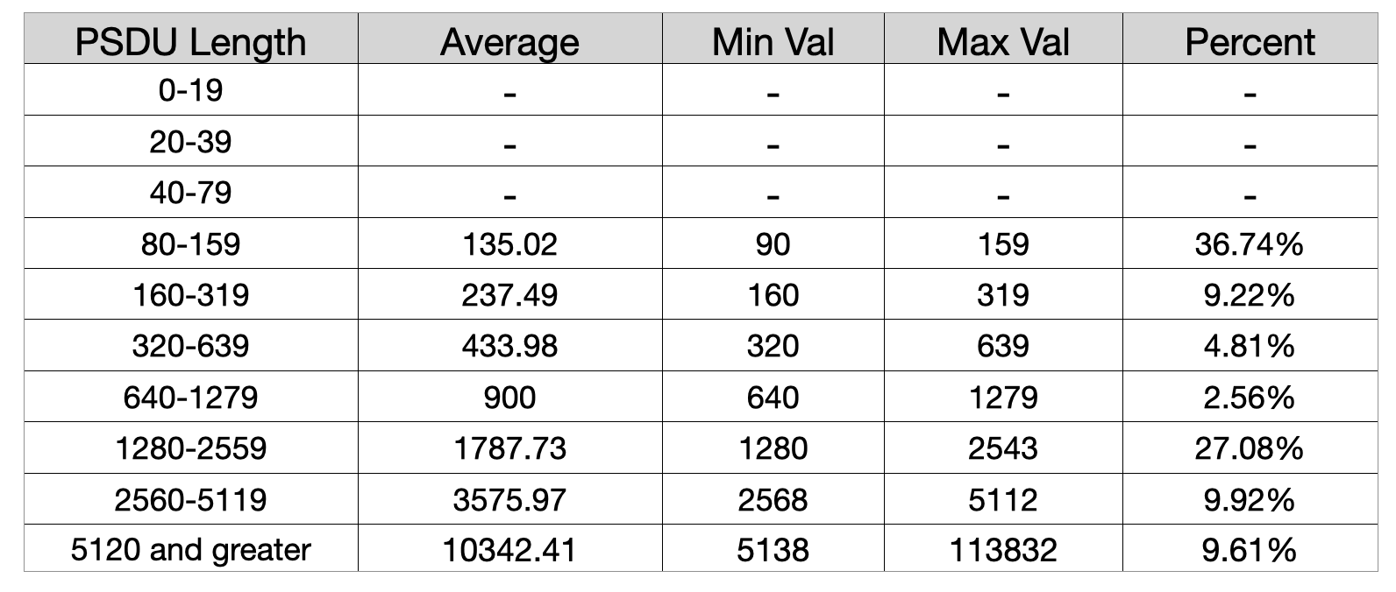
Issues of the Packet Length Statistics in [1]
We calculated PSDU lengths for smart phone usage (Everything except 4K video streaming) considering AMPDUs from measurements and compared to Packet Lengths shown in [1]. Only 802.11 MPDU data plus MAC header are used in PSDU length calculation.
Figure: Packet Size Distribution in [1] of 11ax PPDU size for QoS Data frame coded by LDPC
Figure: PSDU size (bytes) distribution when considering A-MPDUs from measurement
Our initial findings are different than [1], the % of packets with PSDU length greater than 1280 bytes is about 47% compared to 15% in [1], including 20% of packets with PSDU length greater than 2560 bytes.

Slide 4
Summary
We encourage members to do their own due diligence to collect and share the QoS data PSDU size statistics.
Impact of LDPC rate matching design on rate adaptation and RvR improvement should be evaluated before going to detailed designs.

Slide 5
Reference
[1] Revisiting of the LDPC rate matching, IEEE 802.11-23/0667r0.
[2] Analysis on the LDPC rate matching, IEEE 802.11-23/1877r0.
[3] Clarifications on the LDPC rate matching, IEEE 802.11-24/187r0.

