Slide 1
Extended 6 GHz channelization
Date: 2024-03-08
Authors:
Name | Affiliations | Address | Phone | Email
Thomas Derham | Broadcom |  |  | thomas.derham@broadcom.com
Ron Porat
Chris Szymanski

Slide 2
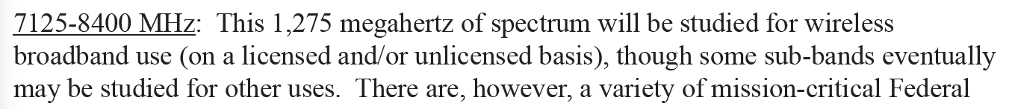
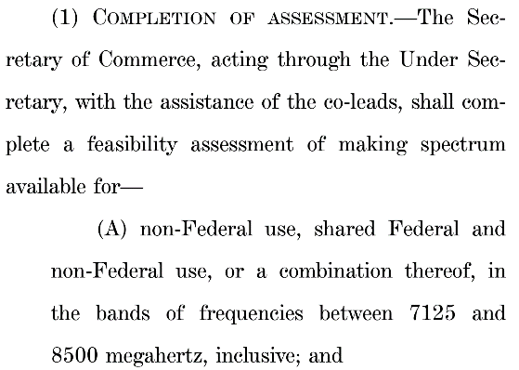
Overview
UHR PAR defines operation up to 7.250 GHz
  quote:
In current baseline (REVme + 11be), 6 GHz channelization is defined up to 7.125 GHz
  this aligns with the maximum frequency defined by many regulators for upper 6 GHz band operation (e.g. top of U-NII8 subband)
Currently multiple regulators are engaged in active discussions on enabling unlicensed access in 7-8 GHz band
  e.g. see NTIA’s National Spectrum Strategy (Nov 23) https://www.ntia.gov/sites/default/files/publications/national_spectrum_strategy_final.pdf
  e.g. see US Senate Commerce Cte’s proposed legislation “Spectrum and
  National Security Act of 2024”
  https://www.commerce.senate.gov/services/files/E29CCF6E-C888-
  4037-8938-6983261FFF07

Slide 3
New channelization
Within this band, the 7.125 – 7.250 GHz range seems particularly promising because many of the federal incumbents in the band are similar to those that operate in the 6 GHz band (e.g., Fixed Microwave Service, Fixed Satellite Service)
  It is likely that the UNII-8 rules could be extended to cover this frequency range
The availability of this range for unlicensed operation would enable one additional 160 MHz channel, immediately adjacent to the currently defined 6 GHz channels
  and, therefore, an additional (overlapping) 320 MHz channel

Slide 4
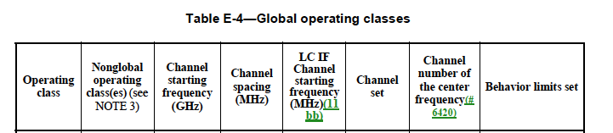
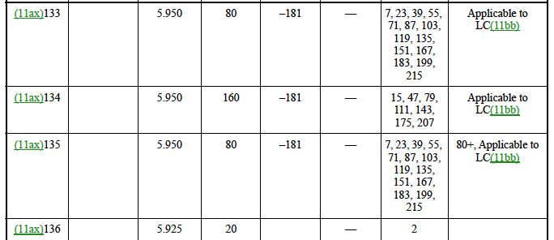
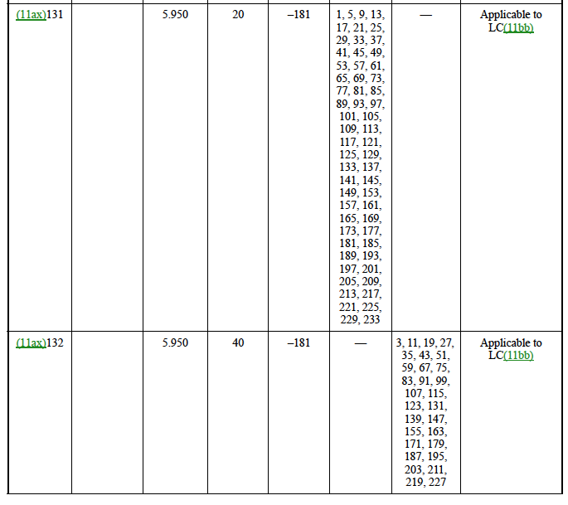
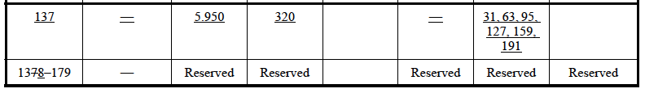
Example new channelization per Table E-4
231, 247
239
231, 247
223
237, 241, 245, 249, 253, 257
Note: Adding channels to existing OpClasses, vs defining new OpClasses for the new channels, is TBD
235, 243, 251

Slide 5
Example new channel map
7125
7245
233
257
20 MHz
227
251
40 MHz
215
247
80 MHz
207
239
160 MHz
223
320 MHz-1
191
320 MHz-2
= newly defined channels

Slide 6
Proposed next steps
(1) Define channelization in 11bn that covers 7.125-7.250 GHz
  Note: This is in accordance with the frequency range specified in the approved UHR PAR, and therefore does not require any PAR modification
(2) Continue to monitor regulatory progress in defining unlicensed operation above 7.250 GHz in 7-8 GHz band
  Consider PAR modification if it seems likely such additional spectrum will be available in 11bn deployment lifecycle

