Slide 1
Extended 6 GHz channelization
Date: 2024-03-08
Authors:
Name | Affiliations | Address | Phone | Email
Thomas Derham | Broadcom |  |  | thomas.derham@broadcom.com
Ron Porat
Chris Szymanski

Slide 2
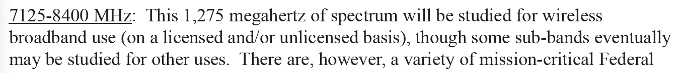
Overview
UHR PAR defines operation up to 7.250 GHz
  quote:
In current baseline (REVme + 11be), 6 GHz channelization is defined up to 7.125 GHz
  this aligns with the maximum frequency defined by many regulators for upper 6 GHz band operation (e.g. top of U-NII8 subband)
Currently multiple regulators are engaged in active discussions on enabling unlicensed access in 7-8 GHz band
  e.g. see NTIA’s National Spectrum Strategy (Nov 23) https://www.ntia.gov/sites/default/files/publications/national_spectrum_strategy_final.pdf
Within this band, the 7.125 – 7.250 GHz range seems particularly promising
  Regulatory updates that call out this frequency range as an opportunity are expected soon, e.g. when NTIA’s implementation plan is published
The addition of this range would enable one additional 160 MHz channel
  and, therefore, an additional (overlapping) 320 MHz channel

Slide 3
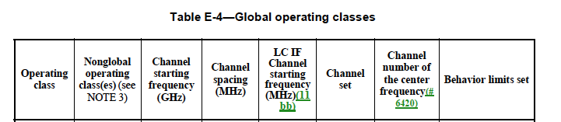
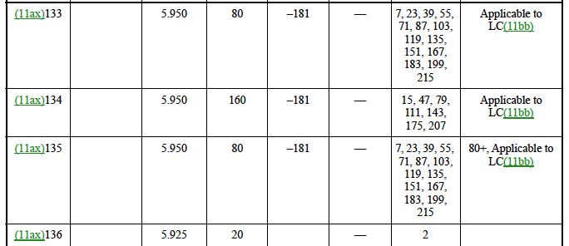
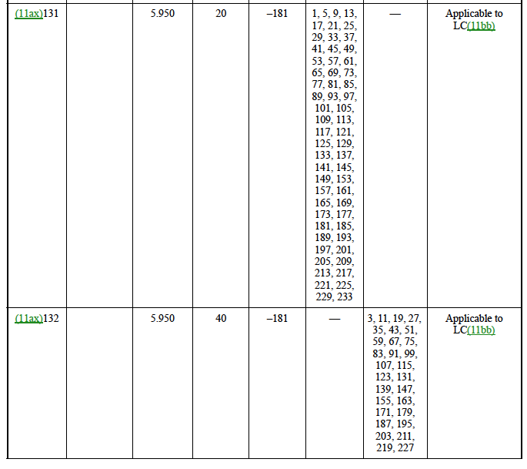
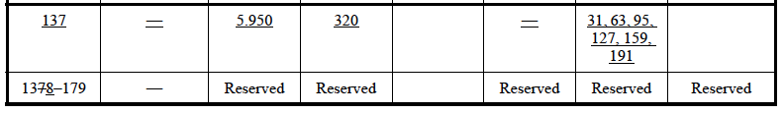
Example channelization in Table E-4
231, 247
239
231, 247
223
237, 241, 245, 249, 253, 257
Note: Adding channels to existing OpClasses, vs defining new OpClasses for the new channels, is TBD
235, 243, 251

Slide 4
Example channel map
7125
7245
233
257
20 MHz
227
251
40 MHz
215
247
80 MHz
207
239
160 MHz
223
320 MHz-1
191
320 MHz-2
= newly defined channels

Slide 5
Proposed next steps
(1) Define channelization in 11bn that covers 7.125-7.250 GHz
  Note: This is in accordance with the frequency range specified in the approved UHR PAR, and therefore does not require any PAR modification
(2) Continue to monitor regulatory progress in defining unlicensed operation above 7.250 GHz in 7-8 GHz band
  Consider PAR modification if it seems likely such additional spectrum will be available in 11bn deployment lifecycle

