Slide 1
UEQM – Further Details
Date: 2024-04-24
Authors:
Name | Affiliations | Address | Phone | email
Ron Porat | Broadcom |  |  | ron.porat@broadcom.com
Qijia Liu | Broadcom

Slide 2
Introduction
[1]-[4] introduced the topic of UEQM
UEQM provides gain but the number of combinations is potentially very large which complicates implementation and link adaptation.
Our goal in this presentation is to find the sweet spot between the number of combinations and performance.
We focus on two aspects:
  What should be the maximum QAM difference between the strongest and weakest streams
  How many UEQM combinations should we support
In r1 we add simulations for Nss=4 (slide 9 onwards)

Slide 3
Simulation Assumptions
SVD based Tx beamforming
MIMO Configs: 2x2, 3x3, 4x4
80MHz
DNLOS, BLOS, 500 channel realizations for each MIMO config
MCS0-13 on all streams
Including RF impairments
Gain numbers based on RvR simulation, which uses genie rate selection per channel realization at each SNR point

Slide 4
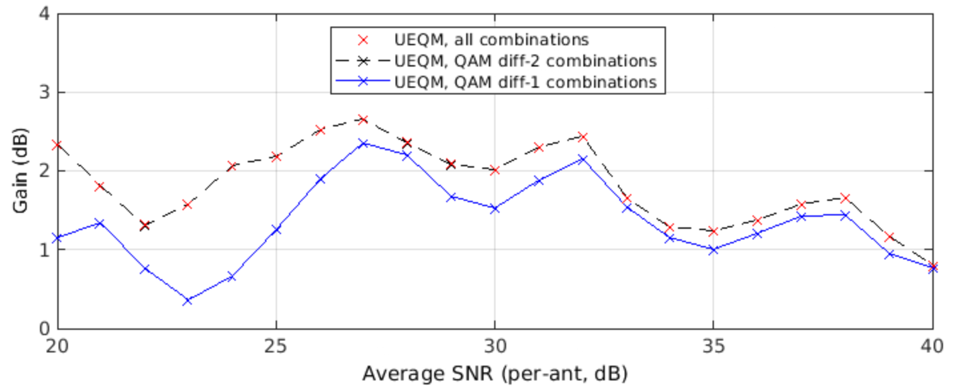
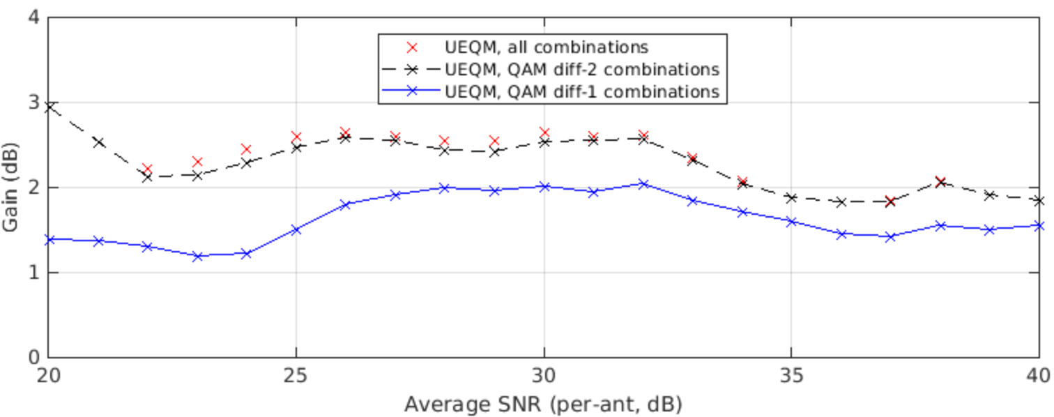
Optimal UEQM combinations for Nss=2
80MHz 2x2 DNLOS TXBF
 | Mod[stream] |  | combinations
 | 0 | 1 | all | diff-2 | diff-1
0 | x | x | ✓ | ✓ | ✓
1 | x | x-1 | ✓ | ✓ | ✓
2 | x | x-2 | ✓ | ✓
3 | x | x-3 | ✓
4 | x | x-4 | ✓
Up to QAM diff-2 recommended in order to achieve full potential gains with limited complexity
80MHz 2x2 BLOS TXBF

Slide 5
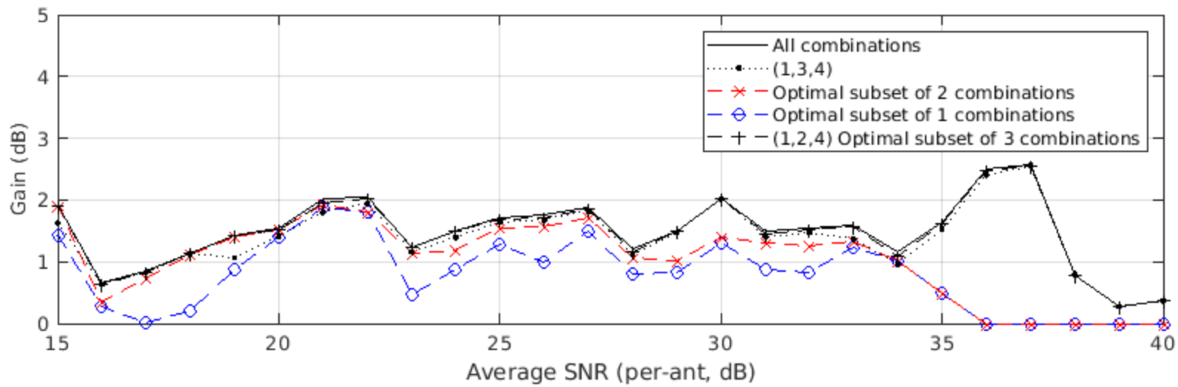
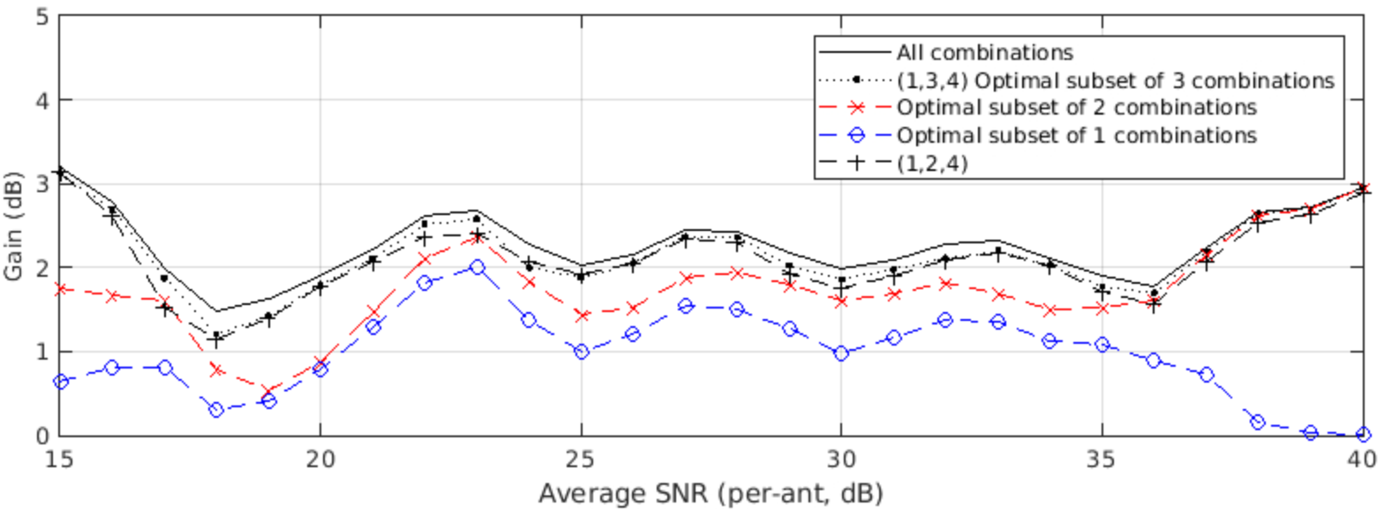
Optimal UEQM combinations for Nss=3 in 4x4
80MHz DNLOS 4x4 Nss=3 TXBF
 | Mod[stream] |  |  | # UEQM combinations
 | 0 | 1 | 2 | 1 | 2 | 3
0 | x | x | x | ✓ | ✓ | ✓
1 | x | x | x-1 |  |  | ✓
2 | x | x-1 | x-1 | ✓ | ✓ | ✓
3 | x | x | x-2
4 | x | x-1 | x-2 |  | ✓ | ✓
5 | x | x-2 | x-2
80MHz BLOS 4x4 Nss=3 TXBF
 | Mod[stream] |  |  | # UEQM combinations
 | 0 | 1 | 2 | 1 | 2 | 3
0 | x | x | x | ✓ | ✓ | ✓
1 | x | x | x-1 |  | ✓ | ✓
2 | x | x-1 | x-1 | ✓
3 | x | x | x-2 |  | ✓ | ✓
4 | x | x-1 | x-2 |  |  | ✓
5 | x | x-2 | x-2
-

Slide 6
Discussion
Metric for best Nss=3 UEQM combination subsets: max average goodput gain percentage in SNR [20,30]dB (see Appendix A for switching point between Nss=3 and Nss=4)
Compared with “all combinations” (UEQM with QAM diff-3 and 4), limiting to QAM diff-2 is close to optimal.
Selecting only l or 2 UEQM combinations results in sub-optimal performance.
Out of the 5 possible diff-2 combinations for Nss=3, combinations (1,3,4) or (1,2,4) provide good performance.

Slide 7
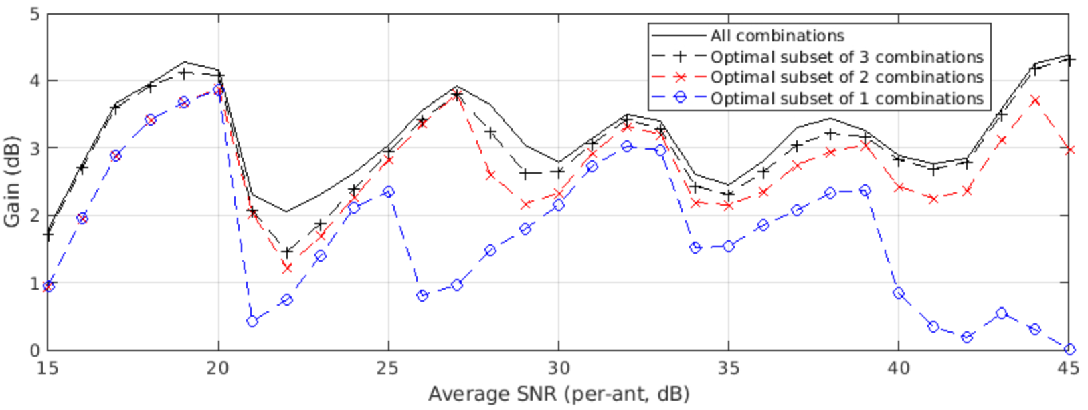
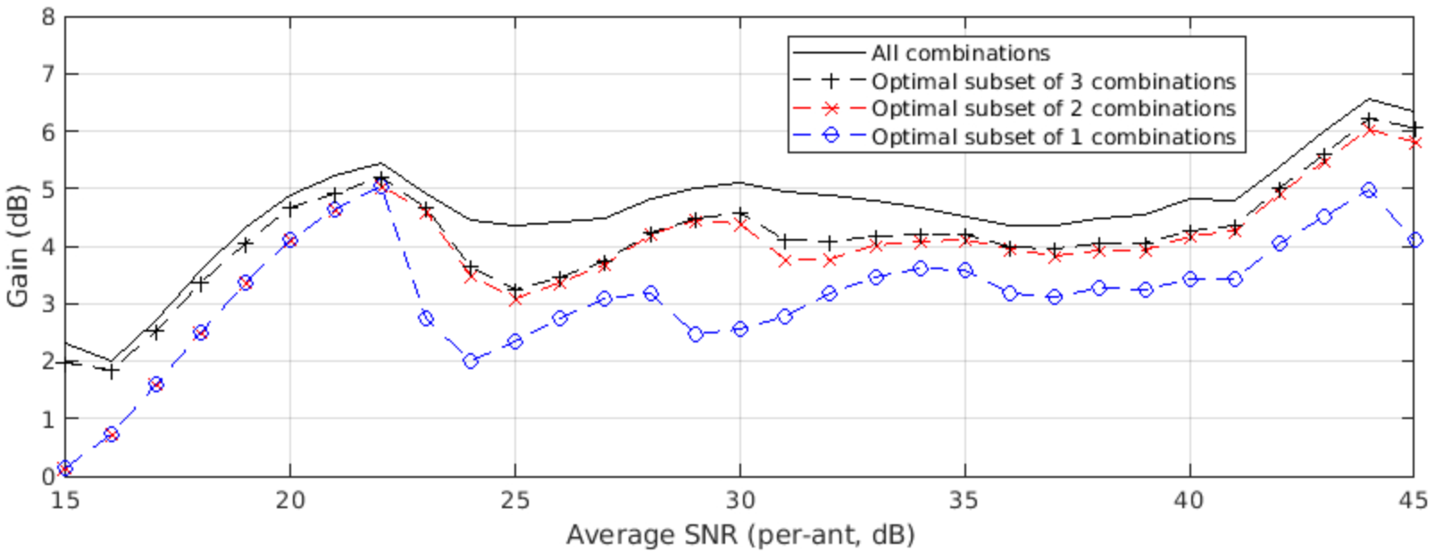
Optimal UEQM combinations for Nss=3 in 3x3
80MHz DNLOS 3x3 Nss=3 TXBF
 | Mod[stream] |  |  | # UEQM combinations
 | 0 | 1 | 2 | 1 | 2 | 3
0 | x | x | x | ✓ | ✓ | ✓
1 | x | x | x-1 |  |  | ✓
2 | x | x-1 | x-1
3 | x | x | x-2 | ✓ | ✓ | ✓
4 | x | x-1 | x-2 |  | ✓ | ✓
5 | x | x-2 | x-2
80MHz BLOS 3x3 Nss=3 TXBF
 | Mod[stream] |  |  | # UEQM combinations
 | 0 | 1 | 2 | 1 | 2 | 3
0 | x | x | x | ✓ | ✓ | ✓
1 | x | x | x-1 |  |  | ✓
2 | x | x-1 | x-1
3 | x | x | x-2 | ✓ | ✓ | ✓
4 | x | x-1 | x-2 |  | ✓ | ✓
5 | x | x-2 | x-2

Slide 8
Discussion
Extended Nss=3 SNR range in 3x3: max average goodput gain percentage in SNR [15,50]dB
In summary combination (1,3,4) is the best for Nss=3, considering 3x3 and 4x4

Slide 9
4x4 Simulations
Our simulations for 4x4 include the proposed new MCS in [5]-[7] which we also support
The simulations also assume higher power backoff for higher QAM (2dB gap) to emulate a realistic implementation.
We have also run the Nss=3 simulations with power backoff but the optimal choice didn’t change

Slide 10
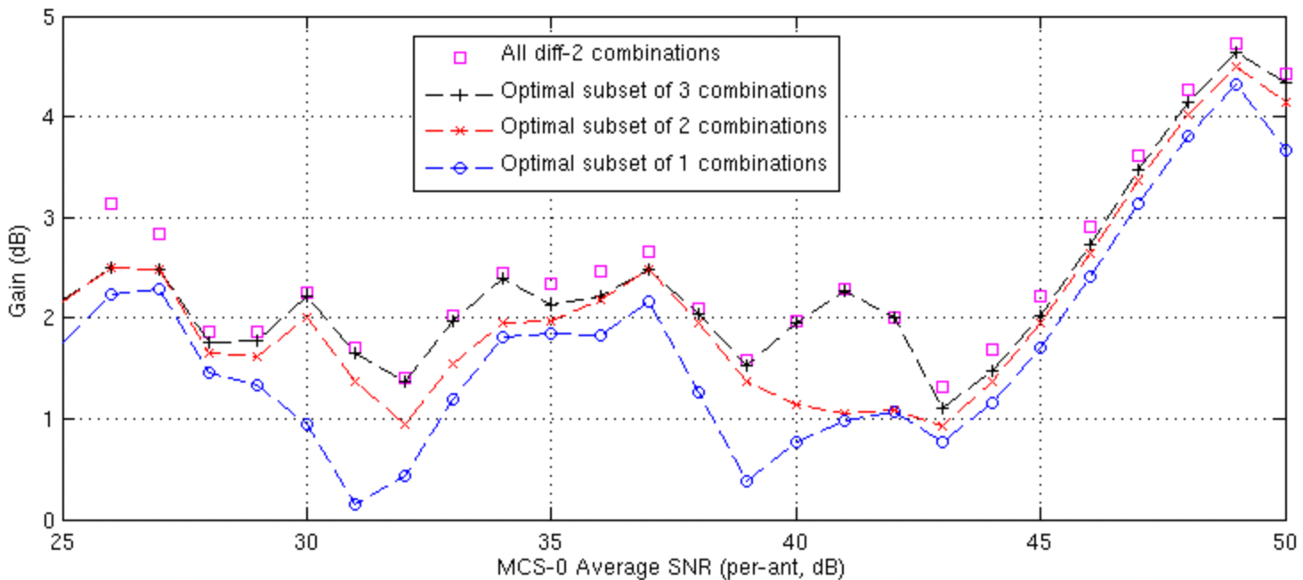
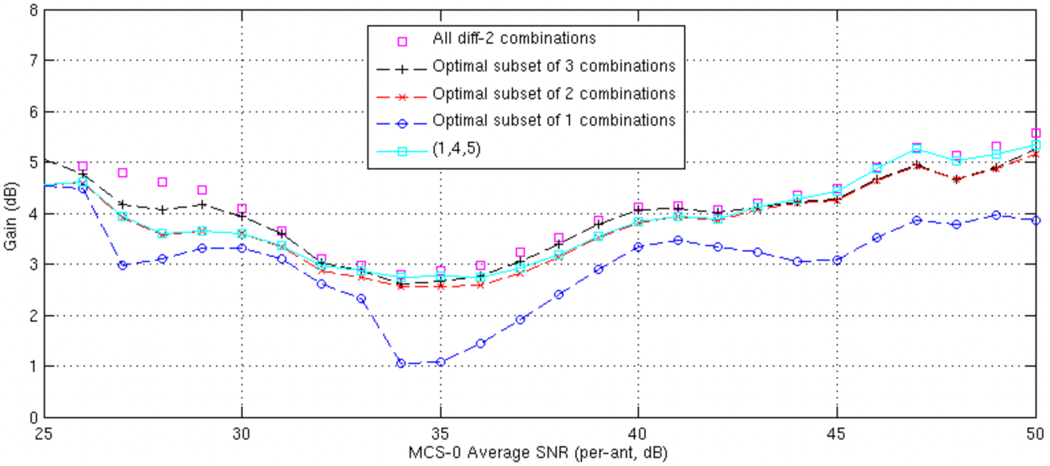
Optimal UEQM combinations for Nss=4 in 4x4 with New MCS
80MHz DNLOS 4x4 Nss=4 TXBF
 | Mod[stream] |  |  |  | # combinations
 | 0 | 1 | 2 | 3 | 1 | 2 | 3
0 | x | x | x | x | ✓ | ✓ | ✓
1 | x | x | x | x-1 |  |  | ✓
2 | x | x | x-1 | x-1
3 | x | x-1 | x-1 | x-1
4 | x | x | x | x-2 |  | ✓ | ✓
5 | x | x | x-1 | x-2 | ✓ | ✓ | ✓
6 | x | x-1 | x-1 | x-2
7 | x | x | x-2 | x-2
8 | x | x-1 | x-2 | x-2
9 | x | x-2 | x-2 | x-2
80MHz BLOS 4x4 Nss=4 TXBF
 | Mod[stream] |  |  |  | # combinations
 | 0 | 1 | 2 | 3 | 1 | 2 | 3
0 | x | x | x | x | ✓ | ✓ | ✓
1 | x | x | x | x-1
2 | x | x | x-1 | x-1
3 | x | x-1 | x-1 | x-1
4 | x | x | x | x-2 |  | ✓ | ✓
5 | x | x | x-1 | x-2 | ✓ | ✓ | ✓
6 | x | x-1 | x-1 | x-2
7 | x | x | x-2 | x-2 |  |  | ✓
8 | x | x-1 | x-2 | x-2
9 | x | x-2 | x-2 | x-2

Slide 11
Discussion
Combination (1,4,5) is best for DNLOS
In BLOS (4,5,7) slightly better on average (in the SNR range [25 50]dB) but (1,4,5) is better at the higher SNR which might be more important. Note also due to higher condition number the gains in BLOS are higher irrespective of the combinations choice.
→ prefer to use (1,4,5)

Slide 12
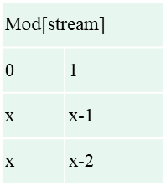
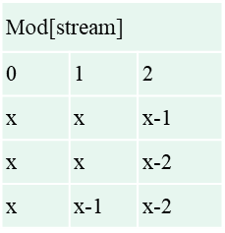
Conclusions
It is possible to achieve almost all the gains of UEQM with up to 3 combinations and with a limitation to a difference of up to 2 levels of QAM between the strongest and weakest streams
Recommend that 11bn adopts the following options for UEQM:
Nss=2 Nss=3 Nss=4
Mod[stream]
0 | 1 | 2 | 3
x | x | x | x-1
x | x | x | x-2
x | x | x-1 | x-2

Slide 13
References
[1] 11-24-0117-01 Improved Tx Beamforming with UEQM
[2] 11-24-0016-01-00bn-uhr-mimo-rvr-enhancement-with-unequal-modulation
[3] 11-24-0113-01-00bn-unequal-modulation-in-mimo-txbf-in-11bn
[4] 11-24-0176-01-00bn-unequal-modulation-over-spatial-streams
[5] 11-24-0474-00-00bn-UHR unequal modulation pattern and new MCS
[6] 11-24-0498-00-00bn-Unequal Modulation in MIMO TxBF and New MCS for 11bn
[7] 11-24-0469-00-00bn-New MCSs for 11bn

Slide 14
SP #1
Do you agree to add to the 11bn SFD :
UEQM is limited to the following combinations:
Nss=2 Nss=3 Nss=4
Mod[stream]
0 | 1 | 2 | 3
x | x | x | x-1
x | x | x | x-2
X | x | x-1 | x-2

Slide 15
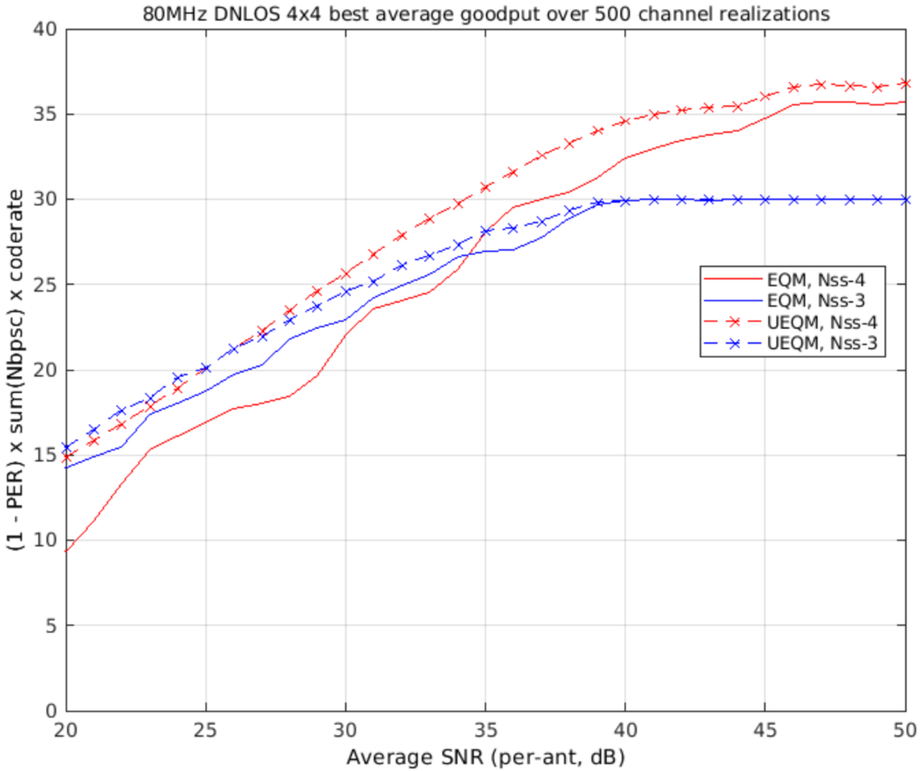
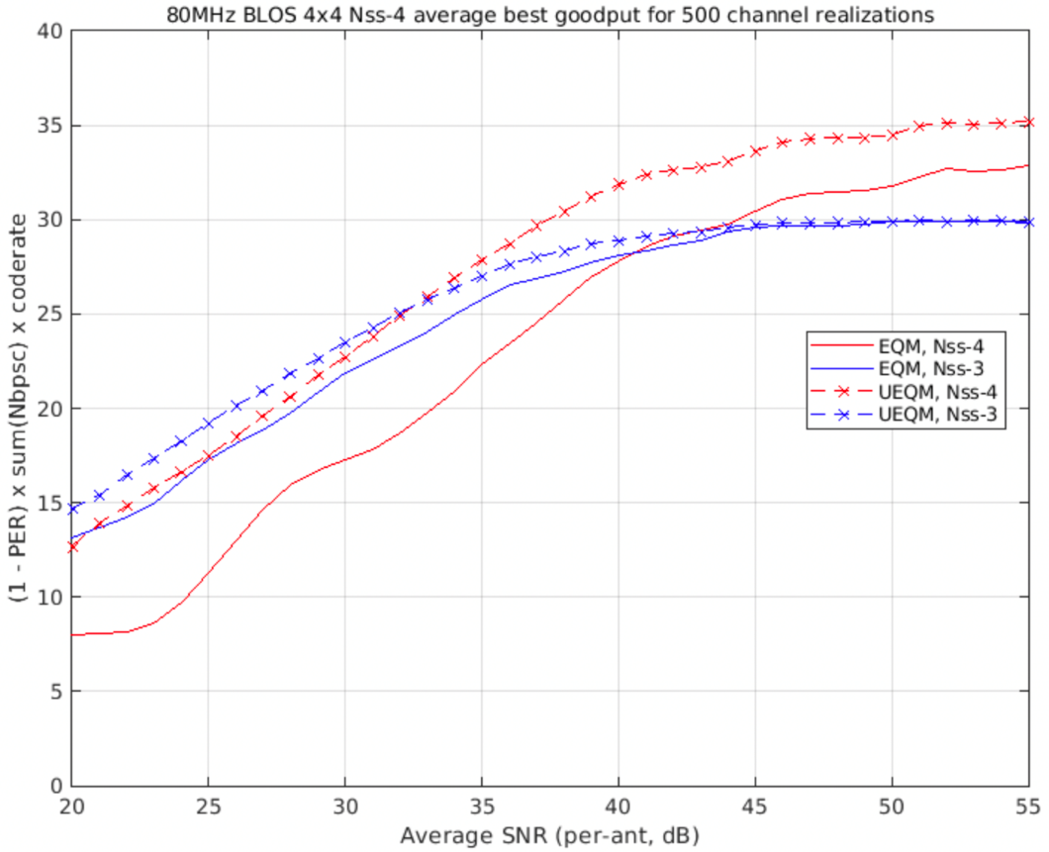
Appendix A - Nss=3 and Nss=4 Link Adaptation
To help decide the SNR range for Nss=3, we show the Nss=3 to Nss=4 transition SNRs with 4x4 antenna configs and TXBF
Nss=4 transition SNR (dB) | DNLOS | BLOS
EQM | 34 | 41
UEQM | 26 | 33
80MHz DNLOS 4x4 Nss=4 TXBF
80MHz BLOS 4x4 Nss=4 TXBF

Slide 16
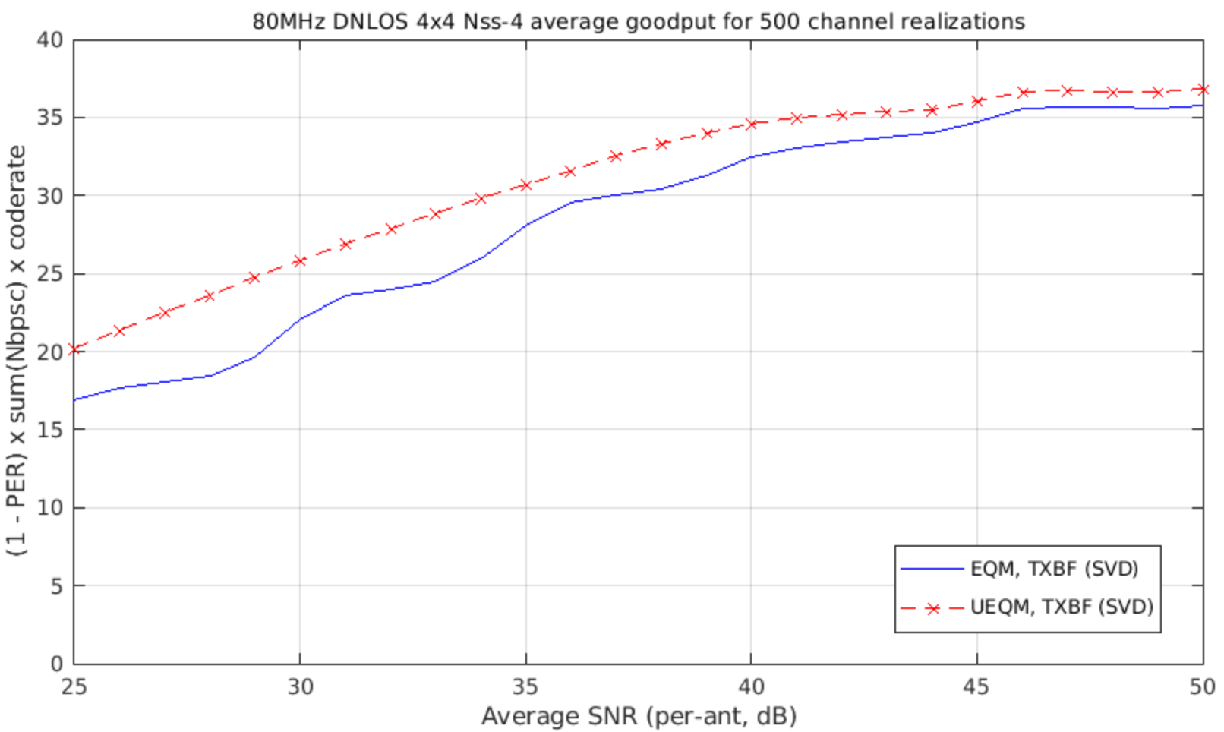
Appendix B – Why does the gain of UEQM fluctuates over SNR?
As shown below, looking at the Gput curves themselves and not just the horizontal dB gain, EQM Goodput fluctuates due to fewer rates available (essentially just the MCS resolution we have) whereas UEQM has more rates and as such smoother.

