Slide 1
Some considerations on non-primary channel access
Date: 2024-03-01
Authors:

Slide 2
Background
Non-primary channel access feature has gained much intention in TGbn group [1-18].
  Address the channel underutilization issue when the primary channel is known to be occupied by OBSS
  Allow that both AP and non-AP STA switch to secondary channels for frame exchange when the primary channel is busy because of OBSS transmission or SP
frequency
Busy
40MHz PPDU
80MHz PPDU
Secondary 40MHz
Busy
Secondary 20MHz
Busy
40MHz PPDU
(interference, OBSS)
Primary 20MHz
time
STA can transmit a packet on the secondary channels while the primary channel is busy

Slide 3
Background
To make non-primary channel access (NPCA) feature easily implemented, more details are provided
  Only one anchor channel for NPCA is preferred
  Non-primary transmission should be terminated earlier than OBSS TXOP or SP
  Non-primary transmission should start with RTS based on lower ED threshold like one of medium synchronization schemes
  NPCA channel bandwidth is also discussed
  Accessing the secondary channels of the NPCA primary channel follows the same PIFS rules defined in the baseline
  In this contribution, we raise some issues and hope they pushes the NPCA more complete and competitive.
  Adjacent channel interference
  EU Regulation
  ED threshold

Slide 4
Adjacent channel interference
Current WLAN system is not synchronized system, all APs are not required to do timing synchronization with each other.
Besides time synchronization, transmission in OFDM level synchronization among different BSSs is also easily not achieved.
Like spatial reuse feature in 802.11 ax, non-primary transmission should also not play impact on current OBSS transmission in primary channel
Based on the above facts, we propose that NPCA should take adjacent channel interference into account.
  DON’t play much impact on OBSS transmission in Primary channel

Slide 5
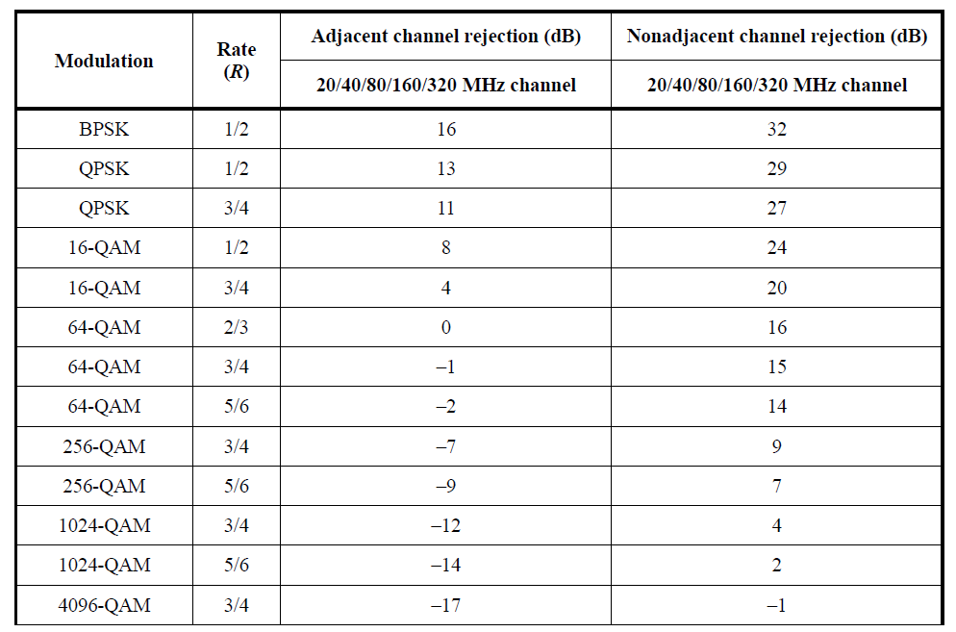
Adjacent channel interference
In baseline spec, we have defined adjacent channel rejection, which could help design NPCA
It is observed the two factors of NPCA channel width and anchor channel will impact on current OBSS transmission.
  Adjacent channel rejection for W MHz (where W is 20, 40, 80, 160, or 320) shall be measured by setting the desired signal’s strength 3 dB above the rate-dependent sensitivity specified in Table 36-67 (Receiver minimum input level sensitivity) in REVme D5.0 and raising the power of the interfering signal of W MHz bandwidth until 10% PER is caused for a PSDU length of 2048 octets for BPSK modulation with DCM or 4096 octets for all other modulations.
  Minimum required adjacent and nonadjacent channel rejection levels is as shown in the right table
  The center frequency of the adjacent channel shall be placed W MHz away from the center frequency of the desired signal

Slide 6
EU Regulation
According to Draft ETSI EN 301 893 (2023-11), for load based equipment, the choice of the Primary Operating Channel in Option 2 (channel bonding with PIFS check) shall follow one of the following procedures:
  the Primary Operating Channel is chosen uniformly randomly whenever the contention window (CW), corresponding to a completed transmission on the current Primary Operating Channel is set to its minimum value (CWmin). For this procedure, a contention window (CW) is maintained for each Priority Class (see clause 4.2.7.3.2.4) within each 20 MHz Operating Channel within the bonded channel.
  the Primary Operating Channel is arbitrarily determined and not changed more than once per second
  The rules with red color are not easily satisfied according to current NPCA
  NOTE- Option 1 for load based that is not suitable for WLAN since it requires independent backoff on each 20 MHz

Slide 7
ED threshold
A few proposals mentioned to reuse current medium synchronization recovery scheme: start with RTS frame based on low ED threshold CCA
However, this default value of ED threshold (-72dB) is not tested. Concern is that the device will abuse this mechanism, leading to much bad impact on current transmission.
On the other hand, concurrent CCA capable AP proposed in [18] can avoid the above issue by using trigger based scheme.
  of course concurrent CCA capable AP requires extra capability.
  Suggest to reconsider current medium synchronization recovery scheme

Slide 8
Summary
In this contribution, we propose that NPCA should take adjacent channel interference into account and leave other two open issues for discussion
  Primary Operating Channel change rule in Draft ETSI EN 301 893
  Medium synchronization recovery scheme: RTS frame may be transmitted with regular ED threshold (-62 dBm)

Slide 9
References
[1] 11-23/34, “Non-primary channel utilization,” Sindhu Verma
[2] 11-23/631, “Secondary channel usage and secondary 20MHz channel backoff,” Liwen Chu
[3] 11-23/797, “Non-primary channel access,” Yongho Seok
[4] 11-23/961, “UHR secondary channel access,” Minyoung Park
[5] 11-23/962, “UHR secondary channel access evaluation,” Dibakar Das
[6] 11-23/1112, “Thoughts on secondary channel access,” Insun Jang
[7] 11-23/1365, “Discussions on non-primary channel access,” Sanghyun Kim
[8] 11-23/1414, “Secondary channel usage follow up,” Liwen Chu
[9] 11-23/1444, “Non-primary channel access evaluation – follow-up,” Dibakar Das
[10] 11-23/1288, “Non-primary channel utilization – follow-up,” Sindhu Verma
[11] 11-23/1911, “Secondary channel access and frame transmission,” Dongju Cha
[12] 11-23/1913, “Secondary channel access operation,” Dongju Cha
[13] 11-23/1935, “Secondary channel usage follow up,” Liwen Chu
[14] 11-23/1951, “Concurrent CCA for non-primary channel access,” Leonardo Lanante
[15]11-23/2023, “Further discussion on non-primary channel access,” Sindhu Verma
[16] 11-23/2039, “Secondary channel usage follow up,” Liwen Chu
[17] 11-23/2005, “Non-Primary Channel Access (NPCA)”, Minyoung Park
[18] 11-23/1951 Concurrent CCA for Non-Primary Channel Access, Leonardo Lanante

Slide 10
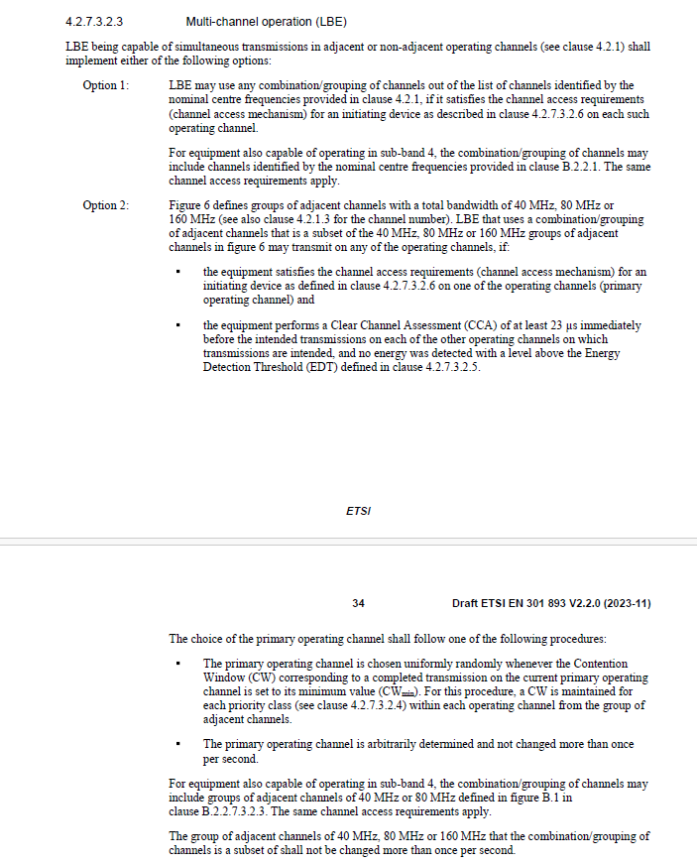
Appendix (Draft ETSI EN 301 893 V2.2.0 (2023-11))

