Slide 1
Details of Context Transfer and Data Forwarding under Enhanced FT Protocol
March 2024
Date: 2024-03-08
Authors:
Notes:
September 2012

Slide 2
Introduction
March 2024
In [1-2], an enhanced fast BSS transition (FT) is proposed to reduce/avoid the packet loss by considering the context transfer and the data forwarding.
In this contribution, some details on the resource request, the context transfer and the data forwarding are discussed.

Slide 3
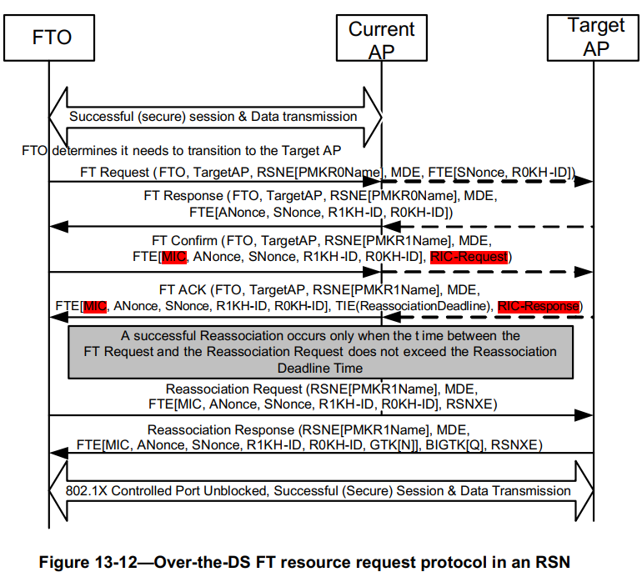
Recap FT resource request protocol
March 2024
FT Confirm/Ack frames are used for the resource request from the non-AP MLD to the target AP MLD.
  Alternatively, the FTO also can include RIC-Request within the Reassociation Request frame to negotiate the resource request with the target AP MLD.

Slide 4

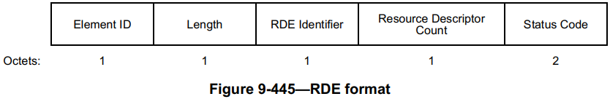
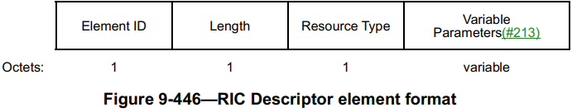
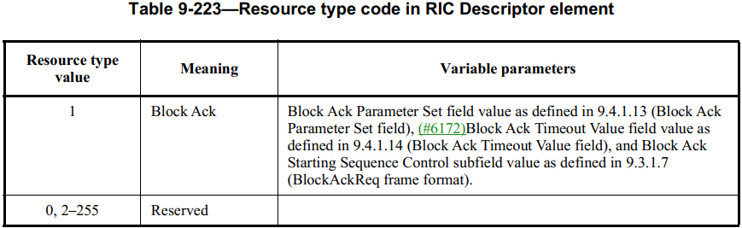
March 2024
Case 1 (802.11 QoS):
  Resource Request
    TSPEC element
    zero or more TCLAS element
    zero or one TCLAS Processing element
    Expedited Bandwidth Request element
  Resource Response
    TSPEC element
    zero or one Schedule element
    zero or more Delay element
Case 2 (Block Ack Parameters):
  Resource Request/Response
    RIC Descriptor element
RIC-Request/Response

Slide 5
Extension on Resource Request
March 2024
Since the resource request only can be initiated by the FTO, the current FT resource request protocol doesn’t support the downlink BA agreement negotiation. We should develop a method to negotiate the downlink BA agreement.
Generally, there are three options:
  Option 1. Allow the target AP MLD to initiate FT Confirm/ACK frame exchange.
  Option 2. Include RIC-Request and corresponding RIC-Response within the FT ACK (which is protected by MIC) and Reassociation Request frames (which is protected by PTK), respectively.
  Option 3 (Prefer). Include RIC-Request and corresponding RIC-Response within the FT Response and Confirm frames, respectively.
    RIC-Request/Response are protected by MICs within the FTE.

Slide 6
Extension on Resource Request (Cont.)
March 2024
Considering 11ax defined a dynamic fragmentation mechanism, a new resource type (named Extension block Ack Parameters) is defined as shown in below.
Resource Type value | Meaning | Variable parameters
1 | Block Ack | Block Ack Parameter Set field Block Ack Timeout Value field Block Ack Starting Sequence Control subfield
2 | Extension Block Ack | Block Ack Parameter Set field Block Ack Timeout Value field Block Ack Starting Sequence Control subfield ADDBA Extended Parameter Set field
0, 3-255 | Reserved

Slide 7
Extension on Resource Request (Cont.)
March 2024
Considering the context transfer scenario, the transmitter may want to negotiate block Ack parameters except the Block Ack Starting Sequence Control, a new resource type (named Block Ack Context Transfer) is defined as shown in below.
Resource Type value | Meaning | Variable parameters
1 | Block Ack | Block Ack Parameter Set field Block Ack Timeout Value field Block Ack Starting Sequence Control subfield
2 | Extension Block Ack | Block Ack Parameter Set field Block Ack Timeout Value field Block Ack Starting Sequence Control subfield ADDBA Extended Parameter Set field
3 | Block Ack Context Transfer | Block Ack Parameter Set field Block Ack Timeout Value field ADDBA Extended Parameter Set field
0, 4-255 | Reserved

Slide 8
Extension on Resource Request (Cont.)
March 2024
Besides the extension on the Block Ack Parameters, we also need to consider other resource types, e.g.
  SCS
  …
In addition, we may also need to consider the negative effect on the roaming if the AP affiliated with the target AP MLD is in the scheduled or unscheduled PS mode.
  The non-AP MLD may temporarily request the AP affiliated with the target AP MLD to exit the PS mode.
  Define another resource type, e.g. Wakeup request.

Slide 9
Context Transfer and Data forwarding (Cont.)
March 2024
The context transfer and data forwarding should be optional. A corresponding capability bit can be added within the FT Capability and Policy field of the MDE.
Only when both the current AP MLD and the target AP MLD supports the context transfer and data forwarding, then the non-AP MLD can request to do the context transfer by including the context transfer request within the Reassociation Request frame .
  Same QoS configuration in the same MDE, e.g. include the same content of the QoS Map element in the (Re)Association Response frame
B0 | B1 | B2 | B3-B7
Fast BSS Transition Over DS | Resource Request Protocol Capability | Context Transfer and Data Forwarding Capability | Reserved

Slide 10
Context Transfer and Data forwarding
March 2024
Procedures
  Step 1. Non-AP MLD sending Reassociation Request to target AP MLD
  Step 2. Target AP MLD sending Context Transfer Request message to current AP MLD via the DS.
    Step A. After receiving Context Transfer Request message, the current AP MLD shall stop the uplink data delivery to the DS through itself and the downlink data transmission.
    Step B. After a guard period, the target AP MLD switches the data path to itself.
  Step 3. Current AP MLD replying Context Transfer Response message to target AP MLD via the DS
  Step 4. Target AP MLD replying Reassociation Response to current AP MLD

Slide 11
Context Transfer and Data forwarding (Cont.)
March 2024
Details on signaling
  The non-AP MLD may include the TID info within the Reassociation Request frame to request the target AP MLD to do the corresponding context transfer, e.g. DL TID bitmap and UL TID bitmap.
    The target AP MLD may also indicate whether the context transfer is successful or not within the Reassociation Response.
  The following info may be included within the defined Context Transfer Request Message
    Non-AP MLD MAC address
    DL TID Bitmap
    UL TID Bitmap

Slide 12
Context Transfer and Data forwarding (Cont.)
March 2024
Details on signaling
  The following info may be included within the defined Context Transfer Response Message
    Non-AP MLD MAC Address
    DL BA context
      TID, Next SN, WinStart_O, WinSize_O
      BA Parameters, e.g. A-MSDU Supported, BA Timeout value, No-Fragmentation, HE Fragmentation
    UL BA context
      TID
      Scoreboard, WinStart_R, WinSize_R
      WinStart_B, WinSize_B
      BA Parameters, e.g. A-MSDU Supported, BA Timeout value, No-Fragmentation, HE Fragmentation
Note. For the same TID, if both resource request with Block Ack Context Transfer and context transfer are requested, corresponding BA parameters (in gray color) in RIC-Response are real values.

Slide 13
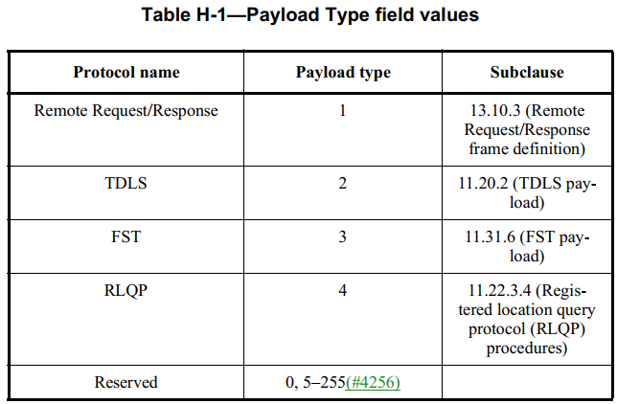
Context Transfer and Data forwarding (Cont.)
March 2024
Suggest to use EtherType 89-0d (See Annex H of D80.11REVme 5.0) frame to enable the data forwarding. Specifically,
  Define a new Payload type, e.g. Data Forwarding
  The corresponding Payload field is shown in the below figure
    TID, SN, End Mark Bit, DA, SA, Length
  Note that the Next SN info can be directly included within the Context Transfer Response message or implicitly indicated by the SN and End Mark Bit.
1
1
1
DSAP | SSAP | Control
3
5
1
Variable
LLC | SNAP | Payload Type | Payload
3
2
Vendor Code | EtherType
2
1
6
6
2
Variable
TID | SN | End Mark Bit | DA | SA | Length | MSDU

Slide 14
Conclusions
March 2024
To realize the seamless roaming, we have discussed some design details on the resource request, context transfer and data forwarding to enhance the FT protocol. Specifically,
  For the resource request, define some new resource request types, e.g. Extension Block Ack, Block Ack Context Transfer, SCS and so on.
  Include RIC-Request and corresponding RIC-Response respectively within the FT Response/Confirm frames to enable the DL BA agreement setup.
  Procedure and signaling details of the context transfer and data forwarding.

Slide 15
References
March 2024
[1] 11-23-1897-00-00bn-thoughts-on-improving-roaming-under-existing-architecture
[2] 11-24-0349-01-00bn-enhanced-fast-bss-transition

