Slide 1
New MCSs for 11bn
Date: 2024-03-08
Authors:
Name | Affiliations | Address | Phone | Email
Shengquan Hu | Mediatek | 2840 Junction Ave. San Jose, CA, 95134 |  | shengquan.hu@mediatek.com
Jianhan Liu |  |  |  | jianhan.liu@mediatek.com
Thomas Pare

Slide 2
Introduction
There are total 16 MCS levels (MCS0~15) in current generation Wi-Fi7/11be. The sensitivity SNR requirement (e.g. at 10% PER) gaps between some neighbor MCSs is quite large, e.g. > 3.5dB between MCS-2 & 3, and > 4dB between MCS-4 & 5 under AWGN, etc.
Furthermore, current generation Wi-Fi 7 only uses half of all possible combinations of modulation and code rate
Code rate R=2/3 is only used for MCS5 so far, it is impossible for 2/3 code rate to be used for unequal modulation (UEQM)
New MCSs could be considered in next generation Wi-Fi 8 by using some of the non-used possible modulation and code rate combinations to achieve higher throughput, better reliability, better UEQM performance and more accurate link adaptation

Slide 3
MCSs in 11be
4 code rates
 | 1/2 | 2/3 | 3/4 | 5/6
BPSK+DCM+DUP | MCS14
BPSK+DCM | MCS15
BPSK | MCS0
QPSK | MCS1 |  | MCS2
16QAM | MCS3 |  | MCS4
64QAM |  | MCS5 | MCS6 | MCS7
256QAM |  |  | MCS8 | MCS9
1024QAM |  |  | MCS10 | MCS11
4096QAM |  |  | MCS12 | MCS13
7 modulations
Total 14 combinations are not used yet
Slide 3
Shengquan Hu, Mediatek Inc.

Slide 4
Spectral Efficiency for All MCS Levels in 11be
The gap between two adjacent MCSs is about 1bit for some cases.
Example: Spectral efficiency gap between adjacent MCS level = 1bit/Tone
MCS14
MCS15
MCS0
MCS13
Slide 4
Shengquan Hu, Mediatek Inc.

Slide 5
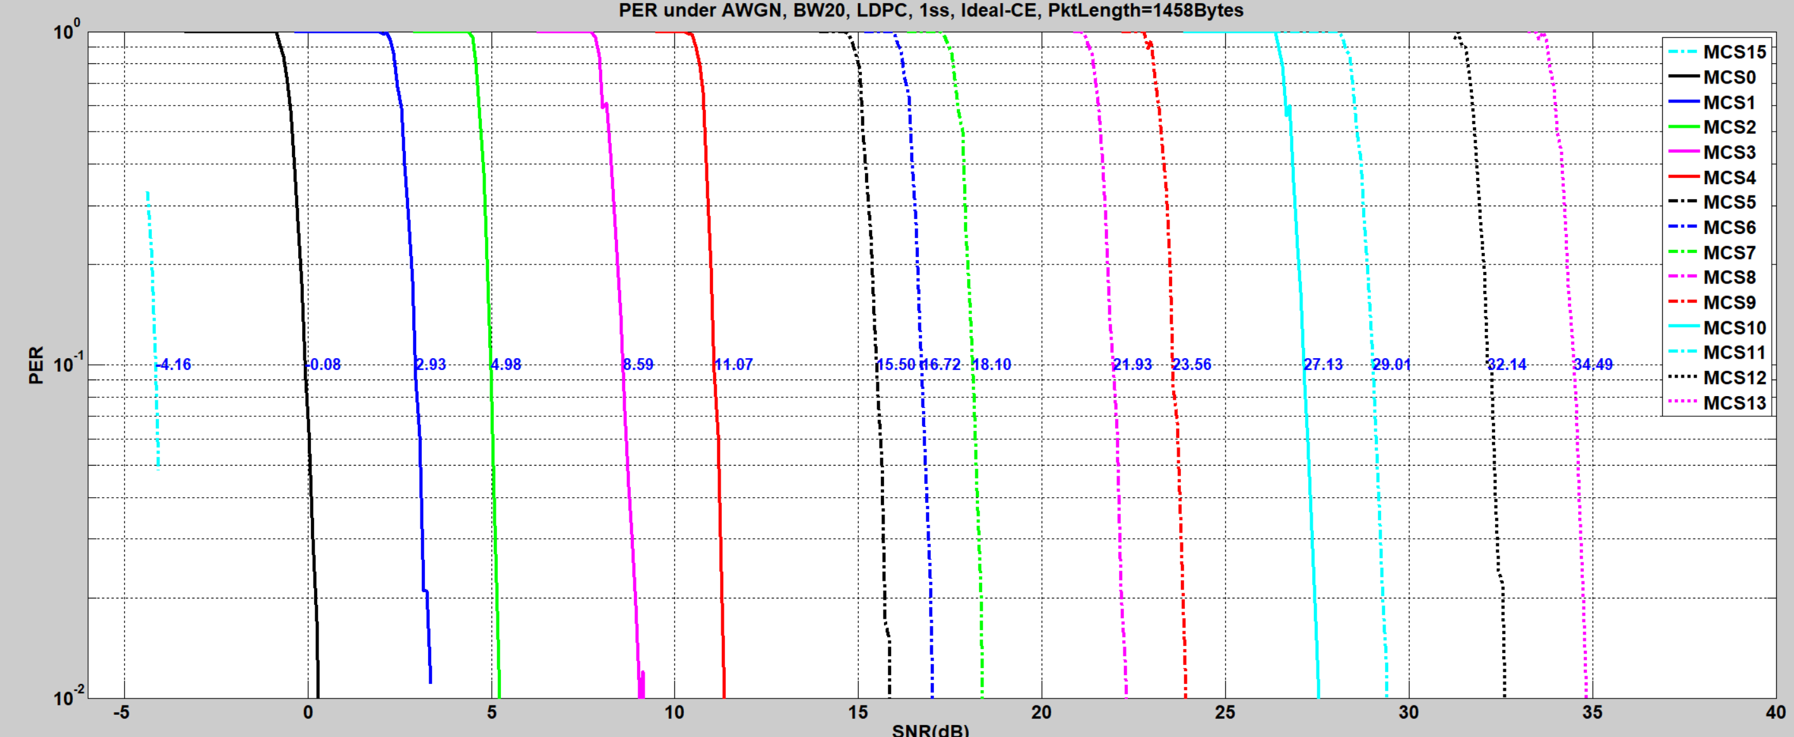
Sensitivity SNR Requirements for Different MCSs on BW20
The sensitivity SNR requirement gap between two adjacent MCS levels can be 3~4 dB for some cases;
The finer MCSs can enable more accurate rate adaptation and better unequal QAM performance.
SNR gap
> 3.5dB
SNR gap
> 4dB
SNR gap
> 3.5dB
Sensitivity SNR (dB) at 10% PER
Slide 5
Shengquan Hu, Mediatek Inc.

Slide 6
Sensitivity SNR Requirements for Different MCSs on BW80
The sensitivity SNR requirement gap between two adjacent MCS levels can be 3~4 dB for some cases;
The finer MCSs can enable more accurate rate adaptation and better unequal QAM performance.
SNR gap
> 3.5dB
SNR gap
> 4dB
SNR gap
> 3.5dB
Sensitivity SNR (dB) at 10% PER
Slide 6
Shengquan Hu, Mediatek Inc.

Slide 7
Considerations to Add New MCSs for 11bn
From above studies & analysis, we observe that:
  The sensitivity SNR gap between some adjacent MCS levels is quite large (e.g. >3 or 4dB)
  There are also spectral efficiency gaps between some adjacent MCS levels
  The existing MCS definition only utilizes a few of combinations of modulation and coding rate
Therefore, we propose adding new MCSs by using existing modulation and coding rate combination to
  fill up the sensitivity SNR gap
  improve the link adaptation accuracy
  increase throughput
  enhance UEQM performance
Slide 7
Shengquan Hu, Mediatek Inc.

Slide 8
Existing MCSs and New MCSs Candidates in Study
QAM/R | 1/2 | 2/3 | 3/4 | 5/6
BPSK | √
QPSK | √ |  | √
16QAM | √ |  | √
64QAM |  | √ | √ | √
256QAM |  |  | √ | √
1024QAM |  |  | √ | √
4096QAM |  |  | √ | √
14 combinations for new MCS candidates
14 existing MCSs
existing MCS index (11be) | QAM | Nbpscs | R | Spectral Efficiency (bits/tone)
0 | BPSK | 1 | 1/2 | 0.500
1 | QPSK | 2 | 1/2 | 1.000
2 | QPSK | 2 | 3/4 | 1.500
3 | 16QAM | 4 | 1/2 | 2.000
4 | 16QAM | 4 | 3/4 | 3.000
5 | 64QAM | 6 | 2/3 | 4.000
6 | 64QAM | 6 | 3/4 | 4.500
7 | 64QAM | 6 | 5/6 | 5.000
8 | 256QAM | 8 | 3/4 | 6.000
9 | 256QAM | 8 | 5/6 | 6.667
10 | 1024QAM | 10 | 3/4 | 7.500
11 | 1024QAM | 10 | 5/6 | 8.333
12 | 4096QAM | 12 | 3/4 | 9.000
13 | 4096QAM | 12 | 5/6 | 10.000
QAM | Nbpscs | R | Spectral Efficiency (bits/tone)
BPSK | 1 | 2/3 | 0.67
BPSK | 1 | 3/4 | 0.75
BPSK | 1 | 5/6 | 0.83
QPSK | 2 | 2/3 | 1.33
QPSK | 2 | 5/6 | 1.67
16QAM | 4 | 2/3 | 2.67
64QAM | 6 | 1/2 | 3.00
16QAM | 4 | 5/6 | 3.33
256QAM | 8 | 1/2 | 4.00
1024QAM | 10 | 1/2 | 5.00
256QAM | 8 | 2/3 | 5.33
4096QAM | 12 | 1/2 | 6.00
1024QAM | 10 | 2/3 | 6.67
4096QAM | 12 | 2/3 | 8.00
Slide 8
Shengquan Hu, Mediatek Inc.

Slide 9

Simulation Setup
BW: 20MHz, 80MHz, 160MHz
Channel: AWGN, D-NLOS, B-LOS, E-NLOS
1ss: 1T1R, 1T2R, 1T4R, 2T1R (BF), 4T1R (BF)
2ss: 2T2R (non-BF)
3ss: 3T3R (non-BF)
4ss: 4T4R (non-BF)
Channel Estimation (CE): Least-Square (LS) CE, and CE with smoothing (SMCE)
Packet length: 1458bytes, 2048bytes, 4096bytes, scaled packet length for each MCS to make Nsym=10
Receiver for MIMO: MLD (for 2ss), ML-type Rx (for 3ss/4ss), MMSE
LDPC
MCS levels:
  Existing 11be MCSs: 0~13
  14 New MCS candidates
Goodput Calculation:
  Assume 3.2us GI
  Goodput
QAM | Nbpscs | R | PktLen (Bytes) | Nsym
BPSK | 1 | 1/2 | 560 | 10
QPSK | 2 | 1/2 | 1120 | 10
QPSK | 2 | 3/4 | 1680 | 10
16QAM | 4 | 1/2 | 2240 | 10
16QAM | 4 | 3/4 | 3360 | 10
64QAM | 6 | 2/3 | 4480 | 10
64QAM | 6 | 3/4 | 5040 | 10
64QAM | 6 | 5/6 | 5600 | 10
256QAM | 8 | 3/4 | 6720 | 10
256QAM | 8 | 5/6 | 7467 | 10
1024QAM | 10 | 3/4 | 8400 | 10
1024QAM | 10 | 5/6 | 9333 | 10
4096QAM | 12 | 3/4 | 10080 | 10
4096QAM | 12 | 5/6 | 11200 | 10
BPSK | 1 | 2/3 | 747 | 10
QPSK | 2 | 2/3 | 1493 | 10
16QAM | 4 | 2/3 | 2987 | 10
16QAM | 4 | 5/6 | 3733 | 10
256QAM | 8 | 2/3 | 5973 | 10
$Gput=max⁡\{\left(1−PER\right)∗\frac{\left\lfloor N_{bpscs}∗N_{sd}∗R\right\rfloor }{12.8+GI}$*$N_{ss}$}
Note: packet length in the table is for Nss=1; for Nss>=2, the packet length will be PktLen*Nss to make Nsym=10 ;
Slide 9
Shengquan Hu, Mediatek Inc.

Slide 10
BW80, D-NLOS, 2x2x2, non-BF, SMCE, Scaled Packet Length, ML-Type Rx
Three figures in this page show the Goodput, the MCS index, and Gput gains of {new MCS+existing MCS} vs {existing MCS}
The new MCS candidates are only selected with the criteria of the Gput gains >= 5%
New MCS candidates {QPSK+R23,16QAM+R23,16QAM+R56,256QAM+R23} improve the data rate >=5%
256QAM
R23
16QAM
R56
16QAM
R23
QPSK
R23
This MCS candidate is not selected due to small SNR region span
256QAM
R23
16QAM
R56
16QAM
R23
QPSK
R23
Gput gain >= 5%
Slide 10
Shengquan Hu, Mediatek Inc.

Slide 11
BW80, D-NLOS, 2x2x2, non-BF, SMCE, Scaled Packet Length, ML-Type Rx
The PER curves for the selected extra MCSs are plotted together with the existing MCSs as below
Selected new MCSs can fill up the sensitivity SNR gap & improve the data rate
The following figure shows that, by using ML-Type receiver:
  New MCS with {QPSK, 2/3} may be added between existing MCS-1 & 2
  New MCS with {16QAM, 2/3} may be added between existing MCS-3 & 4
  New MCS with {16QAM, 5/6} may be added between existing MCS-4 & 5
  New MCS with {256QAM, 2/3} may be added between existing MCS-7 & 8
QPSK
+R2/3
16QAM
+R2/3
16QAM
+R5/6
256QAM
+R2/3
Slide 11
Shengquan Hu, Mediatek Inc.

Slide 12
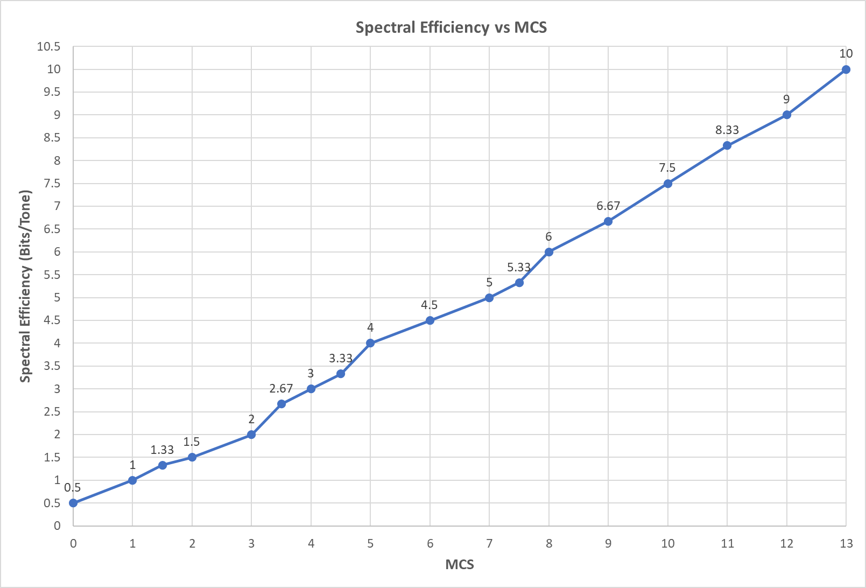
Spectral Efficiency after Adding New MCSs
Adding the selected new MCSs can also fill up the efficiency gaps
256QAM
+R2/3
16QAM
+R5/6
16QAM
+R2/3
QPSK
+R2/3
Slide 12
Shengquan Hu, Mediatek Inc.

Slide 13
Summary of Simulations and Observations
Nss | Config | BF | Channel | CE | PktLen (Bytes) | BW (MHz) | New MCS candidates to achieve Gput gain (>= 5%)
1 | 1T1R | N | AWGN | LS | 1458 | 20 | {C1,C2,C3,C4}
 |  |  | AWGN | LS | 1458 | 80 | {C1,C2,C3,C4}
 |  |  | AWGN | SM | 1458 | 80 | {C1,C2,C3,C4}
 |  |  | AWGN | LS | scaled | 80 | {C1,C2,C3,C4}
 |  |  | AWGN | SM | scaled | 80 | {C1,C2,C3,C4}
 |  |  | D-NLOS | LS | 1458 | 20 | {C1,C2,C4}
 |  |  | D-NLOS | LS | 1458 | 80 | {C1,C2,C4}
 |  |  | D-NLOS | SM | 1458 | 80 | {C1,C2,C4}
 |  |  | E-NLOS |  |  |  | {C1,C2,C4}
 |  |  | B-LOS |  |  |  | {C1,C2}
 |  |  | D-NLOS | LS | scaled | 80 | {C1,C2,C4}
 | 1T2R | N | B-LOS | SM | 2048 | 20 | {C1,C2}
 |  |  | B-LOS | SM | 4096 | 20 | {C1,C2}
 |  |  | D-NLOS | SM | 4096 | 20 | {C1,C2}
 |  |  | D-NLOS | SM | 2048 | 80 | {C1,C2,C3,C4}
 |  |  | D-NLOS | SM | 4096 | 80 | {C1,C2,C3,C4}
 |  |  | B-LOS | SM | 4096 | 80 | {C1,C2}
 |  |  | D-NLOS | SM | 4096 | 160 | {C1,C2,C3,C4}
 |  |  | B-LOS | SM | 2048 | 160 | {C1,C2}
 |  |  | B-LOS | SM | 4096 | 160 | {C1,C2}
 | 1T4R | N | D-NLOS | SM | 2048 | 80 | {C1,C2,C3,C4}
 | 2T1R | Y | D-NLOS | LS | 1458 | 80 | {C1,C2,C3}
 |  |  | B-LOS |  |  |  | {C1,C2,C3}
 |  |  | E-NLOS |  |  |  | {C1,C2,C3}
 |  |  | D-NLOS | LS | 4096 | 80 | {C1,C2,C3,C4}
 | 4T1R |  | D-NLOS | LS | 1458 | 80 | {C1,C2,C3}
 |  |  | B-LOS |  |  |  | {C1,C2,C3}
 |  |  | E-NLOS |  |  |  | {C1,C2,C3,c4}
 |  |  | D-NLOS | LS | 4096 | 80 | {C1,C2,C3,C4}
 | 2T2R | N | D-NLOS | SM | 1458 | 80 | {C1,C2,C3}
2 | 2T2R | N | D-NLOS | LS | 1458 | 80 | {C1,C2,C3}
 | 2T2R |  | D-NLOS | LS | 4096 | 80 | {C1,C2,C4}
 | 2T2R |  | D-NLOS | SM | 4096 | 20 | {C1,C2,C3}
 | 2T2R |  | B-LOS | SM | 4096 | 20 | {C1,C2,C3}
 | 2T2R |  | D-NLOS | SM | 1458 | 80 | {C1,C2,C3}
 |  |  | D-NLOS |  | 4096 |  | {C1,C2,C3,c4}
 |  |  | B-LOS |  | 1458 |  | {C1,C3}
 | 2T2R |  | B-LOS | SM | 4096 | 160 | {C1,C2,C3}
 | 2T2R |  | D-NLOS | SM | 4096 | 160 | {C1,C2,C3,C4}
 | 2T2R |  | D-NLOS | LS | scaled | 80 | {C1,C2,C4}
 | 2T2R |  | D-NLOS | SM | scaled | 80 | {C1,C2,C3,C4}
 | 2T2R |  | B-LOS | LS | scaled | 80 | {C1,C2,C4}
 | 2T2R |  | B-LOS | SM | scaled | 80 | {C1,C2,C3,C4}
3 | 3T3R | N | D-NLOS | SM | 4096 | 80 | {C1,C2,C3}
 | 3T3R |  | B-LOS | SM | 4096 | 80 | {C1,C2,C3}
4 | 4T4R |  | D-NLOS | SM | 4096 | 80 | {C1,C2,C3}
 | 4T4R |  | B-LOS | SM | 4096 | 80 | {C1,C2,C3}
NOTE:
C1 for QPSK+R2/3
C2 for 16QAM+R2/3
C3 for 16QAM+R5/6
C4 for 256QAM+R2/3
The behavior of combinations of QAM & Code rate is different not only for AWGN vs multipath fading channels but also for:
  Tx & Rx antenna config
  Type of MIMO detector
  etc
For most of practical scenarios & settings, the proposed four new MCS candidates can fill the SNR gap and improve the system throughput by 5%~30%
Slide 13
Shengquan Hu, Mediatek Inc.

Slide 14
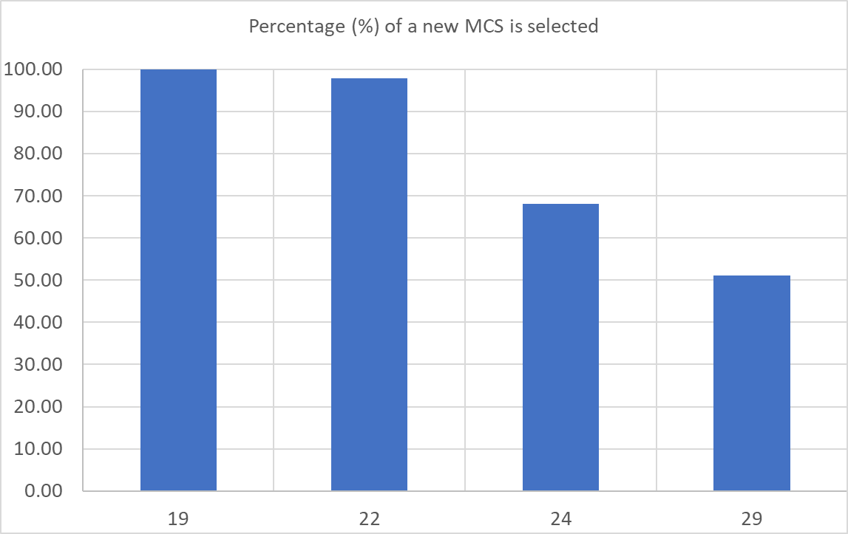
Summary of Simulations
There are total 47 cases considered in the simulations
The following table summarizes the number of times (or occurrence count) for a new MCS is selected over 47 cases with the MCS selection criteria of Tput gain >= 5%
New MCS | (QPSK+R2/3) | (16QAM+R2/3) | (16QAM+R5/6) | (256QAM+R2/3)
Count of Selected | 47 | 46 | 32 | 24
% of selected | 100.00 | 97.87 | 68.09 | 51.06
QPSK
+R2/3
16QAM
+R2/3
16QAM
+R5/6
256QAM
+R2/3
Slide 14
Shengquan Hu, Mediatek Inc.

Slide 15
Summary
We studied the performance and spectral efficiency of current MCSs in 11be.
  There are 3-4dBs SNR gap between some adjacent MCSs.
  There are about 1bit spectral efficiency gap between some adjacent MCSs.
We propose to adding new MCSs to fill the sensitivity SNR requirement gap between adjacent MCSs to achieve higher throughput, better reliability, more accurate link adaptation
Our simulations and analysis show that
  The finer MCSs can improve the throughput by 5%~30% for most of the scenarios
  The combinations of {QPSK, 16QAM, 256QAM} + R=2/3 and 16QAM+R=5/6 could be considered as the new MCSs for 11bn
The new MCSs can be considered as the fundamental base for both EQM and UEQM

Slide 16
Straw Poll #1
Do you agree to include the following text to the 11bn SFD?
  adding new MCS level(s) for 11bn
Slide 16
Shengquan Hu, Mediatek Inc.

Slide 17
Straw Poll #2
Do you agree to include the following text to the 11bn SFD?
  adding the following modulation and code rate combinations as the new MCSs for 11bn?
    Modulations of {QPSK, 16QAM, 256QAM} with code rate R=2/3
    Modulation of 16QAM with code rate R=5/6
Slide 17
Shengquan Hu, Mediatek Inc.

