Slide 1
QoS enhancements for UHR-follow-up
Date: 2024-03-09
Authors:

Slide 2
Introduction
In 11be, some members highlighted the scalability problem with SCS since multiple flows are mapped to same TID (e.g., 11-20-1686) leading to possible HOL blocking problem at layer-2.
To recap, the HOL blocking problem at layer-2 arises because an older packet waiting retransmission and mapped to a given TID would prevent newer packets that have been correctly received at layer-2 to be forwarded up.
  This is not an issue where the newer packet belongs to same traffic flow AND at the application/transport layer the processing of the newer packet has dependence on that of the older packet (i.e., expect in-order delivery).
  However, for cases when that’s not true, HOL blocking may affect user-experience by preventing chances of faster processing.
Previously in 11-23-0697-uhr we proposed a solution to HOL blocking problem .
In this document we provide further details on motivation and evaluations.
: MSDUs Fwded up in TXOP-1
: MSDUs not received in TXOP-1; succesfully retx in TXOP-2
: MSDUs received but not fwded up in TXOP-1 (HOL blocking)
TXOP-1
TXOP-2
BA
OBSS tx
OBSS tx
BA
PPDU(TID-x)
betn AP and STA
Delay due to HOL blocking

Slide 3
HOL blocking cases overview
Depending on the type of traffic that gets blocked there could be roughly three cases.
Case 0: All MSDUs in the blocked traffic belong to same stream/substream and cant be processed without receiving the missing MSDU(s).
  E.g., a TCP file download.
  In this case there is no significant issue with HOL blocking.
Case 1: Some MSDUs in the blocked traffic belong to a different stream/substream than the missing MSDU(s) and there is enough metadata at layer-2 to differentiate between streams.
  E.g., N video/voice streams to/from an edge server PC.
Case 2: All MSDUs in the blocked traffic can be handled above layer-2 even in absence of missing MSDU(s).
  Includes cases where some MSDUs belong to different substream but there is not enough metadata at layer-2 to differentiate between streams
  E.g., QUIC flow that consists of multiple streams encapsulated above IP.
In this presentation, we focus on case 1 and 2 where resolving HOL blocking problem could benefit user performance.

Slide 4
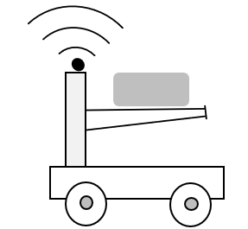


HOL blocking case 1
In this case there are multiple traffic streams that are mapped to same AC between two STAs such as multiple voice/ video sessions, time-sensitive flows, file transfer instances etc. e.g.,
  An edge compute PC that processes video data from multiple robots and send instructions for controlling movement.
  A high compute PC connected to multiple HMDs.
Also, additional metadata (e.g., IP tuple, Port #, metadata) available at layer-2 to identify the different streams.
Video
AGV
PPDU (TID-x)
TID-x and y map to same AC
PPDU (TID-y)
Management PC/
Edge Computing
Notes:
Also, includes cases where a given traffic flow can be split into separate streams (e.g., with different priority levels) and possibly transmitted using different paths by transport.
Example of multiple traffic that map to same AC between an (AP,STA) pair:
An edge compute PC that processes video data from multiple robots and send instructions for controlling movement.
A high compute PC connected to multiple HMDs.
A user live streaming their VR gameplay on a PC with potentially camera input(s)..,

Slide 5
Proposal for case 1
For this case since the transmitter STA has enough information to demultiplex streams and each of those streams require in-order (“IO”) delivery, the HOL blocking can be resolved if we can put them on to different TIDs.
Clearly, this is a problem if the number of such streams exceed the number of TIDs that can today be mapped to an AC.
Proposal: the UHR spec can allow more than 2 TIDs to be mapped to an AC when needed.
Notes:
"The TID subfield contains the TID value of the data frames that are described by this element. The
TID subfield is set to the same value as the User Priority field. The values 8–15 are reserved.”
Note: could obviously also resolve the inaccurate BSR info at AP since each we can sort of map each SCS flow to a unique TID if we don’t have too many such flows.

Slide 6
Mapping multiple TIDs to an AC
Today typically TID = UP and UPs are restricted from 0-7. Also, there is explicit mapping from those 8 UPs to 4 ACs.
Option 1: keep current UP to AC mapping but define mapping from TIDs 8-14 to an AC.
  Only subset of TIDs 8-14 may be mapped and only when there is a flow that needs it (e.g., during an active SCS stream).
Option 2: allow a temporarily unused TID between 0-7 to be mapped to a different AC than that’s derived from default mapping.
  Could be dynamic as well (i.e., only during an active SCS stream).
Notes:
For option 2: may be a beter wording needed. something like "in case if there are unused TID's between 0-7, allow a) re-assignement of a current TID to one of the unused TID and b) allow that new TID to be mapped the original AC.
I.e.: 3 video streams, 2 have same TID 4. There is nothing else in a system right now, so one of TDI4 can be reassigned with TID 2 and/buit mapped to the same AC_VI

Slide 7
HOL blocking case 2
This case consists of scenarios where the upper layer at the receiver STA has mechanisms to handle some out-of-order delivery and partial delivery is sometimes useful. For example,
  A single QUIC flow consisting of multiple streams each with their own sequence numbering above UDP.
  when application layer FEC with RTP [1] is applied in which case the receiver may make use of whatever packets are received at render time.
  A WebRTC stream that tolerates some missing packets with FEC or other packet loss concealment techniques.
In some of these cases layer-2 may not have even enough information to demultiplex streams because its encapsulated at higher layer (e.g., QUIC).
Notes:
RTP has own sequence number.
WebRTC has jitter buffer + RTP to reorder packets.
QUIC uses QUIC stream ID + offset info to demultiplex streams. Since QUIC is designed to be a protocol that resolves HOL blocking at application layer, will be good to ensure wifi doesn’t become bottleneck for that goal.

Slide 8
Proposal for case 2 (recap from 11-23-0697)
For case 2 since the upper layer can handle some packet reordering, we can allow the MAC-SAP to deliver out-of-order (“OOO”) packets optionally for a subset of TIDs.
  Maybe limit to 1 or 2 TIDs. Also, may use only when a flow that can benefit from OOO delivery is established (i.e., following a corresponding SCS negotiation).
This is similar to out-of-order delivery by PDCP feature in 3GPP.
Frame replay detection:
  Today the in-order delivery sequence allows for easy frame replay detection (i.e., just check if the PN number is greater than last highest PN number).
  For out-of-order delivery, the frame replay detection needs to change (e.g., by maintaining a sliding scoreboard of PNs).
  Need a way to separate the PN space used by frames requiring OOO delivery vs ones that require IO.

Slide 9
Possible high-level design to enable OOO delivery
Limit to changes only at driver/software level. No change in low level MAC design including BA score-boarding.
No mixing of IO and OOO delivery in same TID at any time.
Separate key generated during 4-way handshake used to encrypt TIDs with OOO traffic => PN space for OOO frames are different from that of IO frames.
No change in reception for TIDs that contain flows with IO traffic.
The PN window should be equal to size of the maximum number of MPDUs for that TID that can be aggregated in a single PPDU i.e., BA scoreboard size for that TID.
  Otherwise, we will have scenarios where a retransmitted packet wont be forwarded up for failing the replay detect.
  Also, transmitter wont send frames beyond the scoreboard length.

Slide 10
Evaluations (Scenario 1)
Network:
  1 DUT (i.e., wifi-8) AP with one DUT STA and DL flow. Single link, BW = 40 MHz, MCS-5, NSS-2.
  N OBSS APs (where N = 0, 1,…5).
  TXOP at DUT and OBSS AP = 6 ms.
Traffic and KPI:
  At DUT, model very simplistic HTTP response traffic
    generate N objects of size M bytes one time where set of (N, M) = {(5, 80K), (10,40K), (20,20K)}.
      Each object consists of multiple IP packets.
    Interleaved packets modeling network jitter/delay.
    Measure latency for each IP packet of an object as well overall latency for each object.
      For example, this could model progressively loading different parts of a webpage.
  OBSS traffic is full buffer.
Link level PER: (1%, 10%).
Notes:
This roughly models a HTTP Response with each object corresponding to a webpage’s objects. Note: HTTP requests are not captured due to interest of time. Intuitively, HOL blocking issue may also be critical for HTTP requests since it prevents a server from working on received HTTP requests (that could have been forwarded up by AP to remote server) until the next retransmission.
TXOP burst NOT enabled since this models HTTP traffic. Anyway, probably does not matter since entire 6ms TXOP is typically used for first couple PPDUs when there is no error. Plus if we now allow BE traffic to be pre-empted or transmitted within AP coordinated time or through NPC, we cant assume TXOP bursting will be possible.

Slide 11
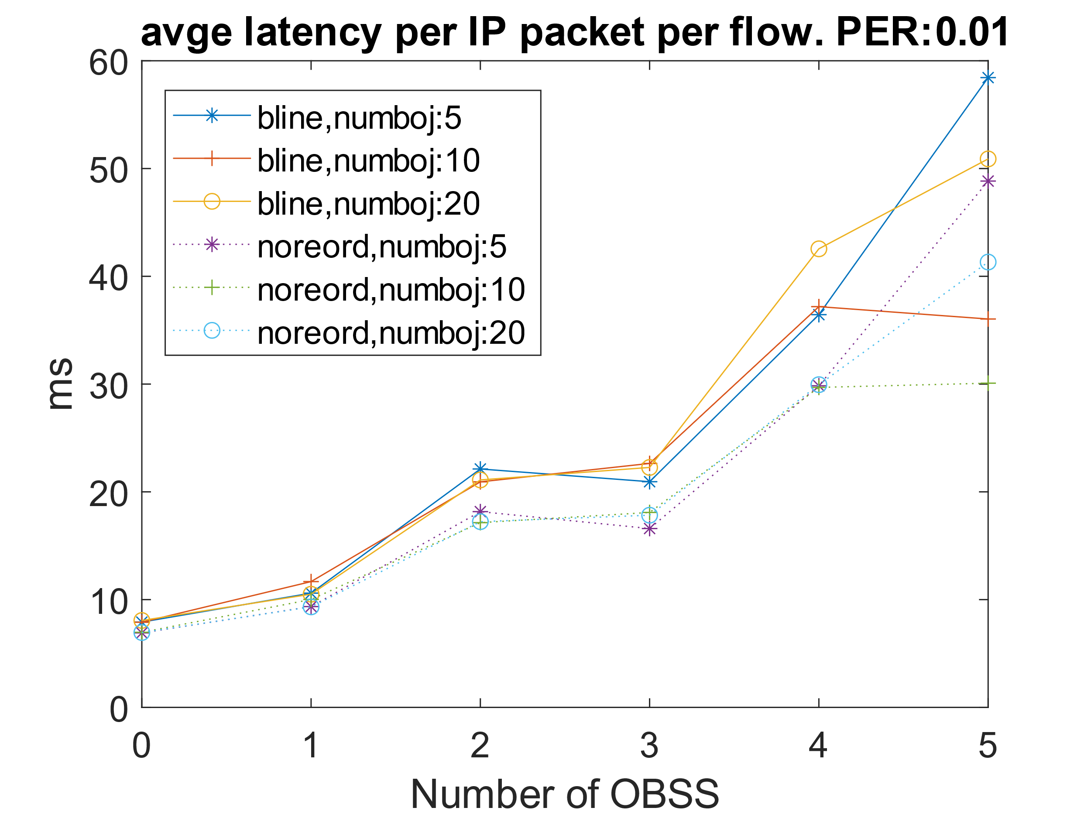
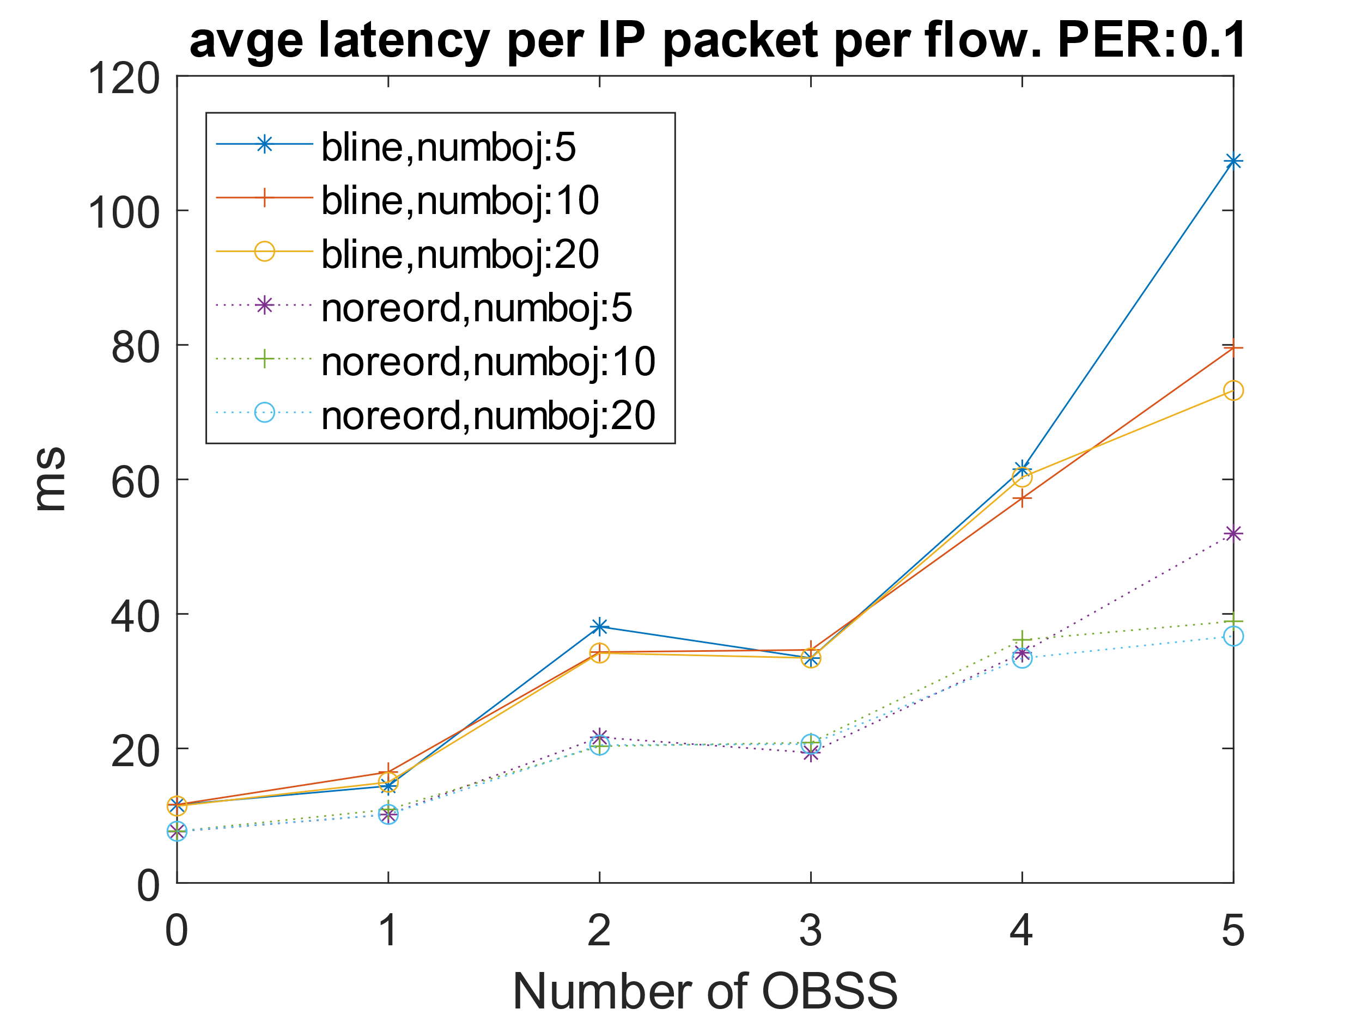
Results (scenario 1 contd.)
Clearly, higher OBSS congestion => more channel access delay for DUT AP.
For 1% and 10% PER cases, OOO delivery (labelled as “noreord”) clearly provides significant latency reduction per IP packet allowing parallel, partial processing.
  For example, from > 100ms with PER = 10% to ~50ms with 5 objects.

Slide 12
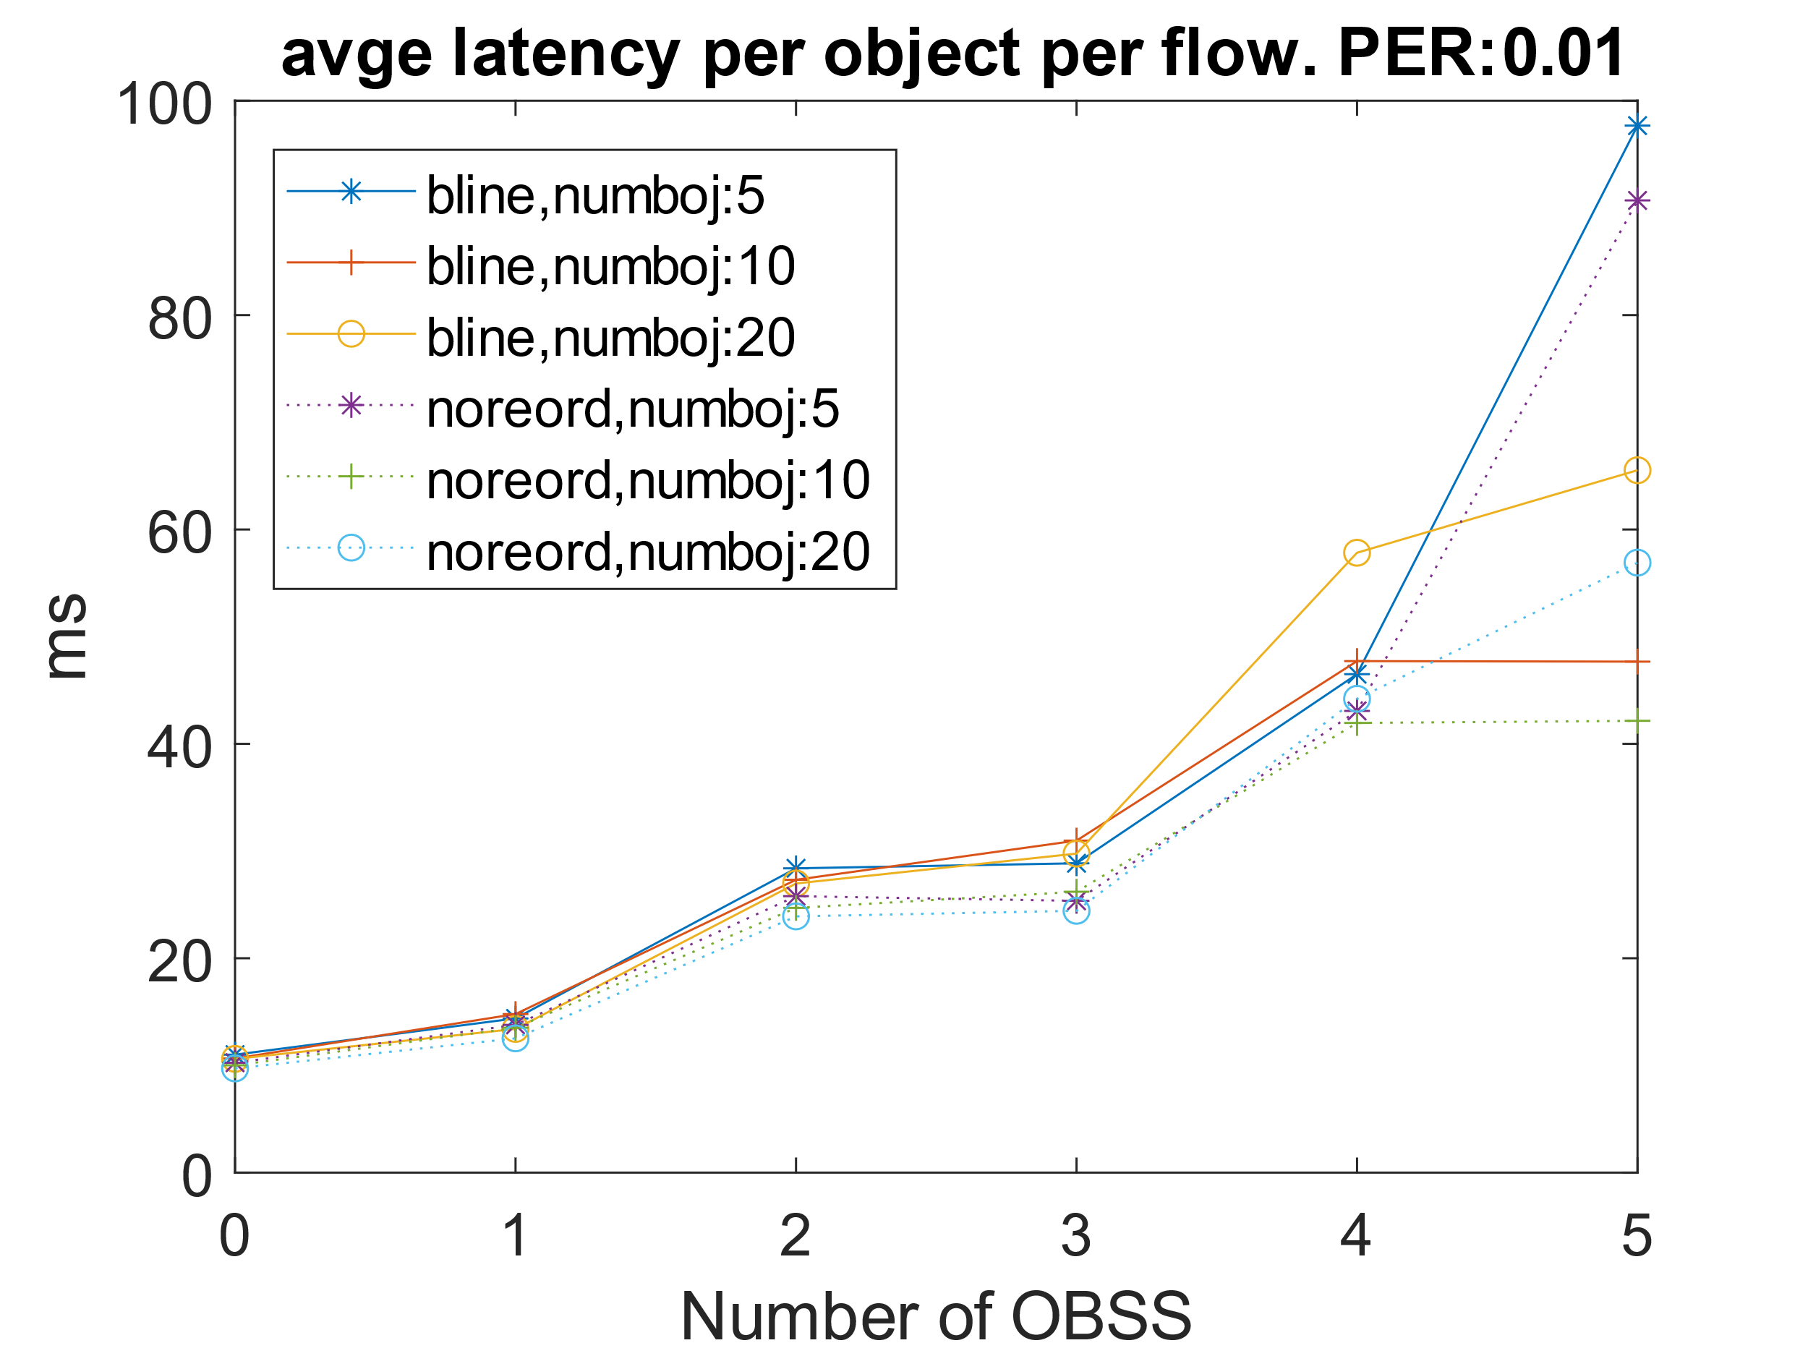
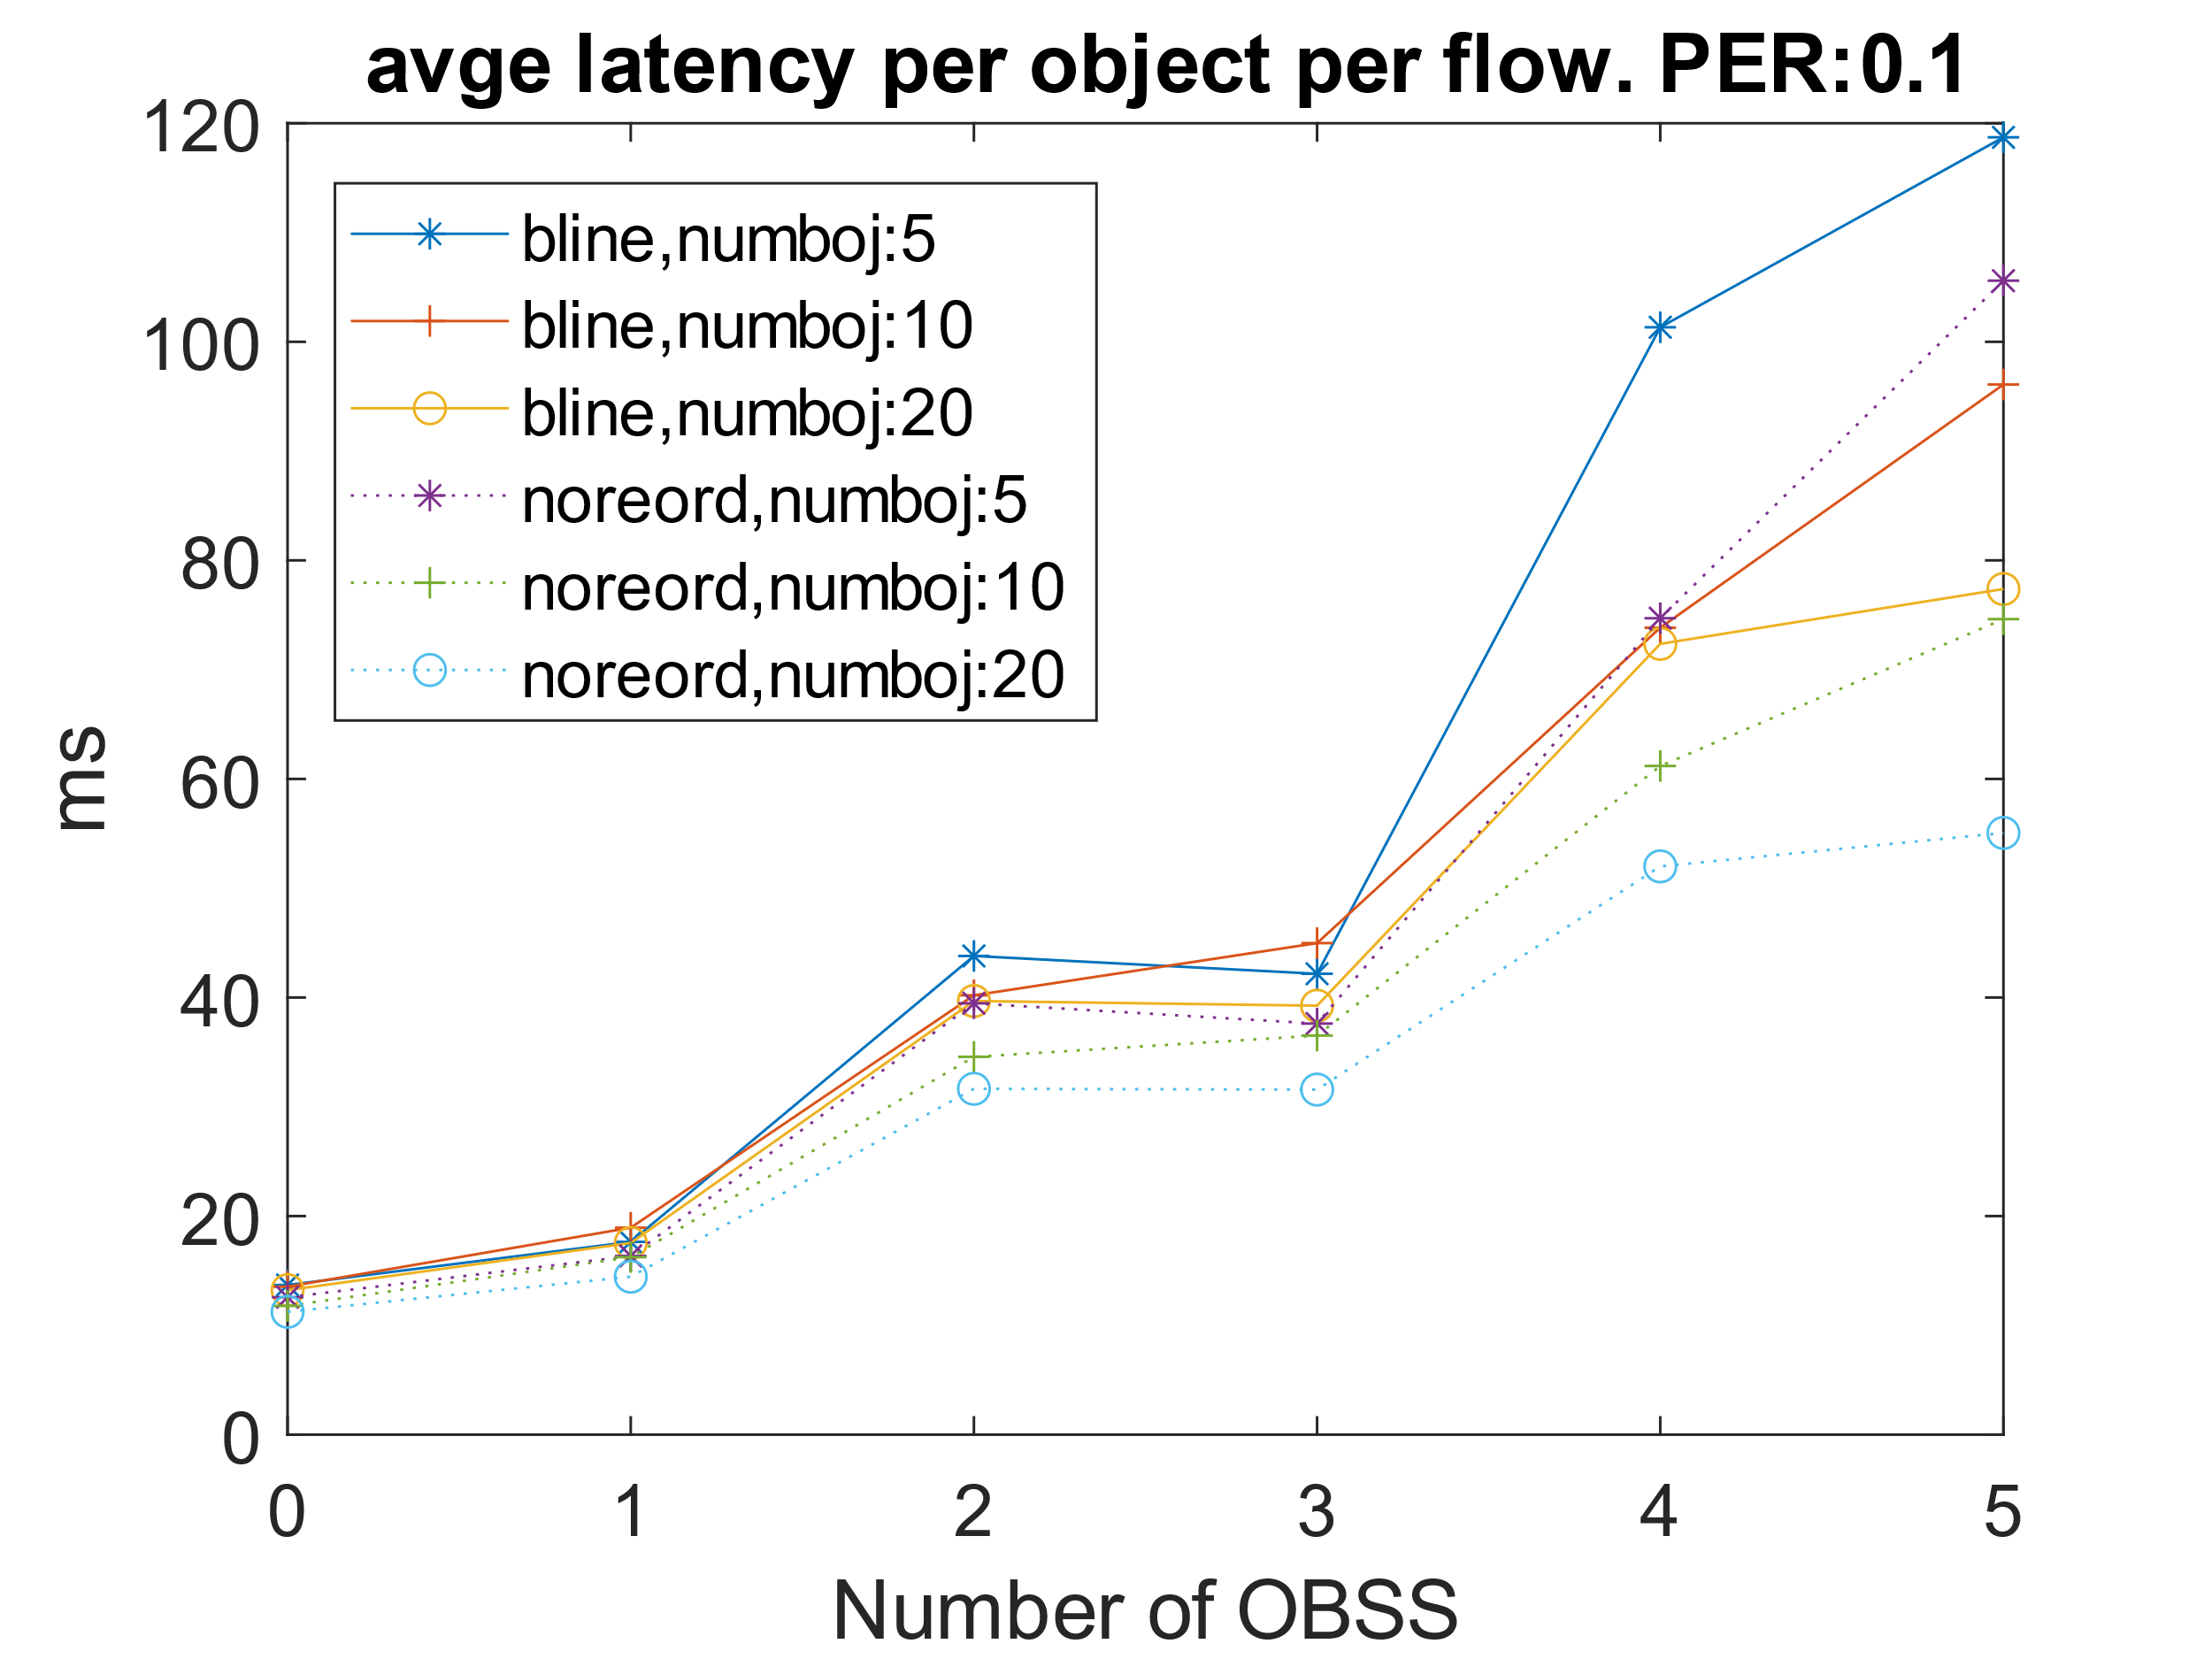
Results (scenario 1 contd.)
Similarly, overall latency for the whole object also improves significantly (e.g., from 77ms to 55ms when number of OBSS STAs is 5, number of objects is 20 and PER is 10%).

Slide 13
Evaluations (Scenario 2)
Network:
  1 DUT AP with one DUT STA and DL flow. Single link, BW = 80 MHz, MCS-7 or 6, NSS-2.
  N OBSS APs (where N = 3, 5).
  TXOP at DUT AP = 3 ms.
Traffic and KPI:
  At DUT, 4 flows modelling 4 point cloud objects [2]
    Flow-1 to 4 has data rates of 53.5, 21.95, 13.63 and 10.0 Mbps respectively with corresponding video frames generated every 16ms and split into 1400B IP packets.
    Interleaved packets modeling network jitter/delay.
    Measure latency for each IP packet of a frame of an object as well overall latency for each frame.
  Each OBSS AP occupy X % of airtime (where X = 10, 20).
Link level PER: (1%, 10%).
Notes:
Think TXOP bursting is enabled for this case.

Slide 14
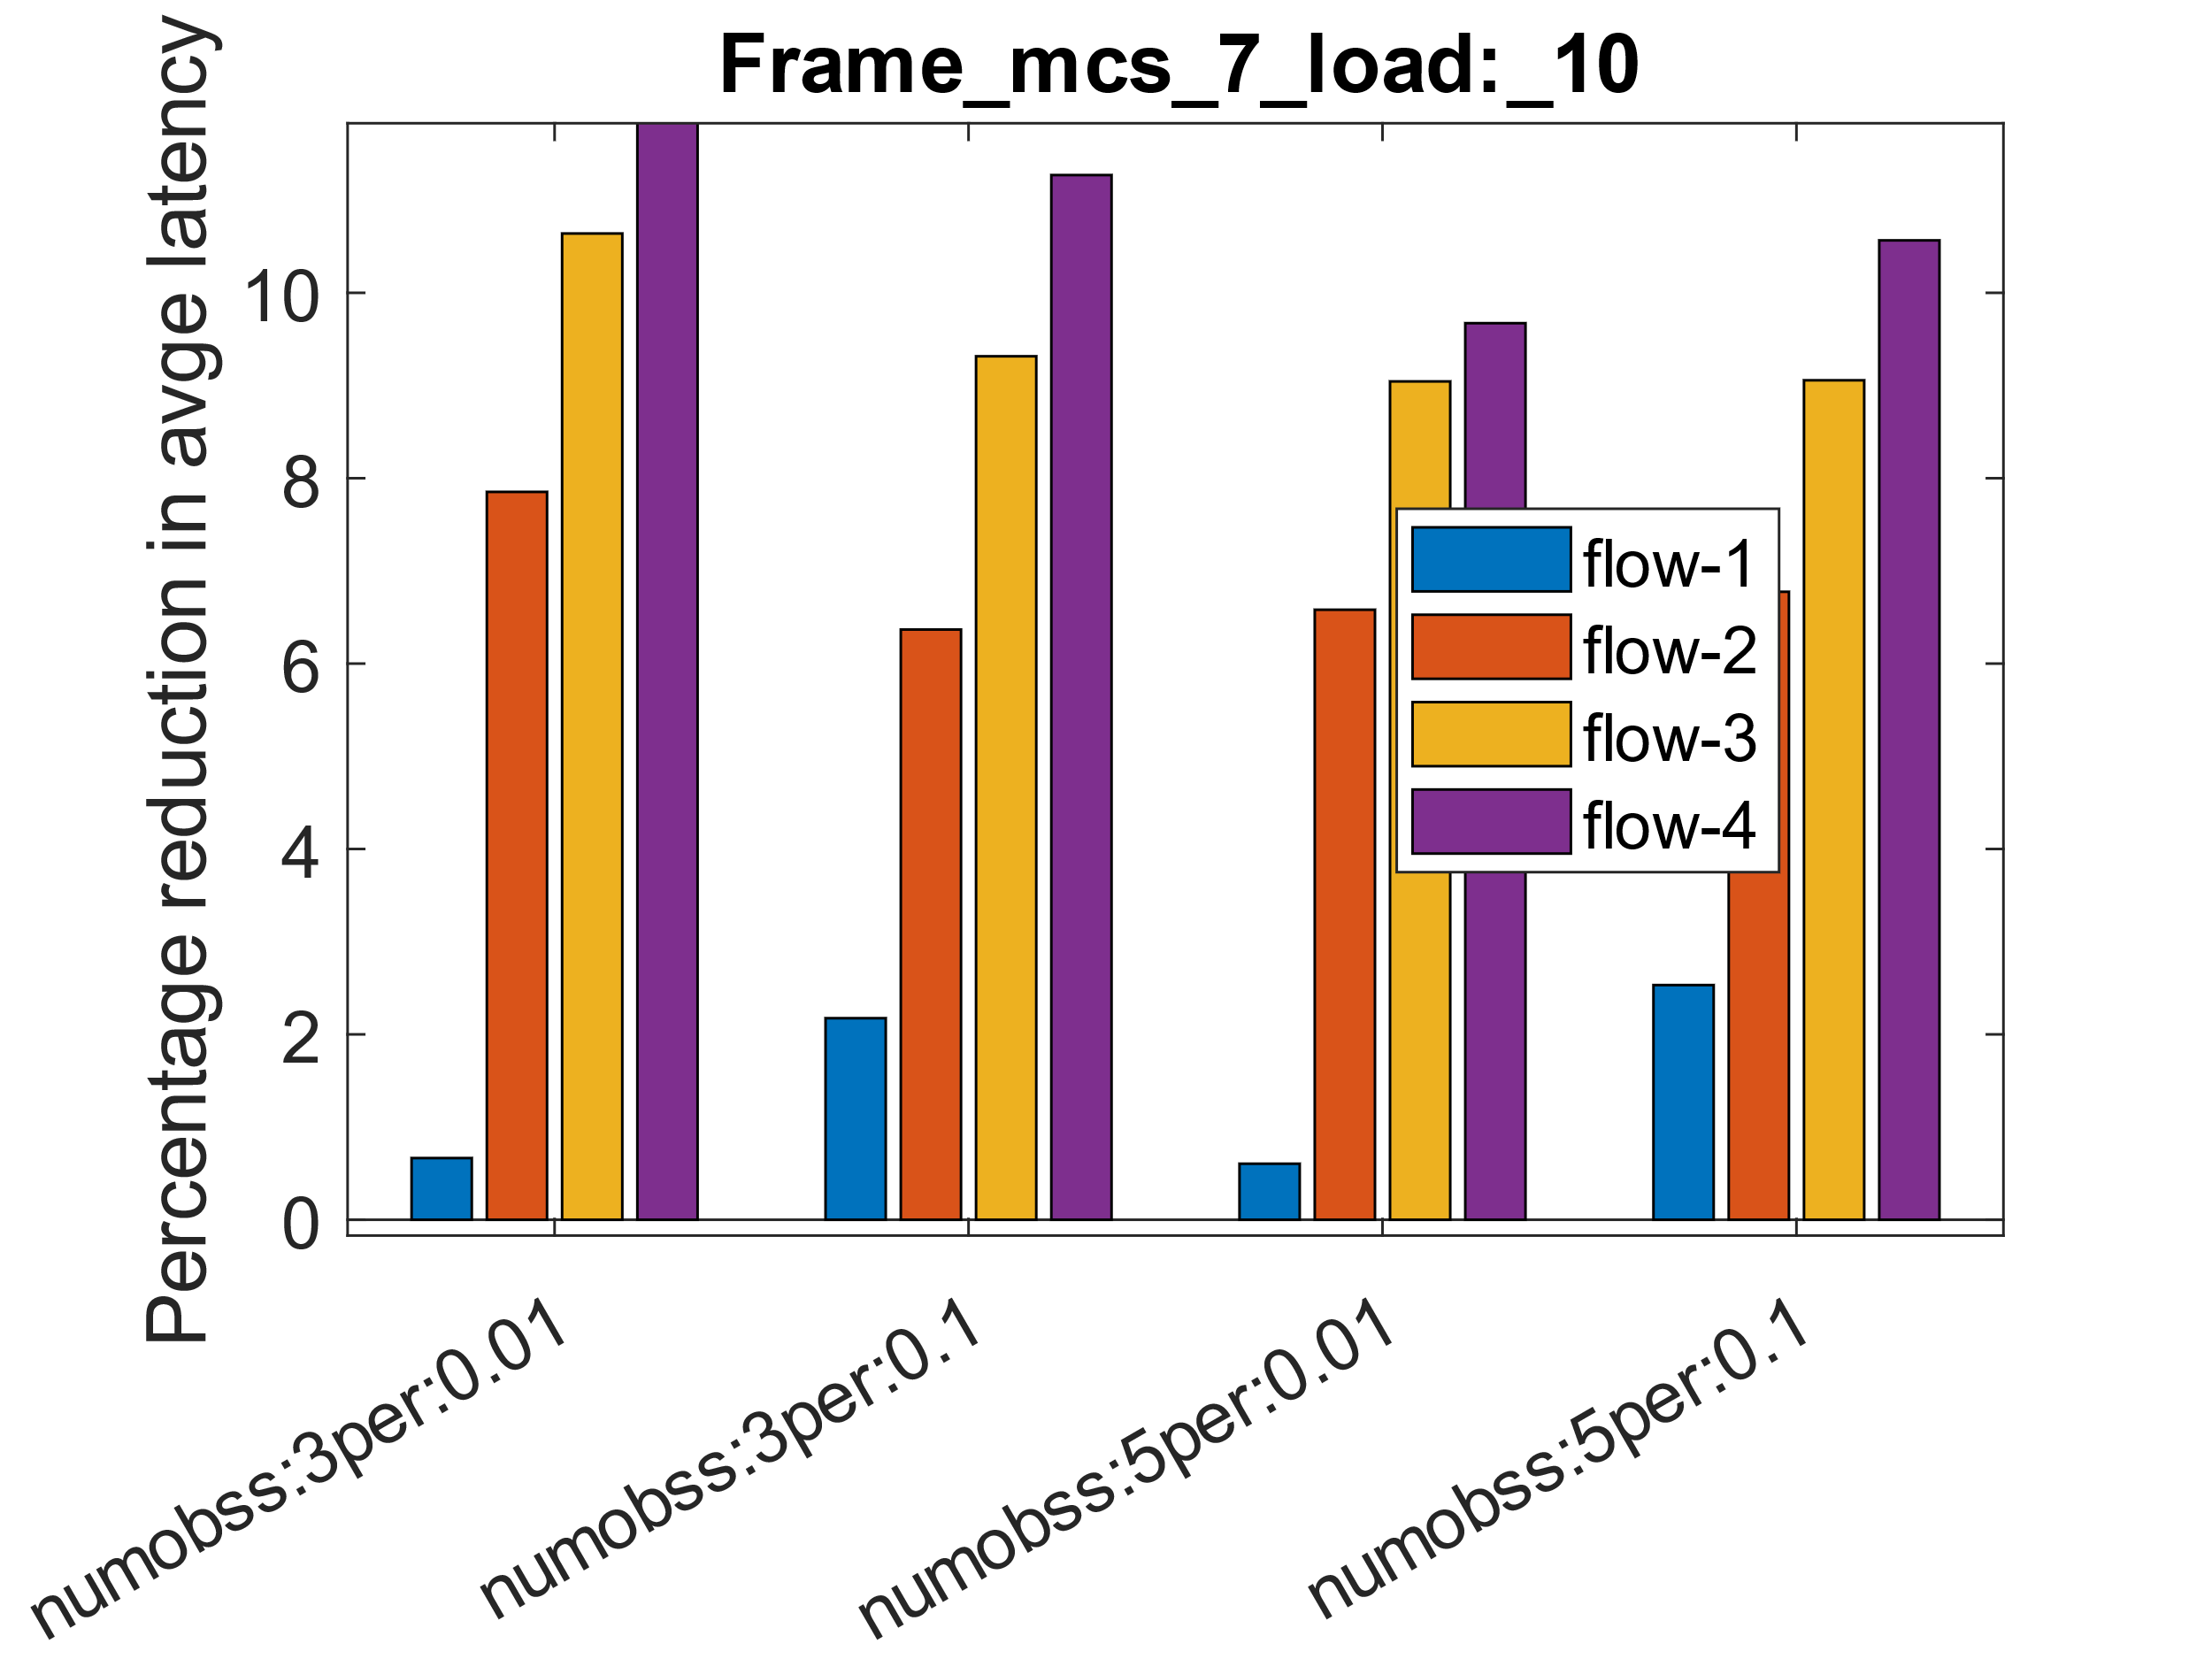
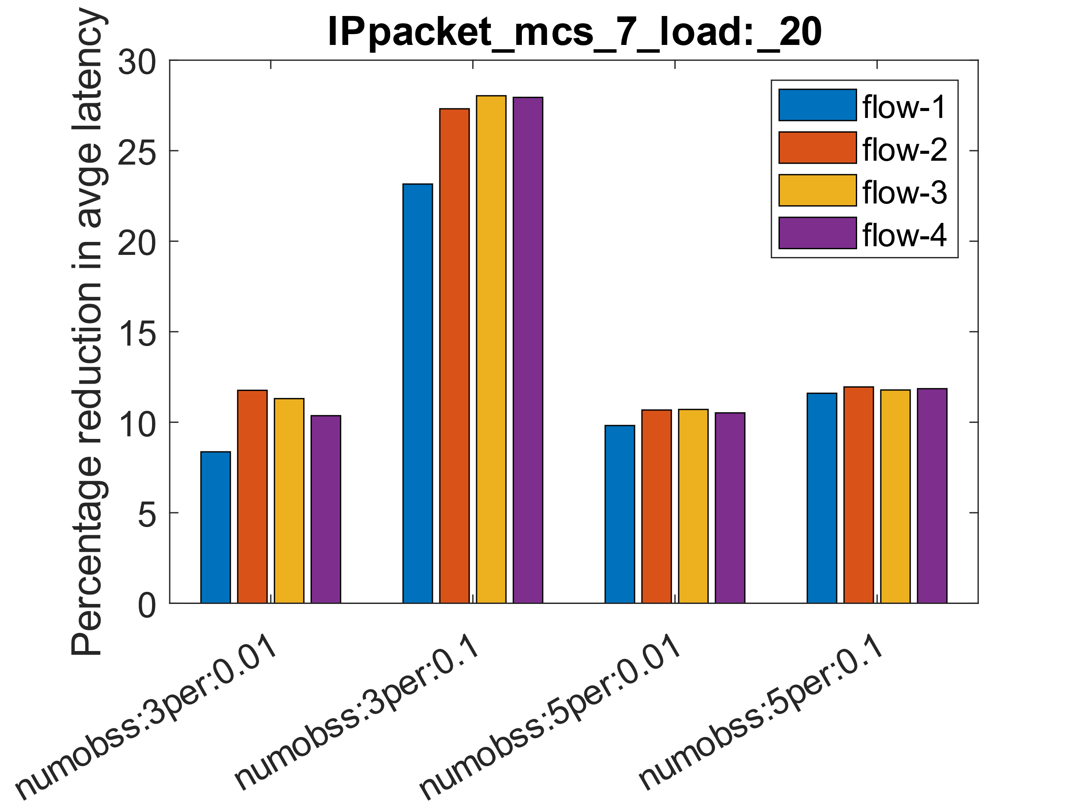
Results scenario 2 average latency per IP packet per frame
Significant reduction in latency (e.g., about 20-30% reduction in latency with number of OBSS =3, PER = 10%).
Low data rate flows (e.g., flow-4) benefits more because they are more likely to be blocked by a packet from a high data rate flow.

Slide 15
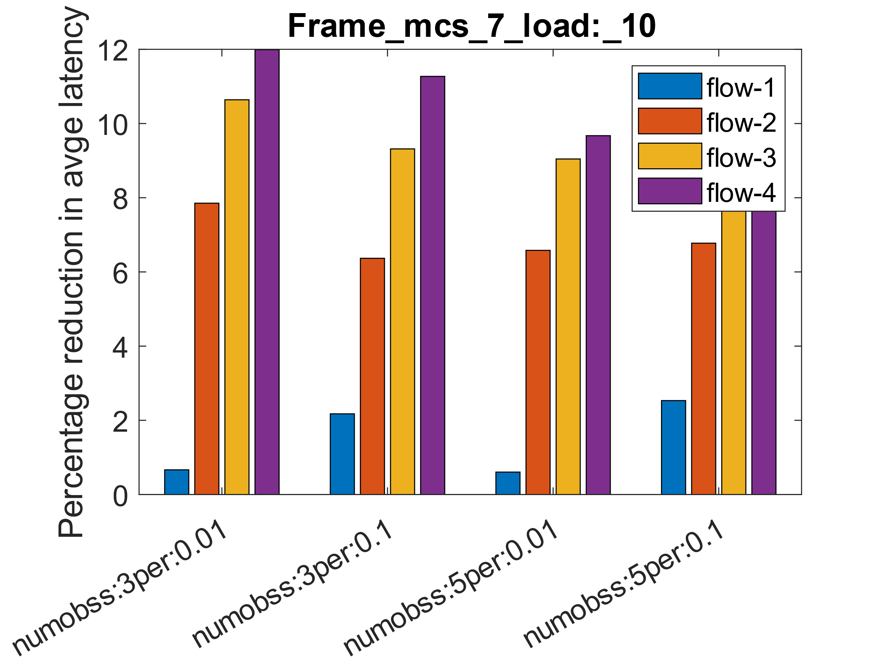
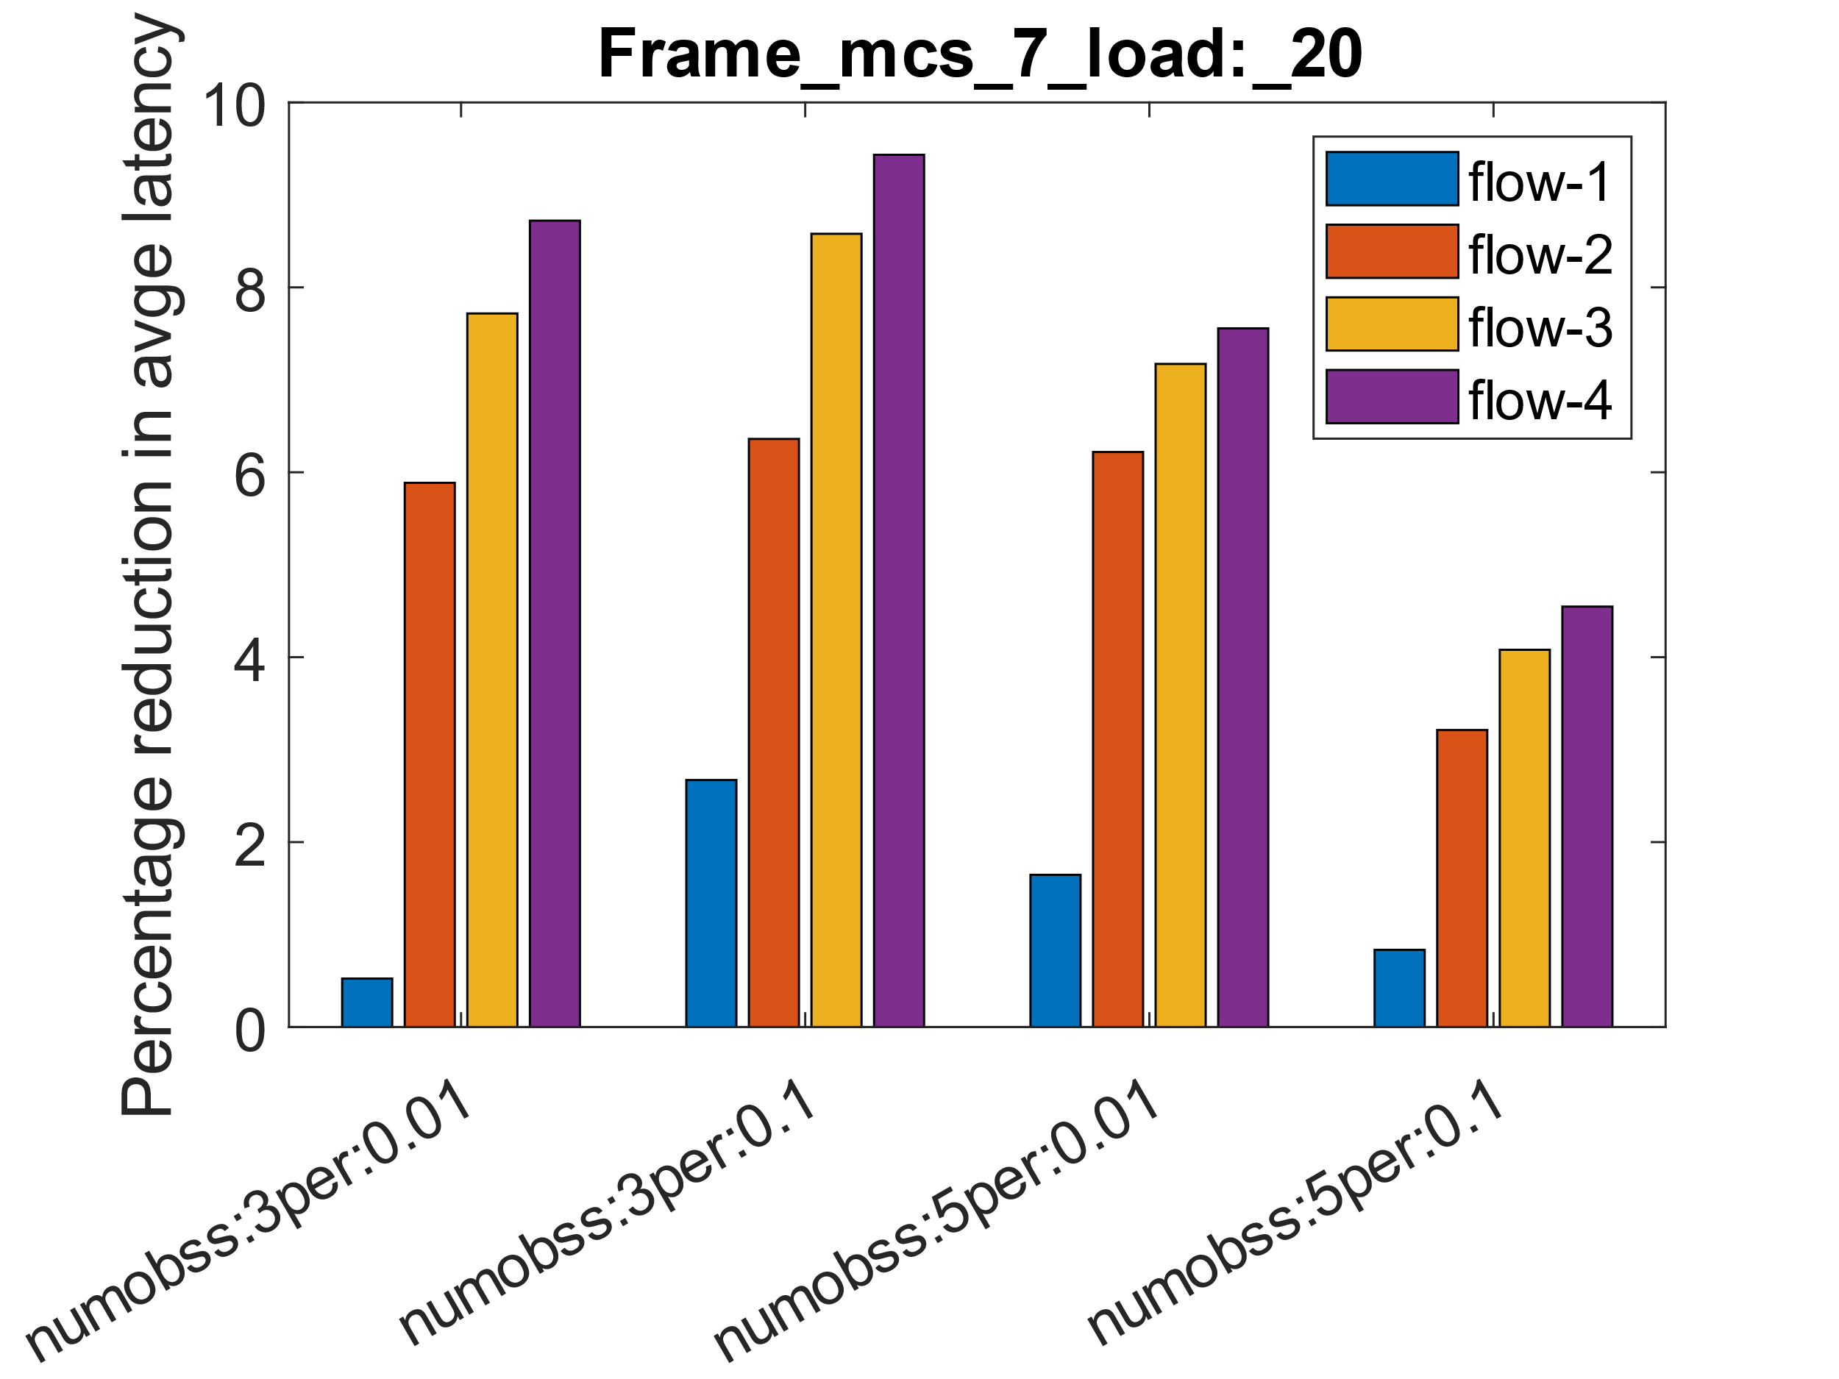
Results scenario 2 average latency per frame
Also, significant reduction in overall frame latency esp. for low data rate flows (~ 10%) .
Notes:
Note that the overall e2e latency bound for XR applications is of the order of 10ms or even less.

Slide 16
Summary
Reviewed the HOL blocking problem in wifi.
Proposed couple of solutions to resolve the HOL blocking issue at MAC layer.
  The solution space partly addresses some inefficiencies of baseline SCS as well as provide hooks for better interworking with new upper layer protocols.
Also, presented some simulation results showing value of resolving this.

Slide 17
References
3GPP TR 26.926 V18.1.0 (2023-12)
8I Voxelized Full Bodies—A Voxelized Point Cloud Dataset
https://blog.research.google/2020/04/improving-audio-quality-in-duo-with.html

Slide 18
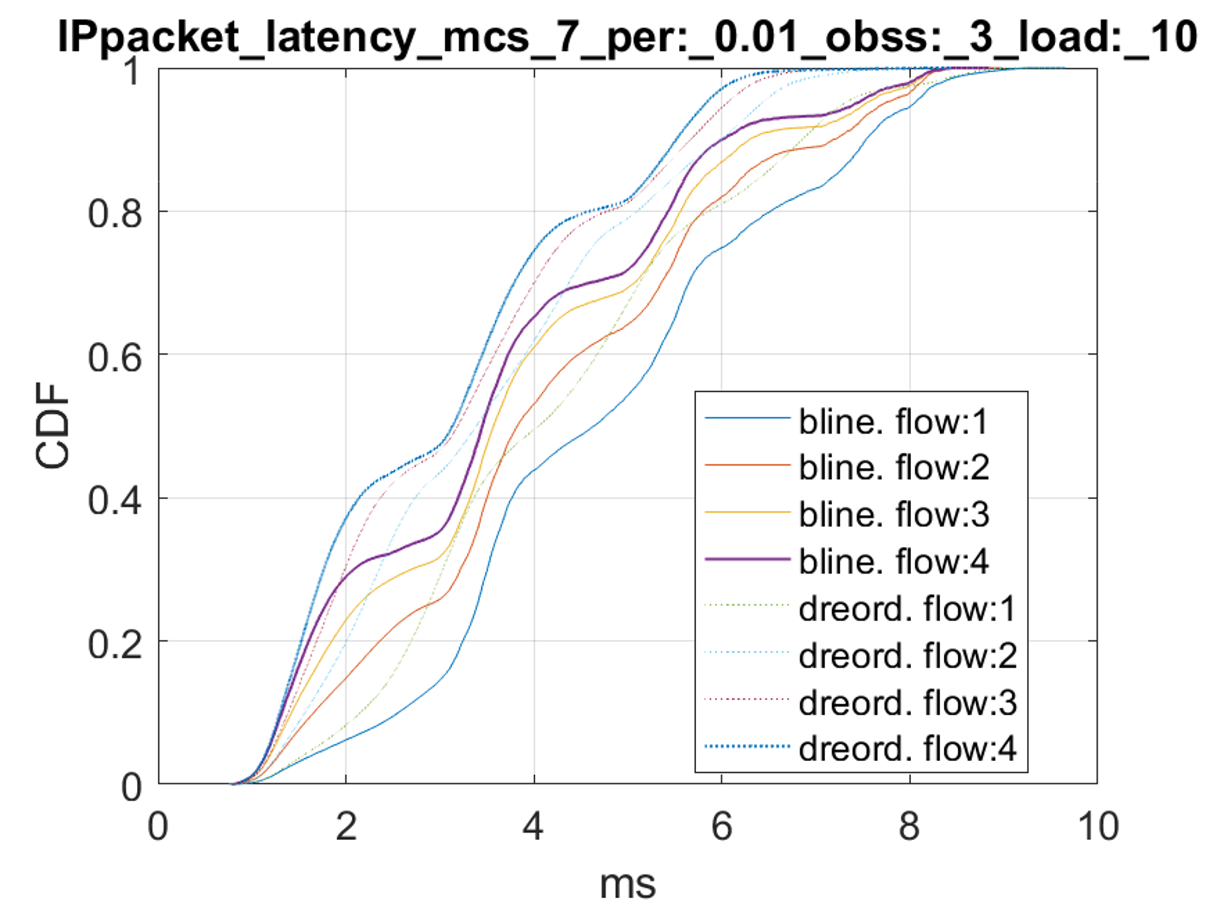
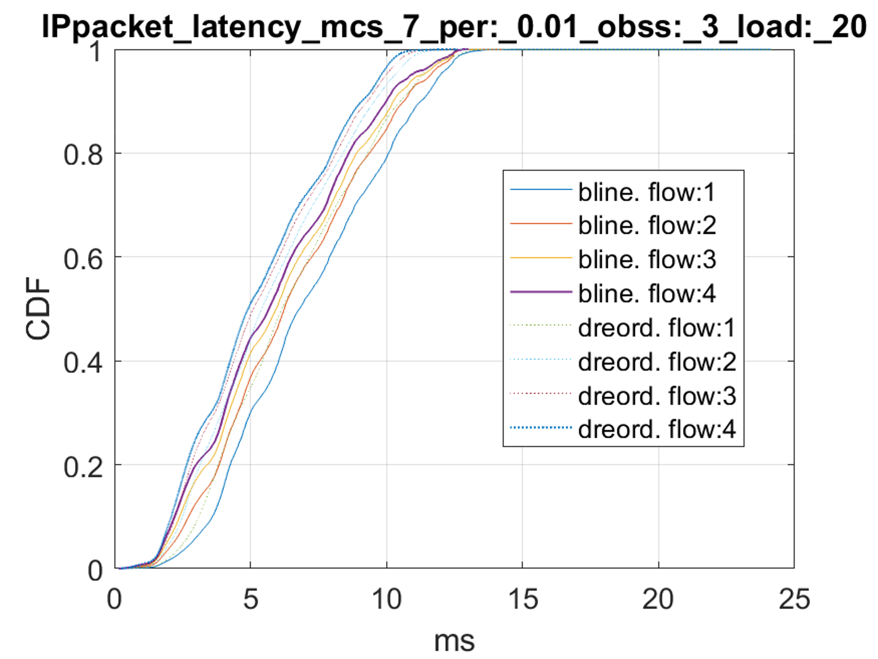
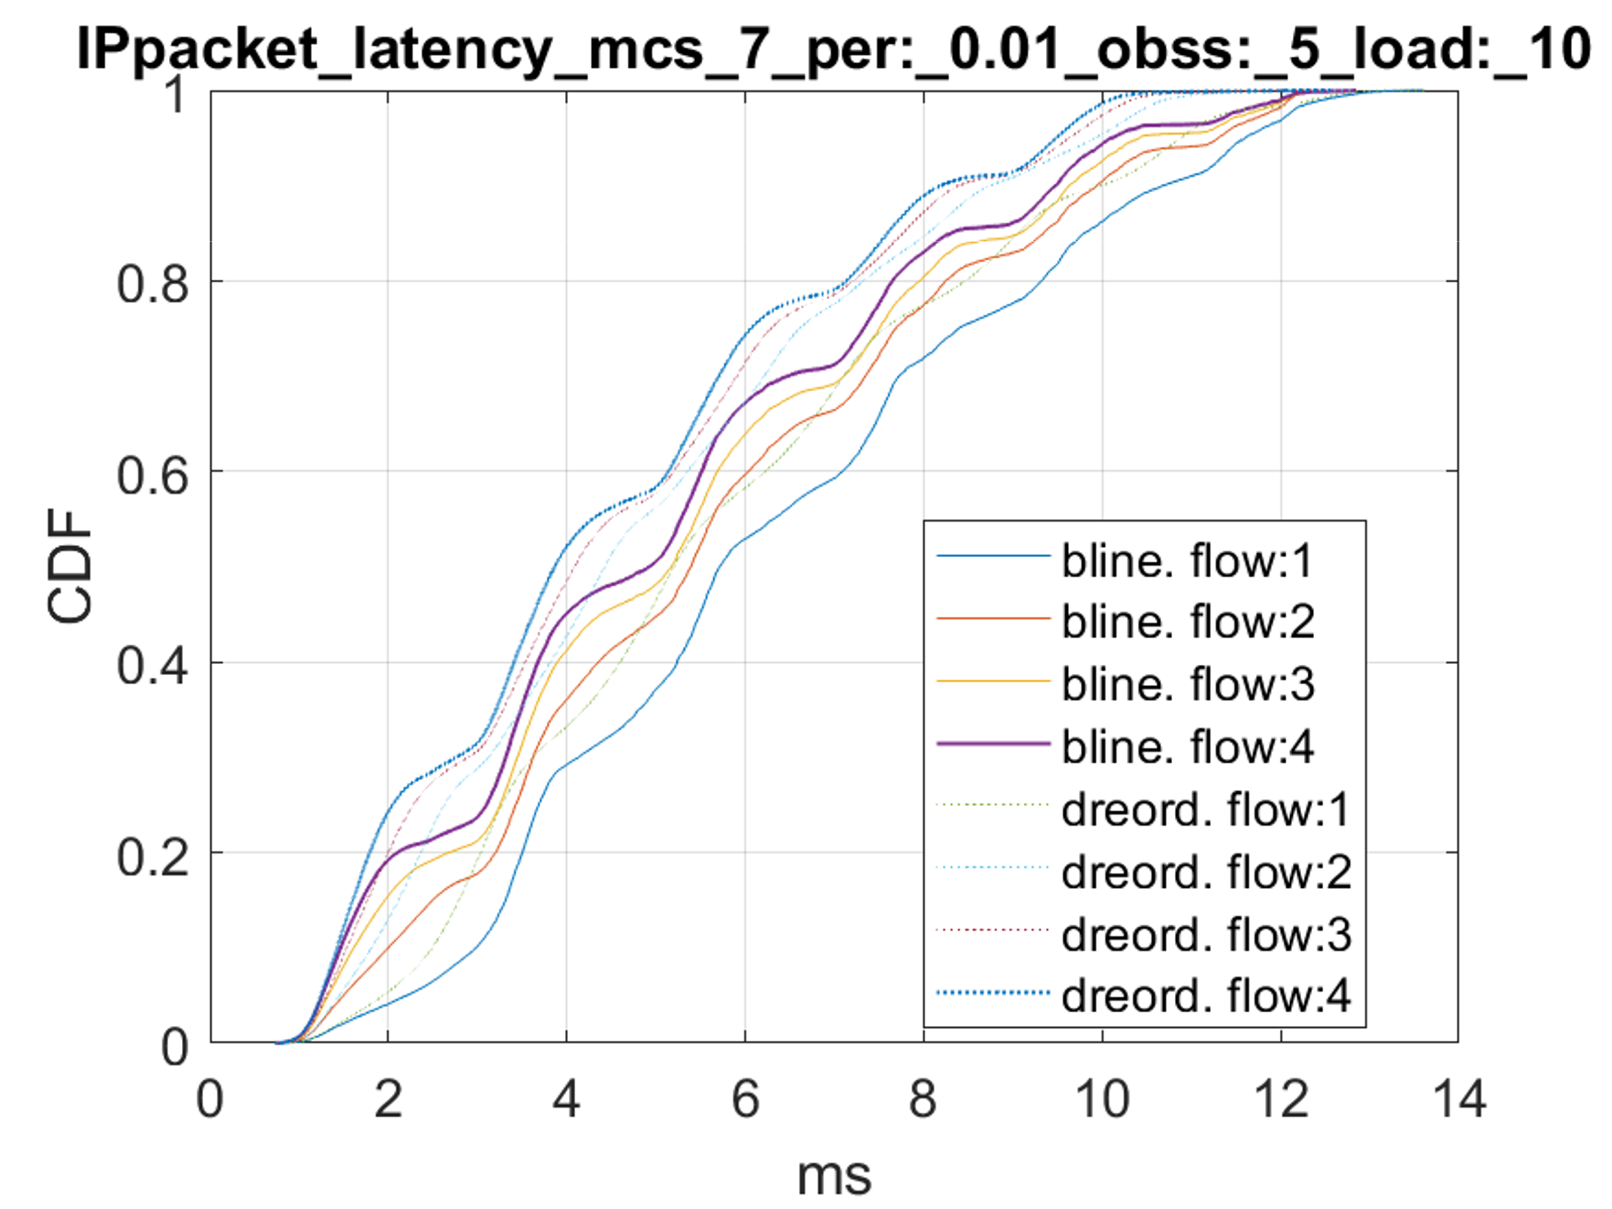
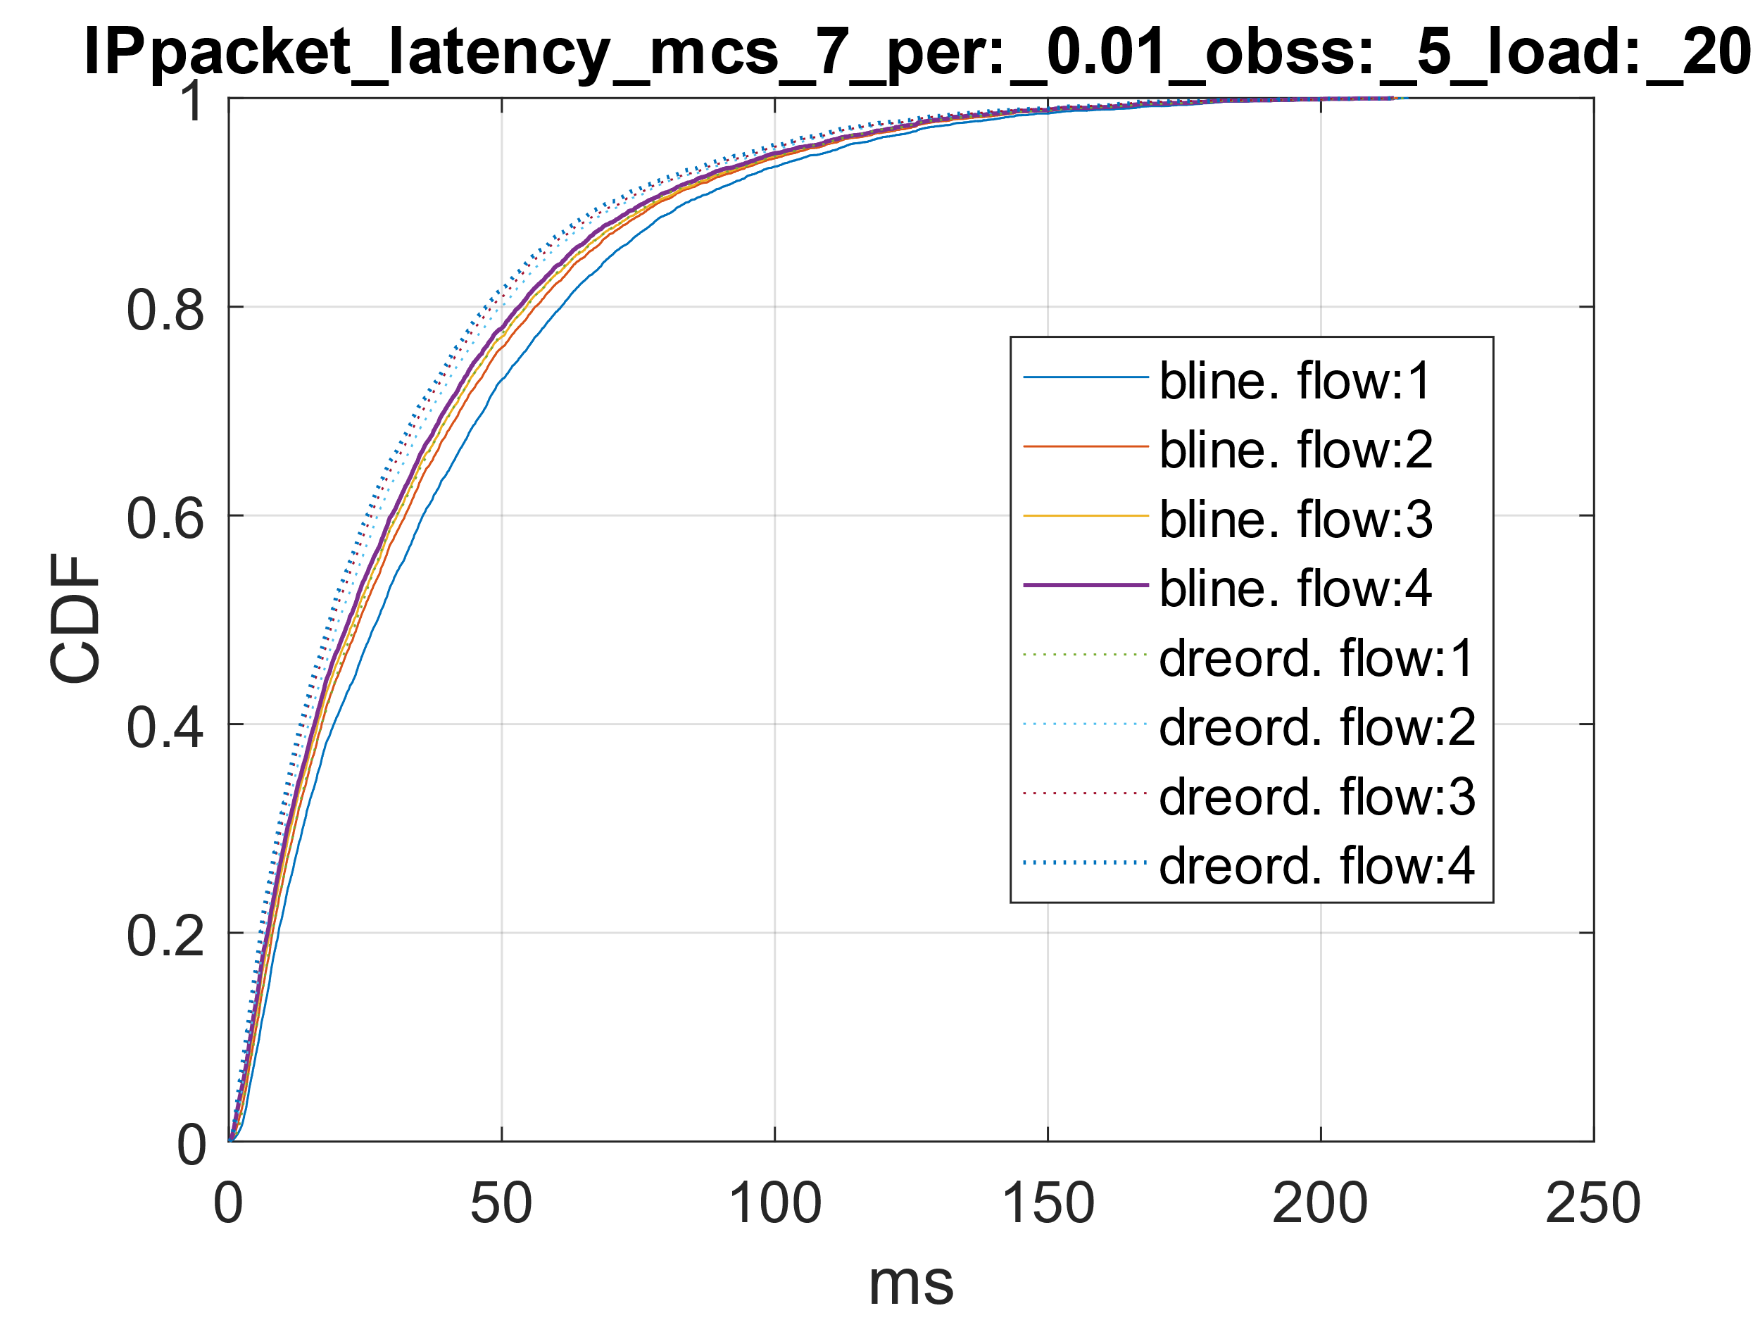
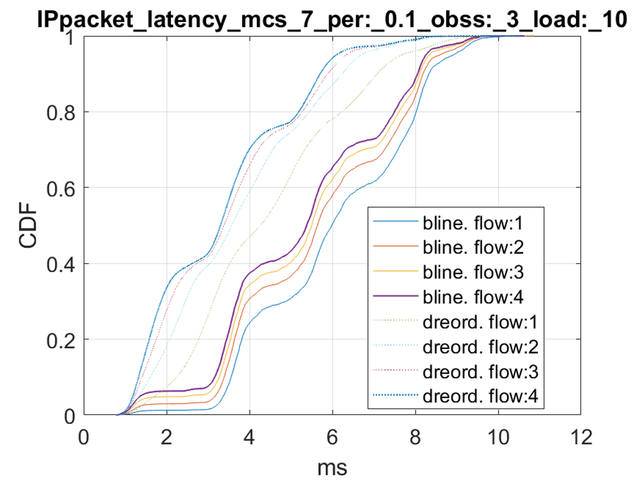
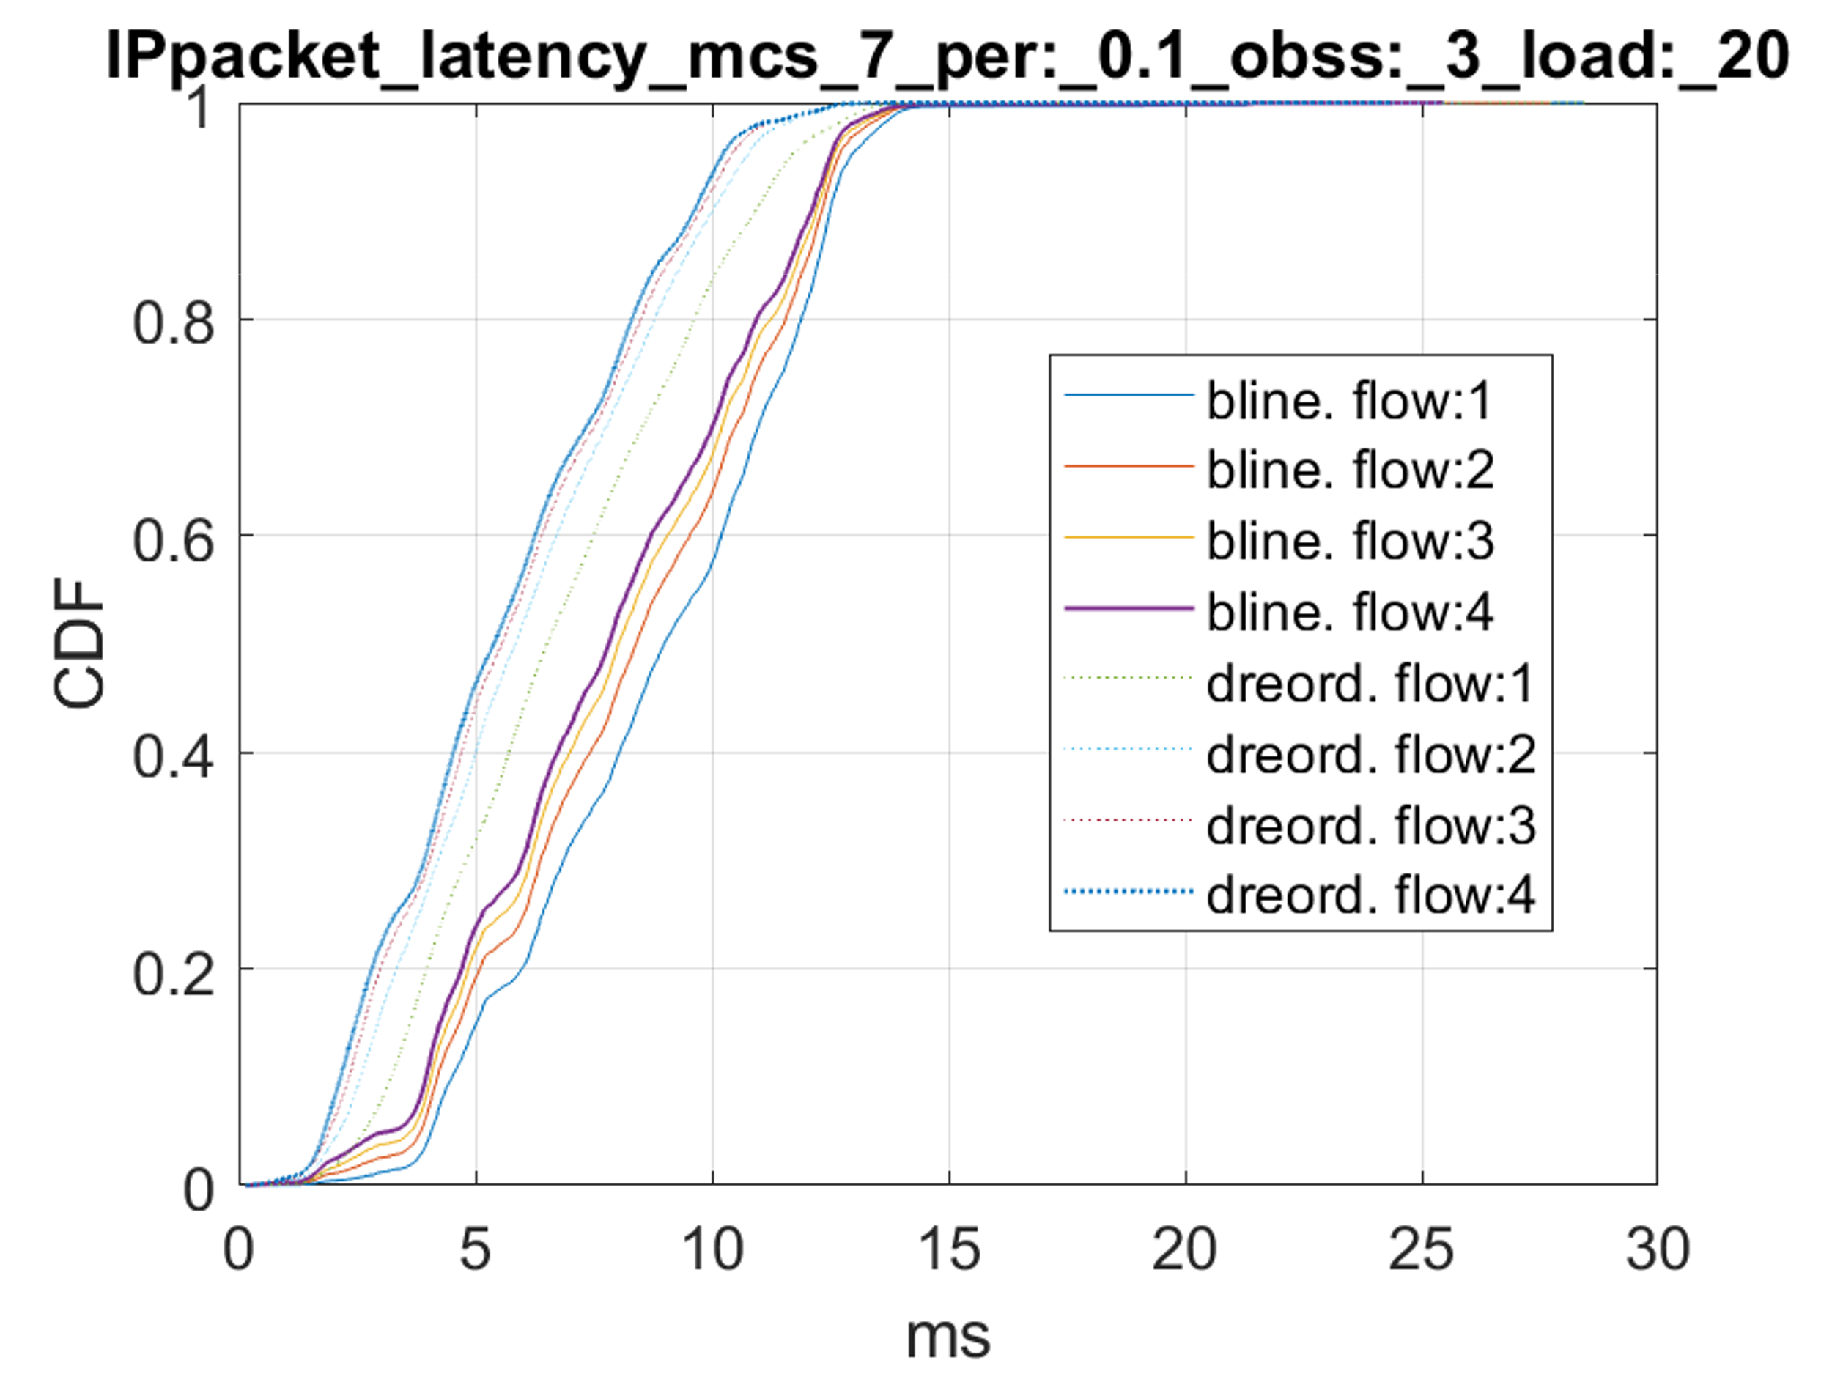
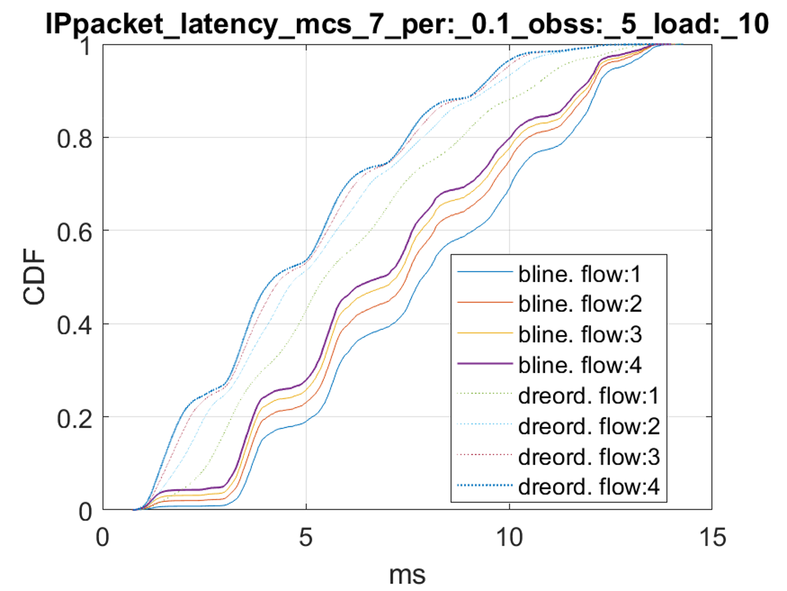
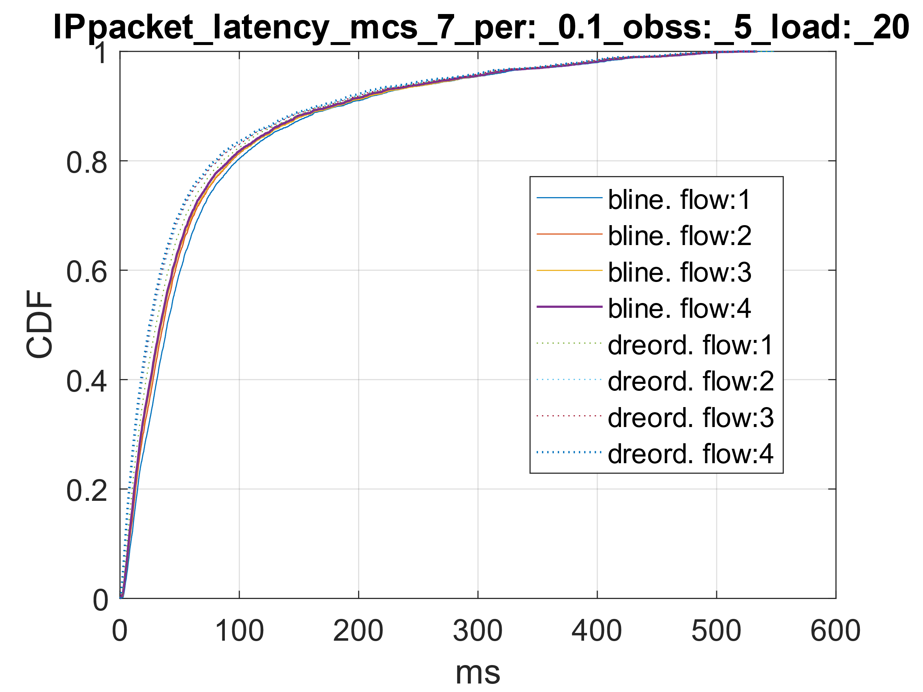
Results (scenario 2 contd. With MCS-7)
Clear gains until the network is below saturation then the DUT has difficulty delivering all traffic.

Slide 19
SP
• Do you agree that UHR should allow more than two TIDs to be mapped to high priority ACs (i.e., VO or VI)?
  o Upto one TID for each AC currently assigned to BE and BK are remapped.
  o Those TIDs may be used dynamically (e.g., following an SCS flow setup).
Notes:
After SCS established, use TID 2 for VI.
Q:

Slide 20
Example flow
After association, STA starts data communication per baseline.
STA starts a second UL QoS flow with UP 4 (VI) for which an SCS stream can be created. TID 2 (BK) is currently unused.
It sends SCS Request (UP = 4, TID = 2) to AP.
After receiving SCS Response (Success), TID 2 carries the traffic for that SCS stream and belongs to AC VI.
After the SCS is torn down, TID 2 is reused for BK traffic.

