Slide 1
Uniform Tone Spacing for Ng = 8 and 16
Date: 2024-03-07
Authors:
Name | Affiliations | email
Steve Shellhammer | Qualcomm | shellhammer@ieee.org
Ali Raissinia |  | alirezar@qti.qualcomm.com
Bin Tian |  | btian@qti.qualcomm.com

Slide 2
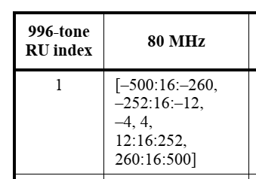
Background
In EHT the feedback tones for Ng = 16 are as follows
These tones are used to estimate the channel on all the tones, for beamforming purposes
In 11bf we adopted the same tones for the Sensing Measurement Report

Slide 3
RF Sensing Techniques
Some RF Sensing Techniques operate in the frequency domain and hence can operate directly on the reported tone set
Some RF Sensing techniques operate in the time domain and need to convert from the reported tone set to the time domain
However, the EHT tone set for Ng=16 is not a uniformly distributed sampling of the 80 MHz segment
This makes conversion from the frequency domain sample set to the time domain complicated due to nonuniform sampling

Slide 4
Proposal
For the RF Sensing Report, we propose to modify the tone set to be a uniformly sampling of the 80 MHz channel
This makes conversion from the frequency domain to the time domain very straightforward
We propose for Ng=16 in the Sensing Measurement Report to use the following tone set
[-496:16:-16, 16:16:496]

Slide 5
Similar Issue for Ng = 8
The current tone set for Ng = 8 is [-500:8 :-4, 4: 8:500]
We propose for Ng=8 in the Sensing Measurement Report to use the following tone set
[-496:8 :-8, 8: 8:496]

Slide 6
Complexity
The memory is already available for the Sensing Measurement Report, which is the largest issue
What is required is a second state machine to select the new tone set for the Sensing Measurement Report, which is slightly different than the state machine for selecting tones for the beamforming report

Slide 7
Straw Poll
Do you agree to replace the current subcarrier values for Ng = 8 and Ng=16 in the Sensing Measurement Report with the following subcarriers?
Yes
No
Abstain
Ng | Tone Set
8 | [-496:8:-8, 8:8:496]
16 | [-496:16:-16, 16:16:496]

