Slide 1
Overview of the 802.11ba PHY
Date: 2024-03-07
Authors:
Name | Affiliations | email
Steve Shellhammer | Qualcomm | shellhammer@ieee.org
Bin Tian |  | btian@qti.qualcomm.com
Pooria Pakrooh |  | ppakrooh@qti.qualcomm.com

Slide 2
Introduction
AMP needs a wake-up radio (WUR) specification
There is an opportunity to leverage the 802.11ba PHY, with possibly some modifications, for the AMP WUR, in the 2.4 GHz frequency band.
The purpose of this presentation is to give an overview of the 802.11ba PHY so the AMP group can begin discussions on what can be leveraged from the 802.11ba PHY and what might need to be modified
Note: 802.11ba supports 2.4 GHz but does not support sub-1GHz operation, so clearly changes will need to be made to 802.11ba to support sub-1GHz frequency bands
A description of both the 802.11ba PHY and MAC is available in [1]

Slide 3
Outline
PPDU Format
Bandwidth
Modulation
Data Rates
Manchester Encoding
Sync Field
Data Field
Symbol Randomization
TX Diversity
Final Comments
Conclusions
References

Slide 4
PPDU Format
Note: Figures from the standard [2] are used in this presentation
The PPDU is divided into the non-WUR Portion and the WUR Portion
Non-WUR Portion:
L-STF, L-LTF, L-SIG, BPSK-Mark1, and BPSK-Mark2
WUR Portion:
WUR-Sync and WUR-Data

Slide 5
PPDU Format (non-WUR Portion)
non-WUR portion
The non-WUR portion (L-STF, L-LTF, L-SIG, BPSK-Mark1, BPSK-Mark2) are OFDM symbol intended to be decoded by Third-Party STAs.
The non-WUR portion signals appears to the Third-Party STAs as an 802.11a PPDU and indicates the duration of the PPDU.
The Third-Party STAs that hear the non-WUR portion will avoid transmitting during the PPDU duration

Slide 6
PPDU Format (WUR Portion)
WUR portion
The WUR portion (WUR-Sync and WUR-Data) are Multicarrier On-Off Keying (MC-OOK) modulated fields.
There are two versions of the WUR-Sync Fields
64 µs duration, used for high-data rate (HDR)
128 µs duration, used for low-data rate (LDR)
The WUR Receiver uses the WUR-Sync field to detect the PPDU, identify the data rate, and perform timing alignment
The WUR-Data field carries the data at either the high or low data rate

Slide 7
Bandwidth
The non-WUR portion is a standard 20-MHz OFDM bandwidth
There is also an optional 80-MHz bandwidth
The WUR portion bandwidth is 4 MHz
The choice of the WUR portion bandwidth is a trade-off between several factors
Factors Considered in selecting Bandwidth of WUR Portion | Affect on Choice of WUR Bandwidth
Regulations | In some regulatory domains there is a PSD limit leading to an allowed TX power increase with wider bandwidth [3].
Receiver Filtering for Adjacent Channel Interference | The WUR Receiver needs to be low-complexity and hence its filtering will be poorer than a regular receiver. To get desired Adjacent Channel Rejection, the TX signal needs to be less than the 20-MHz channel bandwidth.
Overall Receiver power consumption | Wider TX bandwidth requires wider bandwidth baseband signals leading to an increase in Receiver power consumption

Slide 8
Modulation
To enable a WUR Receiver implementation with very low power consumption, the Task Group agreed to use on-off keying (OOK)
The receiver does not require a low phase noise oscillator
An envelop detector can be used for low complexity
There are many research papers demonstrating low power wake-up receivers using OOK
With standard single-carrier OOK the TX bandwidth is set by the OOK symbol rate, and as we will explain later, a low symbol rate has advantages for the WUR

Slide 9
Modulation (cont.)
In order to reuse a standard OFDM transmitter with small changes it was proposed to apply OOK to the OFDM waveform
The 4 µs OFDM symbol was selected
The TX implementation to transmit OOK based on this OFDM symbol can be accomplished by either sending the OFDM symbol or transmitting zeros during that 4 µs period
It turns out there was a need for a 2 µs OOK for the WUR-Sync field and the HDR WUR-Data field.
In that case half of the 4 µs Symbol is used.

Slide 10
Modulation (cont.)
There are additional benefits to this multicarrier on-off keying (MC-OOK) waveform beyond the ease of TX implementation
With single-carrier OOK the TX bandwidth is set by the OOK symbol rate, and as we will explain later, a low symbol rate has advantages for the WUR
With this style of OOK we can have a wider bandwidth than the bandwidth based on the symbol rate
To obtain a 4 MHz bandwidth 13 subcarriers are used, and the other subcarriers are null
This is a much larger bandwidth than would be obtained if a single carrier OOK was used with this symbol rate

Slide 11
Data Rates
The Task Group decided on two data rates
Low Data Rate (LDR) = 62.5 kb/s
High Data Rate (HDR) = 250 kb/s
The LDR has better range given it operates at a lower SNR.
It can operate at 6 dB lower than the HDR.
The HDR has the advantage of a shorter PPDU duration.
The LDR is mandatory and the HDR is optional.

Slide 12
Manchester Encoding
In OOK without a line code (like Manchester encoding) the receiver needs to set a threshold between the receive level of the On and Off symbols, in order to decode.
With Manchester encoding logical bits are encoded by an On symbol followed by an Off symbol or an Off symbol followed by an On Symbol
To decode a bit, the receiver can subtract the power of the first symbol from the power of the second symbol and comparing to zero.
Hence, with Manchester encoding the receiver does not need to determine the optimum threshold between On and Off receive symbols
This simplifies the WUR decoder

Slide 13
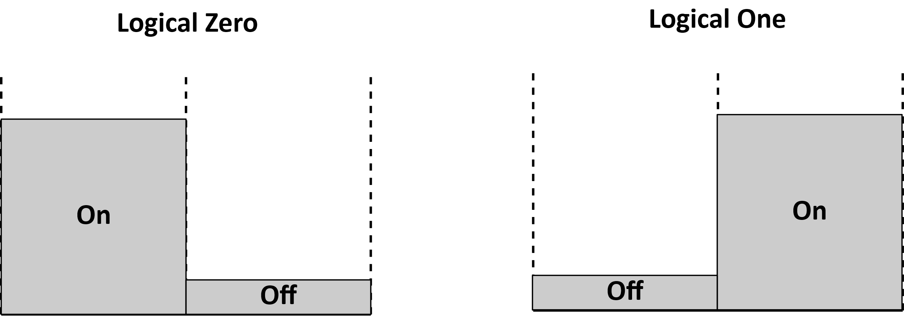
Manchester Encoding (Cont.)
Below we see the reception of either a Manchester encoded Logical Zero or Logical One
The receiver only needs to compare the received energy in the two symbols to decode
Note, this does require two symbols to transmit one logical bit

Slide 14
WUR-Sync Field
The first part of the WUR Portion of the PPDU is the Sync field
As the name implies, it enables the WUR Receiver to synchronize to the transmitted signal
It also allows for packet detection
There are two possible lengths of the Sync field
64 µs duration, used for high-data rate (HDR)
128 µs duration, used for low-data rate (LDR)
The Task Group decided to not include a signal (SIG) field, which is where in other 802.11 standards the data rate, or modulation and coding scheme (MCS) is transmitted
This is intended to simplify the PPDU format
So, the Sync field is used to signal whether HDR or LDR is used in the Data field

Slide 15
WUR-Sync Field (cont.)
The Task Group decided to use 2 µs symbols in the Sync field instead of 4 µs symbols
The reason for this is that for a given duration, more short symbols can be fit into the specified duration
For example, in a 64 µs duration:
If the symbol duration is 2 µs then 32 symbols can be used
If the symbol duration is 4 µs only 16 symbols can be used
Having more symbols makes it possible to design a more robust Sync field

Slide 16
WUR-Sync Field (cont.)
For the HDR the Sync field is specified as the bit sequence $\overline{W}$, which is the logical complement of the sequence $W$
With 1 indicating an On symbol and 0 indicating an Off symbol
For the LDR the Sync field is specified as the bit sequence $WW$, which is the concatenation of two copies of $W$
With 1 indicating an On symbol and 0 indicating an Off symbol

Slide 17
WUR-Sync Field (cont.)
Since the HDR and the LDR use $\overline{W}$ and $W$ respectively, the WUR receiver can be built that is unlikely to confuse an HDR and a LDR WUR-Sync field
Simulations were performed by the Task Group to show that reliable packet detection, data rate identification, and timing recovery can be performed
It was also shown that the Sync field is more robust than the Data field, so the receiver sensitivity is determined by the Data field processing

Slide 18
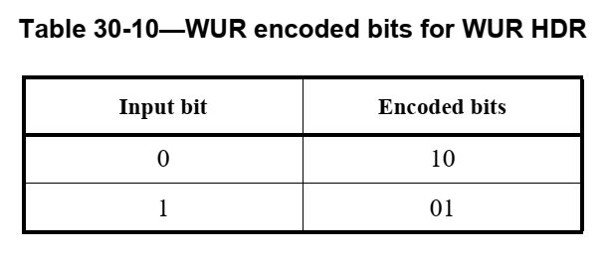
WUR-Data field
The HDR has a data rate of 250 kb/s meaning that the bit duration is 4 µs
A pair of 2 µs symbols are used along with Manchester encoding

Slide 19
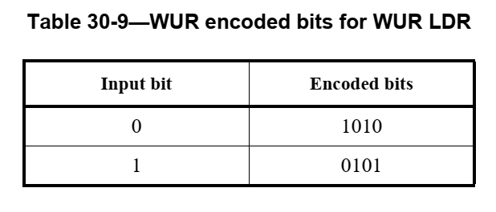
WUR-Data field
The LDR has a data rate of 62.5 kb/s meaning that the bit duration is 16 µs
Four 4 µs symbols are used
It consists of Manchester encoding and repetition coding

Slide 20
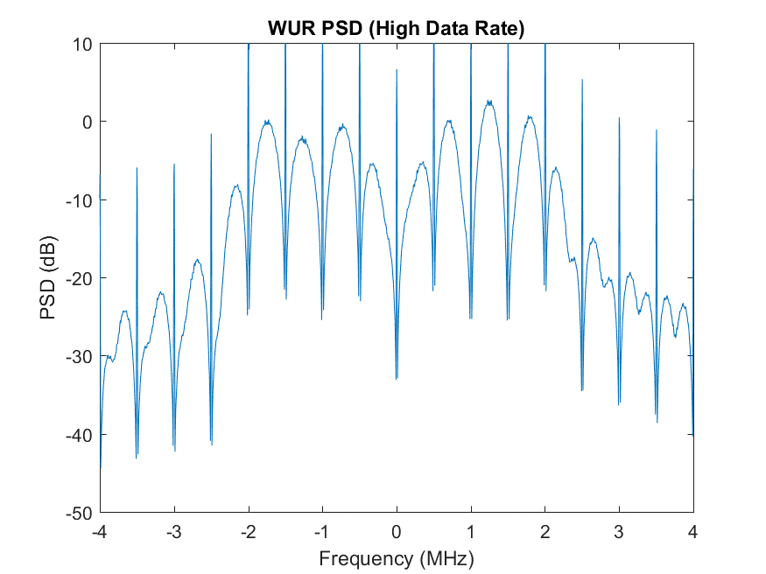
Symbol Randomization
It was pointed out in the Task Group, that if the same ODFM waveform is used for each OOK symbol, then the spectrum of the PPDU will have spectral lines in the frequency domain
Figure from [4]

Slide 21
Symbol Randomization (cont.)
A combination of two methods were used to address this issue
Pseudo random multiplication by $+1$ or $−1$
Pseudo random cyclic shift diversity (CSD) applied to OFDM waveform
A common linear feedback shift register (LFSR) is used to generated the random bit sequence
This was shown to eliminate the spectral lines and improve the flatness of the spectrum

Slide 22
Transmit Diversity
The WUR Transmitter is often an access point
Typical access points have multiple antennas
To avoid unintentional beamforming cyclic shift diversity (CSD) is applied to the TX antennas
Tables of recommended CSD values are provided in the standard
Task Group simulations were performed to compare the packet error rate for different number of TX antennas
The simulations were performed for both an AWGN channel and Channel Model D

Slide 23
Final Comments
Not including a Signal (SIG) field in the WUR Portion had two effects
Different Sync fields were needed to indicated the data rate: HDR or LDR.
There was no PHY field to indicate the length of the Data field, so that needed to be done in the MAC. This is a bit of a cross-layer violation.

Slide 24
Conclusions and Next Steps
Conclusions
An overview of the 802.11ba PHY has been provided to the AMP group, to stimulate discussion on the AMP WUR design
Next Steps
The Task Group can identify in what ways the 802.11ba satisfies the AMP requirements and in what ways modifications needed.

Slide 25
References
Steve Shellhammer, Alfred Asterjadhi, and Yanjun Sun, IEEE 802.11ba: Ultra-Low Power Wake-up Radio Standard, Wiley-IEEE Press, 2023
IEEE Std 802.11ba, IEEE Standard for Local and Metropolitan Area Networks: Wireless LAN Medium Access Control (MAC) and Physical Layer (PHY) Specifications. Amendment: Wake-up Radio Operation, 2021
Steve Shellhammer and Bin Tian, “Regulations and Noise Figure – Impact on SNR,” IEEE 802.11-17/365r0, March 2017
Steve Shellhammer, Bin Tian, and Richard van Nee, “WUR Power Spectral Density,” IEEE 802.11-18/824r0, May 2018

