Slide 1
A Proposal For UHR Mobile-AP Power Save
Date: 2024-03-12
Authors:
Name | Affiliations | Address | Phone | Email
Neel Krishnan | Apple Inc. | 10500 N De Anza Blvd, Cupertino, CA, 95014 |  | neel_krishnan@apple.com
Jarkko Kneckt
Yong Liu
Sid Thakur
Anuj Batra

Slide 2
Abstract
This presentation discusses a proposal to reduce Wi-Fi power consumption in a software-enabled access point (Mobile-AP)

Slide 3
Problem Statement
Mobile APs (aka Soft-APs / Mobile hotspots) are typically battery powered devices that can act as Wi-Fi access points (For example, cell phones, tablets, etc.)
It is desirable to devise schemes that minimize power consumption of a device acting as a Mobile-AP to prolong its battery life
      Reduction of power consumption of APs (including mobile APs) is highlighted in UHR SG [1]
      Some relevant contributions in UHR SG regarding AP power save in references [2] – [5]
Associated STAs expect an AP / Mobile-AP to be always available at full capabilities – maximum advertised receive channel bandwidth, data rate (MCS and number of spatial streams)
      Associated STAs may transmit data to the Mobile-AP at any permitted BW and data rate at any time
Being always available at full radio capabilities results in wasteful expenditure of power by the Mobile-AP, especially if the traffic to / from the associated STAs is light and sporadic
      In the long term, most of the power / energy consumption stems from gratuitous “listening” to the wireless medium with full radio capabilities

Slide 4
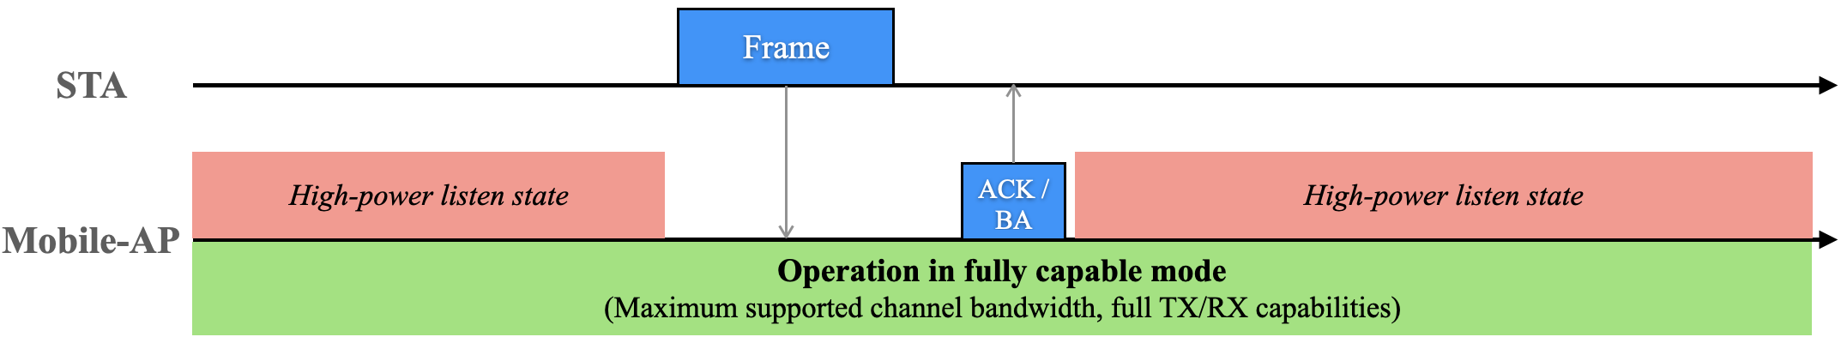
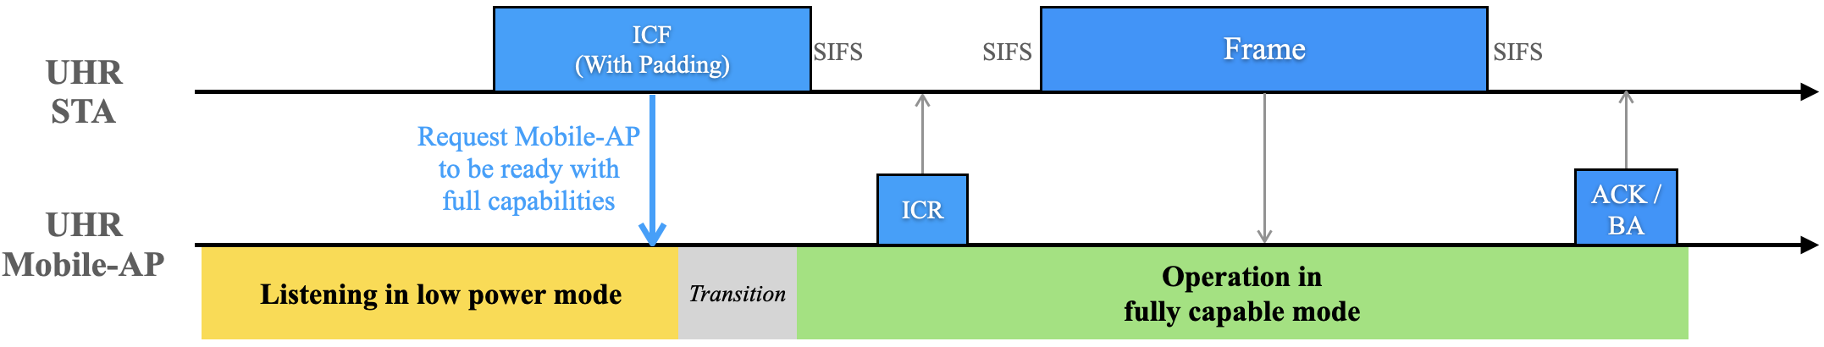
Overview of Solution (1)
Current Operation of Mobile-AP
Proposed Operation of UHR Mobile-AP

Slide 5
Overview of Solution (2)
The focus of this proposal is Mobile-AP operation in a single link
Mobile-AP uses a low-power listen mode [6], [7] when listening to the channel and transitions to fully capable mode (with maximum advertised radio capabilities) only when actively transmitting or receiving frames
      Low-power listen mode may be constrained in its capabilities compared to the fully capable mode (in terms of supported channel bandwidths, data rates, transmit capabilities etc.)
      Low-power listen mode consumes less power [6] compared to listening in fully capable mode
It is imperative that a STA indicates to the Mobile-AP about an upcoming uplink transmission so that the Mobile-AP is primed to receive it
      Proposal — UHR STA sends an initial-control-frame (ICF) to enable transition of UHR Mobile-AP from low-power listen mode to fully-capable mode of operation
Key benefit of the proposal — Enabling dynamic unscheduled power-save in a UHR Mobile-AP while effectively handling aperiodic traffic generated at associated UHR STAs

Slide 6
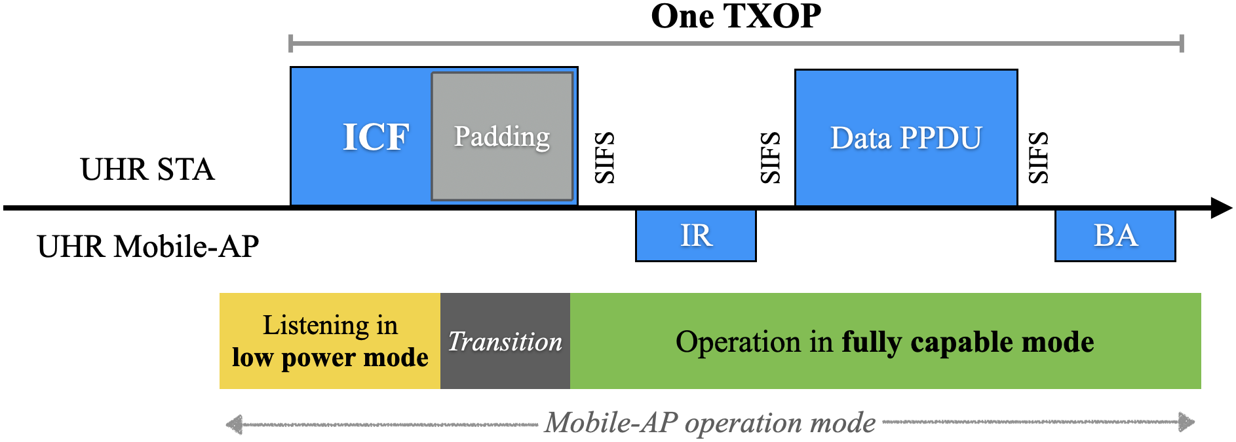
Operation of UHR Mobile-AP with UHR STAs
UHR STA shall initiate each TXOP to UHR Mobile-AP with an initial-control-frame (ICF) with sufficient padding duration
      UHR Mobile-AP shall indicate the requirement of ICF and the required padding duration in beacons / probe responses
      The padding allows Mobile-AP to transition from low power mode to fully capable mode within the current TXOP
      Mobile-AP may specify the maximum MCS and NSS at which the ICF frame shall be transmitted by a UHR STA
UHR STA shall proceed with the TXOP only after it receives an immediate response (IR) frame from UHR Mobile-AP

Slide 7
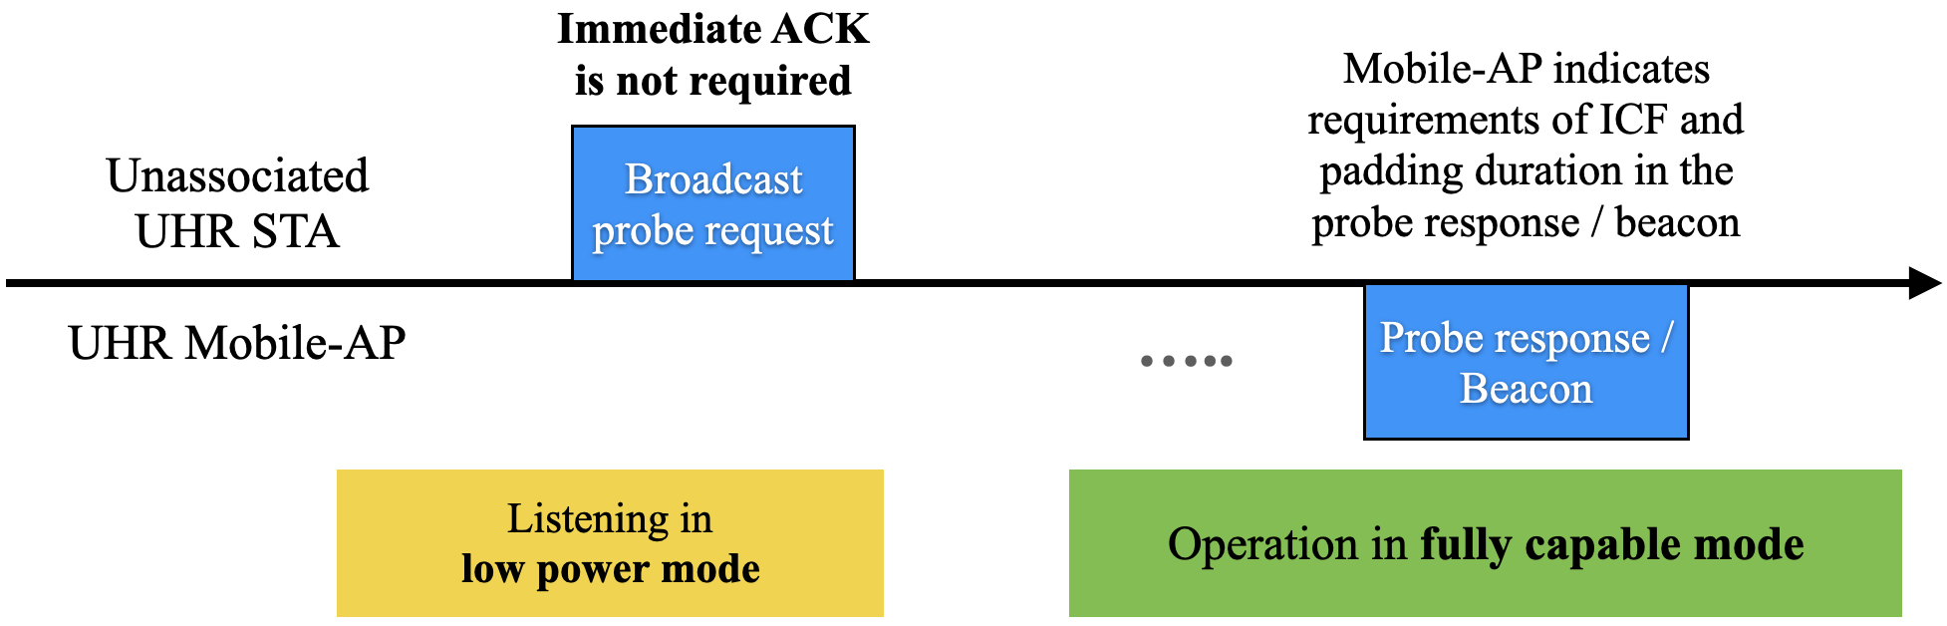
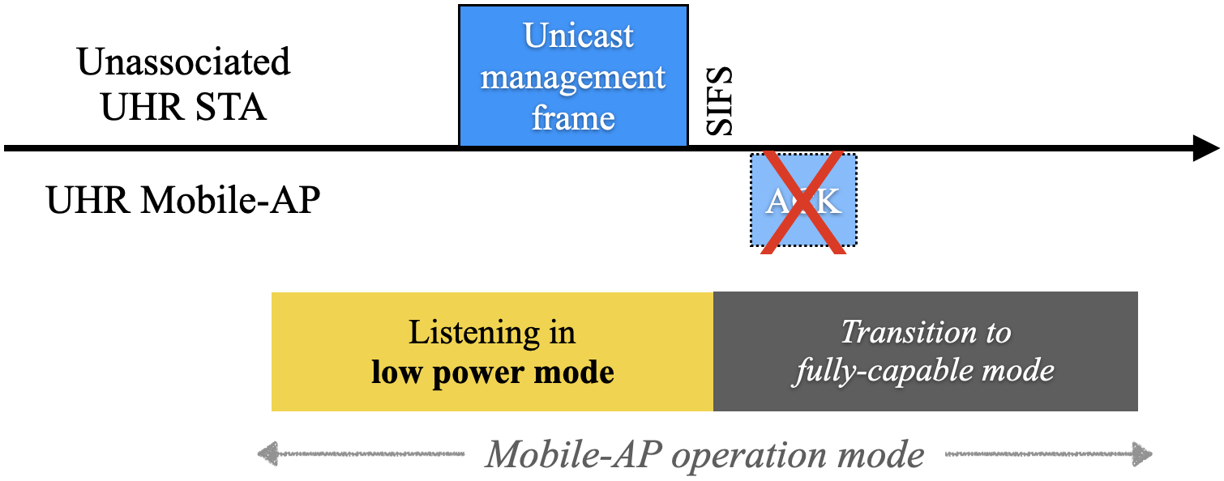
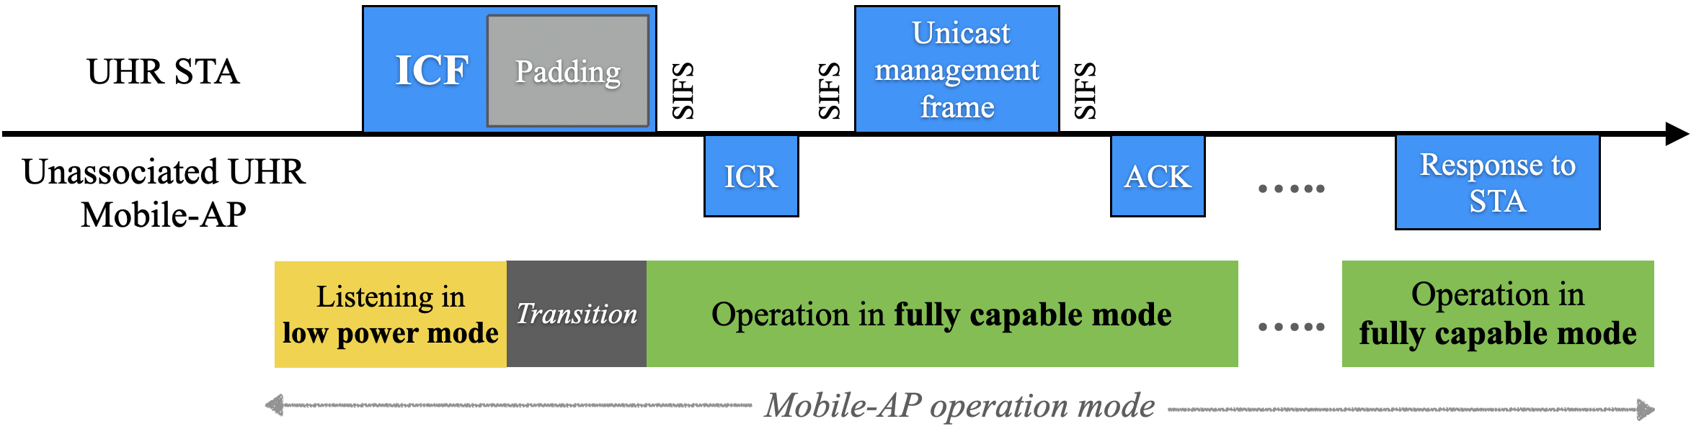
Operation of UHR Mobile-AP with Unassociated UHR STAs
Examples of unicast management frames sent by STA to an unassociated AP – Unicast Probe Request, Association Request
STA expects an immediate Legacy ACK in response to the unicast management frame that it transmits to the (Soft)AP
Mobile-AP may be devoid of transmit capabilities when operating in low-power listen mode to minimize power consumption [6]
Consequence – Potential failure(s) of unicast management frames transmitted by unassociated STA (predicated on the time required at the Mobile-AP to enable fully-capable mode)
UHR Mobile-AP indicates ICF (and padding) requirements in two ways – (a) beacons, and (b) probe response frames sent in response to broadcast probe requests received from STA(s)
Requirement – UHR STAs should transmit an ICF (with sufficient padding) before transmitting unicast management frames to
UHR Mobile-AP

Slide 8
Operation of UHR Mobile-AP with
Pre-UHR (Legacy) STAs
Recall that Mobile-AP, in low-power listen mode, is devoid of transmit capabilities
Requirements of ICF cannot be imposed on Legacy / Pre-UHR STAs
Two paths to pursue:
      [Greenfield UHR BSS] UHR Mobile-AP lets only UHR STAs to associate with it
      UHR Mobile-AP lets any STA (UHR or pre-UHR) associate with it
Pre-association behavior of UHR Mobile-AP with Legacy STAs:
      STAs transmit management frames to unassociated Mobile-AP in 20 MHz, basic rates
      UHR Mobile-AP operating in low-power-listen mode should decode such management frames and respond appropriately
Post-association behavior of UHR Mobile-AP with Legacy STAs:
      UHR Mobile-AP shall disable low-power listen mode of operation if at least one pre-UHR STA is associated with it, if the Mobile-AP chooses to let pre-UHR STAs associate with it
      This is to avoid regression in performance of the associated pre-UHR STA(s)

Slide 9
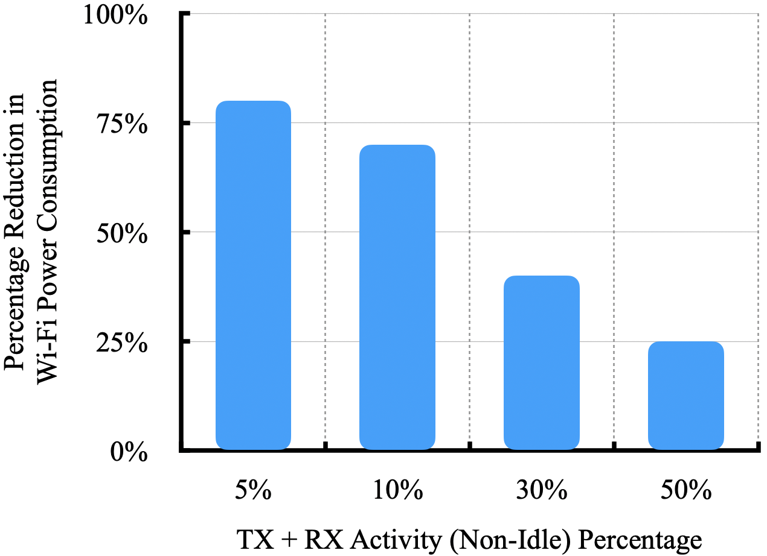
Quantification of Power Save Benefits
Percentage reduction in Wi-Fi power consumption of Mobile-AP with
low-power listen mode compared to always active in fully-capable mode
TX and RX occur in 160 MHz, 2x2
Fully-capable mode — Listening in 160 MHz, 2x2
Low-power listen mode — Listening in low-power mode [6], [7]
Wi-Fi power consumption data references — [6], [8]

Slide 10
Summary
Proposed operation of UHR Mobile-AP in low-power listen mode, when not actively transmitting/receiving frames, to reduce Wi-Fi power consumption
Proposed the following operating principles in the context of UHR Mobile-AP and UHR STA:
      UHR Mobile-AP shall indicate the requirement of ICF and the padding duration for the ICF in beacons and probe responses
      An associated UHR STA shall initiate each uplink TXOP to a UHR Mobile-AP with an ICF with sufficient padding duration, if indicated by the UHR Mobile-AP
      UHR STA shall transmit the ICF to UHR Mobile-AP in non-HT duplicate format
      UHR Mobile-AP may indicate the maximum MCS and NSS at which the ICF can be transmitted by a UHR STA; the UHR STA shall abide by these requirements, if indicated by UHR Mobile-AP
      An unassociated UHR STA should transmit an ICF to the UHR Mobile-AP before transmitting unicast management frames (unicast probe response, association request, etc.)

Slide 11
References
IEEE 802.11-23/480r3, UHR Proposed PAR
IEEE 802.11-23/0010r0, Considerations for enabling AP power save
IEEE 802.11-23/0015r0, AP MLD power management
IEEE 802.11-23/225r0, Considering Unscheduled AP Power Save
IEEE 802.11-23/244r1, AP Power Save PAR addition proposal
IEEE 802.11-22/1414r1, Low Power Listening Mode
IEEE 802.11-22/1841r0, Follow up on the low power listening
IEEE 802.11-14/0980r16, TGax Simulation Scenarios

