Slide 1
Follow-up to IEEE 802.11-24/0055r0,
“Evaluation of Puncturing for Coexistence of IEEE 802.11 and Bluetooth in 6 GHz”
Date: 2024-03-12
Authors:

Slide 2
Introduction
This presentation is a follow-up to [3], considering received comments
  Different mode of operation for the “Dynamic Bandwidth” adaptation with less time required to adapt the PPDU bandwidth
  Gaming delay KPI without Internet delay

Slide 3
Assumptions
Assumption 1: Bluetooth adds Listen-Before-Talk (LBT) to the channel hopping medium access
  Several contributions show benefit to both IEEE 802.11 and Bluetooth itself
  Exact details will be developed by the Bluetooth SIG
Assumption 2: Bluetooth is using the complete available spectrum for the channel hopping
  Adaptive Frequency-Hopping (AFH) is not active / is not triggering due to low activity / has not yet converged

Slide 4
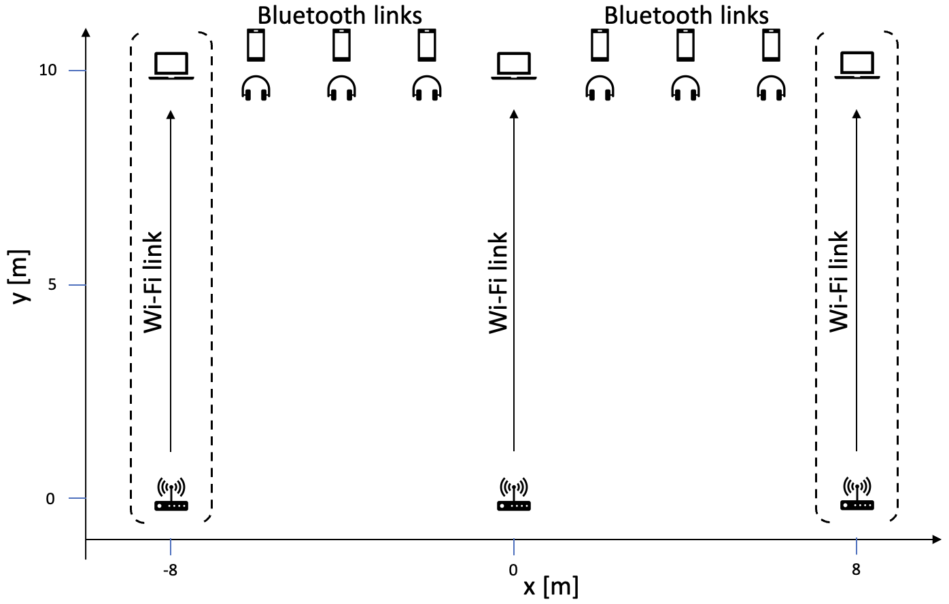
Simulation Setup
IEEE 802.11
Bluetooth
3⨯160 MHz channels
  Channel number 15, 47, 79
  Primary 20 MHz always the 2nd 20 MHz
Cloud gaming traffic
(VR Downlink + Control Uplink)
KPI: Gaming Delay (mean & 95th percentile)
1 MHz channels with 2 MHz spacing
  233 data channels
Frequency hopping size randomly 44 to 94
One to six links
  Constant bitrate traffic 1280 B/20 ms
  (57 % channel occupancy)
Async Connection-Oriented Link (ACL) with 10 ms connection interval
Performance ignored here

Slide 5


Cloud Gaming Traffic Model & KPI
Downlink: XR Video Model over RTP
  Mean load 30 Mb/s with 10 Mb/s standard deviation
  60 frames/s, every 120th frame is an I-frame (2⨯size)
  Access category video
  Measure frame delivery delay
Uplink: Control Messages over UDP
  Mean size 468 B with 90 B standard deviation
  Mean inter-frame interval 15 ms with 6 ms standard deviation
  Access category voice
  Measure frame delivery delay
KPI: (Mean & 95-percentile) Gaming Delay

Slide 6
Results
median (solid) & 95-percentile (dashed)
Significant degradation of delay due to Bluetooth interference
  Just one single Bluetooth link:
  6 ms → 19 ms
  Six Bluetooth links have high probability to block the channel
  Even with active Listen-before-talk for Bluetooth

Slide 7
Order of Events on the Channel
IEEE 802.11 before Bluetooth
IEEE 802.11 backoff on secondary channel fails
Bluetooth LBT fails
Bluetooth before IEEE 802.11
f [MHz]
f [MHz]
160
160
Data
Data
Ack
p20
p20
t
t
Clear Channel Assessment (CCA) result is idle on all 20 MHz subchannels
IEEE 802.11 transmission starts
Bluetooth hops on channel, LBT detects transmission and defers
  Mitigation, depending on Bluetooth LBT details
Bluetooth hops on channel, LBT detects an idle channel
Bluetooth transmission starts
IEEE 802.11 CCA detects Bluetooth transmission and defers
  Bluetooth is on primary channel: anytime during backoff
  Bluetooth is on secondary channel: during the last 25 µs of the backoff
IEEE 802.11 continues to observe until the channel is idle and re-starts backoff

Slide 8
Wi-Fi Adaptation (i): Fully Dynamic
Dynamically puncture occupied channel(s)
Puncturing allows 20 MHz-sized “holes” in the spectrum
Primary 20 MHz must be idle
Fully dynamic in
  Time: Puncturing is instantaneously, backoff simply continues
  Frequency: Puncture arbitrary
  20 MHz-channel holes
Provides upper-bound performance of any puncturing scheme
f [MHz]
160
Data
ACK
p20
Data
ACK
t

Slide 9
Wi-Fi Adaptation (ii): Dynamic Channel Bandwidth
Dynamic Backoff allows adapting the channel bandwidth during countdown
Primary 20 MHz must be idle
Only available bandwidths are full 160 MHz, 80 MHz, 40 MHz, and 20 MHz

Slide 10
Wi-Fi Adaptation (iii): Slow Dynamic Channel Bandwidth
Backoff fails
Restart with 40 MHz PPDU
f [MHz]
Remember maximum PPDU width for next backoff
160
Frequency adaptation same as ”Dynamic Channel Bandwidth”
  Fallback from 160 MHz to
  80 MHz, 40 MHz, or 20 MHz
Slower time adaptation:
  Start a new backoff with adapted PPDU width
  If non-primary 20 MHz gets busy (i and ii):
    Stop backoff
    Determine which minimum puncturing would have continued the backoff
    Start new backoff with punctured PPDU
  If primary 20 MHz gets busy (iii):
    Stop backoff
    Start new backoff with full PPDU
  If backoff completes (all):
    Start transmission, and
    Determine which minimum puncturing would have completed the backoff for the next PPDU
(i)
Backoff fails
Restart with 40 MHz PPDU
p20
Data
ACK
Remember maximum PPDU width for next backoff
t
f [MHz]
160
Backoff fails with p20 busy
Restart on idle channel with full bandwidth
(ii)
p20
Data
ACK
t
f [MHz]
160
Data
ACK
(iii)
p20
t

Slide 11
Wi-Fi Adaptation (iv): Slow Fully Dynamic
f [MHz]
160
Frequency adaptation same as ”Fully Dynamic”
Slower time adaptation same as “Slow Dynamic Channel Bandwidth”
(i)
Data
ACK
p20
Data
ACK
t
f [MHz]
160
Data
ACK
(ii)
p20
Data
ACK
t
f [MHz]
160
Data
ACK
(iii)
p20
t

Slide 12
Results
median (solid) & 95-percentile (dashed)
”Fully Dynamic” achieves the best latency
“Dynamic Channel Bandwidth” has very similar results
  Latency-sensitive traffic requires low channel access delay, but no high throughput
Slow variants suffer from random frequency hopping
  No learning / prediction of hopping pattern possible

Slide 13
Results
Bluetooth without Wi-Fi’s primary-20MHz channels
median (solid) & 95-percentile (dashed)
Bluetooth does not use Wi-Fi’s primary scanning channels
  2nd 20 MHz channel of every 80 MHz channel
  480 MHz − 120 MHz = 360 MHz remaining spectrum for NBFH
  Deviation from “Assumption 2”
No bandwidth adaptation: increase in delay
  Bluetooth links are limited to less bandwidth, hence more likely to block Wi-Fi
”Fully Dynamic”: No effect of Bluetooth transmissions
“Dynamic Channel Bandwidth”: Only small effect of Bluetooth transmissions

Slide 14
Conclusions
Adaptive channel bandwidth selection is necessary for
low-latency traffic under Narrowband Frequency-Hopping (NBFH) interference
Impact depends on the adaptivity scheme
  A simplistic dynamic bandwidth adaptation performs as nearly good as the fully dynamic upper-bound
  Coexistence should assume adaptivity

Slide 15
What if ...
Until now:
  Wi-Fi uses 3 ×160MHz
  Bluetooth uses 480MHz or 360MHz
What if
  Wi-Fi detects the presence of Bluetooth, and uses static puncturing to vacate x MHz of the spectrum
  Bluetooth detects that some parts of the spectrum are not used by Wi-Fi, and uses Adaptive Frequency Hopping to limit the channel set
Result: separation in frequency
  Gaming delay is essentially undisturbed by reduced spectrum – but gains from immediate channel access
Challenges
  Detection probability / false negatives & positives
  Transition time
  Dynamic scenarios / how to re-allocate vacated spectrum
Wi-Fi Gaming Delay with static puncturing

Slide 16
References
[1] Sebastian Max et al., “IEEE 802.11 and Bluetooth Coexistence Simulations,” IEEE 802.11 submission 11-23/1477r1
[2] Menzo Wentink, “NBFH coexistence with Wi-Fi,” IEEE 802.11 submission 11-23/1622r0
[3] Sebastian Max et al., “Evaluation of Puncturing for Coexistence of IEEE 802.11 and Bluetooth in 6 GHz,” IEEE 802.11 submission 11-24/055r0

Slide 17
Annex: Cloud Gaming Traffic Model & KPI

Slide 18
Cloud Gaming Traffic Model & KPI
Downlink: XR Video Model over RTP
  Mean load 30 Mb/s with 10 Mb/s standard deviation
  60 frames/s, every 120th frame is an I-frame (2⨯size)
  Access category video
  Measure frame delivery delay
Uplink: Control Messages over UDP
  Mean size 468 B with 90 B standard deviation
  Mean inter-frame interval 15 ms with 6 ms standard deviation
  Access category voice
  Measure frame delivery delay
KPI:
(Mean & 95-percentile) Gaming Delay

Slide 19
Single Simulation
Single simulation results in CDFs for the downlink video packet delay & uplink control packet delay

Slide 20
99-percentiles of 100 simulations
Run 100 simulations
  100 CDFs
  100 UL Control
  99-percentiles
  100 DL Video
  99-percentiles
Define ”gaming delay”: sum of UL & DL
99-percentiles
  100 gaming delays
KPI: Mean / 95-percentile of gaming delay
UL Control
99-percentiles
DL Video
99-percentiles

