Slide 1
Latency reduction for immediate real-time application traffic transmission
Date: 2024-4-9
Authors:

Slide 2
Abstract
In this presentation, we introduce a dedicated RU for real-time application (RTA) with low latency (LL) traffic which can be piggybacked on ongoing regular traffic. This method may benefit for the RTA traffic in both UL and DL cases.

Slide 3
Introduction
  The approved PAR intends to define at least one mode of operation capable of improving the tail of the latency distribution and jitter compared to Extremely High Throughput MAC/PHY operation.
  Reducing the low latency for the increasing demand of real-time application (RTA) is important in 11bn:
      The need for 11bn includes: “more stringent requirements are needed to meet the demands of new applications (including metaverse, augmented and virtual reality, robotics, industrial automation for industrial IoT, logistics and smart agriculture)”.
      Lower latency leading to better customer experience (especially worst case latency/jitter mattering).
      Low latency communication becoming essential building block for RTA. According to KPI and PAR discussions [1], some use cases, e.g., real-time gaming requires at least less than 5ms for latency and 2ms for jitter.
Use cases | Intra BSS latency [ms] | Jitter variance [ms] | Packet loss | Data rate [Mbps]
Real-time gaming | < 5 | < 2 | < 0.1 % | < 1
Cloud gaming | < 10 | < 2 | Near-lossless | < 0.1 (Reverse link) > 5Mbps (Forward link)
Real-time video | < 3 ~ 10 | < 1~ 2.5 | Near-lossless | 100 ~ 28,000

Slide 4
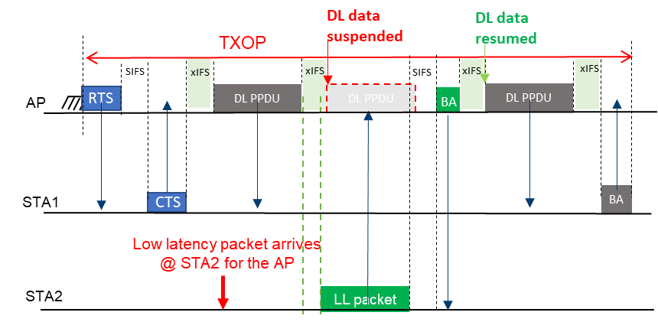
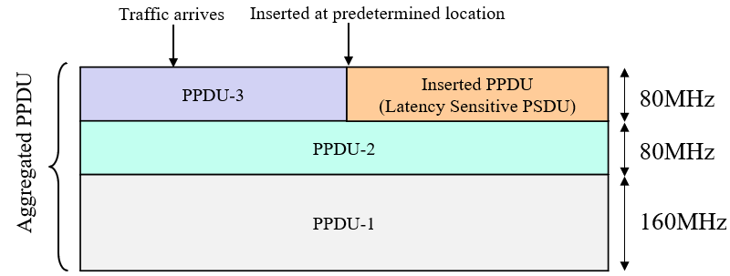
Background
To improve the LL traffic, preemption is considered:
within a PPDU [2, 3]: In case of long PPDU transmission, a TXOP holder can transmit the LL frame by inserting it into the current PPDU.
within a TXOP [4-7]: In case of LL frame buffered at a non-TXOP holder, the low latency frame can be transmitted before finishing the current TXOP.
within both time and frequency resource unit [8, 9]: a TXOP holder can transmit the LL frame on the ongoing PPDUs using 2D A-PPDU for DL and 2D UORA for UL.
HDR
Payload
Payload
Payload
Payload
HDR
PPDU Payload
HDR
LS payload
HDR
PPDU Payload
PPDU Payload
PPDU Payload
Fig. 1 inserting LL payload into current PPDU [2]
Fig. 2 preemption in a TXOP [5]
Fig. 3 2D A-PPDU [8]

Slide 5

RTA transmission request
  Real time traffic enqueued
PPDU
  PPDU transmission start
  LL traffic
  enqueued
  PPDU transmission end
  LL traffic
  enqueued
  Ongoing PPDU transmission
  …
  Medium access by other devices and back-off
  time
  latency
  RTA with LL traffic may suffer from unpredictable and large transmission latency.
  RTA with LL traffic may request for extremely low medium access latency, in which the LL traffic can be transmitted as soon as being enqueued.

Slide 6
Proposed solution
  New protocol for immediate transmission of RTA traffic
  LL traffic enqueued
PPDU
  PPDU transmission start
  LL traffic
  enqueued
  PPDU transmission end
  LL traffic
  transmitted
  Ongoing PPDU transmission
  …
  Medium access by other devices + back-off
  time
  latency
  LL traffic piggybacked on
  ongoing transmission
  LL traffic enqueued
  PPDU transmission start
  LL traffic
  enqueued
  PPDU transmission end
PPDU
  Ongoing PPDU transmission
  latency
  time
  Real time
  Traffic
  transmitted

Slide 7
Proposed solution (cont’d)
  LL traffic allowed to be immediately piggybacked to ongoing transmission. The LL traffic may come after the transmission begins.
  A dedicated new type of the RUs (specially reserved for latency sensitive transmission) spared for possible immediate transmission.
  STF, LTF, and reduced PHY header could be transmitted in the middle of transmission.
  To reserve the channel from being “stolen” by OBSS STAs, methods can be considered, e.g., reservation by AP/other non-LL STAs or via the help of MAP.
  Dedicated RUs reserved for possible
  Immediate transmission
  RUs assigned for regular transmission
  Frequency
STF + LTF
  Time
  Regular transmission
  LL traffic

Slide 8
Proposed solution (cont’d)
  Before 11bn:
  RU may not belong to someone and contention may be needed, e.g., in RARU.
  Occupiable after frequency domain back-off.
  When the RTA traffics enqueue after transmission, it cannot transmit anymore.
  Transmission over RU should align with regular transmission.
  In this proposal:
  Newly introducing a special type of RU specially dedicated for latency sensitive traffics.
  Immediately occupiable and may not require back-off.
  When the RTA traffics enqueue after the current transmission, it may still take a chance to transmit.
  Transmission over new type of RUs possibly need not align with regular transmission.
  New type of RU can be available for both uplink and downlink.
  RUs assigned for regular transmission
  frequency
STF + LTF
  Time
  Regular transmission
  RUs assigned for regular transmission
  dedicated RU
  frequency
PHY header
  Time
  Regular transmission
  LL traffic
Notes:
PSD tones.
If less than 20MHz, preamble is new. For 11bn devices.
Detect the OFDM symbol and start at some signature such as the delimiter/pilot/mid-amble.

Slide 9
Conclusion
A dedicated RU for RTA with LL traffic is proposed in this presentation.
The dedicated RU can be piggybacked on ongoing regular traffics, which can reduce the latency for both UL and DL transmission.
In future contributions, we plan to discuss more details on how to reserve and protect the dedicated RU for RTA traffic.

Slide 10
References
[1] Considerations on UHR PAR and KPIs, IEEE 802.11-22/1919
[2]11-21-0670-00-00be-further-improve-latency-performance-in11be
[3]11-22-1880-01-0uhr-latency-and-reliability-enhancements-for-uhr
[4]11-23-0018-01-0uhr-low-latency-support-in-uhr
[5]11-23-1174-00-0uhr-txop-preemption-follow-up
[6]11-23-0092-00-0uhr-preemption
[7]11-23-1229-00-0uhr-preemption-for-low-latency-application-follow-up
[8]11-23-1953-00-00bn-two-dimensional-resource-allocation (UL OFDMA)
[9]11-23-1954-00-00bn-two-dimensional-a-ppdu (DL)

