Slide 1
DPWiFi for IEEE802.11bn WMANs
Date: 2024-04-07
Authors:

Slide 2
Abstract
    TWI’s proposed “DPWiFi” IEEE802.11bn PHY/MAC, particularly relevant to Wireless Metropolitan Area Networks (“WMANs”), represents Breakthrough wireless enabling Disruptive radios forming Revolutionary networks delivering Transformative Broadband, worldwide in the not too distant future

Slide 3
Proposed DPWiFi IEEE802.11bn PHY/ MAC Specification
32 IEEE802.11be concurrent, cochannel EHT RF streams
  32x32 MIMO Dynamic Polarization Multiplexing
  32x32 MIMO Tx/Rx DLOS/ nLOS/ NLOS Beam Forming/ Steering
  Propagation Channel Impairment Mitigation
  Rx Interference Cancellation
  AP Tx Multi-beaming
  Client Rx Multipath Recombination
  90D/ 10U TDMA MAC
  5-7 GHz UNII Operation

Slide 4
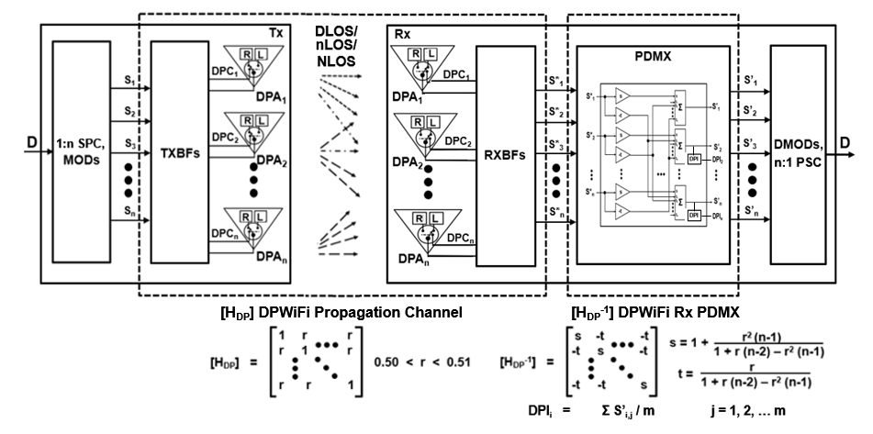
Breakthrough DPWiFi Technology
    The WMAN DP propagation channel [H_{DP}] is an n-dimensional “Polarization Space”
    The upper bound for n, if it exists, greatly exceeds 32
    The [H_{DP}] channel transfer function is non-singular, deterministic, scalar and uniform
      I.e., h_{ij} = 1, i = j; h_{ij} = 0 ≤ r < 1 , i ≠ j
      The Propagation Channel Dynamic Polarization Index (ChDPI) “r” varies with [H_{DP}] impairments
    DPWiFi DLOS, nLOS and NLOS links are subject to [H_{DP}] “depolarization”
      (i.e., induced Rx angular polarization rotation wrt Tx-established orthogonality baseline)
    DLOS links experience atmospheric fog, rain, etc. of up to 5º [H_{DP}] depolarization
    nLOS links obstructed/ diffracted by foliage or structures face up to 15º depolarization
    NLOS links reflected by structures or vehicles depolarize by up to 45º

Slide 5
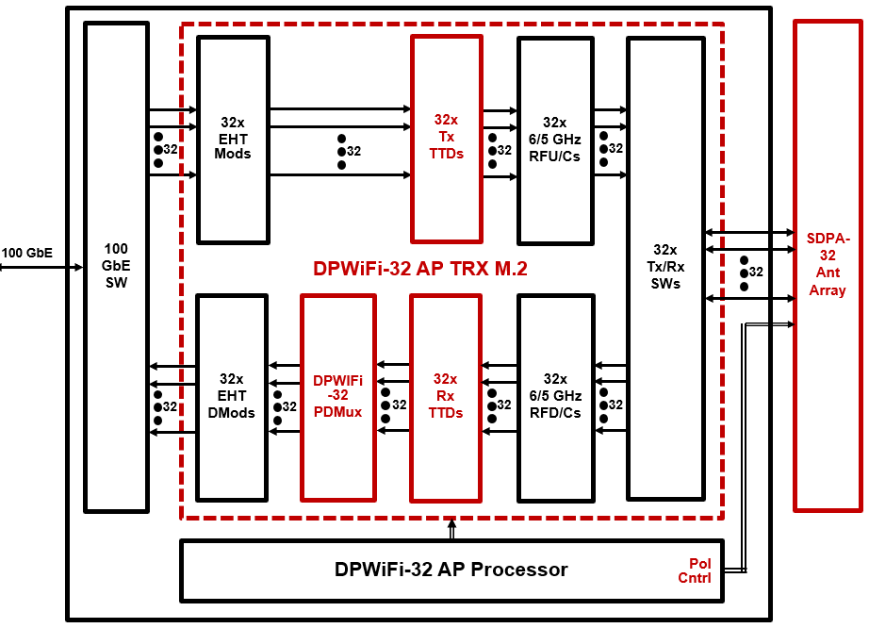
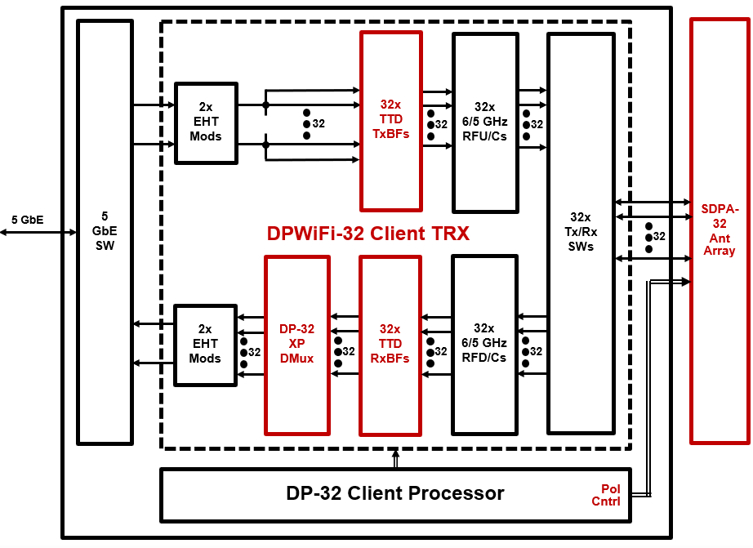


Breakthrough DPWiFi Chipsets

Slide 6
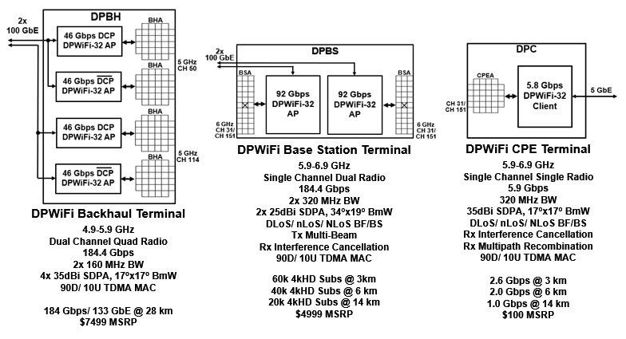
Disruptive DPWiFi APs and Clients
    The 2 DPWiFi SoCs enable 3 core DPWiFi Radios:
      DPWiFi Backhaul (“DPBH”): High Directivity 184 Gbps AP/ Meshnode
      DPWiFi Base Station (“DPBS”): Wide Coverage 184 Gbps AP
      DPWiFi CPE (“DPC”): High Directivity 5.8 Gbps Client

Slide 7
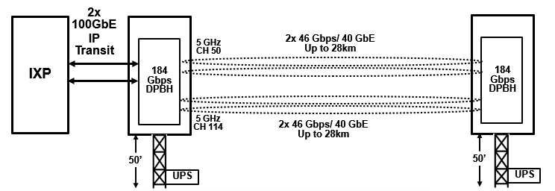
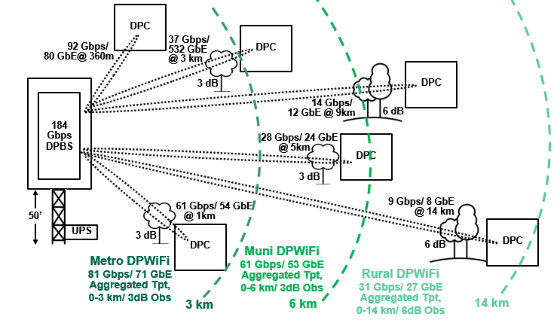
Revolutionary DPWiFi Networks
DPWiFi Backhaul
One DPWiFi Backhaul link
transports 184 Gbps up to 28 km
      “Metropolitan DPWiFi” for densest population cities
      “Municipal DPWiFi” for sparser population cities
      “Rural DPWiFi” for lightly populated regions
DPWiFi Distribution
One DPWiFi Distribution NW
supplies dedicated 4kHD to
60k subscribers within 3 km, or
40k subscribers within 6 km, or
20k subscribers within 14 km

Slide 8
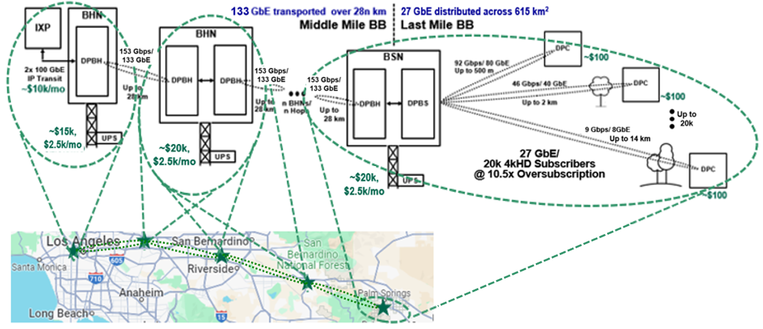

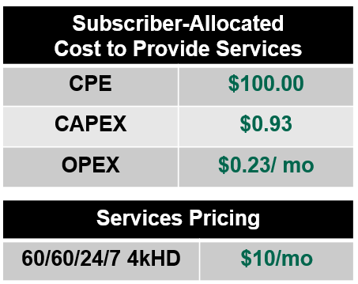
Transformative “Fixed WiFi Access” Rural WMANs
    Rural “FWiFiA”: 184 Gbps Base Station/ Up to 20k Subscribers up to 14 km away
    Rural DPWiFi 90% Gross Margin
    BLOWS UP today’s Exurban
    FWA Business Model

Slide 9
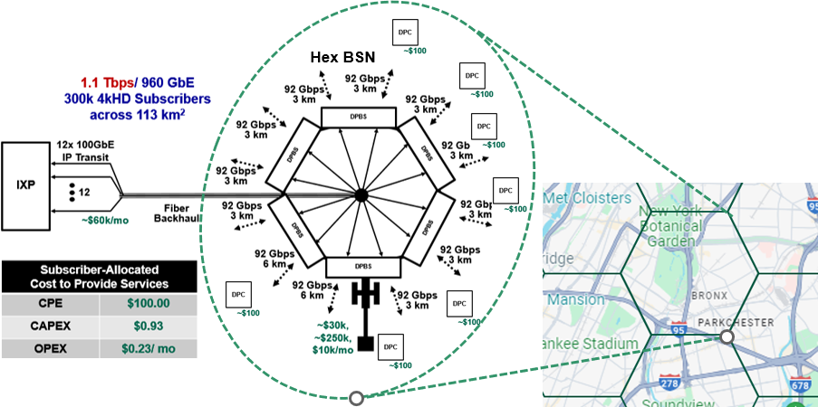


Transformative Fixed WiFi Access Urban WMANs
    Metro FWiFiA: 1.1 Tbps Base Station/ Up to 300k Subscribers per 3km radius city cell
    Metro DPWiFi 97% Gross Margin
    BLOWS UP today’s Urban
    FWA Business Model

Slide 10

What’s to Become of DPWiFi WMANs?
    There are ~1.4B Fixed Broadband (“FBB”) connections worldwide today
      ~ 72.8% Fiber (FTTx)
      ~ 16.0% Cable (Mostly USA-CN DOCSIS)
      ~ 8.7% Copper (DSL, ADSL, VDSL)
    More About that North American Fixed Wireless Access
      ~3k WISPs are vying to BB-connect ~12k communities (500-50k residents) with $50-100/mo HD
      And achieve a 1 – 5% penetration of ~60% of the USA-Canada population (~80M households)
      $10/mo 60/60/24/7 Dedicated 4kHD Rural FWiFiA would capture practically ALL those households
      This means ~80M DPWiFi CPEs ultimately deployed, or ~40M DPCs sold annually
      For a $800M SoC/ $4B CPE annual business in as little as 3 years
    Fixed WiFi Access will completely upend that Global Broadband Order
      Global FBB incumbent NWOs will overbuild their own urban networks with Metro/ Muni FWiFiA
      Those same incumbents then expand into the neighboring countryside with Rural FWiFiA
      All those FWiFiA networks combine to offer $10/mo 60/60/24/7 4kHD to up to 2B global subs by 2029
      And don’t forget many subs will also drive connected cars by then, accounting for ~ 500M more connections
      This means ~2.5B DPWiFi CPEs deployed, or ~1.25B DPCs sold yearly
      Or a $25B SoC/ $125B CPE yearly business by 2030
DPWiFi WMANs will EAT Legacy Fixed Broadband!

Slide 11
References
1. 23/1606r1-UHRSG
Dynamic Polarization Multiplexing and Beamforming WLANs
Carlos A Rios (Terabit Wireless Internet), 13-Sep-2023
23/1756r3-TGbn
MIMO Dynamic Polarization and Beamforming: Proposed IEEE802.11bn PHY
Carlos A Rios (Terabit Wireless Internet), 16-Nov-2023
24/0041r12-TGbn
DPWiFi MATLAB Validation
Carlos A Rios (Terabit Wireless Internet), 02-Feb-2024

