Slide 1
Interference Mitigation for Improved Reliability – More Insights
Date: March 3, 2024
Authors:

Slide 2
Introduction
In previous contributions [1-3] we presented two Interference Mitigation approaches and the respective benefits
Receiver interference mitigation is a very promising approach that can be used to achieve the ultra high reliability & low latency goals of TGbn
In this contribution we address some issues and questions which were raised recently, and add some more insights into the potential benefits:
  Impact of using IM Pilots on the design & Tx block diagram
  Using it to strengthen Spatial Reuse
  Applicability of applying receiver IM to a STA with 2 Rx antennas

Slide 3
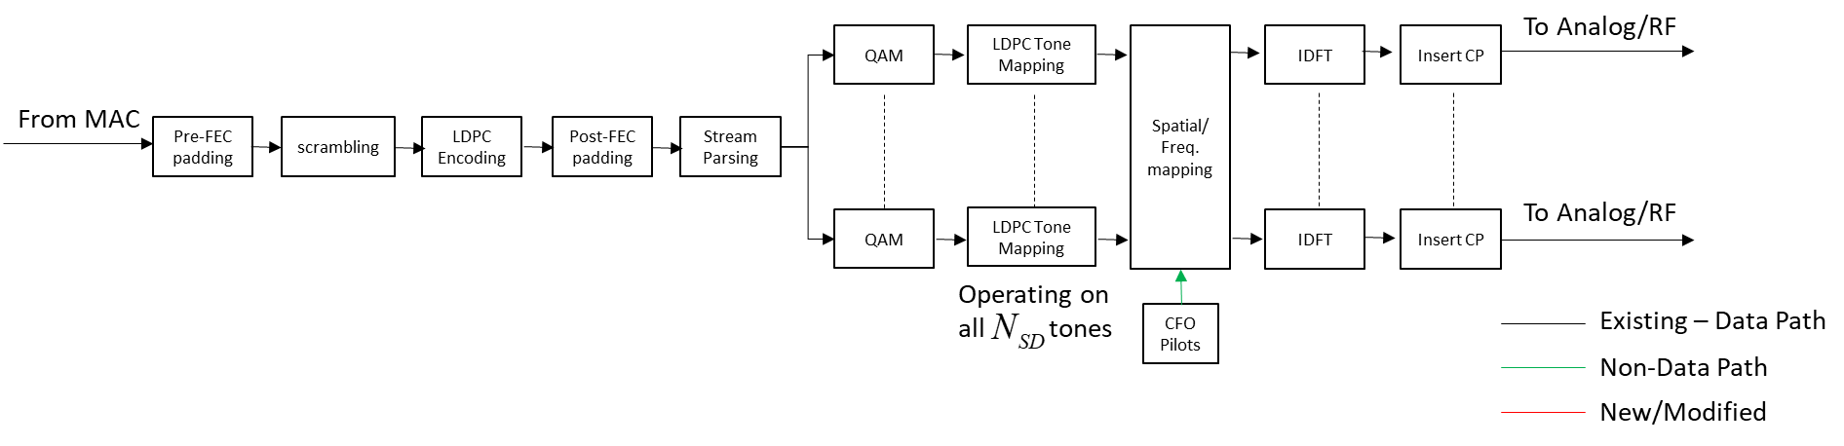
Impact of IM Pilots on Tx Block Diagram
The existing transmitter block diagram is the following
In the next slide, we show the minimal impact incorporating Interference Mitigation Pilots will have on the transmitter block diagram
Based on payload size and
number of tones ( ), determine:
#OFDM Symbols
Padding
LDPC Parameters (e.g. #codewords, puncturing LDPC extra symbol)

Slide 4
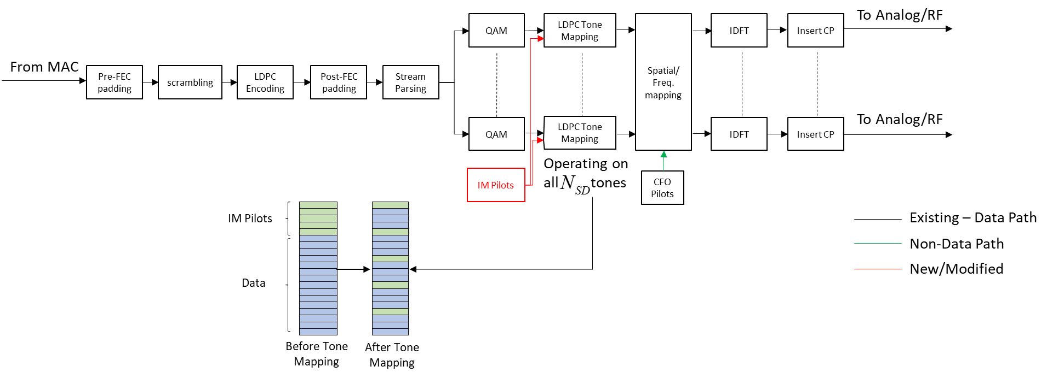
Impact of IM Pilots on Tx Block Diagram – cont.
We define the number of IM pilots belonging to a certain RU as
and the number of data subcarriers remaining in the RU as such that the value of doesn’t change:
Tx Block diagram is almost unchanged – no impact on LDPC operation or tone mapping (using same ); applying LDPC Tone Mapping on data+IM Pilots yields IM Pilots which are spread almost evenly in frequency
Based on payload size and
smaller number of tones
( ), determine:
#OFDM Symbols
Padding
LDPC Parameters (e.g. #codewords, puncturing, LDPC extra symbol)

Slide 5
Impact of IM Pilots on Rx Block Diagram
At receiver side, the have to be extracted to compute the covariance of the noise and interference
Instead of performing equalization on tones, the receiver now performs equalization on fewer tones (per OFDM symbol)

Slide 6
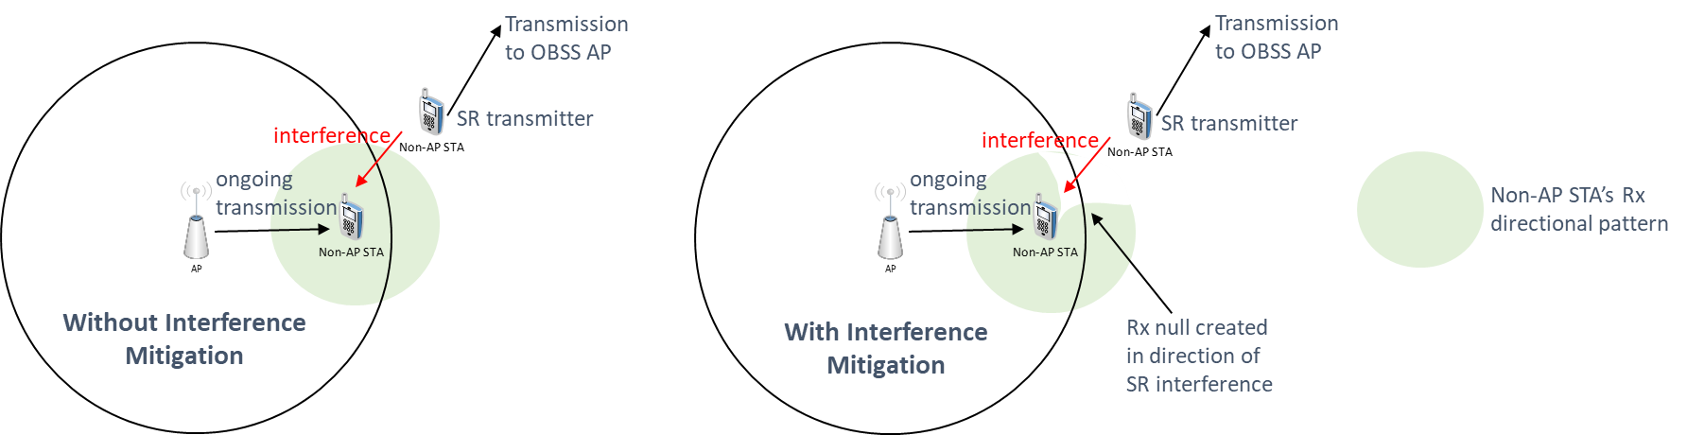
Strengthening Spatial Reuse (SR)
IM applied at the Rx side can be used to enhance SR performance; with SR an OBSS STA is allowed to transmit while there is an ongoing transmission in the BSS, but it limits its transmit power as a function of the OBSS PD threshold
  In other words, with SR an ongoing BSS transmitter ‘allows’ an OBSS STA to transmit simultaneously such that it doesn’t create too much interference at target BSS receiver
  However, the interference to the ongoing transmission is not fully controlled
Using IM pilots, the ongoing transmission can ensure high reliability at its Rx side, in particular resilience to interference – exactly the aim of SR
  OBSS STA can also use IM pilots to ensure high reliability at its own target receiver side

Slide 7
Performance with 2Rx antennas
In previous contributions [1-3] we presented results for a 4-antenna receiver
Here we extend these results to a 2-antenna receiver (applicable for many non-AP STAs)
We assume transmission of a
single stream, 10dB SIR and
20% IM Pilots (when IM is used)
The figure on the right shows
the big impact of applying IM
at the receiver side, taking
overhead and impact on PER
into consideration
These results show that receiver
interference mitigation can be used
at both AP and non-AP STA

Slide 8
Performance with 2Rx antennas – cont.
For the scenario in the previous slide, we also show below the MCS & PHY rate used in each case (per SNR) - when we use the IM Pilots to apply interference mitigation we can reach a much higher MCS/PHY rate
Furthermore, despite the lower PHY rate due to IM pilot overhead, it is still significantly higher than the case of no interference mitigation

Slide 9
Conclusions
In this contribution we addressed some previous questions related to the design and implementation of interference mitigation within 11bn
We also addressed the performance of a 2 antenna device and showed that this approach is valid for such devices (in particular non-AP STAs in the downlink)
Furthermore, we showed that receiver interference mitigation can be used to strengthen Spatial Reuse – receiver would be able to mitigate the interference resulting from the SR transmitter
These new results show that incorporating interference mitigation can yield many benefits – especially in the context of increased reliability

Slide 10
References
[1] 11-23-1490r0: Physical Layer Reliability Improvements (Shimi Shilo et al)
[2] 11-23-1943r1: Physical Layer Reliability Improvements – Follow Up (Shimi Shilo et al)
[3] 11-24-107r0: PHY Layer Interference Mitigation for Improved Reliability (Shimi Shilo et al)
Notes:
at least one mode of operation capable of improved support, compared to 802.11be, for applications with stringentworst-case latency and jitter requirementscompared to 802.11be // i.e., avoid “worst-case”

