Slide 1
Range Extension with dRU
Date: 5-Mar-24
Authors:

Slide 2
Introduction
Distributed RU (dRU) has been positioned as a way to achieve range extension
Most of the focus has been on the power boost that can be achieved in the data field
  Relative to “regular” RU
However, in order to achieve range extension both the legacy preamble and the data field need to be considered
  At range, legacy preamble errors and misdetection can dominate
  Power boost in Data Field may not translate directly into range extension without corresponding improvement in (legacy) preamble power or detection probability
We need to confirm that legacy preamble will not be a bottleneck when using dRU

Slide 3
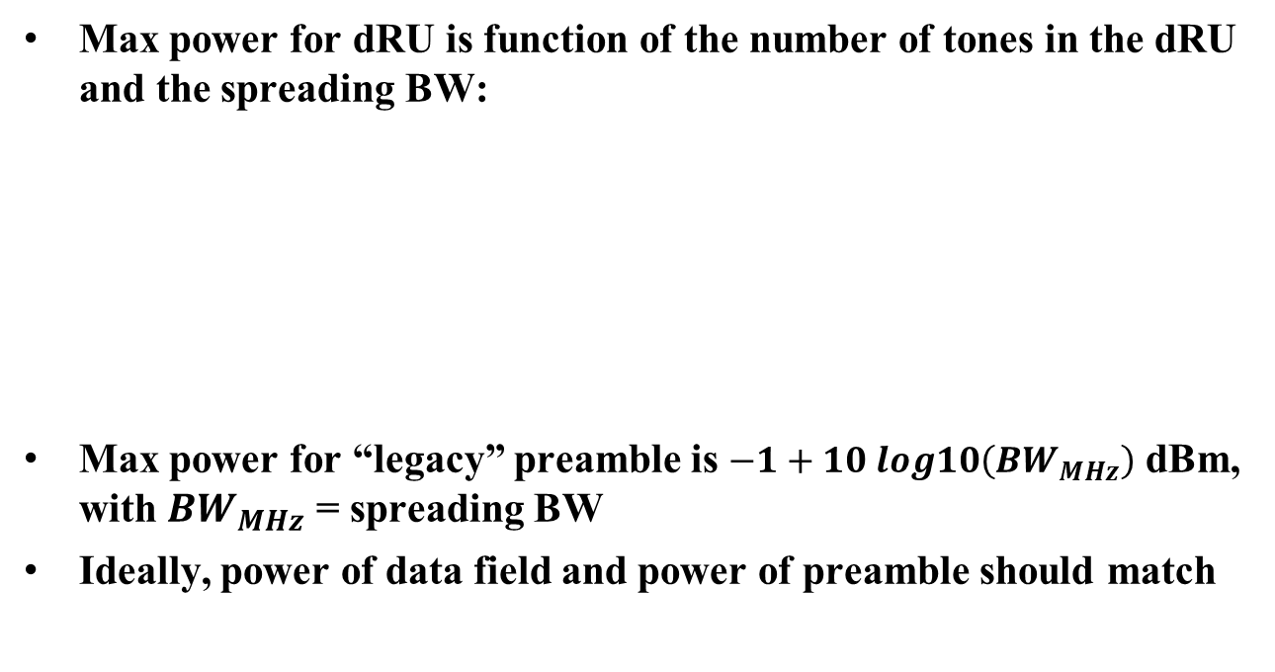
Allowed Power under PSD constraint
(e.g., -1 dBm/MHz)
Max power for dRU is function of the number of tones in the dRU and the spreading BW:
Max power for “legacy” preamble is $−1+10 log10\left({BW}_{MHz}\right)$ dBm, with ${BW}_{MHz}$ = spreading BW
Ideally, power of data field and power of preamble should match
Power values in dBm

Slide 4
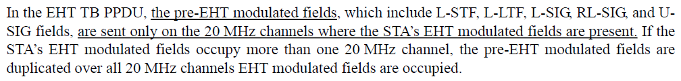
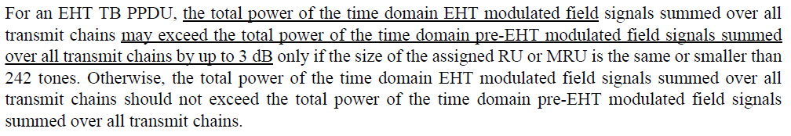
Additional Preamble requirements for (EHT) TB PPDU
Where to send legacy preamble (36.3.4)
Power of legacy preamble and Data (36.3.11.4)
  i.e., power of non-EHT modulated fields is not higher than power of EHT modulated fields
We’ll assume that the same rules apply for dRU

Slide 5
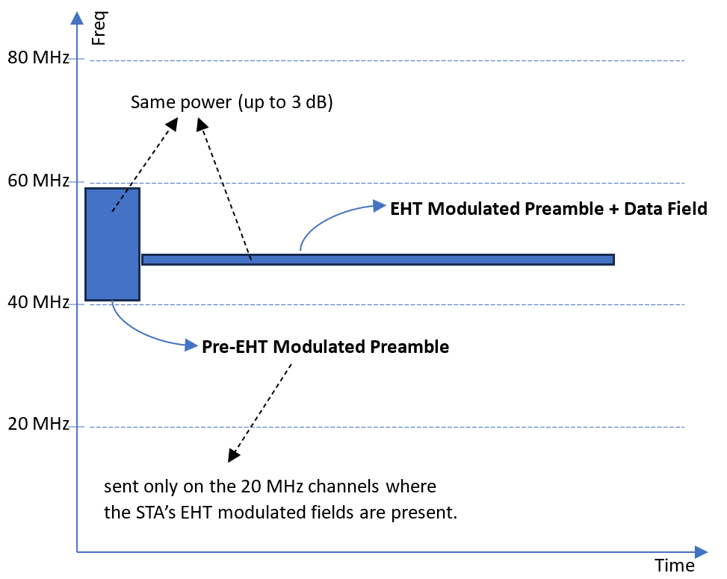
Illustration of TB PPDU with “regular” RU
The pre-EHT modulated fields are sent on the 20 MHz channels where the STA’s EHT modulated fields are present.
(802.11be, 36.3.4)

Slide 6
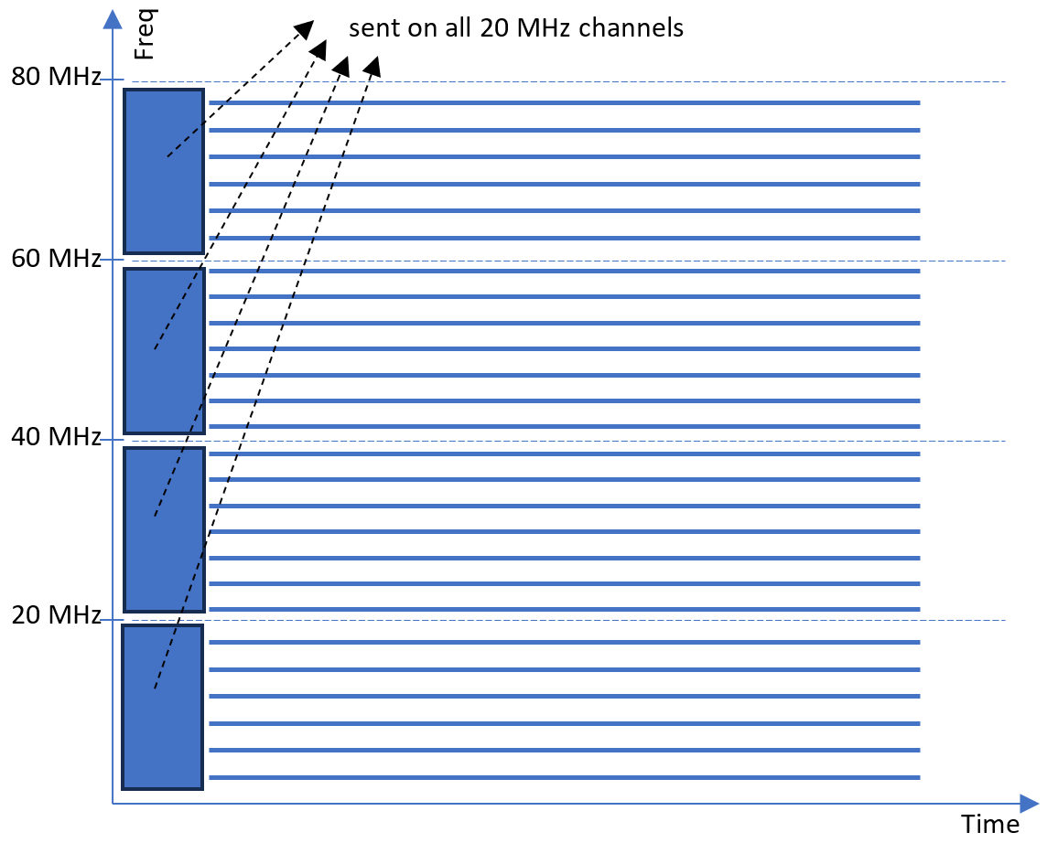
Illustration of TB PPDU with dRU
Again assume that “The pre-EHT modulated fields are sent on the 20 MHz channels where the STA’s EHT modulated fields are present.”
i.e., across spreading BW

Slide 7
Allowed Tx Powers for TB PPDU
(EHT and non-EHT modulated fields)
Higher power in Data Field allows boost in preamble (per EHT standard)
Max power allowed in preamble actually slightly higher than power allowed in dRU
Power of legacy preamble limited to power of data field (per EHT standard)
  Not a direct regulatory constraint
Power in preamble likely limiting factor for range

Slide 8
Intermediate Conclusion
(Legacy) Preamble power is impacted by both regulatory and standard constraints
  Standards constraint is the most stringent for small RUs
The dRU power boost in the Data Field allows boosting the power of the legacy preamble
  Per EHT Standard
Both legacy preamble and the data field are improved, as required for range extension

Slide 9
Additional power benefit at receiver (AP)
Previous illustrations only discuss transmit power for a single TB PPDU
Response to a Trigger frame typically involves multiple simultaneous TB PPDUs, with the (legacy) preambles adding up coherently at the receiver (AP)
  See illustrations on next slides

Slide 10
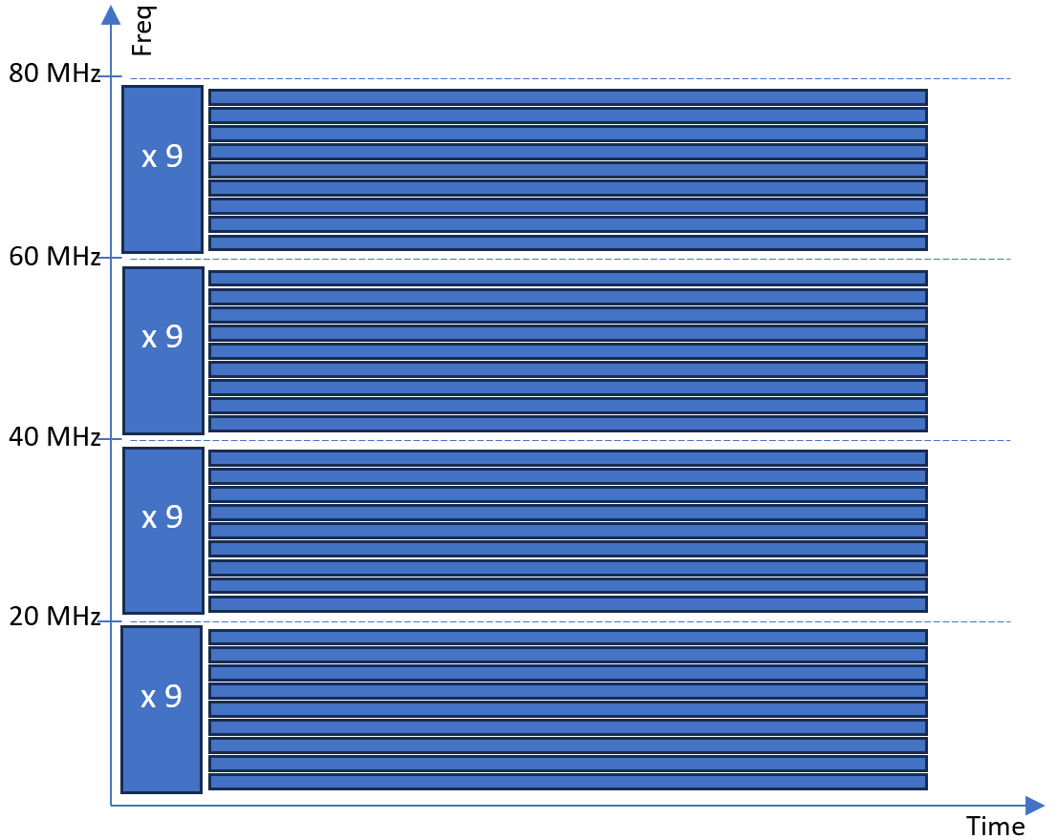
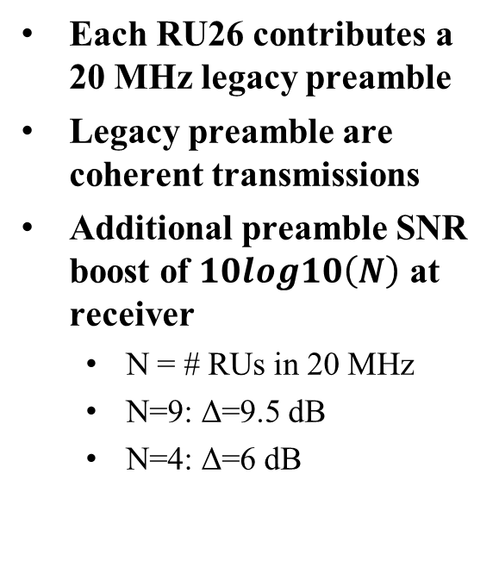
Multiple TB PPDU arriving at receiver (illustration for RU26)
Each RU26 contributes a 20 MHz legacy preamble
Legacy preamble are coherent transmissions
Additional preamble SNR boost of $10log10\left(N\right)$ at receiver
  N = # RUs in 20 MHz
  N=9: Δ=9.5 dB
  N=4: Δ=6 dB

Slide 11
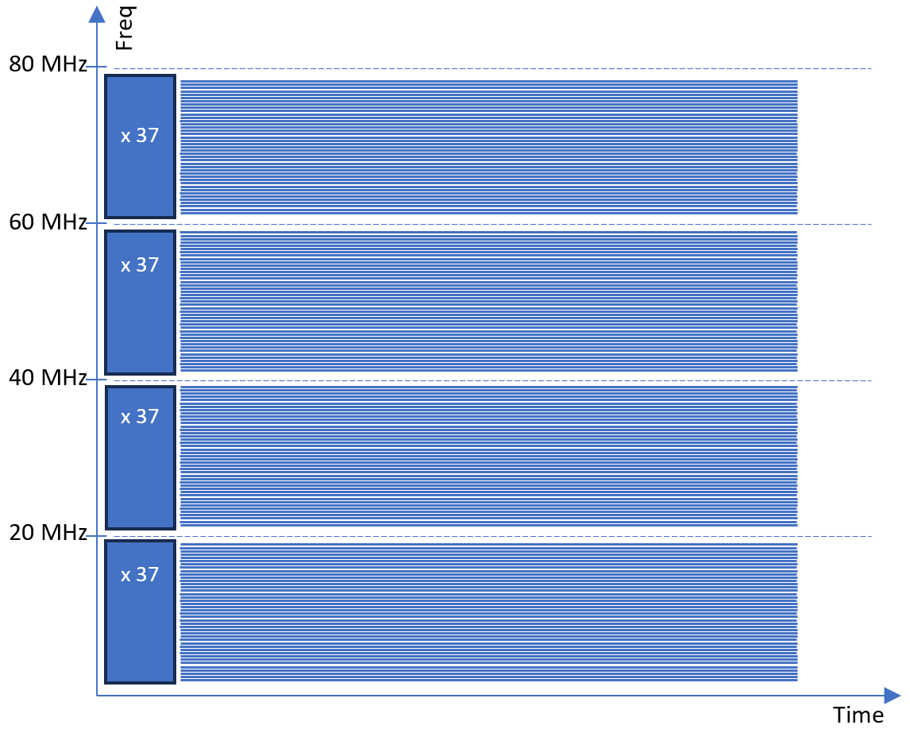
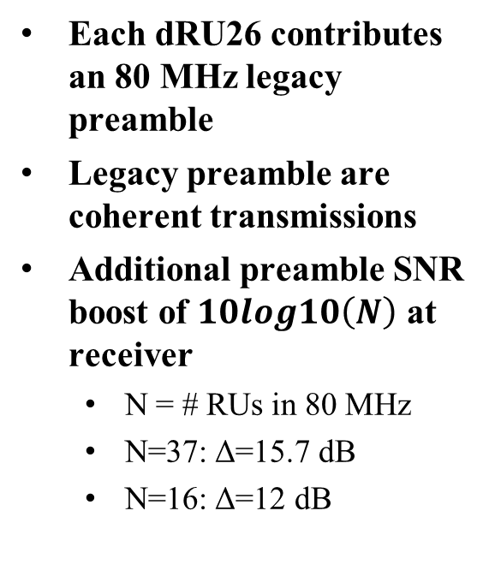
Multiple TB PPDU arriving at receiver (illustration for dRU26)
Each dRU26 contributes an 80 MHz legacy preamble
Legacy preamble are coherent transmissions
Additional preamble SNR boost of $10log10\left(N\right)$ at receiver
  N = # RUs in 80 MHz
  N=37: Δ=15.7 dB
  N=16: Δ=12 dB

Slide 12
Conclusion
For good range extension, the following criteria need to be satisfied
  SNR Boost in Data Field
  Power Boost in Legacy preamble
  Efficient use of spectrum
If the EHT rules for TB PPDU are followed, the power boost for dRUs benefits the legacy preamble as well
Simultaneous reception of multiple TB PPDUs may further enhance detection probability of legacy preamble
The three “range extension” criteria appear to coincide favorably for the case of UL OFDMA with dRU
  For range extension, the focus of dRU should be on UL OFDMA

