Slide 1
UHR preamble design options
Date: 03/01/2024
Authors:

Slide 2
Introduction
Preamble distinguishes different PHY generations
Typically, legacy preamble (L-STF + L-LTF + L-SIG) is common to all formats
  Allows for backwards compatibility in detection
Newer-generation systems have to be able to distinguish the new PHY from older ones
Older-generation systems should discard the newer generation preambles
  Without knowing the specifics of the new PHY preambles
  Up to the new PHY generation to devise a mechanism that will cause older systems to discard the new PPDU format
Auto-detection

Slide 3
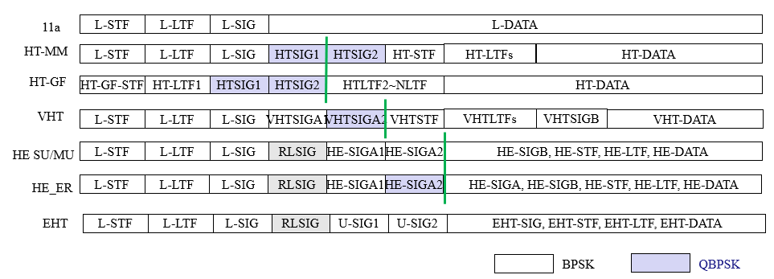
Before EHT
Before EHT, PHY Clauses defined an ad-hoc preamble format auto-detection
Some examples mechanisms use:
  Specific L-LENGTH values (modulo)
  BPSK/QPSK modulation in SIG field (HT, VHT)
  RL-SIG (HE, EHT)

Slide 4
EHT preamble
EHT defined a preamble format that is intended to be forward compatible [2-4]
  No more need for “hacks” to differentiate from prior generations
  Uniform preamble processing for EHT and subsequent generations
    U-SIG always present
    Format explicitly signaled as part of U-SIG
EHT preamble has version independent fields in fixed locations and version dependent fields that can be specific for each PHY Version
In addition, reserved bits allow for further additions directly to the EHT PHY

Slide 5
Forward compatible preamble – details
EHT preamble has the following defining characteristics:
  L_LENGTH mod 3 = 0
  Presence of L-SIG/RL-SIG
  PHY version Identifier in U-SIG = 0
Subsequent PHY generations will use the same structure, but with different PHY version Identifier
  Only PHY version identifier = 0 defined so far (EHT)
  Value of the PHY version Identifier could indicate changes to the preamble only understood by newer generations

Slide 6
Reserved bits – details
The EHT preamble also kept a large number of reserved bits in U-SIG
  Partially in anticipation of 11be R2 features (which didn’t materialize)
Two types of reserved bits
  Validate
    Terminate reception of a PPDU early if not set to reserved value
  Disregard
    To be ignored – no impact on the STA’s continued reception of the PPDU, regardless of value
In EHT:
  8 reserved bits in U-SIG of EHT MU PPDU (3 validate, 5 disregard)
  12 reserved bits in U-SIG of EHT TB PPDU (11 disregard, 1 validate)

Slide 7
EHT U-SIG details
EHT MU PPDU
EHT TB PPDU

Slide 8
UHR preamble fundamental design options
The current EHT preamble allows two paths forward for addition of new features:
  Define a new PHY version
    Keep version independent fields
    Version dependent fields to be defined for UHR – consistency with EHT not required
  Keep PHY version=0 and Employ reserved bits
    EHT preamble as a starting point (including PHY version)
    Strategically use reserved bits to signal new features in backwards compatible manner
    Version independent are maintained and version dependent fields could be maintained towards older devices
    Incompatible changes can be encoded through Validate bits
In our opinion, the second approach is preferred

Slide 9
Comparison between approaches
Scenario | New PHY Version | Use of reserved bits
Send UHR PPDU with non-EHT-compatible extra UHR functionality to EHT Rx | EHT Rx will recognize new PHY version, stop processing and send version-independent info to MAC layer. | Use Validate bit. EHT Rx will recognize change in Validate bit, stop processing and send version-independent info to MAC layer.
Send UHR PPDU with EHT-compatible extra UHR functionality to EHT Rx | Not possible - EHT Rx will recognize new PHY version, stop processing and send version-independent info to MAC layer. | Use Disregard bit. EHT Rx will ignore modified Disregard bits and process PPDU.
Send UHR PPDU with extra UHR functionality to UHR Rx | UHR Rx will recognize PHY version, interpret preamble accordingly and process PPDU. | Use reserved bit. UHR Rx will recognize meaning of modified Validate or Disregard bits, interpret preamble accordingly and process PPDU.
Backwards compatible operation with EHT-only devices | Not possible - Need to send PPDUs in EHT format to be able to communicate with EHT devices. | EHT Rx will naturally process any PPDU that only modifies Disregard bit – or modifies no Reserved bits at all.
Support of "legacy" features (e.g. OFDMA, …) | Since new preamble processing is involved, features need to be re-validated to ensure they work in UHR mode. | An EHT-capable and -certified device will support legacy features without need for further validation.
Flexibility in changing preamble | New PHY version in principle allows new definition of all version-dependent fields and other parts of the preamble (training fields, …) | Position of at least one Validate bit should remain the same, but in principle any other version-dependent fields can be changed.

Slide 10
Comparison between approaches
Both approaches allow similar functionality
  Notably, early termination of packet processing in case of EHT-incompatible changes
Next slides will outline some reasons for using reserved bits as opposed to defining a new PHY version

Slide 11
UHR is incremental
UHR will add features to EHT
  Candidate features: M-AP, Distributed RU, Relay, Channel access, Additional MCS/code rates, …
One could conceivably send an UHR frame that doesn’t use any of these new features
  Such a frame would essentially be an EHT PPDU
  Better to start from EHT preamble than to duplicate functionality for this case

Slide 12
UHR inherits 11be R2
Many of the features discussed for 11bn where once considered candidates for 11be R2
There is no reason for these features to require a new preamble design
  Indeed, the initial intention was to build them into 11be
  11be preamble would have been used if 11be R2 had happened
    Presumably differentiating the new features through use of reserved bits

Slide 13
Post-IEEE Certification
May be outside of scope of 802.11, but important in practice
802.11 spec is the basis for certification programs and products
When a novel preamble is defined (e.g. different PHY version number), verification needs to restart “from scratch”
  E.g. in WFA certification programs
  Fundamental “legacy” features like OFDMA, … need to be (re-)verified with this new preamble
If UHR builds on the EHT preamble, legacy features are fully EHT
  no such re-validation is necessary

Slide 14
Reserved bits provide sufficient flexibility for Version-dependent fields
Both reserved bits and new PHY version allow for significant changes in the preamble if needed
Reserved bits allow for more streamlined backwards compatibility with EHT

Slide 15
In practice: How to implement in the UHR Amendment?
Changes/additions to the preamble should be proposed as amendments to Clause 36
  No new PHY Clause needed (at least not for preamble)
  Compare with e.g. 802.11az, 802.11bf, …
Handling new MAC requirements TBD
  Multi-AP may warrant its own Clause
  Other features may be added in existing clauses
    E.g. any extensions to MLO may fit better in existing MLO clauses

Slide 16
Conclusion
There are two fundamental options for the preamble design in 11bn
  New PHY version
  Use reserved bits of EHT
There appears to be no need for UHR to define a new PHY version identifier value
  UHR can be seen as an extension of EHT
EHT preamble can be reused by strategic use of reserved bits
Reserved bits allow for more streamlined backwards compatibility with EHT and more convenient certification

Slide 17
Side note on use of PHY version in 802.11be
PHY version is used to distinguish PHY generations in U-SIG
Also used in Special User Info field
  May not be the best choice
  No a priori reason that every PHY version needs exactly one type of special user info field
    Some may require none, other may require more than one
Solution: decouple version identifier in Special User Info from PHY version identifier

Slide 18
Straw Poll
Do you agree that UHR preamble should use the same PHY Version Identifier as EHT?

Slide 19
References
[1] 802.11-19/1085r0, High-level EHT Preamble Structure
[2] 802.11-19/1021r1, Preamble Design Harmonization
[3] 802.11-19/1519r0, Forward Compatibility for Wi-Fi Preamble Design
[4] 802.11-20/0110r0, 11be Preamble and forward Compatibility

