Slide 1
EDCA for Non Primary Channel Access
Date: 2024-03-05
Authors:
Name | Affiliation | Address | Phone | Email
Dongju Cha | LG Electronics | 19, Yangjae-daero 11gil, Seocho-gu, Seoul 137-130, Korea |  | dongju.cha@lge.com
Insun Jang
 |  |  |  | insun.jang@lge.com
Jinsoo Choi
 |  |  |  | js.choi@lge.com
Hongwon Lee |  |  |  | hongwon.lge@lge.com
Sunhee Baek |  |  |  | sunhee.baek@lge.com
Geonhwan Kim |  |  |  | geonhwan.kim@lge.com
Yelin Yoon |  |  |  | yl.yoon@lge.com
Eunsung Park |  |  |  | esung.park@lge.com
Dongguk Lim |  |  |  | dongguk.lim@lge.com
Jinyoung Chun |  |  |  | jiny.chun@lge.com
Insik Jung |  |  |  | insik0618.jung@lge.com
HanGyu Cho |  |  |  | hg.cho@lge.com
Sanggook Kim |  | 10225 Willow Creek Rd, San Diego, CA, USA |  | sanggook.kim@lge.com

Slide 2
Introduction
To improve medium efficiency of the large bandwidth, Non-Primary Channel Access (NPCA) has been discussed in several contributions in UHR SG and 11bn TG [1]~[9]
STA(s) performing NPCA need to perform EDCA procedure on the Non-Primary Channel (NPCH) to mitigate the frame collision that may lead to the medium wastage
To perform EDCA procedure on the NPCH, few considerations need to be discussed (see next slide)

Slide 3
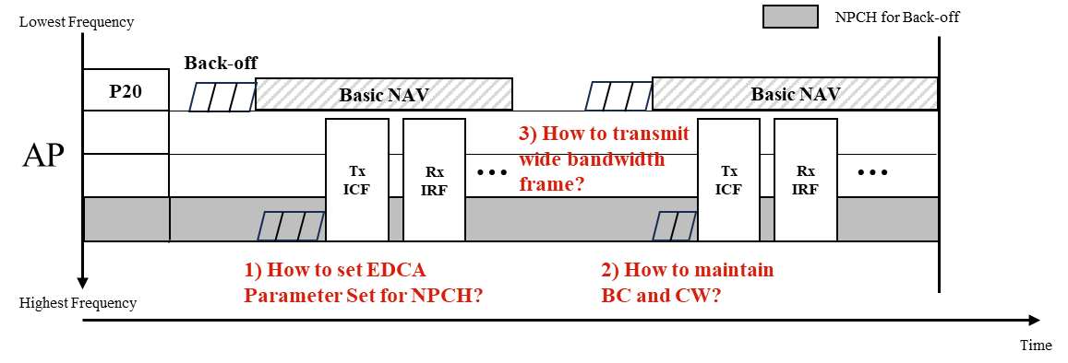
Recap: Non-Primary Channel Access (NPCA)
In the previous contribution, we’ve shared our thoughts on EDCA procedure w/ some restrictions for medium access recovery when STA(s) switches to NPCH [1]
  Attempt to obtain a TXOP shall be initiated w/ short control frame (e.g., RTS) using regular EDCA backoff using baseline CCA but TBD ED threshold value
In this contribution, we discuss the EDCA procedure
  EDCA Parameter Set for NPCH
  Backoff Counter and Contention Window for NPCH
  Wide Bandwidth Frame Transmission

Slide 4
EDCA Parameter Set for NPCH
To perform channel access on the NPCH, AP shall announce EDCA Parameter Set for NPCH
Option 1: Seperate EDCA Parameter Set for NPCH (Preferred)
  AP can consider each of the channel condition for PCH / NPCH and announce the separate EDCA Parameter Set for NPCH while reusing the existing format
  With this, AP can adjust the prioritization of the PCH and NPCH
  EDCA Parameter Set for NPCH may have lower priority compared to the PCH
    To reduce the impact on the STAs on OBSS
    E.g., MU EDCA Parameter Set can be adapted for the NPCH
Option 2: EDCA Parameter Set for PCH can be shared w/ NPCH
  However, not to affect the channel access each other, CW and BC is updated and maintained seperately on PCH and NPCH while sharing the EDCA Parameter Set

Slide 5
BC and CW for NPCH
STA(s) performing NPCA switches its channel that performs channel access dynamically from the PCH to the NPCH (vice versa)
  How to maintain the BC and CW on the NPCH need to be discussed
Option 1: Maintain the BC and CW that STA used last time when it performed channel access on the NPCH (Preferred)
  When maintaining the CW, frame collision may be reduced since the channel condition of the previous channel access on the NPCH is considered
  When maintaining the BC, fairness of channel access opportunity among STAs in BSS can be guarateed
Option 2: Initialize the BC and CW whenever STA(s) switches to the NPCH
  E.g., STA sets its BC to a random value selected from [0, CWmin]
  Simple to design / Memory overhead can be reduced

Slide 6
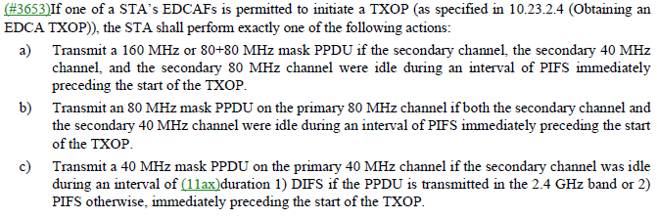
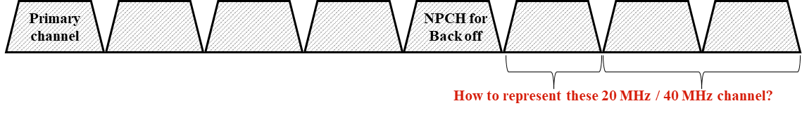
Wide Bandwidth for NPCA
According to the current spec (REVme) , STA(s) are able to transmit N MHz PPDU according to EDCA channel access rule
  The width of transmission is determined by the CCA status of the nonprimary channels during an interval of duration before transmission
To define EDCA channel access for NPCA, primary N MHz and secondary N MHz for NPCA may need to be defined

Slide 7
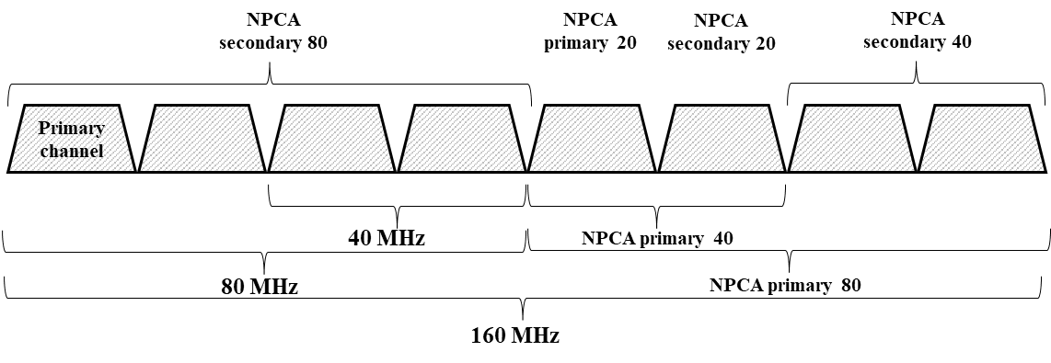
Primary N MHz and Secondary N MHz for NPCA
NPCA Primary Channel and NPCA Secondary Channel can be defined as follows
  NPCA P20: 20MHz CH that STA contends for NPCA
  NPCA S20: 20MHz CH adjacent to the NPCA P20 that together forms the NPCA P40
  NPCA P40: 40MHz CH including NPCA P20 that is used to transmit 40MHz PPDU
  NPCA S40: 40MHz CH adjacent to the NPCA P40 that together forms the NPCA P80
  NPCA P80: 80MHz CH including NPCA P20 that is used to transmit 80MHz PPDU
  NPCA S80: 80MHz CH adjacent to the NPCA P80 that together forms the NPCA P160
  NPCA P160: 160MHz CH including NPCA P20 that is used to transmit 160MHz PPDU
  NPCA S160: 160MHz CH not including NPCA P20, which together w/ the NPCA P160, forms the 320MHz channel

Slide 8
Wide Bandwidth Frame Transmission for NPCA
To obtain EDCA TXOP on NPCH, STA(s) performs back-off on NPCA P20 and when BC reaches 0, a PPDU including Frame(s) can be transmitted on NPCA P20 including other IDLE NPCH(s) according to the CCA results
  Transmits 20MHz PPDU on the NPCA P20
  Transmits 40MHz PPDU on the NPCA P40
  Transmits 80MHz PPDU on the NPCA P80
  Transmits 160MHz PPDU on the NPCA P160
  Transmits 320MHz PPDU on the NPCA P320
    If NPCA S20, NPCA S40, NPCA S80 and NPCA S160 were idle during an interval of PIFS immediately preceding the start of TXOP

Slide 9
Conclusion
In this contribution, we’ve proposed EDCA for NPCA
  EDCA Parameter Sets for NPCH
  How to maintain backoff counter and contention window value whenever STA switches between the PCH and SCH
  Define Primary N MHz and Secondary N MHz for NPCA
    Wide bandwidth frame transmission can be done based on defined Primary N MHz and Secondary N MHz for NPCA

Slide 10
Reference
[1] 23/1112r0, Thoughts on Secondary Channel Access
[2] 23/1911r0, Secondary Channel Access and Frame Transmission
[3] 23/034r1, Non-primary Channel Utilization
[4] 23/1444r1, Non-primary channel access evaluations_followup
[5] 23/1419r0, Nonprimary channel access discussions
[6] 23/1365r0, Discussions on Non-primary Channel Access
[7] 23/797r0, Non-primary channel access
[8] 23/1288r0, Non-primary Channel Utilization Follw-up
[9] 23/1414r0, secondary channel usage follow up

Slide 11
SP1
Do you agree to include the following into the 11bn SFD?
  AP shall announce an separate EDCA Parameter Set for performing channel access on a non-primary channel
  Detailed signaling is TBD

Slide 12
SP2
Do you agree to include the following into the 11bn SFD?
  STA shall maintain backoff counter and contention window it used last time when it performed channel access on a non-primary channel

Slide 13
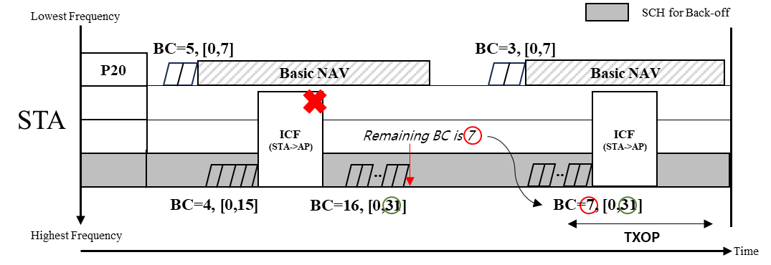
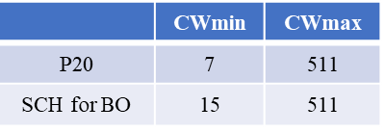
Appendix: Example of Backoff Procedure on NPCH
Below example figure adapts EDCA Parameter Set for NPCH (on slide 4) option 1 and BC / CW for NPCH (on slide 5) option 1
When STA performs NPCA, STA maintains its CW value (e.g., 31) and BC (e.g., 7 which is remaining BC from previous NPCA) used from previous channel access on the NPCH
  Switching back to the PCH does not affect the backoff procedure (in terms of BC and CW value) on the NPCH

