Slide 1
Enabling Flexible Coexistence Operation
March 2024
Date: 2024-03-05
Authors:
Notes:
September 2012

Slide 2
Introduction
March 2024
Several contributions [1-4] has discussed the in-device coexistence.
In this contribution, we will share some thoughts on the in-device coexistence.

Slide 3
Recap In-device Coexistence
March 2024
In-device non-WiFi radio types:
  BT, BLE, UWB, 5G NR-U…
In-device non-WiFi radio application profiles:
  Periodic
  Aperiodic.
The STA can report periodic or aperiodic unavailable SPs due to the in-device coexistence.
  Start time, interval, Duration
  Affected BW in unit of 20 MHz
  …

Slide 4
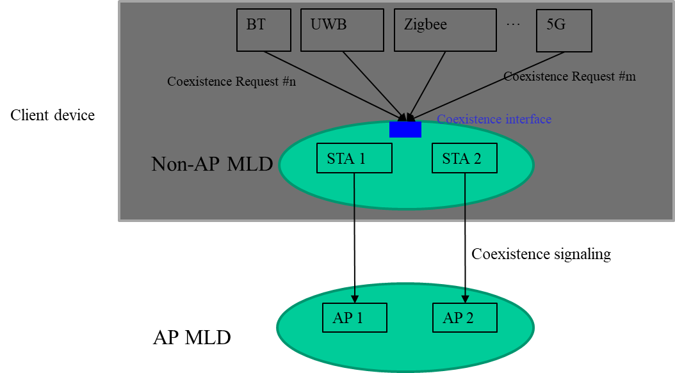
In-device Coexistence Model
March 2024
The in-device coexistence model is illustrated as shown in the below figure

Slide 5
Requirements
March 2024
Since a coexistence request may be received at anytime, the UHR coexistence protocol should allow a non-AP MLD timely reports an in-device coexistence request to the peer STA through one of following potential manners:
  Initial Control frame exchange at the beginning of a TXOP
    e.g. MU-BSRP/BSR
  BA frame
  Cross-link signaling through A-Control field or a newly defined Management frame
So prefer to define a new signaling container, rather than reuse the TWT signaling.

Slide 6
Coexistence Request ID
March 2024
For the periodic interference, the STA is easy to predict in advance but hard to predict its end. For example,
  The interference may be not always present during these interference SPs
  The interference may end before the indicated time point due to the transmission of the non-WiFi radio ends in advance.
In order to facilitate the management of coexistence Requests and signaling, the non-AP MLD can assign an ID, named Coexistence Request ID, to uniquely identify a coexistence request when it is added.
Thus the non-AP MLD can flexibly manage an existing coexistence request by using the corresponding Coexistence Request ID when the behavior of the corresponding non-WiFi radio is changed.

Slide 7
Coexistence Request Type
March 2024
After a coexistence request is added, the non-AP MLD may remove/suspend/revise this coexistence request.
Define a Coexistence Request Type to indicate the specific operation, as shown in below table.
Table Coexistence Request Type definitions
Value | Name
0 | Add
1 | Remove
2 | Suspend
3 | Revise

Slide 8
Unavailable for Tx, Rx, or both
March 2024
Considering a STA could be an interfering or interfered one, the STA unavailability can be classified into the following three cases:
  Unavailable for Tx and Rx
    Scenario. share a common antenna with other non-WiFi radio
  Unavailable for Tx only
    Scenario. the interference between Wi-Fi radio and 5G NR-U radio which does the DL reception
  Unavailable for Rx only
    Scenario 1. the interference between Wi-Fi radio and 5G NR-U radio which does the UL transmission
    Scenario 2. the interference between Wi-Fi radio and the BT Radio. And the BT radio as the master transmits a unidirectional audio flow (i.e. no ACK) to the BT headset.
This info could be used for the aligned Tx/Rx between Wi-Fi radio and non-WiFi radio.
  In addition, the Radio Type (e.g. 5G NR-U, BT and so on) may be reported to help the AP make decision on scheduling the STA’s Tx/Rx.

Slide 9
Unavailable for Tx, Rx, or both (Cont.)
Example 1. Asymmetric interference between Wi-Fi radio and non-WiFi radio due to the significant differences on the transmission power and the bandwidth
  The reception of the Wi-Fi radio maybe can tolerate the short-time interference from the BT, e.g. replying ACK. But the reception of the BT radio cannot tolerate the interference generated by the Wi-Fi Radio.
  Then the STA reports periodic unavailable windows for Tx only to the associated AP.
Unavailable for Tx only
Unavailable for Tx only
STA
In-device
Tx Window
Tx Window
BT as Master
AC
K
AC
K
AC
K
AC
K
BT as slave
(Headset)
Data
Data
Data
Data
Connection Interval

Slide 10
Unavailable for Tx, Rx, or both (Cont.)
Example 2. Asymmetric interference between Wi-Fi radio and non-WiFi radio due to the unidirectional Tx with no ACK
  The BT radio periodically broadcasts. Or the BT radio activates a transmission mode with no ACK for the real-time application.
  Then the STA reports periodic unavailable windows for Rx only to the associated AP.
STA
Unavailable for Rx only
Unavailable for Rx only
In-device
Tx Window
Tx Window
BT as Master
Data
Data
BT as slave
(Headset)
Connection Interval

Slide 11
Conclusions
March 2024
In this contribution, we have proposed the following signaling designs for the in-device coexistence:
  The non-AP MLD assigns a Coexistence Request ID for each coexistence request.
  The non-AP MLD can add/revise/suspend/remove a coexistence request by indicating the corresponding Coexistence Request ID
  The non-AP MLD indicates whether it is unavailable for Tx, Rx or both within periodic/aperiodic SPs indicated by a coexistence request.

Slide 12
References
March 2024
[1] 11-23-0816-01-0uhr-enhancements-for-latency-sensitive-traffic-and-in-device-coexistence
[2]11-23-0298-00-0uhr-improved-reliability-in-presence-of-interference
[3] 11-23-1103-00-0uhr-in-device-interference-discussion
[4] 11-23-1964-01-00bn-coexistence-protocols-for-uhr

Slide 13
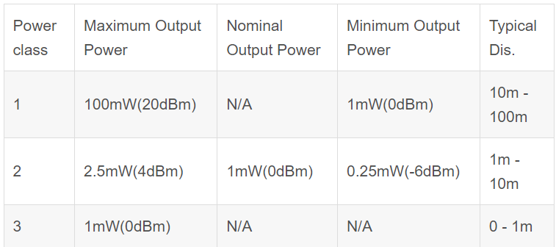
Appendix Tx Power of Bluetooth

Slide 14
SP 1
Do you support to define the following unavailable types for the in-device co-existence to improve the transmission and medium efficiency?
  Unavailable for Tx Only
  Unavailable for Rx Only
  Unavailable for both Tx and Rx

Slide 15
SP 2
Do you support to define a new signaling container for the in-device coexistence, rather than reuse the TWT signaling?

