Slide 1
Data Offload Using WLAN in Connected Vehicle Case
March 2024
Date: 2024-03-12
Authors:
Jing Ma (Toyota)

Slide 2
Abstract
March 2024
The market for connected vehicles is grow rapidly, and vehicles are becoming large producers and consumers of data
Currently, connected vehicles are exclusively relying on cellular networks, which have overwhelmed the cellular capacity and is posing significant costs.
Hence, offloading data from cellular to WLAN is crucial for connected vehicles.
Current solutions such as IEEE 802.11u do not fully support the connected vehicle’s data offloading case
For the connected vehicle case, it is important to discuss and address the new challenges for supporting data offload using WLAN to complement cellular connectivity
To support connected vehicles, it is essential to understand these challenges and identify the gaps in the current IEEE standards

Slide 3
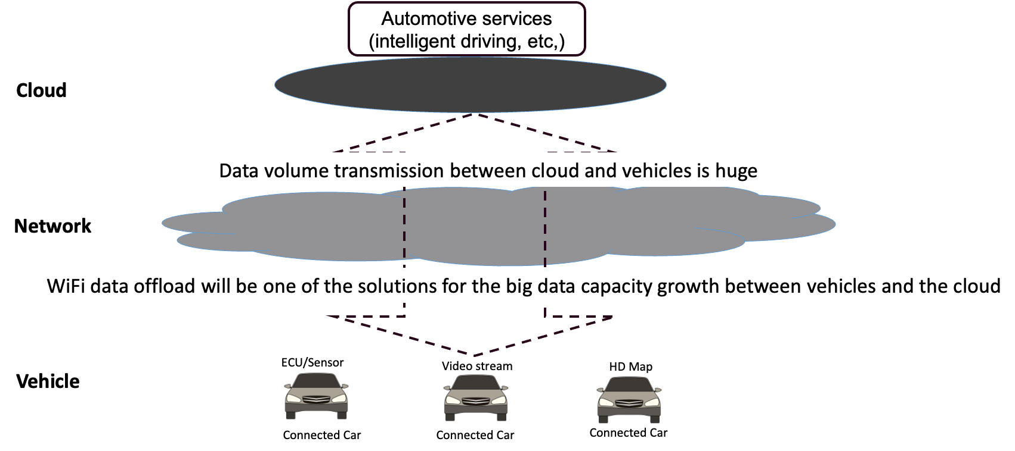
Background
March 2024
Global connected vehicle market size is forecast to reach US$ 198 B, with vehicles
transferring approximately 100 petabytes of data monthly to the cloud
Jing Ma (Toyota)

Slide 4
Motivation
March 2024
Connected vehicles have become large procurers and consumers of data
  Data transmission for automotive services may be data-intensive, computation-intensive, and delay-sensitive
Connected vehicles exclusively rely on cellular network, which is overwhelming the cellular capacity and is posing significant costs.
As such, Wi-Fi data offloading is crucial for connected vehicles
  Wi-Fi infrastructures are increasingly getting deployed across major metros
    Home Wi-Fi network
    Provider-managed Wi-Fi network
  Low cost
    Provider-managed WiFi services are marketed as a perk attached to the home-Internet contract

Slide 5

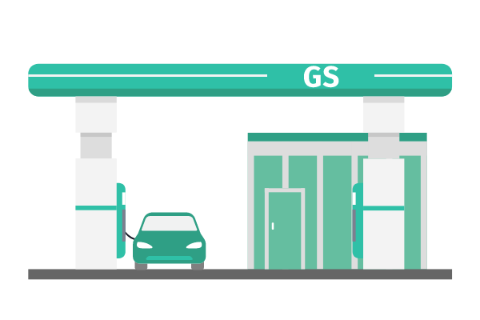




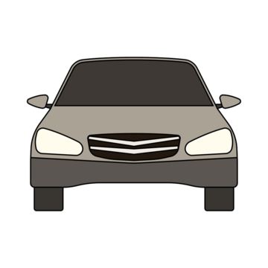


Data offload using WLAN
March 2024
When vehicles stop at home, gas/charging station, or pass roadside infrastructure such as street poles, vehicles connect to WLAN to offload vehicular data
Wi-Fi
10m/s
100m
Vehicles connect to a secured and stable home WLAN for long enough time for
- Large File Transfers
Streaming media
Cloud backup and sync
Software update
Vehicles connect to gas/charging station’s WLAN temporarily during its short stop for
- Remote diagnostics
Non-real-time software updates
Location-based services
Vehicles connect briefly to WLAN mounted at roadside infrastructure when passing by for
- Local information advertisement
Non-critical notifications
Non-real-time delivery

Slide 6
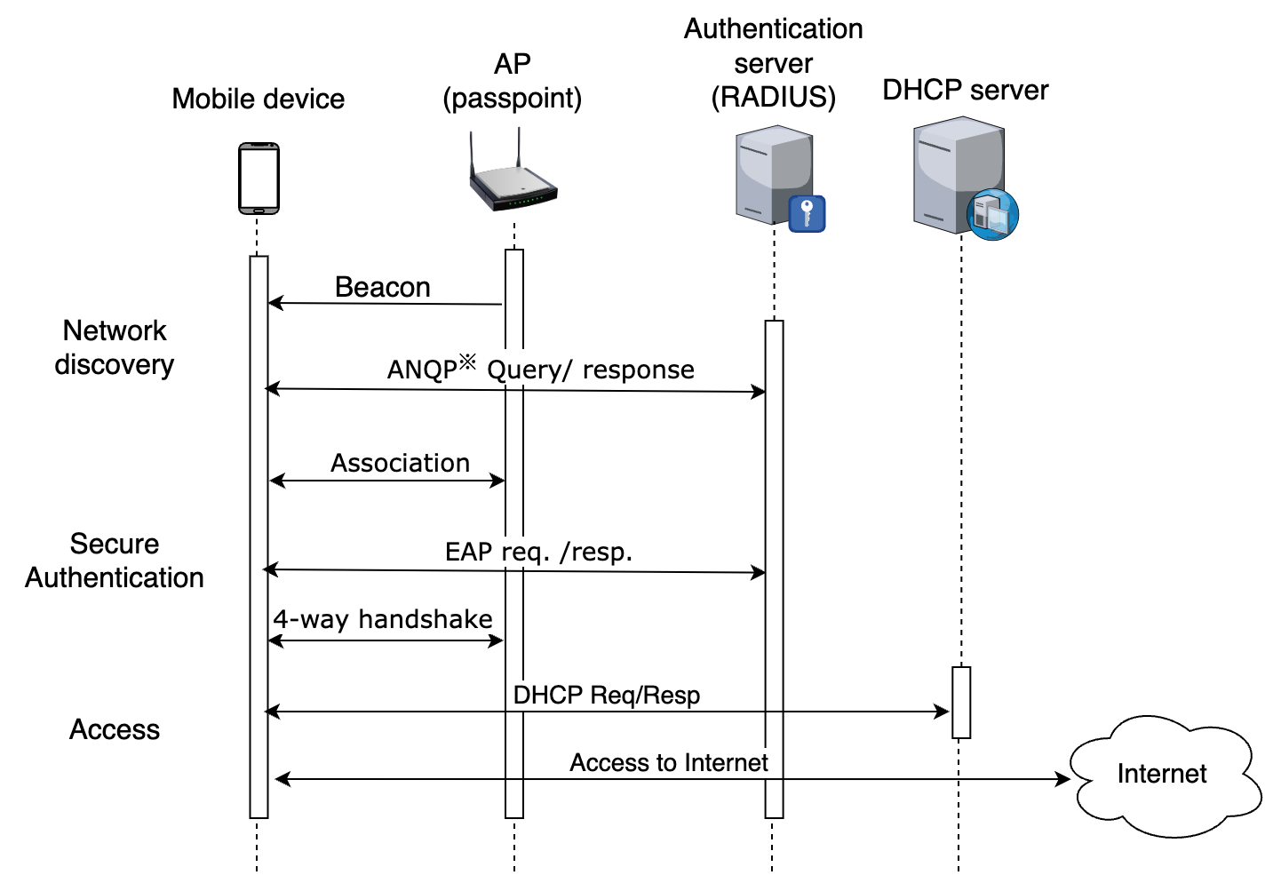
Current offload solutions
March 2024
IEEE 802.11u-based solution makes connecting to WLAN easier and secure[2-3]
Network discovery
  Discover and gather information of available Wi-Fi
  networks before connecting (ANQP, beacon enhancements)
Automatic network selection
  Devices automatically select and connect network without
  user intervention
Secure authentication and access
  - Pre-configured credentials for automatically authentication
  - Support secure authentication methods like EAP
Jing Ma (Toyota)

Slide 7
Requirements
March 2024
Fast association & authentication protocol is essential.
  Currently, authentication & association setup may take a few seconds to complete, which poses challenges in the case where a connected vehicle has a limited time window during which it can establish a connection (e.g. only attaching to an AP for 10s)
Reducing handover complexity/time is crucial.
  A connected vehicle in high-speed motion cause excessive handovers, introducing complexities and potential disruptions in data transmission
Optimized roaming algorithms are necessary
  Urban Wi-Fi environments may exhibit intermittent connectivity, leading to potential disruptions in data transmission
Jing Ma (Toyota)

Slide 8
Requirements
March 2024
Network selection and prioritization
  Balancing cost-effectiveness (connected vehicle data plans vs. Wi-Fi infrastructure investments) with network performance being key.
Maintaining continuity of a communication session
  Handover interruption, authentication & authorization delay and so on cause failure or interruption in connectivity and accordingly session disruption and data loss
  Session continuity management such as some support from high layer is needed
Jing Ma (Toyota)

Slide 9
Summary
March 2024
Data offload using WLAN for connected vehicle is introduced
Current solutions such as IEEE802.11u do not fully support the connected vehicle case which introduces new challenges
  Association & Authentication latency, handover complexity, intermittent connectivity and so on
Help is needed to address challenges for supporting smooth data offload using WLAN to complement cellular connectivity for connected vehicle case
Next Steps
  Gap analysis between the requirements for data offload to WLAN in connected vehicle case and current IEEE specifications
  Proposing to form a TIG group to investigate solutions to bridge the gaps
Jing Ma (Toyota)

Slide 10
References
March 2024
[1] GSMA. (2012). 2025 Every Car Connected. Retrieved April 3, 2023
[2] WiFi Alliance,”Passpoint Specification", 2022.
[3] IEEE 802.11u-2011
[4] F. Yang, etc., “Revisiting WiFi offloading in the wild for V2I applications”, Computer Networks, vol. 202, p. 108634, Jan. 2022
Jing Ma (Toyota)

