Slide 1
Data Offload Using WLAN in Connected Vehicle Case
March 2024
Date: 2024-03-12
Authors:
Jing Ma (Toyota)

Slide 2
Abstract
March 2024
The market for connected vehicles is grow rapidly, and vehicles are becoming large data prosumers
Connected vehicles are currently exclusively relying on cellular network, which have overwhelmed cellular capacities and pose significant costs.
Offloading data from cellular to WLAN is crucial for connected vehicles.
Current solutions such as 802.11u do not fully support the connected vehicle’s data offloading case
In connected vehicle case, discussion on addressing new challenges for supporting data offload using WLAN to complement cellular connectivity should be important
To support connected vehicles, it is essential to understand the challenges and identify the gaps in the current IEEE standards

Slide 3
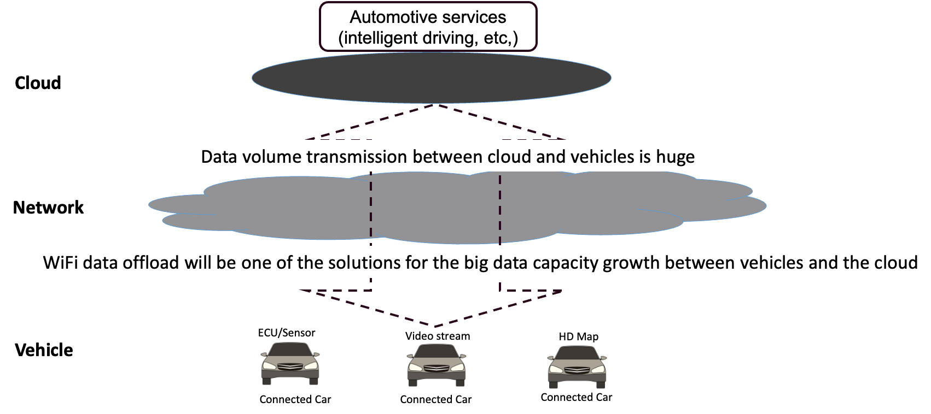
Background
March 2024
Global connected vehicle market size is forecast to reach US$ 198 B, with vehicles
transmitting approximately 100 petabytes of data monthly to the cloud
Jing Ma (Toyota)

Slide 4
Motivation
March 2024
Connected vehicles become large data prosumers
  Data transmission for automotive services may be data-intensive, computation-intensive, delay-sensitive
Connected vehicles exclusively rely on cellular network, which overwhelm cellular capacities and pose significant costs.
Wi-Fi data offloading is crucial for connected vehicles
  Wi-Fi infrastructures are increasingly getting deployed across major metros
    Home Wi-Fi network
    Provider-managed Wi-Fi network
  Low cost
    Provider-managed WiFi services are marketed as a perk attached to the home-Internet contract

Slide 5

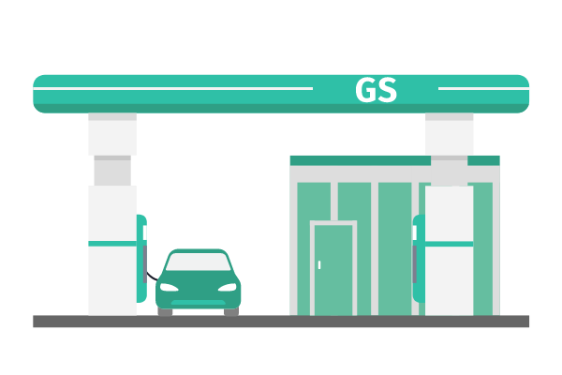




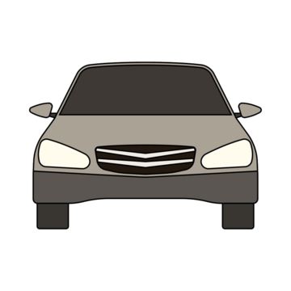


Data offload using WLAN
March 2024
When vehicles stop at home, gas/charging station, or pass roadside infrastructure such as street poles, vehicles connect to WLAN to offload vehicular data
Wi-Fi
10m/s
100m
Vehicles connect to a secured and stable home WLAN for long enough time for
- Large File Transfers
Streaming media
Cloud backup and sync
Software update
Vehicles connect to gas/charging station’s WLAN temporarily during its shot stop for
- Remote diagnostics
Non-real-time software updates
Location-based services
Vehicles connect briefly to WLAN mounted at roadside infrastructure when they passing by for
- Local information advertisement
Non-critical notifications
Non-real-time delivery

Slide 6
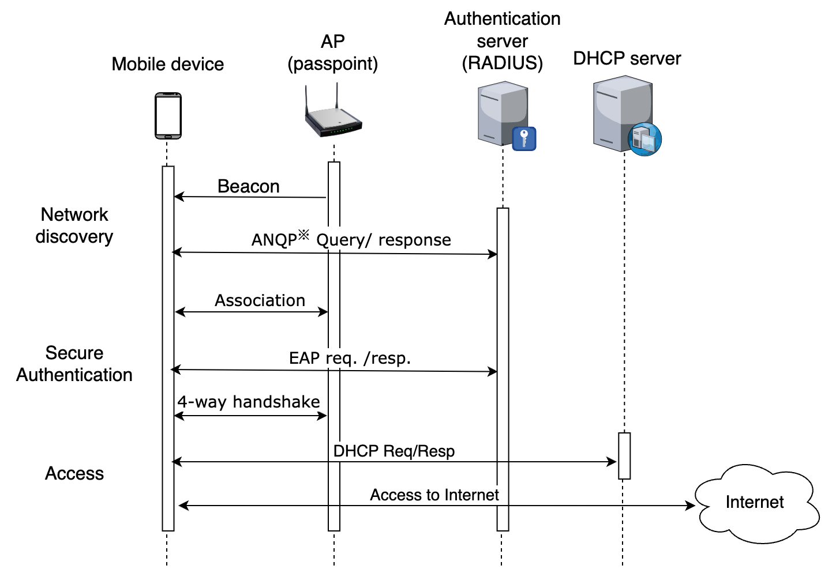
Current offload solutions
March 2024
802.11u-based solution makes connecting to WLAN easier and secure[2-3]
Network discovery
  Discover and gather information of available Wi-Fi
  networks before connecting (ANQP, beacon enhancements)
Automatic network selection
  Devices automatically select and connect network without
  user intervention
Secure authentication and access
  - Pre-configured credentials for automatically authentication
  - Support secure authentication methods like EAP
Jing Ma (Toyota)
Notes:
Access Network Query Protocol (ANQP): Allows devices to discover and gather information about available Wi-Fi networks before connecting, such as network type, security policies, and capabilities.
Beacon enhancements: Beacons now include additional information about the network, helping devices identify compatible and preferred networks.

Slide 7
Challenges
March 2024
Fast association & authentication protocol is essential.
  Authentication & Association setup may take a few seconds to complete, which poses challenge in the case where a connected vehicle has limited time window to establish a connection (e.g. only attaching to an AP for 10s)
Reducing handover complexity is crucial.
  A connected vehicle in high-speed motion cause excessive handovers, introducing complexities and potential disruptions in data transmission
Optimized roaming algorithms are necessary
  Urban Wi-Fi environments may exhibit intermittent connectivity, leading to potential disruptions in data transmission
Jing Ma (Toyota)
Notes:
Access Network Query Protocol (ANQP): Allows devices to discover and gather information about available Wi-Fi networks before connecting, such as network type, security policies, and capabilities.
Beacon enhancements: Beacons now include additional information about the network, helping devices identify compatible and preferred networks.

Slide 8
Challenges
March 2024
Network selection and prioritization
  Balancing cost-effectiveness (connected vehicle data plans vs. Wi-Fi infrastructure investments) with network performance is key.
Maintaining continuity of a communication session
  Handover interruption, authentication & authorization delay and so on cause failure or interruption in connectivity and accordingly session disruption and data loss
  Session continuity management such as some support from high layer is needed
Jing Ma (Toyota)
Notes:
Access Network Query Protocol (ANQP): Allows devices to discover and gather information about available Wi-Fi networks before connecting, such as network type, security policies, and capabilities.
Beacon enhancements: Beacons now include additional information about the network, helping devices identify compatible and preferred networks.

Slide 9
Summary
March 2024
Data offload using WLAN for connected vehicle is introduced
Current solutions such as 802.11u do not fully support connected vehicle’s data offload case which introduces new challenges
  Association & Authentication latency, handover complexity, intermittent connectivity and so on
Help is needed to address challenges for supporting smooth data offload using WLAN to complement cellular connectivity for connected vehicle case
Next Steps
  Gap analysis between the requirements for data offload to WLAN in connected vehicle case and current IEEE specifications
  Proposing to form a TIG group to investigate solutions to bridge the gaps
Jing Ma (Toyota)

Slide 10
References
March 2024
[1] GSMA. (2012). 2025 Every Car Connected. Retrieved April 3, 2023
[2] WiFi Alliance,”Passpoint Specification", 2022.
[3] IEEE 802.11u-2011
[4] F. Yang, etc., “Revisiting WiFi offloading in the wild for V2I applications”, Computer Networks, vol. 202, p. 108634, Jan. 2022
Jing Ma (Toyota)

