Slide 1
Seamless Roaming Recommendation
Date: 2024-05-14
Authors:
Name | Affiliation | Address | Phone | Email
Yelin Yoon | LG Electronics | 19, Yangjae-daero 11gil, Seocho-gu, Seoul 137-130, Korea |  | yl.yoon@lge.com
Insun Jang
 |  |  |  | insun.jang@lge.com
Jinsoo Choi
 |  |  |  | js.choi@lge.com
Sunhee Baek |  |  |  | sunhee.baek@lge.com
Geonhwan Kim |  |  |  | geonhwan.kim@lge.com
Dongju Cha |  |  |  | dongju.cha@lge.com
Eunsung Park |  |  |  | esung.park@lge.com
Dongguk Lim |  |  |  | dongguk.lim@lge.com
Jinyoung Chun |  |  |  | jiny.chun@lge.com
Insik Jung |  |  |  | insik0618.jung@lge.com
HanGyu Cho |  |  |  | hg.cho@lge.com
Sanggook Kim |  | 10225 Willow Creek Rd, San Diego, CA, USA |  | sanggook.kim@lge.com

Slide 2
Re-cap
In the previous contribution[1], we proposed a Seamless Roaming architecture and the procedure
The Roaming procedure involves:
  Step 1: AP Advertisement/Discovery
    The information of the APs affiliated with the same UFT AP MLD are announced to the non-AP STA
  Step 2: Recommendation
    The current AP MLD provides the list of recommended AP MLDs that the non-AP STA could roam to
  Step 3: Roaming
    We want to use a reconfiguration instead of re-association and re-authentication
    The non-AP STA can roam to one of the recommended list provided by the UFT AP MLD

Slide 3
Introduction
Through recommendation of the candidate AP MLDs, we aim to improve roaming management for both the non-AP MLD and the AP MLD
We propose to provide a recommendation of the AP MLD candidates that a non-AP MLD can roam to before roaming
In the current spec, a BSS Transition Management frame recommends the list of APs for a BSS Transition
  We have an option of re-using the BSS Transition Management frame but this may be an inefficient solution as it needs to be sent to each STA not in an MLD level
  We want to find a more efficient way to recommend in a Multi-Link situation

Slide 4
Proposed Solution
We propose to use the Reconfiguration Notify frame to recommend the APs
  It contains the AP IDs that are recommended for roaming
    Preferred in AP MLD’s perspective
We can have one more additional step to allow a non-AP STA to request an AP to send the Reconfiguration Notify frame via transmitting a Reconfiguration Notify Request frame
  The non-AP STA may send the Reconfiguration Notify Request frame to the AP when it finds the current connection is not satisfactory or when it changes its location
  The Reconfiguration Notify Request frame may contain AP IDs that the non-AP STA wants to roam to (Optional)
    Preferred in Non-AP STA’s perspective
  This frame may be sent anytime

Slide 5
Discussion on Contents
Roaming Reason Code field
  This field provides the roaming reason which may aid an AP MLD/non-AP STA to decide which APs to recommend
  It can be included in an Reconfiguration Multi-Link element
Type field
  This field can be used for notifying that the frame is for roaming
  Opt. 1: Use the reserved bit of the Type field in the Reconfiguration Multi-Link element
  Opt. 2: Check the existence of a Roaming Reason Code field
    If the frame consists a Roaming Reason Code field, the one can perceive the frame is for roaming

Slide 6
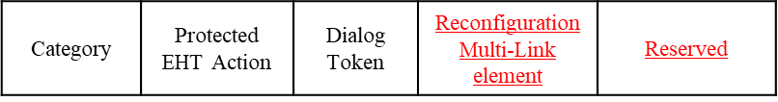
Reconfiguration Notify Request frame
The frame used for soliciting the Reconfiguration Notify frame
  A non-AP MLD may send this frame if it wants the AP MLD to provide its recommendation of the candidate APs.
  It may include the preferred list of APs in the non-AP MLD’s perspective using the APs using the Reconfiguration ML element
  It can add its roaming reason using the Roaming Reason Code field

Slide 7
Reconfiguration Notify frame
The frame used to recommend the candidate APs for roaming in the AP MLD’s perspective
  We can extend the Reconfiguration Multi-Link element to include the candidate APs
    The Roaming Reason Code and the Type field can be included in the Reconfiguration Multi-Link element

Slide 8
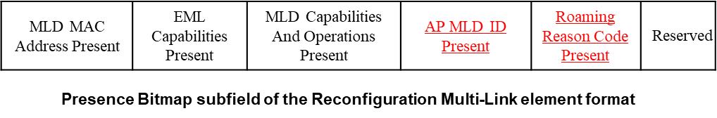
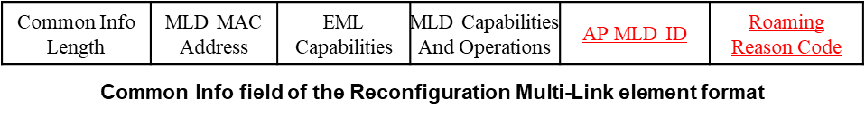
Changes in the elements (1/3)
The current Reconfiguration Multi-Link element can only carry the information of the APs that are affiliated with the same AP MLD
  We want to extend the Reconfiguration Multi-Link element to include more than one AP MLD as the candidate APs may be affiliated with more than one AP MLD
Case 1: The candidate APs are affiliated with the same AP MLD
  Presence Bitmap subfield of the Reconfiguration Multi-Link element format
    AP MLD ID is added in the Common Info field
  Common Info

Slide 9
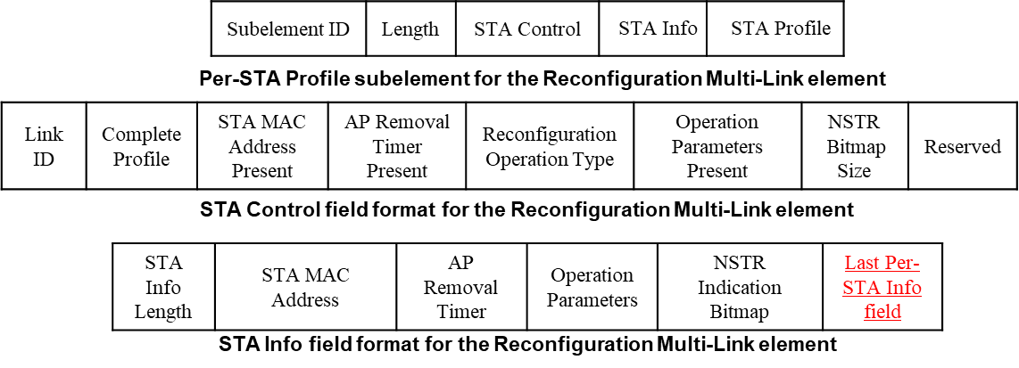
Changes in the elements (2/3)
Case 2: The candidate APs are affiliated with more than one AP MLD
  We can use the extended version of the Reconfiguration ML element which is formed with a format such that it contains multiple [common Info + Per-STA] pairs
  In order to extend the Reconfiguration ML element, we need a method for a non-AP MLD to carry on decoding the element even after it reaches the end of the first Per-STA profile
  Option 1: Last Per-STA Info field indication
    If the Last Per-STA Info field is set to 0, it indicates that there are more [Common Info + Per-STA] pairs in the following

Slide 10
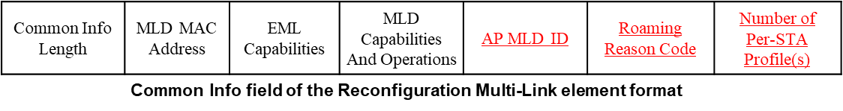
Changes in the elements (3/3)
  Option 2: Indicating how many Per-STA Profile is present in the Common Info field
    The non-AP STA can carry on reading if it has not read all the Per-STA Profiles indicated in the Number of Per-STA Profile(s) field
  Option 3: More Common Info field
    If the More Common Info field is set to 1 in the Common Info field, the non-AP STA recognizes that there is another Common Info field corresponding to a different AP MLD after the last Pre-STA Profile
    This field may be needed or it can be combined with either Option 1 or 2

Slide 11
Conclusion
We have introduced a method using a Reconfiguration Notify frame to recommend the APs for roaming
  We can have a Reconfiguration Notify Request frame that solicits the Reconfiguration Notify frame
We have shared new fields that could be added to the frames sent for recommendation
  A Roaming Reason Code field informs the reason for roaming
  A Type field informs that the corresponding frame is a roaming related frame
We have proposed the methods for a non-AP MLD to read the extended Reconfiguration ML elment

Slide 12
SP #1
Do you agree to add the following text to the TGbn SFD?
  A recommendation of one or more AP MLD candidates is provided to a non-AP STA that it can roam to?

Slide 13
SP #2
Do you agree to add the following text to the TGbn SFD?
  The Reconfiguration Notify frame is used to recommend one or more candidate AP MLDs that a non-AP STA can roam to?

Slide 14
SP #3
Do you agree to add the following text to the TGbn SFD?
  11bn supports to extend the Reconfiguration ML element to recommend more than one AP MLDs?

Slide 15
SP #4
Do you agree to add the following text to the TGbn SFD?
  11bn supports to include the Reason Code in the Reconfiguration Notify frame?
    Reason Code indicates the reason that a non-AP MLD needs to roam to another AP MLD

Slide 16
SP #5
Do you agree to add the following text to the TGbn SFD?
  A Reconfiguration Notify request frame solicits the Reconfiguration Notify frame?

Slide 17
References
[1] 11-23/1907r1 Seamless Roaming

