Slide 1
Unified IF interface for integrated mm- and light-wave
Date: 2024-03-10
Authors:

Slide 2
Abstract
This contribution proposes a unified IF interface for integrated mm- and light-wave.

Slide 3
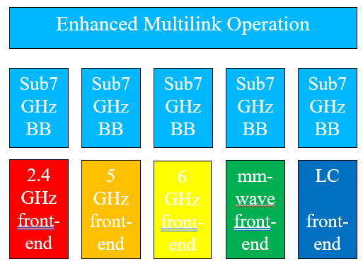
Previous work and this contribution
Recent contributions showed significant interest in use of bands above 7 GHz
  [1-4] proposed to reuse existing Sub-7 GHz baseband
  [2] proposed non-overlapping channels for mm-wave
  [5, 6] proposed to limit the scope in general
  [7] proposed to reuse sub-7 GHz bands for control and mgmt.
  [8] proposed an initial PAR
Besides, it is proposed to also include optical bands
  [9, 10] provided background on recent 11bb standard
  [11] proposed that optical bands are equally integrated into MLO
  [12] argued that optical bands can use similar non-overlapping channels like mm-wave
  [13] indicated that optical bands can be operated using both, the sub-7 GHz or an up-clocked sub-7 GHz numerology
  [14] proposed optical bands can use 11bb for control/mgmt. and new light-wave channels for data (non-standalone)
This contribution proposes a unified IF interface for mm- and light-wave
Source: 11-23/2016r2 [12]

Slide 4
Typical frontend interfaces (exemplary)
Digital IQ
  large # of digital ports
Analog IQ
  two analog ports for I and Q
  digital SPI port, proprietary commands e.g., for power and frequency control
Analog IF/RF
  single TX port
  further simplified
p_control
DAC(I)
PHY TX DSP
VGA
DAC(Q)
f_control
0°
-90°
Synthe-
sizer
ref. clock
Digital
IQ
Analog
IQ
Analog
IF/RF

Slide 5
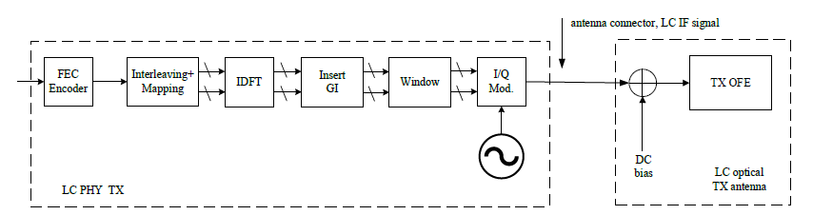
IF to mm-wave
antenna connector, mm-wave IF signal
0°
mm-wave IQ mod.
IF signal
90°
~
mm-wave
signal
mm-wave
local oscillator
Direct Conversion
Single-sideband (SSB) up-conversion to mm-wave is possible
  well known: 0°and 90°image signals cancel each other
  the IQ modulator has impairments, due to IQ imbalance
  SSB avoids in-band interference but creates out-of-band interference (typ. 20-30 dB below main signal)
  interferes with an AP in another room or at STA at another location (scenario-dependent)

Slide 6
IF to light-wave
antenna connector, light-wave IF signal
Direct Conversion
Direct modulation of IF signal onto the light source, same as in 11bb
  other impairment effects, e.g. due to clipping at zero optical power
  clipping noise can be controlled via DC bias and percentage of the light being modulated
  well-known trade-off between performance and range

Slide 7
IF can be transported over fixed media
Sub-7 GHz is NLOS technology
  due to multipath, AP covers every corner of the home
  just attenuated by walls and other objects
  coarse planning of AP location in the home is enough
mm- and light-wave are LOS technologies
  will be blocked by walls and other objects
  allow smaller cells w/o interference (1 room = 1 cell)
AP

Slide 8
IF signal can be transported over fixed media
Sub-7 GHz is NLOS technology
  due to multipath, AP covers every corner of the home
  just attenuated by walls and other objects
  coarse planning of AP location in the home is enough
mm- and light-wave are LOS technologies
  will be blocked by walls and other objects
  allow smaller cells w/o interference (1 room = 1 cell)
Frontends are ideally placed at the ceiling
  planning of antenna / optical frontend locations is critical
Fixed backbone to all distributed frontends
  deployment is similar to the lighting infrastructure
  analog IF signals can be transported over various fixed media
AP

Slide 9
Summary
Previous contributions indicated that mm- and light-wave
  can use similar channelization
  while mm-wave needs up-clocked numerology, which light-wave can use as well, besides the original sub-7 GHz numerology
mm- and light-wave frontends can both be connected to the AP via a unified IF interface
  using same channelization and a configurable baseband numerology
  analog IF signals can be transported over fixed media

Slide 10
References
[1] Integrated mmWave Design Considerations, doc. 11-23/1819r1 https://mentor.ieee.org/802.11/dcn/23/11-23-1819-01-immw-integrated-mmwave-design-considerations.pptx
[2] High-Level Design Considerations of IMMW, 11-23/1878r1, https://mentor.ieee.org/802.11/dcn/23/11-23-1878-01-immw-high-level-design-considerations-of-immw.pptx
[3] Requirements Analysis for IMMW Use Cases, 11-23/1977r1, https://mentor.ieee.org/802.11/dcn/23/11-23-1977-01-immw-requirements-analysis-for-immw-use-cases.pptx
[4] Discussion on Enabling MIMO in IMMW, 11-23/1991r, https://mentor.ieee.org/802.11/dcn/23/11-23-1991-00-immw-discussion-on-enabling-mimo-in-immw.pptx
[5] Technical scope proposal, 11-23/2004r0, https://mentor.ieee.org/802.11/dcn/23/11-23-2004-00-immw-technical-scope-proposal.pptx
[6] High-level thoughts on IMMW, 11-23/1905r0, https://mentor.ieee.org/802.11/dcn/23/11-23-1905-00-immw-high-level-thoughts-on-immw.pptx
[7] mmWave operation without mmWave Beacon, 11-23/2152r0, https://mentor.ieee.org/802.11/dcn/23/11-23-2052-00-immw-mmwave-operation-without-mmwave-beacon.pptx
[8] IMMW proposed PAR, 11-24/0116r1, https://mentor.ieee.org/802.11/dcn/24/11-24-0116-01-immw-immw-draft-proposed-par.docx
[9] IEEE Std 802.11bb-2023, https://standards.ieee.org/ieee/802.11bb/10823/
[10] IEEE 802 Tutorial “IEEE 802 Standards on Light Communication” https://mentor.ieee.org/802.11/dcn/23/11-23-0277-01-0000-ieee-802-standards-on-light-communication.pdf
[11] Extend IMMW scope to include optical bands, 11-23/2016r2, https://mentor.ieee.org/802.11/dcn/23/11-23-2016-02-immw-extend-immw-scope-to-include-optical-bands.pptx
[12] Channelization to include optical bands, 11-24/0062r0, https://mentor.ieee.org/802.11/dcn/24/11-24-0062-00-immw-channelization-to-include-optical-bands.pptx
[13] Numerologies to include optical bands, 11-24/0077r0, https://mentor.ieee.org/802.11/dcn/24/11-24-0077-00-immw-numerology-to-include-optical-bands.pptx
[14] Thoughts on IMMW extension to optical bands, 11-24/0081r0, https://mentor.ieee.org/802.11/dcn/24/11-24-0081-00-immw-thoughts-on-immw-extensions-to-optical-bands.pptx

