Slide 1
Managed on-channel P2P communication
Date: 4-23-2024

Slide 2
Introduction
802.11bn targets the improvement of packet delivery by reducing the transmission latency and enhancing network reliability [1]
Applications and use cases with QoS-related requirements (e.g., bounded latency and reliability) have been growing in recent times [2]
  The critical QoS services can be mainly characterized by periodic traffic patterns, and strict timing requirements for data exchange [2, 3]
Some of these specific applications would employ Peer-to-peer (P2P) links [4, 5], which could be beneficial in terms of latency and efficiency, offloading the AP workload

Slide 3
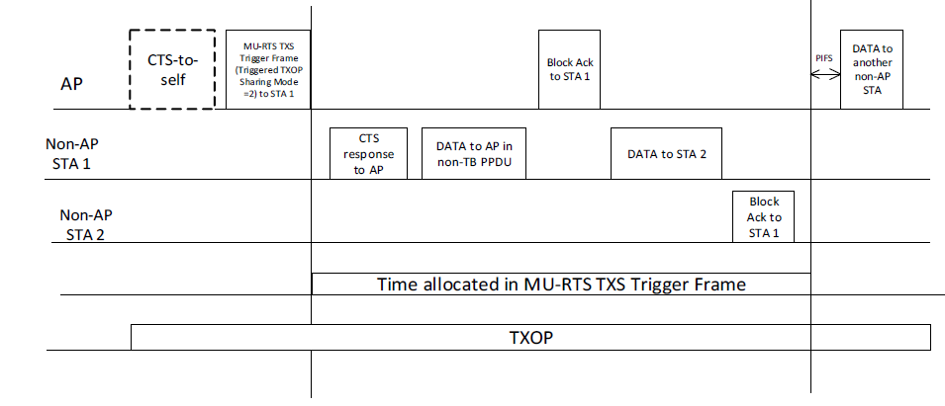
P2P: Recap
Peer-to-peer links allow direct communication between two non-AP STA devices, without any intervention of the AP, except for setting up the link in the case of on-channel P2P.
The AP uses a triggered TXOP sharing (mode 2) mechanism to grant airtime to a non-AP STA that would send data frames to another non-AP STA.
  Other P2P mechanisms exist but the focus of this proposal is on extending TXOP sharing P2P mechanism

Slide 4
Problem Statement (1/2)
Some P2P target applications, such as VR/AR/XR, are based on bidirectional data exchange (closed-loop communication).
  Another example would be any application layer based on TCP communication.
The triggered TXOP sharing (mode 2) mechanism is limited to transferring data in one direction.
  The granted non-AP STA1 can send data to another non-AP STA2, but the non-AP STA1 cannot receive data, as it does not support mechanisms such as trigger frames.

Slide 5
Problem Statement (2/2)
Using the existing TXS Mode 2 would require several consecutive TXOP grants, requiring the continuous action of the AP.
Therefore, the current TXOP sharing (mode 2) mechanism does not provide the optimal functionality to support new latency-sensitive P2P applications that would require fluid bidirectional data exchange.

Slide 6
P2P Group
P2P groups were introduced [6] to allow the AP to recognize a STA group involved within the same P2P application, and allocate resources on a per-group basis.
The P2P communication could be generalized to more than two devices, but can be expected to be limited to a small number of devices (e.g., up to four devices).
  Not necessarily all P2P group members are associated with the AP
The granted TXOP should serve the entire P2P group in any direction, as they share the same target application, and the communication is related.
The P2P group members should request the resources from the AP in a previous negotiation phase.

Slide 7
Light-weight Contention Mode
The AP’s granted TXOP time window could be seen as a local contention period for the P2P group, considered as a low congested scenario. The AP would grant the time to allow data exchange in any direction within the group.
To this aim, we define a “light-weight” contention mode for EDCA, where the P2P STAs contend for the channel, assuming a low probability collision environment, as the data transmission would be driven by a common distributed application.

Slide 8
MU-RTS TXS Trigger Frame
We identify three different scenarios, and at least one STA is associated with the sharing AP:
  All the P2P members are associated with the sharing AP
  Some of the P2P members are in ad hoc mode
  Some of the P2P members are associated with other AP from the same ESS
Current MU-RTS TXS Trigger frame sends one User info field, we need to define a new mode that allows sending the TF to the P2P group, even if the STA is not associated (but listening in the same channel)
We define the Group ID (GID) for identifying an entire P2P group, which is sent in the Trigger Frame for sharing the TXOP
  Replaces the AID in the User Info field
The P2P STAs will join the GID in a previous negotiation phase (TBD), and the associated STA will collect the GID to request resources to the sharing AP

Slide 9
MU-RTS TXS Trigger Frame
The process for creating the P2P group and executing the data exchange is roughly described in three phases:
  Discovery Phase: The STAs talk each other without the intermediation of the AP (mechanism TBD), discovering the STA members of the P2P group, assigning the Group ID.
  Resources Request Phase: The associated STA requests to AP, the required QoS resources (e.g., SCS) for a specific Group ID and optionally awake time windows (e.g., TWT) for the STAs with PS requirements.
  TXOP Sharing Phase: P2P Group data exchange by sharing the AP TXOP
Sharing AP
Resources
Request
Phase
P2P group (GID)
TXOP Sharing
P2P group (GID)
TXOP Sharing
P2P group (GID)
TXOP Sharing
STA1
P2P Group
Discovery
Phase
(GID)
…
…
STA2
Time
P2P group composed of STA1 and STA2
STA1 associated with AP
TWT Window

Slide 10
Light-weight Contention
TXOP
RTS TXS Trigger frame
Light-weight contention start
Light-weight contention end
SIFS
Light-weight contention
Sharing AP
CTS to Self
TF
RA: GID
TA: AP
RA: STA1
STA1
CTS
TA: STA1
RA: STA2
Ack
TA: STA1
RA: STA2
Ack
STA2
CTS
Ack
TA: STA2
RA: STA1
Ack
Time
Time Allocated to P2P group
TWT Window
After the sharing AP sends the TF to the P2P group (GID), the light-weight contention starts between the STA members, until the allocated time ends, and the AP recovers the TXOP
  GID is a group identifier, including non-associated STAs
In case of having PS constraints, a pre-negotiated TWT window ensures the STAs are awake for receiving the starting frame

Slide 11
Light-weight Contention
TXOP
RTS TXS Trigger frame
SIFS
Light-weight contention
AP
CTS to Self
TF
RA: GID
QoS
Data
CF End
STA1
CTS
STA1 -> STA2
Ack
STA1 -> STA2
STA2
P2P group
CTS
Ack
STA2 -> STA1
Ack
STA3
P2P group reset their NAV counter and start contending
Ack
Time
Time Allocated to P2P group
P2P time allocated NAV internal counter
BSS NAV
NAV counter of the P2P group is reset after receiving the TF, allowing the P2P group to start contending for the channel using the lightweight contention mode
  Other STA devices, including OBSS devices, will not change the NAV, and they will consider the channel as busy
Another internal time shall count the remaining time for the allocated time
Once the allocated time finishes, the P2P group restores the BSS NAV

Slide 12
Light-weight Contention
There could be several options for implementing the light contention within the P2P group contention period
  High-performance EDCA parameters (AISFN and CW)
    The Voice access category could be a good starting point to define these values. We assume that there are a very small number the devices within the contention period, whose QoS data traffic is driven by the application, and most likely there will be an order of transmission
  No contention with fixed IFS
    Assuming the application has a fixed order of data transmission, the contention could be removed, and set a fixed xIFS separation between the frames, as there will be no collisions
  Token-based arbitration
    As an additional mechanism for avoiding collisions, there could be a token-based arbitration mechanism for allowing a P2P group member to transmit. The token will be passed through the members (different strategies could be used).

Slide 13
Summary
A new Triggered TXOP sharing mode is proposed, which enables a light-weight contention period for QoS P2P group members
  The MU-RTS TXS Trigger frame must support a new User Info field including a Group ID, instead of AID.
  The P2P group STAs need to reset their NAV counter after receiving the new TF frame (RA: Group ID), and start the light contention
  The P2P group STAs need to maintain an internal counter of the allocated time by the AP
  After the allocated time expires, the P2P group STAs recover the BSS TXOP NAV counter
There could be different light-weight contention options, according to application nature

Slide 14
Conclusion
We have identified the P2P communication links for some QoS time-sensitive applications, and current on-channel P2P mechanism limitations attending to the needs for bidirectional communication (closed loop)
Based on the P2P group concept, we have proposed a new triggered TXOP sharing mode that would allow direct communication with the P2P group
A light-weight contention mechanism is proposed to enhance the transmission efficiency and improving the end-to-end communication latency

Slide 15
References
[1] IEEE 802.11-23/0028r6, UHR PAR discussion
[2] Inaki Val and et al. (MaxLinear), “High Criticality Use Cases and Requirements”, 23/1522r0, September 2023.
[3] Oliver Holland and et al. “Low Latency Communication White Paper”, P802.24-23-0010r4, July 2023.
[4] Dibakar Das and et al. (Intel), “TXOP sharing extensions for XR use-cases”, 23/1387r1, August 2023.
[5] Guoqing Li and et al. (Meta), “Proxy QoS management for XR use cases”, 23/1958r0, November 2023.
[6] Rubayet Shafin and et al., “P2P Resource Management”, 23/1929r0, November 2023.

