Slide 1
Preemption for Low Latency
Date: 2024-04-10
Authors:

Slide 2
Introduction
Reducing the latency distribution tail in UHR devices with latency sensitive application is one objective of 802.11bn
Channel access delay is believed to be the main source of the latency distribution tail
Congestion of the channel due to other BSS or OBSS STAs traffic
Collision of packets due to increased number of STAs and the exponential backoff
Long TXOP by some devices blocking the channel for long period of time
Large non-low latency PPDU transmission or reception by the the device with pending low latency traffic
802.11 bn is discussing channel access topics that can help with reducing channel access delay like SCA, DSO, M-AP and preemption

Slide 3
Problem Statement
When channel is congested or blocked by other BSS or OBSS STAs TXOP
STA with low latency traffic can use a different link (or sub-channel)
When a STA with low latency (LL) traffic is engaged in transmitting or receiving non-low latency traffic, it must wait for the TXOP to terminate to contend for channel access
A solution should cover the following use cases:
STA while transmitting non-LL traffic needs to transmit LL traffic
STA while receiving non-LL traffic needs to transmit LL traffic
STA while transmitting non-LL traffic, the receiver needs to transmit LL traffic to the transmitting STA
STA while receiving non-LL traffic, the receiver needs to transmit LL traffic to the transmitting STA
Shortening the TXOP limit to enable low latency traffic access affects the medium efficiency
Any proposed solution should be scalable and should not degrade legacy performance

Slide 4
Revisiting Preemption
Preemption is a method to STOP the current ongoing transmission and START transmitting low latency traffic such that the delay bound could be met in time.
Problems:
Shall we allow to STOP all types of traffic in case of a preemption intent?
Who can START: TXOP Holder, TXOP responder, a 3rd Party STA?

Slide 5
Preemptable Traffic Types
VO or VI traffic should not be preempted due to its inherent requirement on delay bound
However, the Internet today has evolved to prefer the majority or all traffic to have low latency
Say, loading webpage as quickly as possible
In addition to DSCP bleaching problem, there are also major real-time audio/video applications that mark their traffic as BE
The 802.11 MAC layer has no knowledge of incorrect traffic categorization
Be Mindful before Preempting BE Traffic!

Slide 6
When to Preempt?
The TXOP holder or the TXOP responder decides whether to preempt
The TXOP holder or the TXOP responder is responsible for the consequences and deems preemption a better choice for THEMSELVES
It is better not to allow the problematic 3rd party preemption
Regression on the performance of existing applications, especially when the Client is the TXOP holder
Concern on abusing the preemption methods
No incentive for a STA to allow others to preempt its own traffic without its permission
Proposed solutions are complicated and not scalable

Slide 7
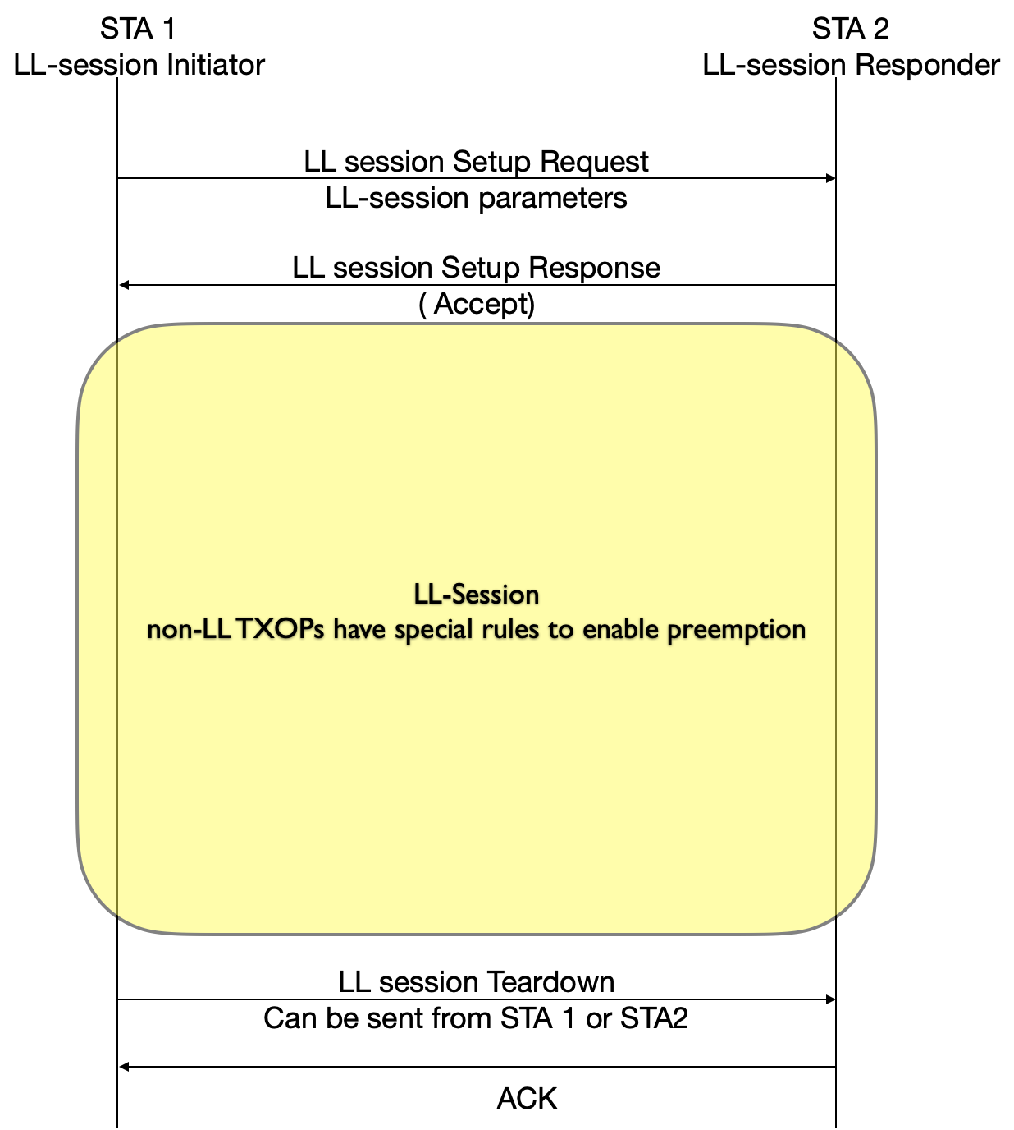
Proposed Solution
When low latency data is expected between a STA and its associated STA, it requests to establish a LL-Session
The LL-Session initiator and LL-Session responder agrees to enable preemption
STAs exchange LL-Session Setup Request and Response frames to negotiate preemption parameters
Any non-LL TXOP in a LL-Session initiated by any of the STAs with active LL-Session follow the LL-Session rules
Legacy devices and WiFi-8 devices with no active LL-Session
Channel access as usual and performance is not affected

Slide 8
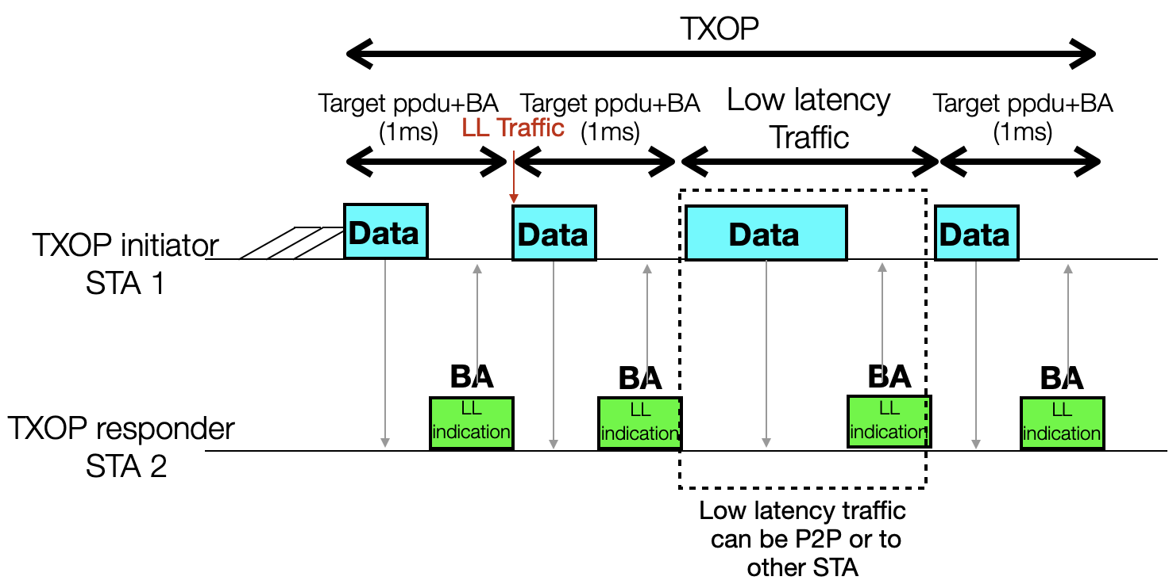
UHR STAs with Active LL-Session Behavior
LL and non-LL TXOPs limits for the UHR STAs with active LL-Session follow the legacy STAs TXOP limit
The TXOP initiator divides the large PPDU into small PPDUs with target length equals to an agreed-on value at the LL-Session setup when transmitting non-LL traffic, for example 1ms
TXOP initiator can preempt its own TXOP to transmit low latency traffic to the TXOP responder or any other STA ( infra or P2P)
The TXOP responder sends a response frame after each PPDU with LL traffic indication
TXOP responder requests to preempt the on-going TXOP
TXOP initiator allows preemption based on the request
The TXOP initiator always in control whether to share the TXOP or not
TXOP initiator reject the request by continuing bursting

Slide 9
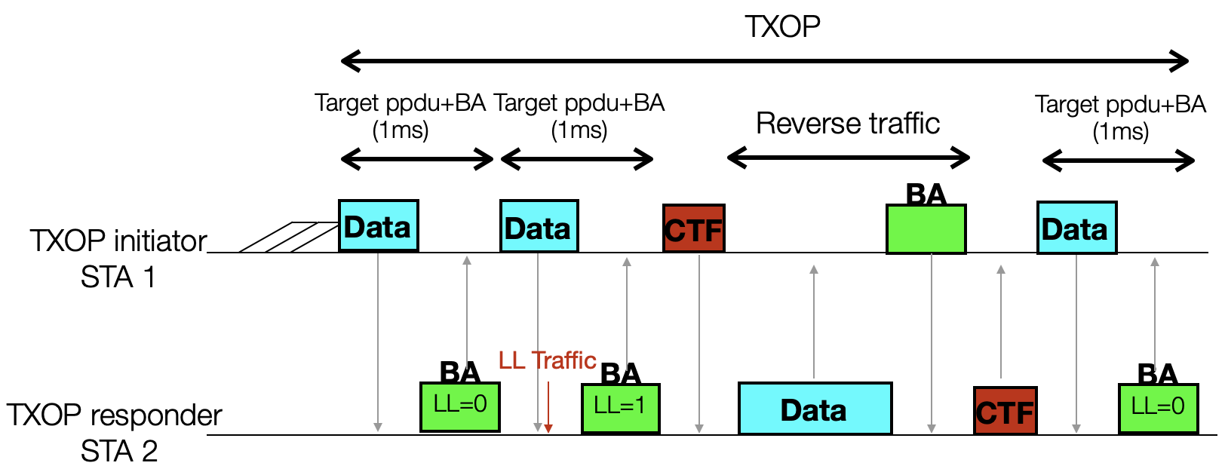
UHR STAs Preemption Requests and Responses
TXOP responder sends LL traffic indication to the TXOP initiator in a control response frame to request preemption, example requests:
Request to transmit LL traffic to the TXOP initiator in the same TXOP (ex:LL= 1)
Request to transmit LL traffic to a STA that is not the TXOP initiator in the same TXOP (ex: LL=2)
Request to disengage from current TXOP (ex: LL=3)
No request available (ex: LL=0)
TXOP initiator responds to the TXOP responder request through
Sharing the TXOP with the TXOP responder
Continue bursting to the TXOP responder
Stopping traffic to this STA in the current TXOP
Terminating the TXOP
TXOP initiator shall accept the reverse traffic from the TXOP responder in an active LL-Session
Once the TXOP responder finishes using the TXOP, it may send a control frame to return the TXOP to the TXOP initiator
The TXOP initiator can use the LL indication for future scheduling decision

Slide 10
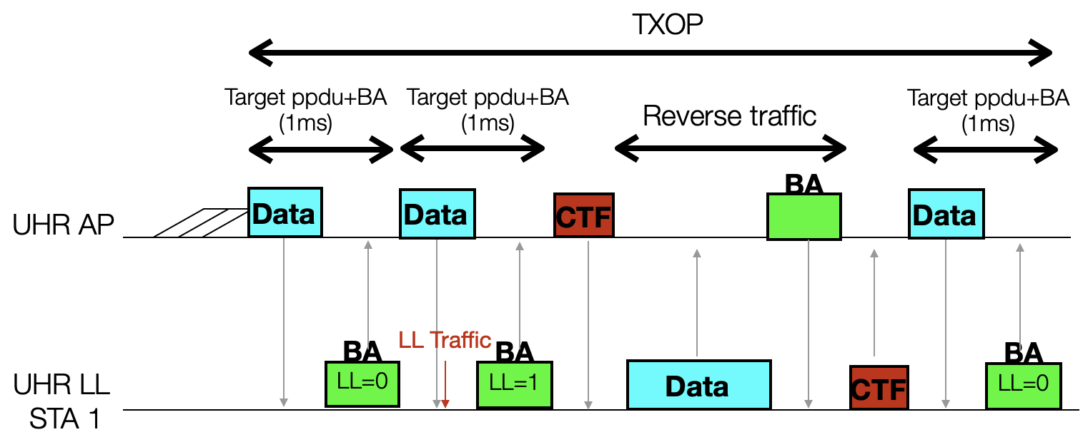
DL Preemption Examples
AP bursts DL frames to the UHR STA with active LL-Session
Target STA can send a preemption request in the PPDU response frame to indicate pending LL traffic
AP can share the TXOP with the TXOP responder to send its LL traffic to the AP

Slide 11
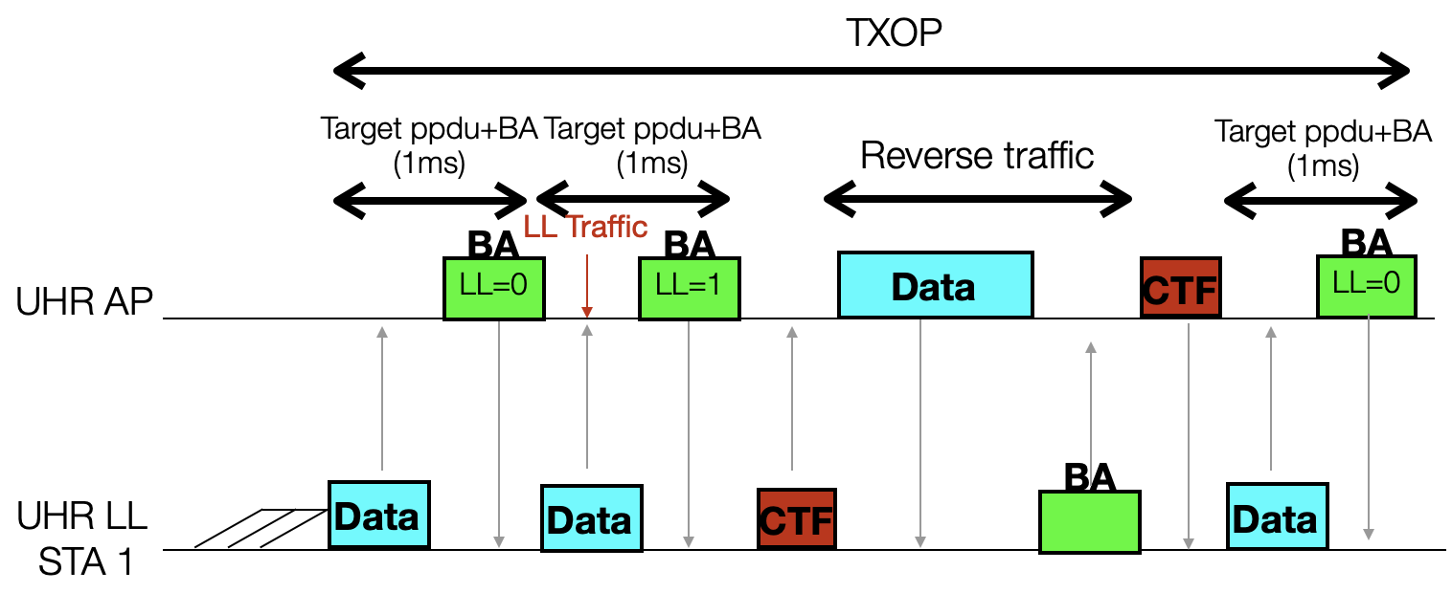
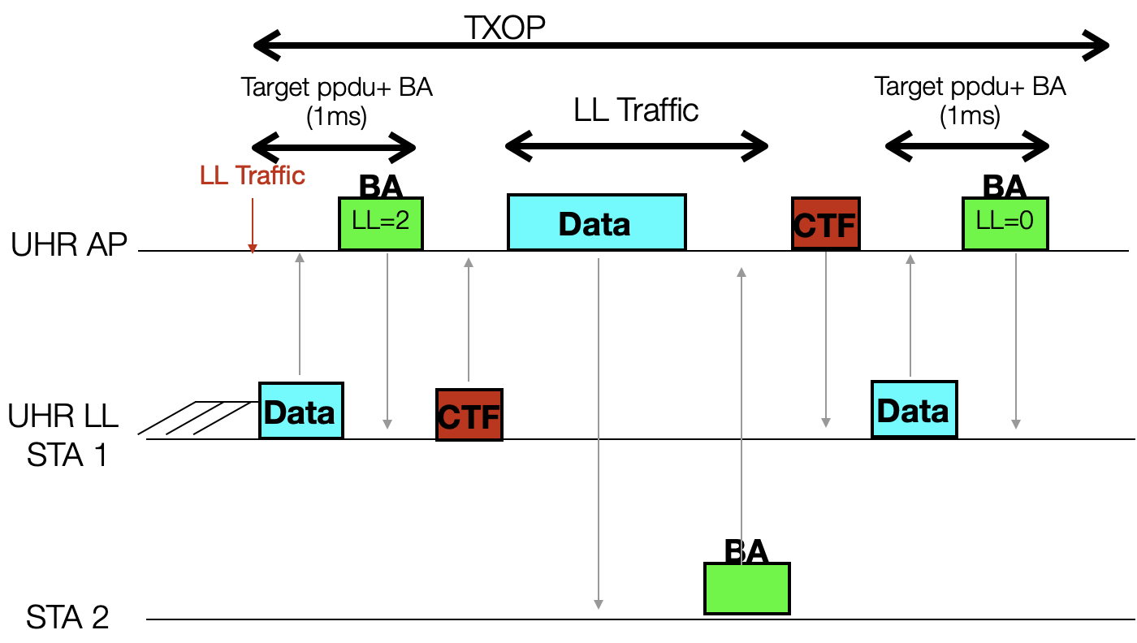
UL Preemption Examples
A UHR with active LL-Session STA bursts UL frames to a UHR AP
AP can send a preemption request in the PPDU response frame to indicate pending LL traffic to the TXOP initiator
STA can share the TXOP with the AP to send its LL traffic to the TXOP initiator
AP can send a preemption request in the PPDU response frame to indicate pending LL traffic to a STA other than the TXOP initiator
STA can share the TXOP with the AP to send its LL traffic to another STA

Slide 12
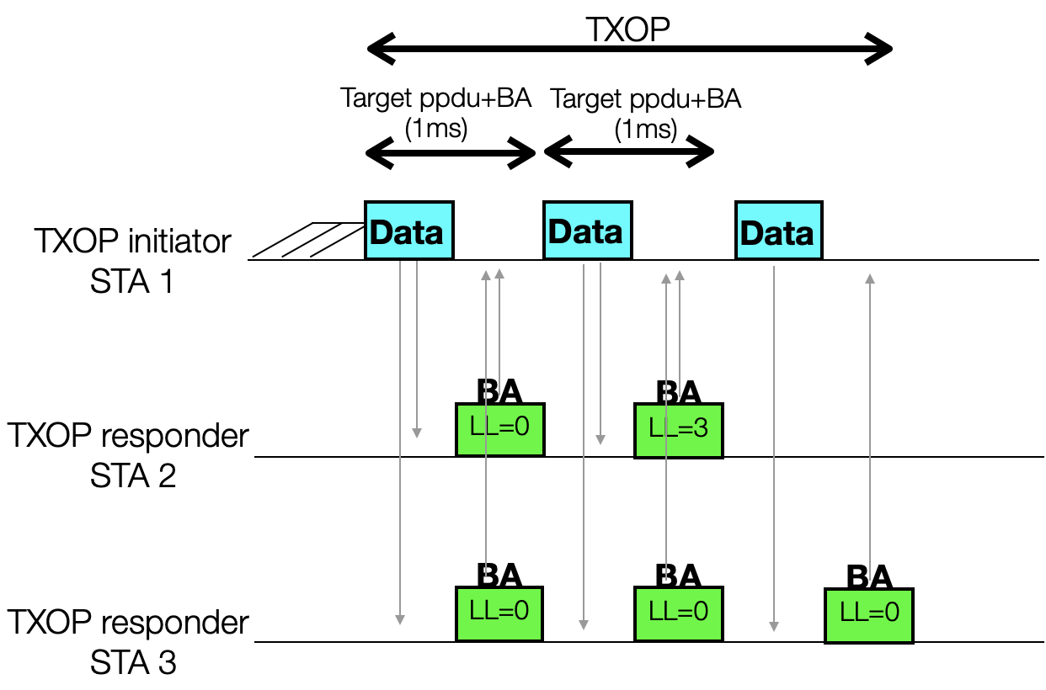
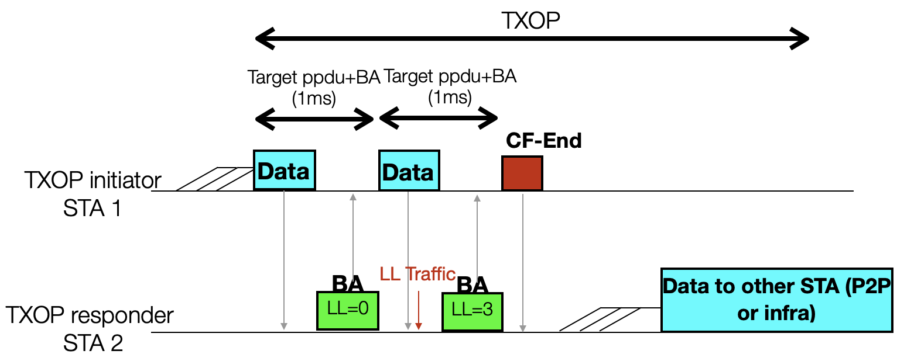
TXOP Disengagement Examples
A UHR STA with active LL-Session can request to disengage from the current TXOP from the TXOP initiator
The TXOP initiator can accept the request and continue the TXOP with other STAs
The TXOP initiator can terminate the current TXOP

Slide 13
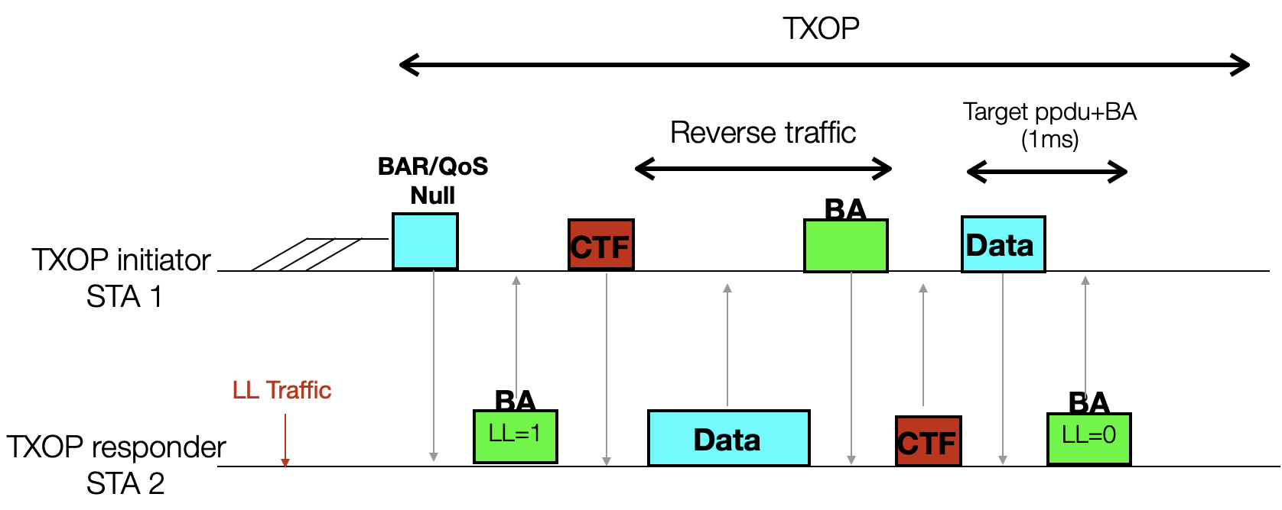
TXOP Preemption at the Beginning of the TXOP
A STA ( AP or non-AP STA) can enable preemption at the beginning of the TXOP by soliciting a BA with Preemption Indication at the beginning of the TXOP
Example:
The STA can send a BAR at the beginning of the TXOP to solicit a BA with LL indication
The STA can send a QoS Null to solicit a BA with LL indication
The STA can decide to continue with the TXOP or share the TXOP with the TXOP responder

Slide 14
Summary
TXOP preemption can be enabled when needed to enable the TXOP initiator and the TXOP responder to preempt on-going TXOPs
The TXOP responder sends preemption request to the TXOP initiator
The TXOP initiator shares the TXOP with the TXOP responder when allowed based on the preemption request

