Slide 1
Low Latency based on L4S

Slide 2
Introduction
11bn PAR includes the reduction of tail latency in its scope of the project[1]
Several contributions about L4S have proposed in the last few months
  [2] shares the concept of congestion control, L4S feature and motiviation of Wi-Fi supporting L4S
  [3] provides simulations of Wi-Fi supporting L4S, which indicates it’s a tradeoff between throughput and latency
    comparing to classic queue, the L4S queue gains better latency performance with sacrificing a little bit throughput
  [4] proposes Dual Queue AQM (for AC_BE and AC_VI) to isolate L4S stream to guarantee its latency requirement
  This contribution proposes to extend ECN signal of L4S to MAC layer for the downlink, regardless of which AQM used(which means specific congestion monitoring and detection are out of scope)
      For classifying L4S MSDU, extension in TCLAS element if supporting SCS, and extension in MA-UNITDATA.request primitive if not supporting SCS
      Relevant congestion notification transmitted between AP and STA, while congestion occurs in MAC queue
      ECN signal in the MA-UNITDATA.indication to report congestion

Slide 3
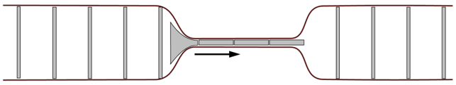
Recap of queuing delay
  Bottleneck of end-to-end QoS includes WLAN links due to the wireless medium condition
  Quite amount of data buffered in the MAC queue leads to high queuing delay
    define the queuing delay(referencing [4]) as the duration from the time MSDU enters the MAC to the time contention starts, which precludes the medium access delay
LLC
data
data
Data packets →
MAC
...
queuing delay
WLAN links
contend medium

Slide 4
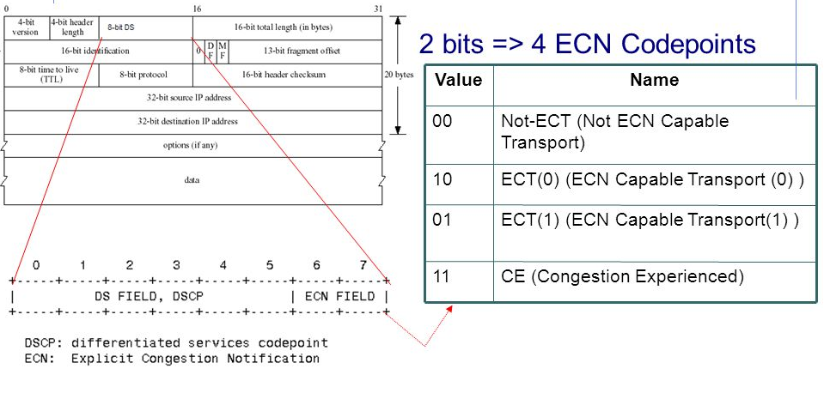
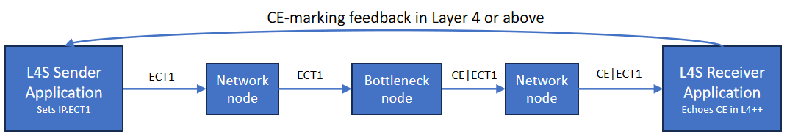
Recap of ECN signal
  L4S uses ECN(explict congestion notification) to report congestion from layer 3 to above layer as shown in the bottom figure(e.g., cloud VR end-to-end transmission)
  Sender transmits IP packet supporting L4S with ECT1
  bottleneck node sets IP packet with CE|ECT1 when congestion occurs
  Receiver gets above IP packet and reports congestion to TCP layer
  Receiver transmits a TCP response with congestion flag in the TCP header
  Sender adjusts its congestion window(i.e., lower sending rate) to mitigate queuing delay

Slide 5
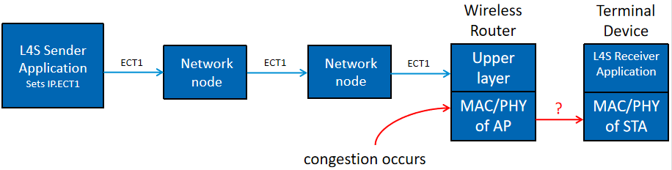
Problem
  For E2E transmission, L4S can provide congestion control signal from layer 3 to layer 4 or above, when congestion happens on layer 3.
  But if congestion(i.e., high queueing delay) occurs on the MAC of AP, L4S can’t detect such congestion and notify the L4S Receiver
  We need a new scheme to report congestion signal from MAC layer to upper layer, as similar as L4S does.

Slide 6
Motivation
L4S has been widely used for low-latency, low-loss, and low-congestion internet services(such as online gaming, cloud service, and real-time application)
  As previous slide shows, L4S supports congestion notification(ECN) reported from layer 3 to layer 4 or above(e.g., from IP layer to TCP layer)
To support L4S, the congestion notification should also be generated and reported to the above layer to finally mitigate the queuing delay, when congestion occurs in the MAC layer
  It more depends on the implementation whether congestion could be reported to layer 3 and it’s allowed to modify the ECN field of the IP header of the relevant MSDU when MSDU still buffered in AP MAC queue.
  In this submission, it’s assumed that congestion notification can only be added in the MAC layer and no modification can be added for the upper layer when the MSDU buffered in the AP MAC queue
  [5] introduces a method to report congestion from layer 2 to layer 4 for 802.1Q(i.e., wired transmission)

Slide 7
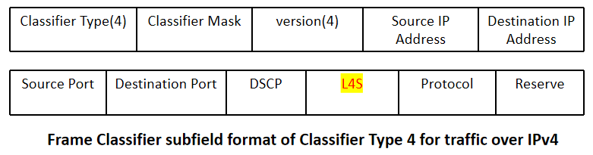
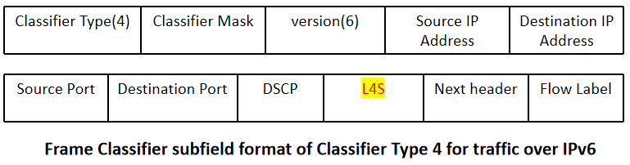
Propsoal 1-classify L4S(ECN capable) traffic
Comparing to non-L4S traffic, L4S one may have different QoS requirement(e.g., delay bound)
  Traffic classification should involve L4S(ECN capable) field in the TCLAS element as shown in the below figure
QoS characteristic element in the EHT SCS procedure may provide some parameters(or even a new queuing delay bound) as references for the AQM to detect whether the congestion happens
  PIE algorithm is based on current delay and target delay to detect if the congestion occurs

Slide 8
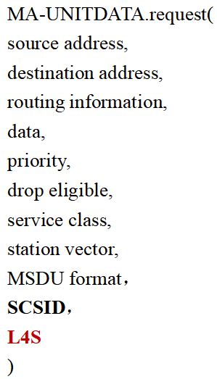
Propsoal 1-classify L4S(ECN capable) traffic (cont’d)
If supporting SCS, the current SCSID of MA_UNITDATA.request primitive can identify the corresponding L4S MSDU
For not supporting SCS, a new L4S(ECN capable) parameter should be added in the MA_UNITDATA.request primitive to indicate the capability of L4S
  When identifying the L4S MSDU, diverse methods can provide assistence for the L4S MSDU(i.e., the dual-Q coupled AQM mentioned in [4] or many MAC features for low latency)

Slide 9
Proposal 2- Congestion Notification in the air
For the downlink, AP should provide congestion notification to the corresponding STA if the congestion occurs in the AP MAC queue(need more consideration on the ECN signal for the uplink)
Option1: action frame
Option2: data frame with congestion flag in the mac header(i.e., QoS field or A-control field)
  bind the congestion notification with each data frame where the encapsulated MSDU(s) suffered congestion when buffered in the AP MAC queue
As the TCP sender may adjust its congestion window based on the amount of TCP response with congestion flag, (Option2)it’s a better way to provide accurate congestion information.

Slide 10
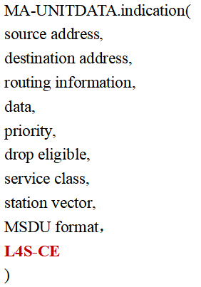
Proposal 3- report congestion signal to LLC
(STA)When an MSDU comes to LLC layer from MAC layer, congestion flag(L4S-CE) should be added in the MA-UNITDATA.indication primitive to report the MSDU was congested in the AP MAC queue
  LLC or above layer will report such congestion notificaiton to IP layer and then it comes to the current L4S standard(may need 802.1Q to support such modification of this primitive)

Slide 11
Illustration
AP
STA
Proposal 1(1)
SCS request[TCLAS(L4S/ECN capable),QoS characteristic]
downlink data packet arrives
SCS response
MU-UNITDATA.request primitive(L4S/ECN capable)
Proposal 1(2)
congestion occurs
Proposal 2
congestion notification
congestion control monitoring and detection(out of scope)
MU-UNITDATA.indication primitive(L4S-CE)
Proposal 3

Slide 12
Summary
Analyze the queuing delay problem in MAC queue and share the L4S ECN feature
(AP)Propose to support for classifying L4S/ECN capable MSDU
  by adding an L4S(ECN capable)field in the TCLAS element(if supporting SCS)
  by adding a new parameter in the MU-UNITDATA.request primitive(if not supporting SCS)
Propose to transmit the congestion notification between AP and STA(assuming no change allowed for layer 3 or above when the MSDU buffered in AP MAC queue)
(STA)Propose to add a parameter in the MU-UNITDATA.indication primitive for reporting congestion from mac layer to LLC layer

Slide 13
THANK YOU ☺

Slide 14
Reference
[1] 802.11bn PAR
[2] 11-23-2065-00-0wng-l4s-and-implications-for-wi-fi
[3] 11-24-0080-01-0arc-l4s-over-wi-fi-links
[4] 11-23-0679-00-0uhr-low-latency-qos-based-on-l4s
[5] 1-23-0034-01-ICne-congestion-signaling-csig

