Slide 1
Low Latency based on L4S

Slide 2
Introduction
11bn PAR includes the reduction of tail latency in its scope of the project[1]
Several contributions about L4S have proposed in the last few months
  [2] shares the concept of congestion control, L4S feature and motiviation of Wi-Fi supporting L4S
  [3] provides simulations of Wi-Fi supporting L4S, which indicates it’s a tradeoff between throughput and latency
    comparing to classic queue, the L4S queue gains better latency performance with sacrificing a little bit throughput
  [4] proposes Dual Queue AQM (for AC_BE and AC_VI) to isolate L4S stream to guarantee its latency requirement
  This contribution proposes to extend ECN signal of L4S to MAC layer, regardless of which AQM used
  TCLAS element to support classification of L4S stream
  L4S-capable parameter in the MA-UNITDATA.request primitive
  Relevant congestion notification frame while congestion occurs in MAC queue
  ECN signal in the MA-UNITDATA.indication

Slide 3
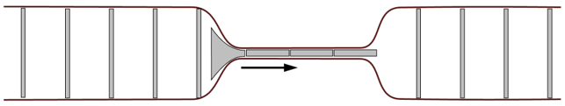
Recap of queuing delay
  Bottleneck of end-to-end QoS includes WLAN links due to the wireless medium condition
  Quite amount of data buffered in the MAC queue leads to high queuing delay
    define the queuing delay as the duration from the time MSDU enters the MAC to the time contention starts, which precludes the medium access delay
LLC
data
data
Data packets →
MAC
...
queuing delay
WLAN links
contend medium

Slide 4
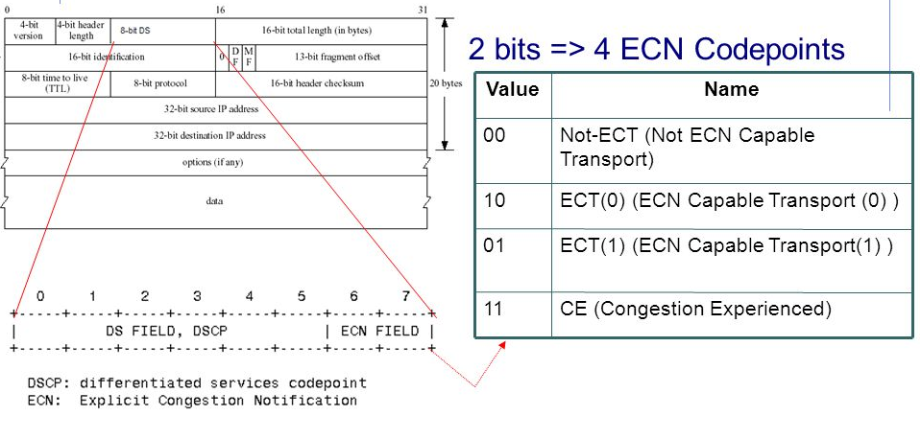
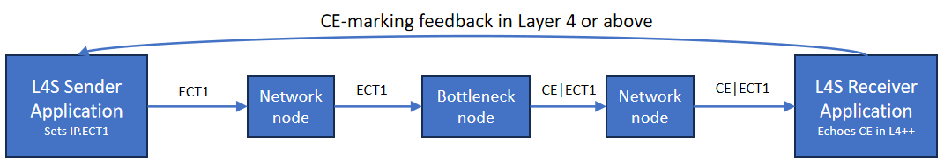
Recap of ECN signal
  L4S uses ECN to report congestion to above layer as shown in the bottom figure
  Sender transmits IP packet supporting L4S with ECT1
  bottleneck node sets IP packet with CE|ECT1 when congestion occurs
  Receiver gets above IP packet and reports congestion to TCP layer
  Receiver transmits a TCP response with congestion flag in the TCP header
  Sender adjusts its congestion window(i.e., lower sending rate) to mitigate queuing delay

Slide 5
Motivation
As previous slide shows, L4S supports congestion notification(ECN) reported from layer 3 to layer 4 or above(e.g., from IP layer to TCP layer)
When congestion occurs in the MAC layer, the congestion notification should also be generated and reported to the above layer to finally mitigate the queuing delay

Slide 6
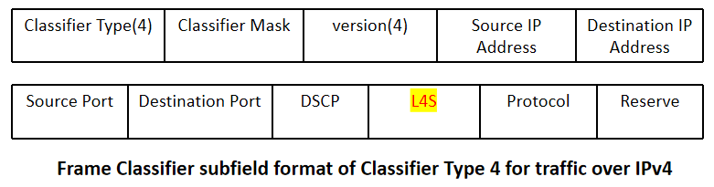
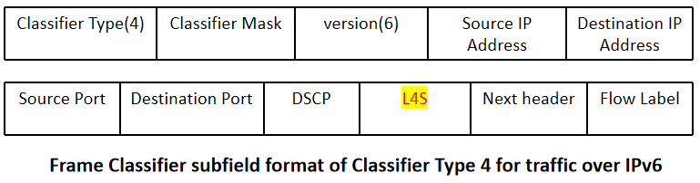
Propsoal 1-classify L4S traffic
Comparing to non-L4S traffic, L4S one may have different QoS requirement(e.g., delay bound)
  Traffic classification should involve L4S field in the TCLAS element as shown in the below figure
QoS characteristic element in the SCS procedure may provide some parameters as references for the AQM to determine whether the congestion happens
  PIE algorithm is based on current delay and target delay to judge if the congestion occurs

Slide 7
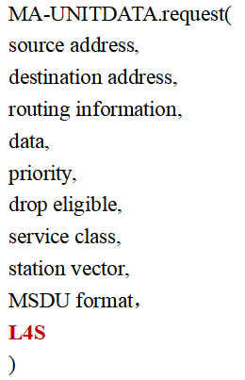
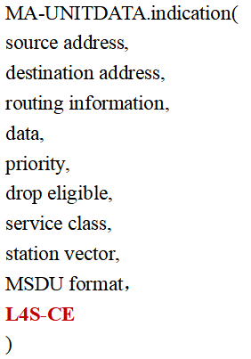
Proposal 2- identify L4S traffic and report congestion signal by primitive
(AP)When a MSDU comes to MAC layer from LLC layer, L4S field should be added in the MA-UNITDATA.request primitive to indicate whether the MSDU supports L4S
  AQM sets congestion notification for the L4S MSDU if congestion happens
(STA)When a MSDU comes to LLC layer from MAC layer, congestion flag(L4S-CE) should be added in the MA-UNITDATA.indication primitive to report the MSDU was congested in the MAC queue
  LLC or above layer will report such congestion notificaiton to IP layer and then it comes to the current L4S standard

Slide 8
Proposal 3- Congestion Notification in the air
For the downlink, AP should provide congestion notification to the corresponding STA if the congestion occurs in the MAC queue(need more consideration for the uplink)
The type how to report the congestion notification is TBD(e.g., a new action frame )

Slide 9
Summary
Analyze the queuing delay problem in MAC queue and share the L4S ECN feature
Propose to add a L4S field in the TCLAS element to support classifying the L4S stream
Propose to add new parameters in the MU-UNITDATA primitive to support L4S capability signal and congestion notification between MAC layer and LLC layer
Propose to transmit the congestion notification between AP and non-AP STA

Slide 10
THANK YOU ☺

Slide 11
Reference
[1] 802.11bn PAR
[2] 11-23-2065-00-0wng-l4s-and-implications-for-wi-fi
[3] 11-24-0080-01-0arc-l4s-over-wi-fi-links
[4] 11-23-0679-00-0uhr-low-latency-qos-based-on-l4s

