Slide 1
NAV protection for C-TDMA
February 2024
Date: 2024-02-27
Authors:
Name | Affiliations | Address | Phone | Email
Si-Chan Noh | Newracom |  |  | sc.noh@newracom.com
Joonsoo Lee |  |  |  | js.lee@newracom.com

Slide 2
Introduction
The C-TDMA operation is discussed in previous contributions by extending the TXS procedure in 11be [1-3]
The proper NAV protection is required to operate C-TDMA [1-4]
  A shared AP’s BSS including legacy STAs to be able to respond downlink and trigger-based uplink transmissions
  A sharing AP to utilize unpredictable returned TXOP
  Fairness issues about neighboring STAs during C-TDMA
This contribution focus on:
  NAV protection considering fairness issues among neighboring STAs
  Return remaining portion of shared AP’s TXOP to a sharing AP

Slide 3
NAV protection considering fairness in C-TDMA
The C-TDMA allow TXOP sharing between M-APs, we can consider fairness issues of neighboring STAs which are not participated in C-TDMA
The NAV protection considering fairness issues of neighboring STAs during C-TDMA procedure can be considered as following :
  Issue 1: STAs hidden to a shared AP cannot utilize the channel
    Due to a control frame(e.g., MU-RTS TXS TF) from a sharing AP to a shared AP, EHT STAs which are not participated in C-TDMA cannot transmit any PPDUs
  Issue 2: If STAs hidden to a shared AP could be offered a chance to utilize the channel, equivalent channel access opportunity could be considered within STAs
    For example, when HE/EHT STA only overhear a control frame(e.g., MU-RTS TXS TF) in C-TDMA, HE STA may reset its NAV but EHT STA should not reset its NAV after the NAVTimeout has expired
One of potential solution for above two fairness issues
  Adjust NAV duration and/or allocate time in a control frame(e.g., MU-RTS TXS TF) when a sharing AP transmit the control frame to a shared AP
    It can allow STAs which are hidden to a shared AP to access channel
    It can allow equal channel access opportunity to neighboring STAs

Slide 4
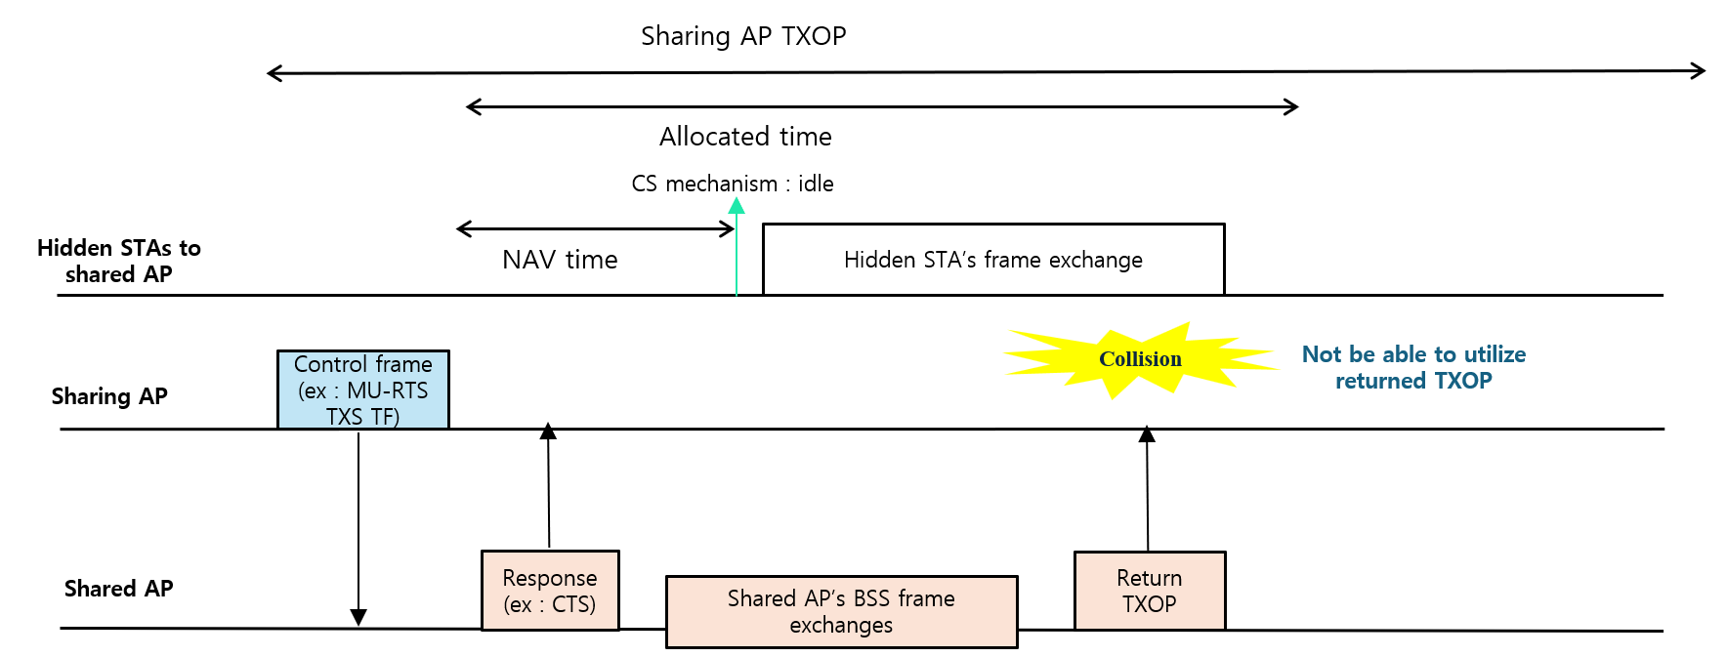
NAV protection considering fairness and return TXOP in C-TDMA
However, contemplating the fairness issues (i.e., previous slide) of STAs which are hidden to a shared AP can affect a sharing AP
  For example, when a shared AP returns the remaining portion of TXOP to a sharing AP
  In this case, the sharing AP may not utilize returned TXOP
    The collision can happen due to the hidden STAs that observe the medium is IDLE after the NAV set duration

Slide 5
NAV protection considering fairness and return TXOP in C-TDMA
To provide opportunity to access the channel for neighboring STAs and to allow a sharing AP to utilize returned remaining portion of TXOP from a shared AP, we can consider the following potential solution
Potential solution :
  Fairness aspect
    Set the duration of a control frame (e.g., MU-RTS TXS TF) not to cover all allocate time
      To offer neighboring STAs including legacy ones which are hidden to a shared AP to contend channel
  Allow the sharing AP to utilize returned TXOP
    The shared AP grants an opportunity to the sharing AP several times
      It can include an indication of returning TXOP (e.g., preemption enabled (PR) indication) to the sharing AP during its BSS frame exchanges before the end of allocated time
      The sharing AP can send frame (e.g., preemption traffic indication (PRI)) to the shared AP before resume its frame exchanges or resumes its frame exchanges without sending frame
      When the shared AP overhears the sharing AP’s frame exchanges or receive frame (e.g., PRI) , it may know that the sharing AP will resume its frame exchanges and terminate TXOP

Slide 6
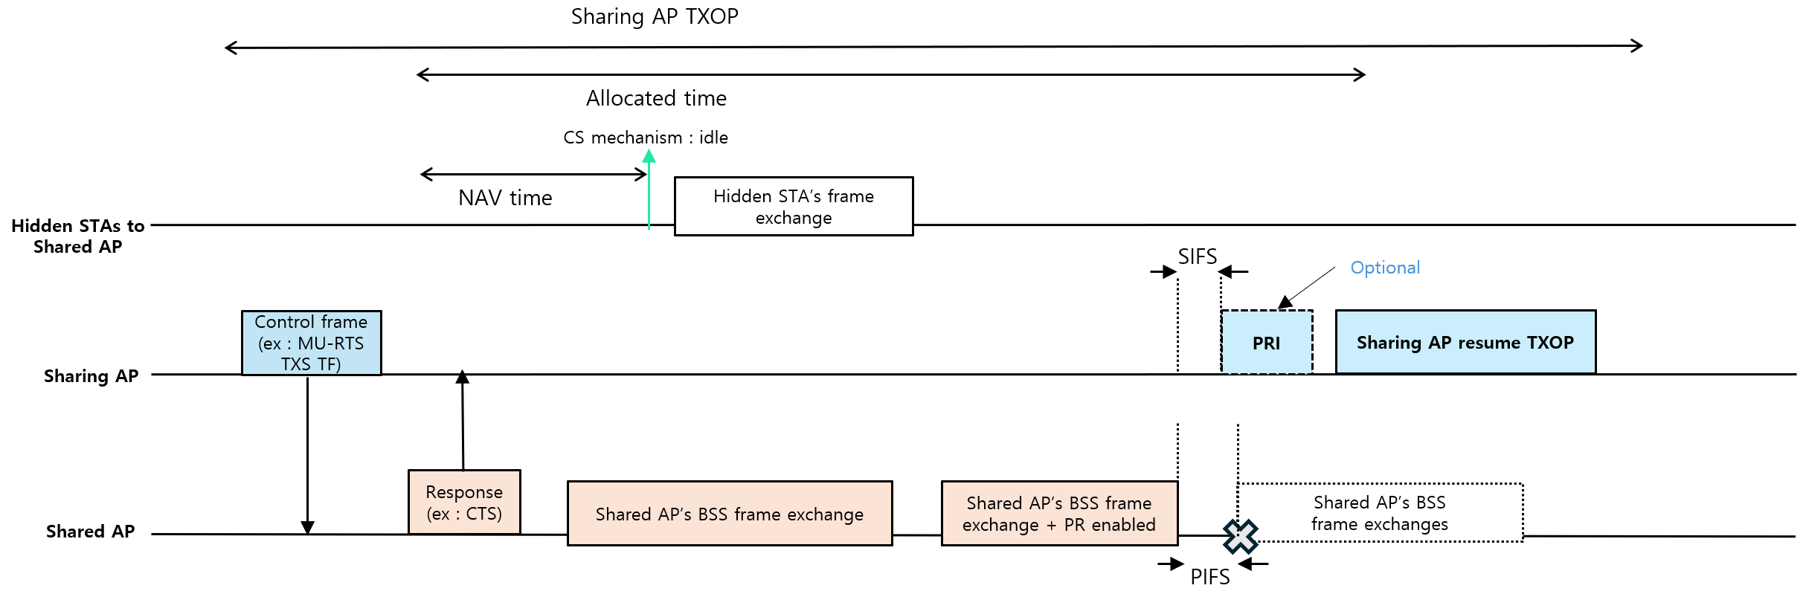
Example of fairness and return TXOP in C-TDMA
Scenario :
  Hidden STAs
    It can access the channel after NAV set duration
  Shared AP
    It can start including indication of returning TXOP during frame exchanges to support last buffered latency sensitive traffic
    It may have more buffered traffics after transmitting last buffered latency sensitive traffic
    It can include indication of returning TXOP several times while frame exchanges for buffered traffics until the sharing AP utilize the returned TXOP
    It can resume its frame exchange in a row if the sharing do not resume TXOP
  Sharing AP
    It can transmit frame (e.g., PRI) optionally before resume its TXOP when it receive indication of returning TXOP
    It can abort TXOP if it cannot recognize the returned TXOP within allocated time

Slide 7
Summary
In this contribution, we presented the NAV protection considering fairness among neighboring STAs
Moreover, we also presented how to return remaining portion of the shared AP’s TXOP with considering fairness issues

Slide 8
Reference
[1] 24/1895r2, C-TDMA frame sequence
[2] 24/0093r1, NAV setting for Coordinated TDMA
[3] 23/1910r1, Coordinated TDMA Procedure
[4] 23/1846r1, Protection of Extended TXOP Sharing

