Slide 1
Enhanced Fast BSS Transition
January 2024
Date: 2024-01-27
Authors:
Notes:
September 2012

Slide 2
Introduction
January 2024
Several contributions [1-2] has discussed the context transfer to enable the data continuity when a non-AP MLD is roamed from the current AP MLD to the target AP MLD.
The fast BSS transition (FT) protocol is a widely implemented roaming protocol, which relies on the concept of “Make before break”.
We also think the FT protocol should be improved by enabling the context transfer to improve the roaming performance between AP MLDs, including between roaming AP MLDs.
In this contribution, we will discuss candidate improvements for the current FT protocol and provide the comparison between the proposed enhanced FT and the roaming AP MLD method with the context transfer.

Slide 3
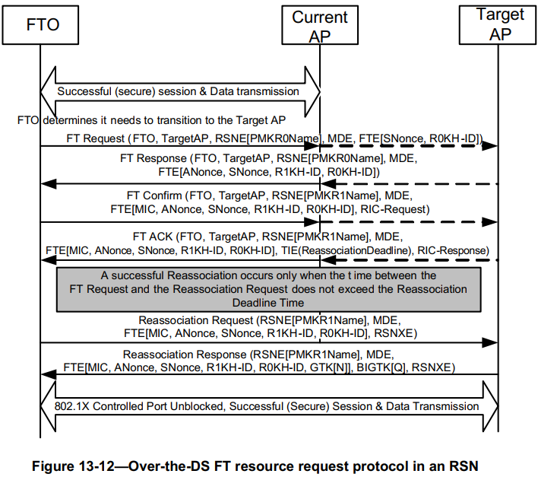
Recap Fast BSS transition [3]
January 2024
Make before break
  Upon a successful reassociation, the PTKSA has been established and proven live. The SME of the AP shall open the IEEE 802.1X Controlled Port. The FTO shall transition to State 4 (as defined in 11.3 (STA authentication and association)). If the target AP is distinct from the previous AP, the FTO shall enter State 1 with respect to the previous AP.
  Upon a successful reassociation, the FTO shall delete any corresponding PTKSA with its previous AP. The SME of the FTO shall issue an MLME-DELETEKEYS.request primitive to delete the pairwise keys with the previous AP, and the FTO and the AP shall issue an MLME-SETKEYS.request primitive and MLMESETPROTECTION.request primitive to install the pairwise keys.
Before successful reassociation with the target AP MLD, the non-AP MLD still can exchange data with the current AP.

Slide 4
Summary of candidate improvements
January 2024
Improvement 1. Enable the context transfer and the data forwarding to avoid the packet loss resulting from flushing the Tx/Rx buffer
  Achieve zero packet loss
Improvement 2. Enable the over-the-DS probing nearby APs
  which can avoid the transmission rate drop resulting from the off-channel scanning
  This is very beneficial to the EMLSR non-AP MLD which only has one link for the data Tx/Rx.

Slide 5
Enhanced FT procedure
January 2024
Specifically, define FT Probe Request/Response frames
  The non-AP MLD exchanges FT Probe Request/Response frames with the current AP MLD to get info on nearby AP MLDs
  Thus the non-AP MLD doesn’t need to switch the channel to probe nearby APs.
And define Context Transfer Request/Response to enable the context transfer.
Non-AP
MLD
Current
AP MLD
Target
AP MLD
DS
DS
FT Probe Request
Current AP MLD
Target AP MLD
FT Probe Response
AP 1
AP 2
AP 1
AP 2
FT Request
FT Response
The non-AP MLD monitors RSSIs received from current AP MLD and target AP MLD respectively and select a propriate roaming point.
Reassociation Request
Context Transfer Request
STA 1
STA 2
Context Transfer Response
Reassociation Response
DS-STA-NOTIFY.Request
(MOVE)
Non-AP MLD

Slide 6
Discussions (1/3)
January 2024
Based on the above enhanced FT procedure, we can see the above Reassociation Request/Response frames can achieve multiple functions which is very time-consuming, e.g.
  Multi-link setup
  Trigger the context transfer
  Unblock the IEEE 802.1X Controlled Port and invoke the reassociation service to update the DS mapping if the reassociation is successful [3]
  …
This may cause the non-AP MLD too hard to estimate the completion time of receiving the Reassociation Response frame and select a propriate roaming point.

Slide 7
Discussions (2/3)
January 2024
Based on the above analysis, another possible improvement is to define new frames to respectively realize the multi-link setup and trigger the context transfer (including the reassociation service). For example
  Define FT Multi-link Setup Request/Response frames to realize the link setup
  Define Roaming Request/Response frames to invoke the reassociation service
Non-AP MLD
Current AP MLD
Target AP MLD
DS
FT Probe Request
FT Probe Response
FT Request
FT Response
The non-AP MLD monitors RSSIs received from current AP MLD and target AP MLD respectively and select a propriate roaming point.
FT Multi-link Setup Request
FT Multi-link Setup Response
Roaming Request
Context Transfer Request
Context Transfer Response
Roaming Response
DS-STA-NOTIFY.Request
(MOVE)

Slide 8
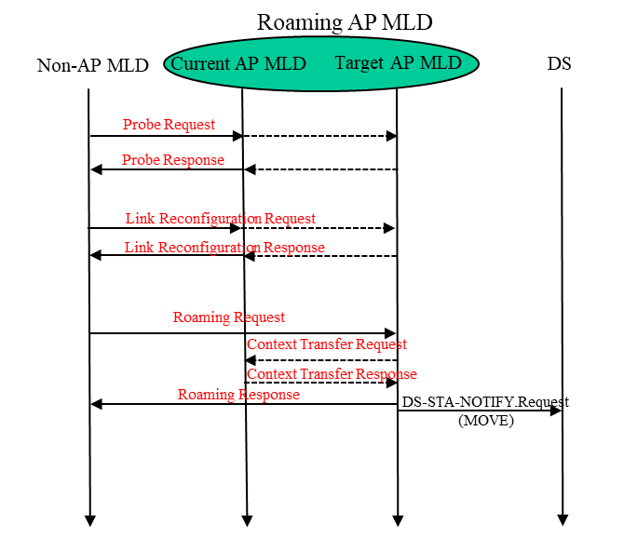
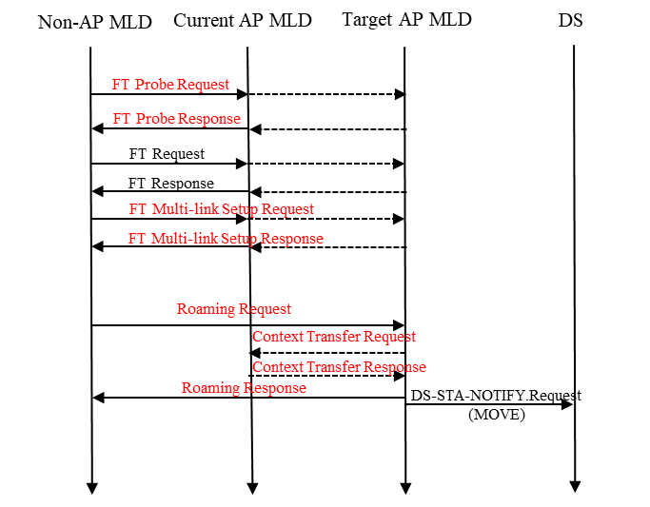
Discussions (3/3)
January 2024
Comparison between enhanced FT and the roaming AP MLD with the context transfer (including the PTKSA). [1]
  We can see the extra negotiation of a new PTKSA will not cause the data connection interruption with the current AP MLD and degrade the roaming performance if the FT protocol is used.
  The proposed enhanced FT method can provide almost the same roaming performance compared with the roaming AP MLD with the context transfer. Then why would we take a risk to allow the PTKSA can be shared among AP MLDs?
  The only advantage of the roaming AP MLD method is the potential support of multiple serving AP MLDs.
Fig. Enhanced FT procedure
Fig. Candidate roaming procedure under roaming AP MLD

Slide 9
Conclusions
January 2024
We have discussed candidate improvements for the FT protocol
  Enable the context transfer and the data forwarding
  Enable probing the target AP MLD over the DS via the current AP
  Enable the over-the-DS multi-link setup and define a new frame to invoke the reassociation service
We also have compared the proposed enhanced FT method with the roaming AP MLD method with the context transfer
  The proposed enhanced FT method can provide almost the same roaming performance compared to the roaming AP MLD method with the context transfer
  So it seems even the roaming AP MLD with the context transfer (including the PTKSA) is allowed from the security point of view, it is not necessary to go this way.

Slide 10
References
[1] 11-23-1996-00-00bn-improve-roaming-between-mlds
[2] 11-23-1897-00-00bn-thoughts-on-improving-roaming-under-existing-architecture
[3] IEEE Draft P802.11REVme_D5.0

Slide 11
Appendix A
There is any precedent to share PTK among APs or AP MLDs even for other standard organizations.
  Example 1. CAPWAP (Control and Provisioning of Wireless Access Points)
    To centralize the authentication and policy enforcement functions for a wireless network. The AC (Access Controller) may also provide centralized bridging, forwarding, and encryption of user traffic. Centralization of these functions will enable reduced cost and higher efficiency by applying the capabilities of network processing silicon to the wireless network, as in wired LANs.
    The CAPWAP protocol supports two modes of operation: Split and Local MAC. In Split MAC mode, all L2 wireless data and management frames are encapsulated via the CAPWAP protocol and exchanged between the AC and the WTP (Wireless Termination Point, e.g. AP).

Slide 12
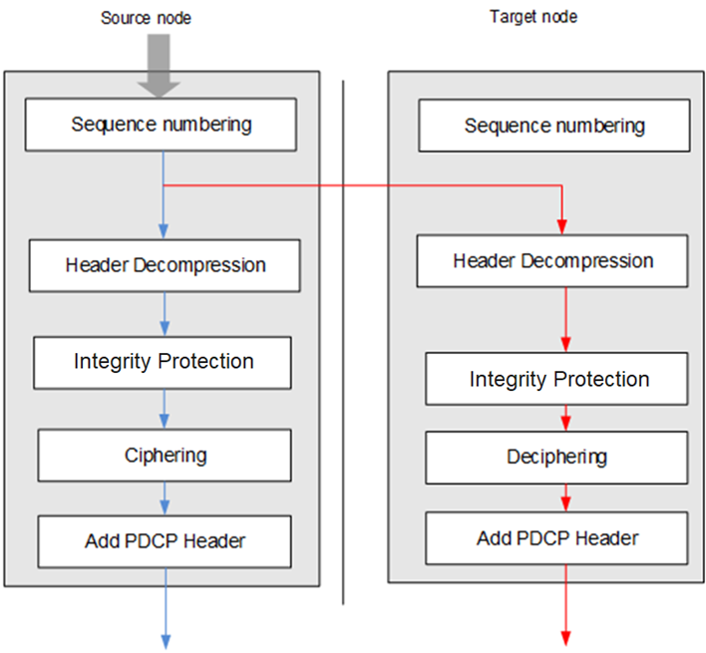
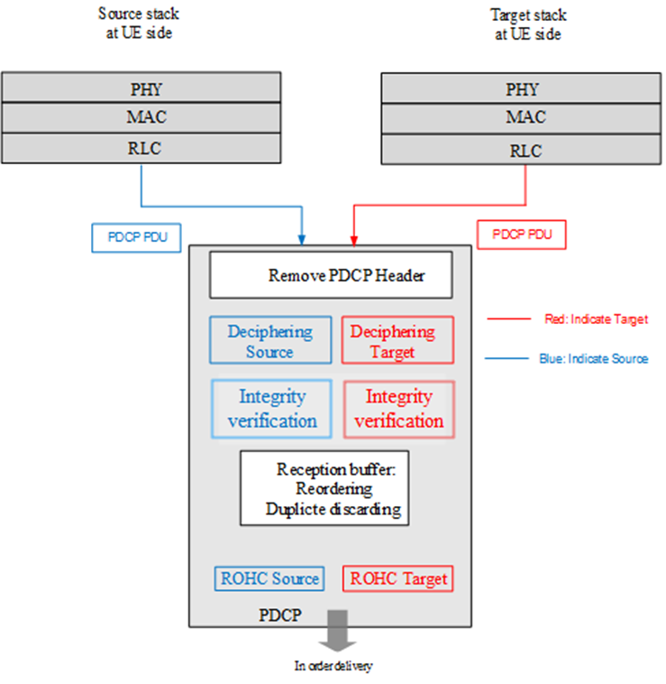
Appendix A (Cont.)
There is any precedent to share PTK among APs or AP MLDs even for other standard organizations.
  Example 2. DAPS (Dual Active Protocol Stack)
    Which allows a UE simultaneously exchange data with two source gNB and target gNB with different ciphering during the roaming period.

Slide 13
Appendix B Definition of (re)association
(Re)association is one important of terms in IEEE 802.11 protocols.
We have the following descriptions on (re)association in REV D5.0 [3]
  Association is one of the services in the DSS.
  For a non-GLK STA, the act of becoming associated invokes the association service, which provides the STA to AP mapping to the DS.
  The reassociation service is invoked to “move” a current association of a non-AP STA from one AP to another. In an ESS, the reassociation service informs the DS of the current mapping between AP and STA as the STA moves from BSS to BSS within the ESS.
  A single IEEE 802.1X Port maps to one association, and each association maps to an IEEE 802.1X Port.
  Each association between a pair of STAs creates a unique pair of IEEE 802.1X Ports, and authentication takes place relative to those ports alone.
  Only the fast BSS transition facility can move an RSNA during reassociation. Therefore, if FT is not used, the old RSNA is deleted and a new RSNA is constructed.
The word ‘(re)association’ should be carefully used especially when we discuss the roaming AP MLD architecture.

Slide 14
Straw Poll 0
January 2024
Do you support to improve the current fast BSS transition protocol in 11bn?
  Yes:
  No:
  Abstain:

Slide 15
Straw Poll 1
January 2024
Do you support to define the context transfer and the data forwarding for the FT protocol in 11bn?
  Details of the context transfer and the data forwarding are TBD.
  Yes:
  No:
  Abstain:

Slide 16
Straw Poll 2
January 2024
Do you support to define in 11bn that a non-AP MLD probes the target AP MLD over the DS via the current AP MLD?
  Yes:
  No:
  Abstain:

Slide 17
Straw Poll 3
January 2024
Do you support to define in 11bn that a non-AP MLD sets up one or more links with target AP MLD over the DS via the current AP MLD?
  Yes:
  No:
  Abstain:

