Slide 1
Initial control frame for bandwidth-switching modes
Date: 2024-02-15
Authors:

Slide 2
Abstract
This document compares MU-RTS and BSRP trigger frames as candidates for the initial control frame for bandwidth-switching operating modes such as: Dynamic sub-band operation (DSO) and Single-link Enhanced Multi-link Single Radio (EMLSR) operation.

Slide 3
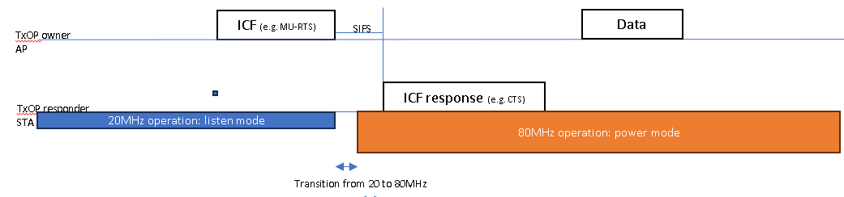
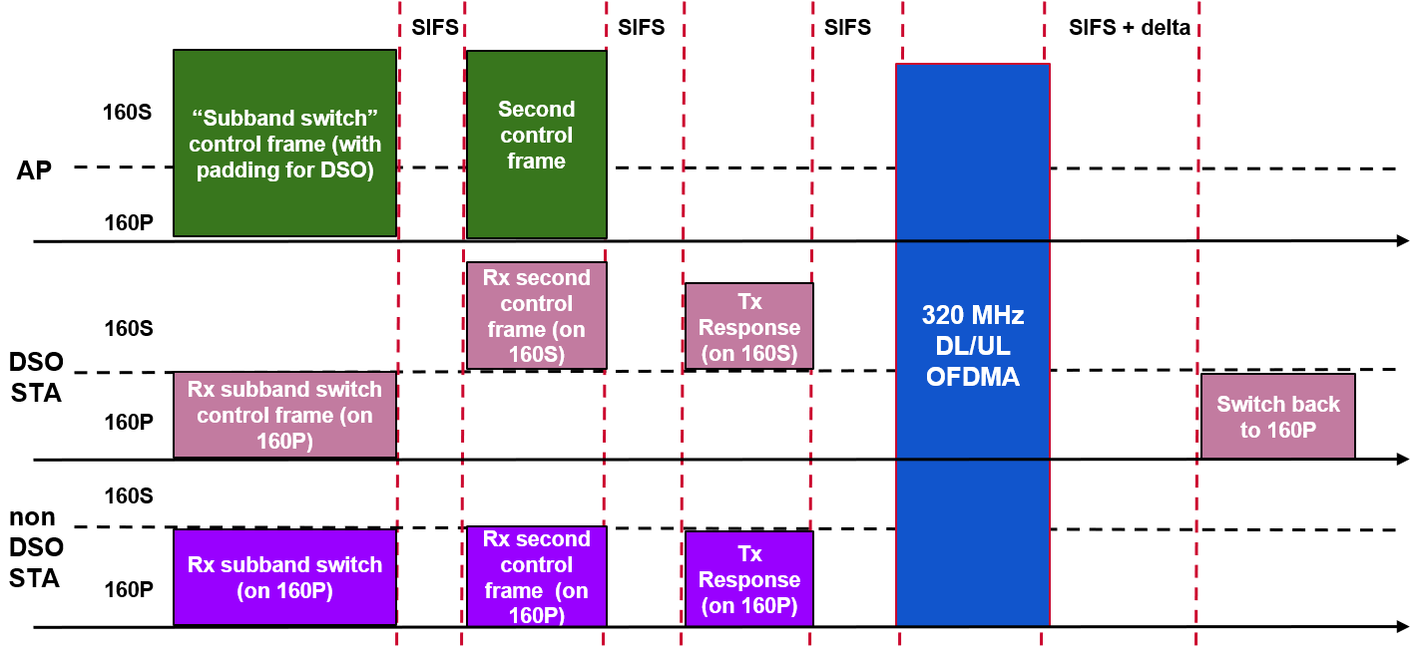
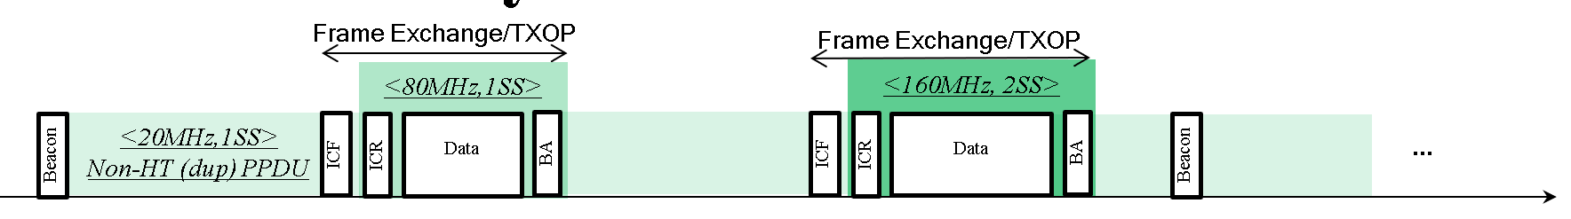
Bandwidth-switching modes in UHR
Several bandwidth-switching operating modes have been proposed in UHR that can help save power or improve transmission efficiency of a non-AP or AP STA:
  Dynamic Sub-band Operation [1]
  Single-link EMLSR Operation [2]
  Dynamic Power Saving [3]
All these operating modes involve a STA changing its bandwidth capabilities or the operating channel upon receiving an initial control frame (ICF) from another STA.
The switch in capablity may take some time, and the ICF is expected to keep the medium occupied while the switch takes place.

Slide 4
Desirable features of the ICF
The ICF should be backward compatible.
  Same ICF should be used for simultaneously allocating resources to legacy (11ax+) devices and the bandwidth switching devices. Trigger frames are a good option for this mechanism (MU-RTS/BSRP etc.).
  Other trigger frames or new variants of trigger frames may not meet this requirement.
The ICF should be decodable on 20MHz bandwidth but able to occupy a wider bandwidth.
  The ICF can be transmitted in non-HT duplicate PPDU format. Alternatively a new UHR PPDU format can be defined for duplicate transmission while allowing newer features, e.g., aggregation.
The ICF should be resource efficient.
  Prior work [4] introduced the idea of pre-allocation of resources, which can reduce the required padding.
The ICF should have sufficient reserved fields for enabling new features specific for these bandwidth-switching modes.
The response frame to the ICF (if applicable) should be easily decodable at the TXOP owner and meet transmit requirements.
The response frame to the ICF should require minimum changes to work, and be able to carry additional information. [Optional]
TXOP
ICF for STA1-6
Serve STA1-2
Serve
STA3-4
Serve
STA5-6
Resp. from STA1-2

Slide 5
Overview of presentation
This talk shall focus on points 4, 5 and 6 from the previous slide.
We shall compare the following options for the ICF:
  The MU-RTS trigger frame.
  The BSRP trigger frame.
Some of the presented aspects may also be relevant to other trigger frames or new variants of trigger frames to be used as ICFs.

Slide 6
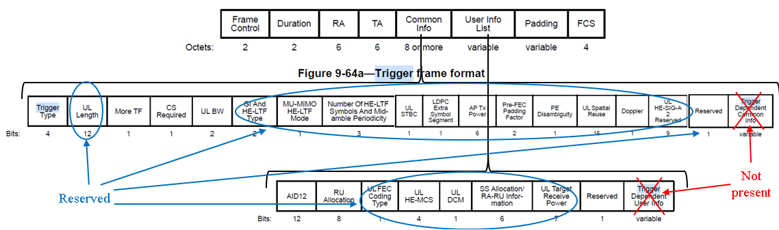
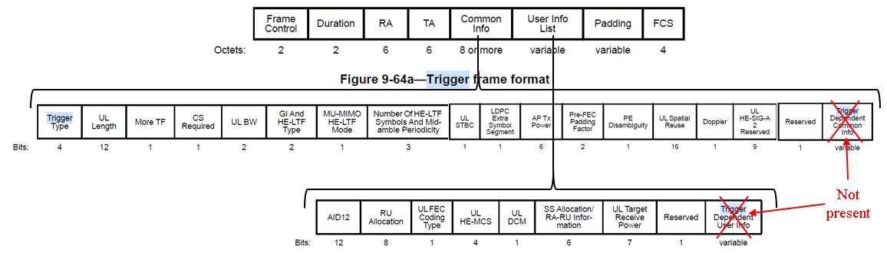
Number of reserved fields (point 4)
An MU-RTS frame has 56 reserved bits in the Common Info field and 13 reserved bits in the User Info field. Trigger-dependent fields are not present.
A BSRP frame has no reserved fields in the Common Info field or the User Info field. Trigger-dependent fields are not present.
  To enable new indications, the format of the User Info field in BSRP may need to be re-defined for the case that the AID12 addresses a STA in bandwidth-switching operating mode. This increases complexity.
Conclusion: MU-RTS is more suitable in terms of available reserved fields.

Slide 7
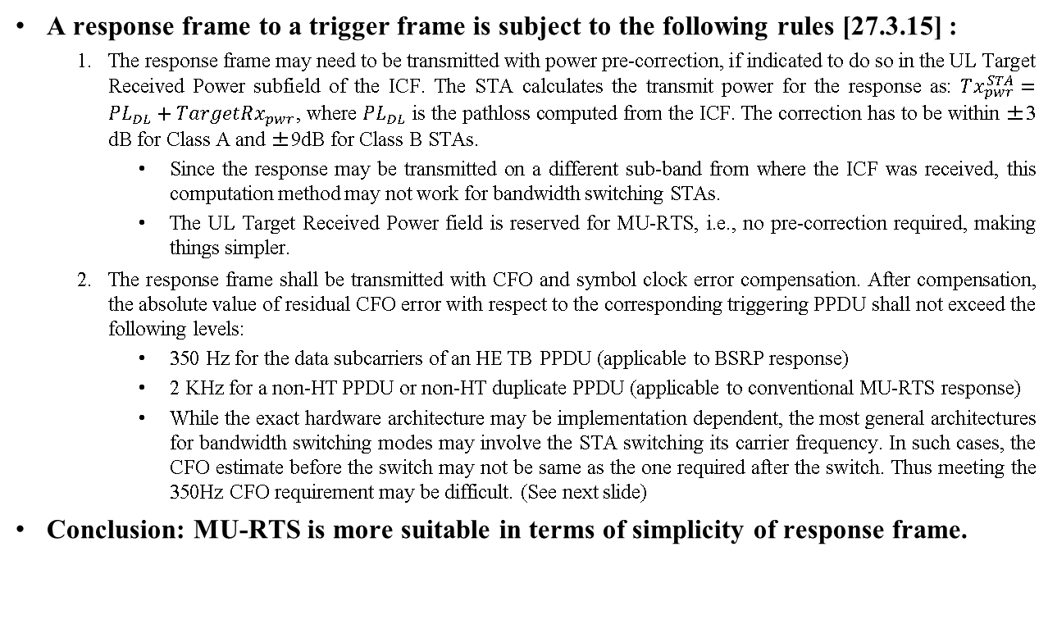
Requirements on response frame (point 5)
A response frame to a trigger frame is subject to the following rules [27.3.15] :
  The response frame may need to be transmitted with power pre-correction, if indicated to do so in the UL Target Received Power subfield of the ICF. The STA calculates the transmit power for the response as: $Tx_{pwr}^{STA}=PL_{DL}+TargetRx_{pwr}$, where $PL_{DL}$ is the pathloss computed from the ICF. The correction has to be within ±3 dB for Class A and ±9dB for Class B STAs.
    Since the response may be transmitted on a different sub-band from where the ICF was received, this computation method may not work for bandwidth switching STAs.
    The UL Target Received Power field is reserved for MU-RTS, i.e., no pre-correction required, making things simpler.
  The response frame shall be transmitted with CFO and symbol clock error compensation. After compensation, the absolute value of residual CFO error with respect to the corresponding triggering PPDU shall not exceed the following levels:
    350 Hz for the data subcarriers of an HE TB PPDU (applicable to BSRP response)
    2 KHz for a non-HT PPDU or non-HT duplicate PPDU (applicable to conventional MU-RTS response)
    While the exact hardware architecture may be implementation dependent, the most general architectures for bandwidth switching modes may involve the STA switching its carrier frequency. In such cases, the CFO estimate before the switch may not be same as the one required after the switch. Thus meeting the 350Hz CFO requirement may be difficult. (See next slide)
Conclusion: MU-RTS is more suitable in terms of simplicity of response frame.

Slide 8
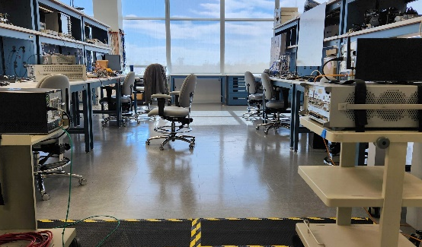
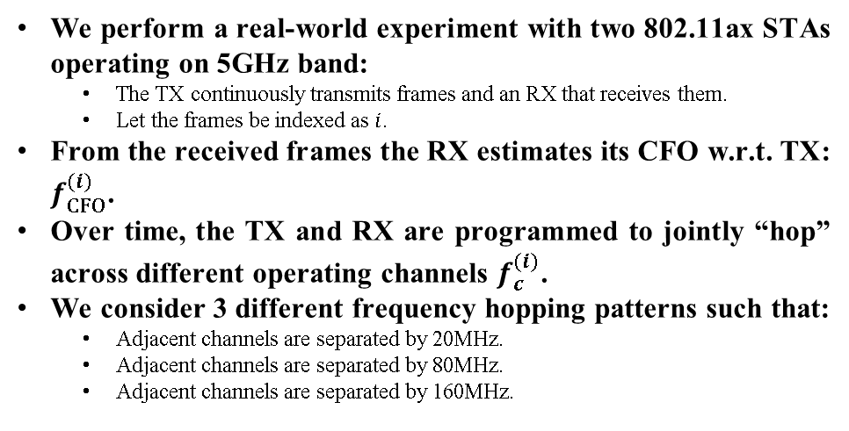
Experiment: CFO vs channel switch
We perform a real-world experiment with two 802.11ax STAs operating on 5GHz band:
  The TX continuously transmits frames and an RX that receives them.
  Let the frames be indexed as $i$.
From the received frames the RX estimates its CFO w.r.t. TX: $f_{CFO}^{(i)}$.
Over time, the TX and RX are programmed to jointly “hop” across different operating channels $f_{c}^{(i)}$.
We consider 3 different frequency hopping patterns such that:
  Adjacent channels are separated by 20MHz.
  Adjacent channels are separated by 80MHz.
  Adjacent channels are separated by 160MHz.
TX
RX
Experimental setup
Adjacent hops = 20MHz
Adjacent hops =±80MHz
Adjacent hops =±160MHz

Slide 9

Experiment: CFO vs channel switch contd.
To study how much the CFO between devices change when one or both devices perform a channel switch we plot a scatter plot of:
$$f_{CFO}^{(i)} −f_{CFO}^{\left(i−1\right)} versus. f_{c}^{(i)}−f_{c}^{\left(i−1\right)} if \left|f_{c}^{(i)}−f_{c}^{(i−1)}\right|≠0$$
As we observe from the results, when the channel switch is for 80MHz or more, the change in CFO can be larger than 350Hz.
Can these CFO changes be predicted and/or calibrated out?
  We also observe that the spread in the scatter plot of $f_{CFO}^{(i)} −f_{CFO}^{\left(i−1\right)}$ for $f_{c}^{(i)}−f_{c}^{\left(i−1\right)}=160$ MHz is more than 350Hz, suggesting that a separate calibration may be required for each start and end channel frequency.
  We anticipate that the CFO change may be time variant and can be hard to calibrate out at least in some implementations.
Adjacent hops = 20MHz
Adjacent hops =±80MHz
Adjacent hops =±160MHz
1000Hz
230Hz
300Hz
500Hz
320Hz
420Hz

Slide 10
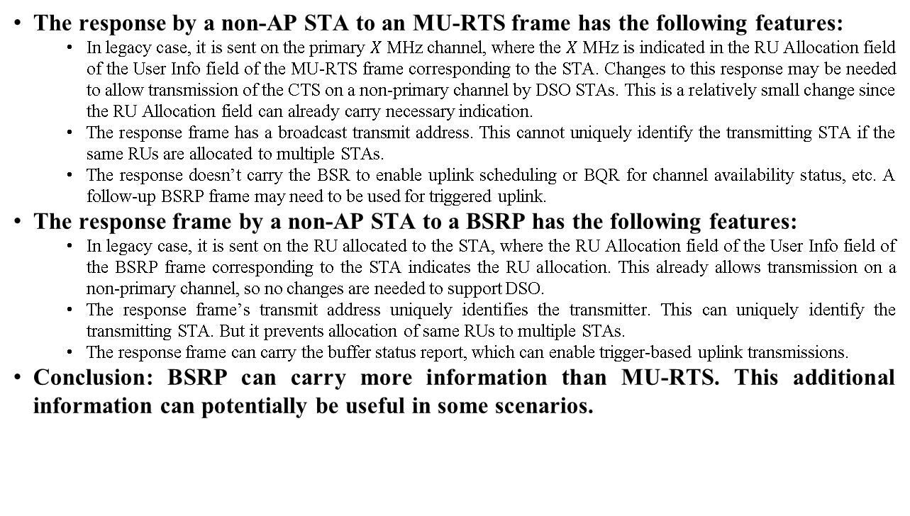
Response frame changes/information (point 6)
The response by a non-AP STA to an MU-RTS frame has the following features:
  In legacy case, it is sent on the primary $X$ MHz channel, where the $X$ MHz is indicated in the RU Allocation field of the User Info field of the MU-RTS frame corresponding to the STA. Changes to this response may be needed to allow transmission of the CTS on a non-primary channel by DSO STAs. This is a relatively small change since the RU Allocation field can already carry necessary indication.
  The response frame has a broadcast transmit address. This cannot uniquely identify the transmitting STA if the same RUs are allocated to multiple STAs.
  The response doesn’t carry the BSR to enable uplink scheduling or BQR for channel availability status, etc. A follow-up BSRP frame may need to be used for triggered uplink.
The response frame by a non-AP STA to a BSRP has the following features:
  In legacy case, it is sent on the RU allocated to the STA, where the RU Allocation field of the User Info field of the BSRP frame corresponding to the STA indicates the RU allocation. This already allows transmission on a non-primary channel, so no changes are needed to support DSO.
  The response frame’s transmit address uniquely identifies the transmitter. This can uniquely identify the transmitting STA. But it prevents allocation of same RUs to multiple STAs.
  The response frame can carry the buffer status report, which can enable trigger-based uplink transmissions.
Conclusion: BSRP can carry more information than MU-RTS. This additional information can potentially be useful in some scenarios.

Slide 11
Conclusions
Overall MU-RTS frame seems to be more suitable than BSRP for the ICF role for bandwidth switching STAs.
  But BSRP still has some advantages (like additional information), so its use as ICF shouldn’t be ruled out.
If MU-RTS is considered as an ICF, minor changes needed to allow the CTS to be sent on a non-primary channel by one or more addressed STAs.
If BSRP is considered an ICF for bandwidth switching STAs, we need to consider several aspects:
  Can all implementations of bandwidth switching STAs respond to BSRP ICF while meeting the trigger response requirements? Do we need a capability indication?
  Should the trigger response requirements be lowered for a response sent by a bandwidth switching STA to a BSRP ICF? This may require limiting the MCS or minimum RU size of the response frame.
  Need additional mechanisms to determine the transmit power for the response frame sent by a bandwidth switching STA to a BSRP ICF.
If we use other trigger frame variants for the ICF, some of the above aspects may still need to be addressed.

Slide 12
References
11-22-2204-00-0uhr-dynamic-subband-operation
11-23-2003-01-00bn-client-power-save
11-23-1965-02-00bn-dynamic-power-save-follow-up
11-23-2027-02-00bn-considerations-for-dso-sub-band-switch-delay

Slide 13
Backup slides

Slide 14
Straw polls
SP1: Do you agree to include MU-RTS trigger frame as an initial control frame for Dynamic Sub-band Operation?
  Yes
  No
  Abstain
SP2: Do you agree to include MU-RTS trigger frame as an initial control frame for single-link EMLSR operation?
  Yes
  No
  Abstain

Slide 15
An alternative solution to consider ...
The ICF used to trigger DSO STAs and/or single-link EMLSR STAs can be a new Action No ACK frame or a No ACK trigger frame, that does not solicit a response.
  The frame can be sent in non-HT duplicate PPDU format.
  The frame can carry sufficient padding to allow all addressed STAs to perform the switch.
The operation for the rest of the TXOP is left to implementation. For example:
  The AP may directly start transmitting in DL to the addressed STAs after SIFS gap.
  The AP may use a follow-up control frame, e.g., MU-RTS, BSRP, BQRP to determine the availability of the STA and obtain other information.
Similar idea was also proposed in [1].
Pros:
  This resolves the issues on transmit requirements (point 5), and can have new fields (point 4).
  It is a simple solution with minimal changes.
Cons:
  It does not solicit any feedback information directly from the STAs (point 6).
  The new frame cannot be used to address legacy devices including 11be EMLSR STAs. So additional ICF with appropriate padding may need to be provided if 11be EMLSR STAs are also served within the same TXOP (point 1).

