Slide 1
Ultra-reliable PHY elements: Low latency, low collision, low power medium access
Date: 2024-02-09
r0 (February 9, 2024): Initial version

Slide 2
Abstract
UHR has many goals and themes; lower latency; higher throughput for some SINRs; reduced packet loss; improved energy efficiency [1].
Ideally, all these objectives should be addressable by common methods. It is therefore useful to investigate optimized universal building blocks.
For all the UHR themes above, it is useful to add methods for STAs:
to access the medium efficiently (quickly, and without collisions),
outside the scope of pre-scheduled agreements, and
to complete transmissions reliably (low or no loss due to interferers),
even at greatly reduced transmit power levels.
This presentation approaches this design problem from the PHY viewpoint.
It is possible to design optimized and universal building blocks that achieve all the above goals, even when many devices cannot hear some or even most transmissions.

Slide 3
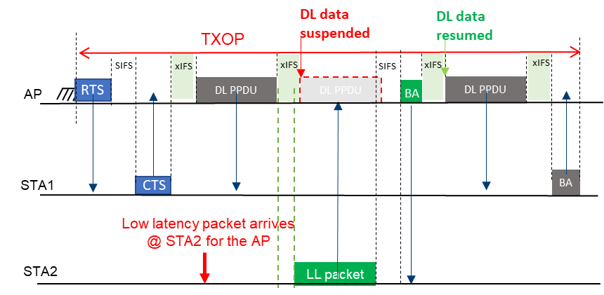
Preemption—PHY signaling properties—I
To derive common methods, we can start with any UHR interest area, and derive detailed requirements, then reuse and apply to other interest areas
For example, preemption is a promising method to reduce tail latency that has been extensively discussed in UHR [2-8]. (For now, consider within-TxOP preemption only.)
Long TxOP currently has lowest overhead, but causes latency for other traffic
Preemption solution is to allow interrupts and suspension of the TxOP
From 11-23/1229r1, “Preemption for Low Latency Application (follow up)”, J. Fang et al. (slide 3)

Slide 4
Preemption—PHY signaling properties—II
There will often / usually be no interrupt, so xIFS represents overhead
xIFS should be as short as possible
There could be multiple STAs that attempt to access an xIFS
Must avoid or manage colliding attempts, including when STAs are hidden nodes
Natural idea is to have a common signal (“preemption request”, “PRI”) that is sent by all such STAs, then await response (by TxOP holder)
Such a common signal should also be as short as possible

Slide 5
Preemption—PHY signaling properties—III
What are reasonable limits for xIFS and PR / PRI?
9μs is enough for detection plus Rx/Tx turnaround—devices do this all the time
Detection decision usually made on first 4μs of short training sequence
13μs should be enough for Tx/Rx turnaround, detection, and Rx/Tx turnaround
This means that DL transmission needs only to be suspended for one OFDMA symbol
DL transmission (if no PR/PRI) could be resumed with no (or little) extra sync signaling
Tx/Rx
turnaround
≈ 4μs
Rx/Tx
turnaround
≈ 4μs
AP
DL PPDU
STA
PR / PRI
Short training sequence
8μs

Slide 6
Preemption—PHY signaling properties—IV
PR/PRI signals indicate interest in transmission, but do not seize the medium:
Here AP (as TxOP holder) retains control
AP might:
Poll some known high priority STAs, or
Utilize UORA, or
Utilize EDCA, or
Seek further information, or,
Do any of the above after a delay,
or some combination of the above, with
or without Block Ack handling, …
AP
DL PPDU
STA1
PR / PRI
STAn
PR / PRI
Re PHY properties:
No pre-negotiation required
⇒ Might be several simultaneous PR/PRIs …
Non-common information will be lost …
STAs cannot seize the medium …
PR/PRI should be minimum for AP to detect
e.g., half short training sequence

Slide 7
PHY signaling properties—V
PR/PRI signals, if very short, can be used far beyond within-TxOP “preemption”
General-purpose way for (UHR) STAs to notify (UHR) APs they wish to transmit
Here STAs use first available slot after TxOP—send PR/PRI and then stop
In this example, further developments are inherently delayed
(Normal medium access rules apply)
In principle, any UHR STA might use this opportunity—no requirement that this should be restricted to some subset of STAs by permission / negotiation in advance
Enables fully responsive / spontaneous protocol (for “event-driven” traffic)
SIFS
AP
TxOP
9μs
STA1
PR / PRI
Half of
Short training sequence
4μs

Slide 8
UL medium access—I
A different problem: uplink medium access with no pre-negotiated agreement
Interference is very likely if deployment is dense
STA1’s best case scenario then requires reducing rate significantly to overcome interference
STA1 is likely to suffer packet loss and delay
STA1 may be unable to achieve any meaningful communication, even if otherwise within range
STA1 wins contention
Co-channel STAs process STA1’s preamble independently
Unless all such STAs defer, STA1’s transmission suffers interference
Co-channel STAs are typically 2 SS devices, listening with 1 SS
Co-channel STAs distributed spatially, will receive STA1 at varying Rx powers, some low
AP
STA1
UL PPDU
STAn
Interferer

Slide 9
UL medium access—II
Situation is better if AP knows STA1 wishes to transmit—AP polls STA1
With event-driven traffic, STA1’s main problem is the initial step of informing the AP that it wishes to transmit
Part of solution: PR/PRI signal
Tells AP that some device wants to transmit
AP may then have a variety of ways to proceed
AP reserves medium, polls STA1
AP Tx power >> STA1’s
AP is intended receiver, so better placed to protect transmission
STA1 transmits
In dense deployment, there is still likely to be some STA that transmits, but it may be much farther from the AP
AP
STA1
UL PPDU
STAn
Interferer

Slide 10
UL medium access—III
PR/PRI function can be iterated to enable fast, scalable identification of STAs
① PR/PRI ② Poll for PR/PRI in window ③ PR/PRI response (4μs slots)
④ Poll for slot 6 ⑤ STA-2 transmits PPDU
STA-1
time
STA-2
AP-1

Slide 11
UL medium access—IV
Same procedure works even if done piece by piece
This permits scalable, efficient identification of STAs
STA-1
STA-2
AP-1
(Delay)
(Delay)
(Repeatable)

Slide 12
UL medium access—V
Re PR/PRI signals sent outside TxOP, e.g., in first EDCA slot:
Received power of STA transmissions can be very low
Rx power, AP detects PR/PRI AP decodes data from STA other STAs decode preamble
MAC
STA-1
Enables unsolicited high priority medium access by STAs
… to send initial “device present” signal
No need to rely on APs to arrange polls, or to await polls
Use only as needed—no overhead due to polls with no response
Any number of STAs can transmit in one slot
STA-2
AP-1
end of TxOP
PHY
<
<
<
<

Slide 13
Coordinated medium access
Multiple APs could use PR/PRIs to coordinate low-interference medium access
E.g., Multiple APs (same or different ESS) collaborate, e.g., by rotating “chair” AP role
“Chair” AP coordinates by soliciting PR/PRIs from STAs with traffic
Responses do not have to be from STAs associated with that AP
For example, BSS can be denoted by slot
“Chair” AP can then allocate time-shared TxOPs
Enables low transmit power devices, by facilitating no-interference operation
No need for “chair” AP to decode data from STAs of other APs—only needs to detect STS
No advance agreement is necessary
Coordinated medium access with connectionless, “zero state” operation
Fully anonymized operation
STAs send only fully generic transmissions outside ESS

Slide 14
Notes
Reuse and reassembly
PR/PRI framework enables fast detection, with many applications
Fast detection even with very low / widely different received powers, many STAs
Losses due to “indirect collisions” are minimized
Elements of detection, identification, and data transmission are decoupled
Timing of elements and relative timing of different elements are easily adjusted
PR/PRI framework also enables fast signaling of a small number of bits
E.g., AP signals choice of a small number of possibilities by location of PR/PRI signal
Testing
It’s straightforward to check that devices detect lone PR/PRIs—standalone PHY test
Optimized modular units that can be tested separately ease testing requirements
Interoperability testing requirements are now a major bottleneck for industry adoption

Slide 15
“UHR in one sentence”
Focus and theme:
What is “UHR”, in one sentence?
Tying compelling idealized goals to concrete layer 1-2 IEEE 802.11 elements will promote successful deployment and accelerate adoption of the eventual Wi-Fi program. Better still: having goals, methods, and solutions that are capable of being measured and demonstrated.
“UHR achieves ultra-high reliability by minimizing or eliminating collisions and tightly managing interference, achieving (… among others …) minimum latency and maximum energy efficiency.”
The framework outlined here fits the theme of ultra-high reliability and links the theme to tangible elements of basic IEEE 802.11 design.

Slide 16
Conclusion
A framework has been outlined that allows STAs:
to access the medium efficiently (quickly, and without collisions),
outside the scope of pre-scheduled agreements, and
to complete transmissions reliably (low or no loss due to interferers),
even at greatly reduced transmit power levels.
using adaptations of basic IEEE 802.11 channel access and detection methods.
The basic PHY elements are scalable and adaptable, and can support many different new functionalities.
In addition to the fundamental usefulness of these goals, they fit the theme of ultra-high reliability.

Slide 17
References
Doc. IEEE 802.11-23/0480r3, “UHR Proposed PAR”.
Doc. IEEE 802.11-23/0092r0, “Preemption”, J. Fang et al.
Doc. IEEE 802.11-23/1174r0, “TXOP preemption follow up”, K. Ryu et al.
Doc. IEEE 802.11-23/1192r0, “Overlapped indication to support preemption”, D. Verenzuela et al.
Doc. IEEE 802.11-23/1229r1, “Preemption for Low Latency Application (follow up)”, J. Fang et al.
Doc. IEEE 802.11-23/1242r0, “Considerations on Inter-PPDU based Preemption Scheme”, J. Moon et al.
Doc. IEEE 802.11-23/1886r3, “Preemption techniques to meet low-latency (LL) targets”, G. Chisci et al.
Doc. IEEE 802.11-24/0102r0, “TXOP Level Preemption for Low Latency Application”, J. Fang et al.

