Slide 1
Timing Information Sharing for Next Generation WLANs
Date: 2024-02-09
Authors:

Slide 2
Abstract
Specification today lacks a procedure by which STAs can report timing information (e.g., expiration times, enqueue time, HOL delay) in real-time to the AP
AP’s scheduler can use this information to improve scheduling performance, for a number of use-cases
  Enhanced low latency support
  Efficient resource sharing, etc.
  In general, delay or expiration time based schedulers are known to perform better (latency, stability) than buffer size based schedulers [1-3]
In this contribution we discuss the benefits of such information sharing in more details along with example use cases that can benefit from such a procedure.

Slide 3
Background
There has been a growing interest for support of new applications with stringent requirements in 11bn:
  A number of applications that can potentially have very low latency requirements have been considered and discussed by the group [4-7]
  For some of the applications near lossless performance is also expected
  Application’s traffic pattern can also be aperiodic/event based
Some use cases and their requirements have also been analysed in the RTA report [8] and a number of other reports [9-13]
Use cases |  | Intra BSS latency [ms] | Jitter variance [ms] | Packet loss | Data rate [Mbps]
Real-time gaming |  | < 5 | < 2 | < 0.1 % | < 1
Cloud gaming |  | < 10 | < 2 | Near-lossless | < 0.1 (Reverse link) > 5Mbps (Forward link)
Real-time video |  | < 3 ~ 10 | < 1~ 2.5 | Near-lossless | 100 ~ 28,000
Robotics and industrial automation | Equipment control | < 1 ~ 10 | < 0.2~2 | Near-lossless | < 1
 | Human safety | < 1 ~ 10 | < 0.2 ~ 2 | Near-lossless | < 1
 | Haptic technology | < 1 ~ 5 | <0.2~2 | Lossless | <1
 | Drone control | < 100 | <10 | Lossless | <1 >100 with video

Slide 4
Frameworks for Reporting Traffic Related Information
Spec provides frameworks for STAs to report a number of traffic related information to the AP:
  BSR – buffer status reports sent by STA to assist AP in resource allocation
  QoS setup – helps to define QoS expectations of a traffic flow

Slide 5
Real-time timing/delay information missing at the AP side
For scheduling purposes, one of the key pieces of information missing at the AP-side is the timing information from the STA side. E.g., enqueue/expiration time, HOL delay
  STA unable to provide it:
    BSR does not carry a timing component
    Often device side does not have traffic pattern/arrival information ahead of time
  AP unable to predict it:
    Non-deterministic packet arrival
    Event based traffic
AP triggers STA1
AP triggers STA2
AP
…
STA1
STA2’s packet expiration time
STA2’s packet already dropped due to expiration
STA2
However, such information is important to enable the AP to assess the urgency of pending traffic and ensure delivery of frames prior to expiration.
Without knowledge of timing information, AP does not know which STA has higher urgency of transmitting its frames. This can result in some inefficiency in network operation.
A framework for timing information reporting can improve AP side scheduling.

Slide 6

Timing Information Reporting
Goal: Enable the STA to report real time timing information to the AP.
High level procedure:
  STA can share timing information with the AP.
  Based on timing information reporting and delay bound information known from QoS setup, AP can compute the urgency of transmission for different STAs.
  AP can prioritize STAs that have higher urgency first when making scheduling decisions. In some cases, this reporting can also inform AP about additional assistance needed on the STA side for transmission of urgent frames (e.g., via triggering).
STA
AP
Timing info
Assessment of expiration time
…
AP triggers STA
STA transmits packet before expiration
Expiration time

Slide 7
Timing Parameter(s) to Report
Parameter | Notes
Enqueue timestamp | AP can prioritize STA with an earlier enqueued backlog. However, if delay bounds are very different, then this may still result in an inefficient scheduling.
Enqueue timestamp coupled with delay bound | This can fix the above issue. However, it requires reporting of two parameters.
Time until expiration | This metric can enable the AP to prioritize a STA that has a shorter time to expiration. However, the value may need to be changed based on retransmission time.
Expiration timestamp | AP can prioritize a STA with an earlier expiration time. Reporting a single metric can be enough. Value does not need to be changed/adjusted based on retransmission time.

Slide 8
Prior Discussion on this Topic
There has been discussion on this topic in TGbe. E.g., [14]
  Unfortunately the group could not reach consensus on this issue at the time.
  Feature was considered as a major spec change and was deferred to UHR/TGbn discussions
During UHR SG, a few contributions raised his issue [15-17].
Our prior contribution [15] in UHR also discussed some factors that need to be considered when designing the framework and signaling for such information sharing.
In this contribution, we follow up on this issue and provide a summary of use cases/features being considered in 11bn that can benefit from such information sharing

Slide 9


Example 1 – Uplink Packet Drop Reduction
Use Case:
  STA has frames of LL traffic for transmission on the uplink. Frames can belong to different TIDs.
Procedure:
  STA reports expiration information.
  AP can assess the urgency of different STAs and can help with retrieving corresponding frames on the uplink via triggering.
Procedure can help to reduce packet drops on STA side.
STA1
AP
STA10
STA2
…
Solicited timing info report
Unsolicited timing info report
AP solicits timing info from the STAs
AP triggers STA1 before packet expiration
AP triggers STA1
AP triggers STA10
AP
…
…
…
AP
…
…
Packet expiration time
STA1
…
Timing info (STA1)
Packet expiration time for STA1
Packet expiration time for STA10
STA 1
Timing information provided in a QoS data frame. Frame can be carrying data of a different TID/AC
LL data transmitted prior to packet expiration time
STA10
Timing info (STA10)

Slide 10
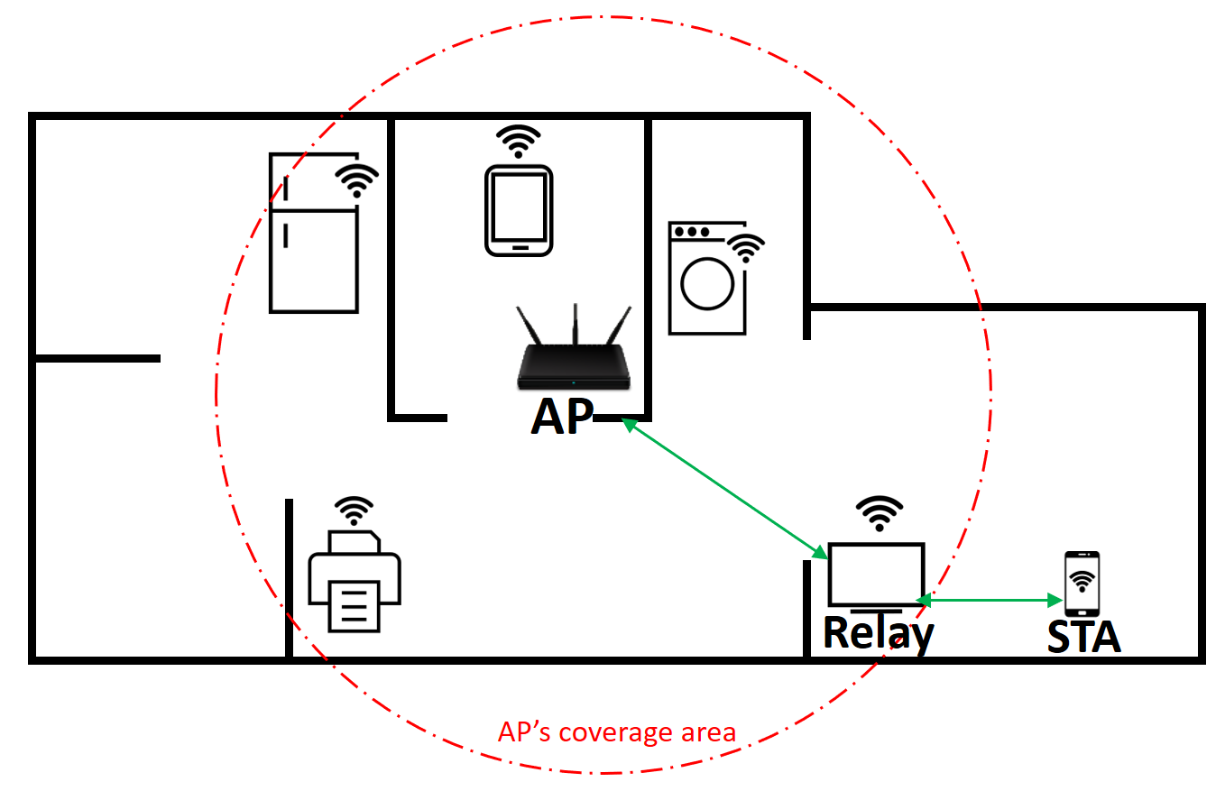
Example 2 – Efficient Relay Operation
Use Case:
  Relay operation has been proposed for range extension [18-21].
Procedure:
  When transmitting frames to the relay, AP/STA can include timing information for the transmitted packet. E.g., expiration time
  Based on the timing information, relay can understand which frames need to be dropped and avoid transmitting expired frames over the air. Additionally, relay can also understand which frames need to be prioritized for transmission.
Procedure can enable efficient use of the wireless medium
AP
Relay prioritizes reporting STA’s packet to be sent before expiration time
…
Relay
STA
…
LL traffic enqueued
STA includes timing information in uplink LL frame.
Packet expiration time

Slide 11
Example 3 – Resource Sharing in Multi-AP Operation
Use case:
  One AP can share time resources with a neighbor AP to assist the neighbor AP [22-25]. Timing information sharing can enable efficient utilization of shared resources.
Procedure:
  APs can share timing information with each other.
  Based on the timing information, sharing AP can assess if the resource can be shared in time.
Procedure can enable efficient resource sharing.
Timing info
AP 1
Resource sharing
AP 2
AP1’s TXOP
AP 1
…
Portion shared with AP2
AP 2
Timing information shared b/w APs
Expiration time

Slide 12
Example 4 – Downlink Traffic Handling
Use case:
  A use case has been discussed in TGbn where traffic flows between two devices associated with the same AP [26-28].
Procedure:
  STA can provide timing information for the transmitted frame.
  Based on the information, AP can assess and prioritize the delivery of frame prior to expiration.
  The information can enable the AP’s scheduler to understand the urgency of the frame and prioritize it for transmission.
AP
STA1
STA2
AP prioritizes the packet for DL transmission prior to deadline
Timing information included in UL frame
AP
…
…
STA1
STA2
Expiration time

Slide 13
Summary
Improving latency support and reliability is one of the objectives of 11bn.
Delay based scheduler can outperform buffer size based scheduler – expiration related information can be crucial for improving AP-side scheduling to meet these objectives
In this presentation –
  We revisited the problem of lack of such expiration related information on the AP-side.
  Discussed useful parameters that can be reported.
  Discussed example use cases being discussed in 11bn that can benefit from such an information sharing framework.

Slide 14
SP
Do you agree to define a procedure for timing information reporting in 11bn?
  Note: Timing information reported can be related to the expiration time or enqueue time
  Note: Signaling for timing information reporting can be TBD.
    Yes
    No
    Abstain

Slide 15
References
[1] Throughput-Optimal Opportunistic Scheduling in the Presence of Flow-Level Dynamics, Liu et al., IEEE Trans. Netw., 2011
[2] Instability of MaxWeight Scheduling Algorithms, P. van de Ven et al., IEEE INFOCOM, 2009
[3] HOL Delay Based Scheduling in Wireless Networks with Flow-Level Dynamics, IEEE GLOBECOM, 2014
[4] Consideration of Industrial Automation Scenarios, IEEE 802.11-23/0815
[5] Discussion on bounded delay in Industrial Scenarios, IEEE 802.11-24,0443
[6] Cloud VR Use Case and Requirements, IEEE 802.11-22/0952
[7] 802.11bx: Enabling Metaverse -- Metaverse, AR/VR, and Wearables, IEEE 802.11-22/0779
[8] RTA report draft, IEEE 802.11-18/2009
[9] Wi-Fi 6/6E for Industrial IoT, WBA (Wireless Broadband Alliance), May 2018.
[10] Wireless TSN — Definitions, Use Cases & Standards Roadmap White Paper, Avnu Alliance, Mar 2020.
[11] Wireless TSN: Market Expectations, Capabilities, & Certification, Avnu Alliance, Feb 2022.
[12] 5G for Connected Industries and Automation, 5G-ACIA, Feb 2019.
[13] IOWN GF-Cyber-Physical System Use Case, IOWN Global Forum, 2021.
[14] Resolution for CID 10674, IEEE 802.11-22/1454

Slide 16
References
[15] Considerations on QoS Enhancement in UHR, IEEE 802.11-23/0885
[16] Dynamic QoS feedback for UHR, IEEE 802.11-23/0740
[17] Urgency-based Delivery of Latency Sensitive Traffic, IEEE 802.11-23/0045
[18] Considerations for Relay Operation in Next Generation Wi-Fi Networks, IEEE 802.11-23/1889
[19] Thought for Range Extension in UHR, IEEE 802.11-23/0042
[20] UHR Rate-vs-Range Enhancement with Relay, IEEE 802.11-22/1908
[21] Consideration on UHR Relay Architecture, IEEE 802.11-23/1450
[22] Considerations on Coordinated TDMA, IEEE 802.11-23/41r0.
[23] Thoughts on Coordinated TDMA, IEEE 802.11-23/1085r0
[24] Follow-up on Coordinated TDMA (C-TDMA), IEEE 802.11-23/739r1
[25] Considerations for Coordinated TDMA, IEEE 802.11-24/512
[26] End-to-end QoS with SCS, IEEE 802.11-23/1885
[27] Proxy QoS management for XR use cases, IEEE 802.11-23/1958
[28] Thoughts on Proxy SCS

Slide 17
Signaling Discussion for Reporting
A number of reporting frameworks can be considered:
  Modified BSR:
    A modified BSR can carry a timing information report.
    Report can be for the most urgent frame/frame at the head of the queue.
    However, there can be space constraints!
  New A-Ctrl:
    A new A-Ctrl can be defined to carry such information
Signaling needs to enable both solicited and unsolicited modes of reporting.

