Slide 1
Protocol Design for UL Beamforming
Date: 2024-09-01
Authors:

Slide 2
Introduction
When transmitting the trigger-based (TB) PPDU, multiple non-AP STAs simultaneously transmit UL frames according to the resource allocation information, contained in the preceding Trigger frame
  There is a scenario that some non-AP STAs participating in the TB PPDU transmission show low throughput or do not meet the target SNR, especially when the non-AP STA is located far away from the AP
  The beamforming technology is one of the solutions to increase the throughput or meet the target SNR
  Several proposals were shown in [1]-[7], where the beamforming for TB PPDU is effective in throughput enhancement
In this contribution, we present a high level design of sounding and channel information feedback protocols for UL beamforming in UHR TB PPDU

Slide 3
Recap: Trigger frame in 11be
 | Trigger Type | UL Length | More TF | CS Required | UL BW | GI And EHT-LTF Type | MU-MIMO EHT-LTF Mode | Number of EHT-LTF Symbols And Mid-amble Periodicity | …
Bits: | 4 | 12 | 1 | 1 | 2 | 2 | 1 | 3
 | UL STBC | LDPC Extra Symbol Segment | AP Tx Power | Pre-FEC Padding Factor | PE Disambiguity | UL Spatial Reuse | Doppler | HE/EHT P160 | Special User Info Field Present | Reserved | Trigger Dependent Common Info
Bits: | 1 | 1 | 6 | 2 | 1 | 16 | 1 | 1 | 1 | 8 | variable
Frame Control | Duration | RA | TA | Common Info | Special User Info | User Info List | Padding | FCS
User Info | User Info | … | User Info
 | AID12 | RU Allocation | UL FEC Coding Type | UL EHT-MCS | Reserved | SS Allocation / RA-RU Information | UL Target Receiver Power | PS160 | Trigger Dependent User Info
Bits: | 12 | 8 | 1 | 4 | 1 | 6 | 7 | 1 | variable

Slide 4
Overview
An example of the proposed ULBF procedure is shown below
  An UHR beamformee (AP) that solicits UHR TB sounding NDP shall transmit BSNP Trigger frame to one or more UHR beamformers (non-AP STAs)
  An UHR beamformee (AP) that solicits UHR TB PPDU using a beamforming steering matrix derived from a UHR ULBF CBF shall transmit Basic Trigger frame to one or more UHR beamformers (non-AP STAs), where Beamformed subfield in the Special User Info field is set to 1
Note: ULBF CBF and Basic Trigger can be either an A-MPDU or separate PPDUs spaced by SIFS

Slide 5
BSNP Trigger frame
Define a new Trigger variant as shown in the table below
  Beamforming Sounding NDP Poll (BSNP)
    Triggers the TB sounding NDP
Trigger Type subfield value | Trigger frame variant
0 | Basic
1 | Beamforming Report Poll (BFRP)
2 | BR-BAR
3 | MU-RTS
4 | Buffer Status Report Poll (BSRP)
5 | GCR MU-BAR
6 | Bandwidth Query Report Poll (BQRP)
7 | NDP Feedback Report Poll (NFRP)
8 | Ranging
9 | Beamforming Sounding NDP Poll (BSNP)
10-15 | Reserved

Slide 6
BSNP Trigger frame
Trigger Dependent Common Info subfield
  The Trigger Dependent Common Info is not present
Trigger Dependent User Info subfield
  The Trigger Dependent User Info is defined in the figure below
  Sounding Dialog Token Number contains a value selected by the beamformee (AP) to identify the BSNP Trigger frame
 | Sounding Dialog Token Number | Reserved
Bits: | 6 | 2

Slide 7
UHR TB Sounding NDP
UHR TB Sounding NDP
  New variant of the TB PPDU
  Uses the TB PPDU format but without the Data field
  It can be transmitted in UL MU-MIMO or UL OFDMA

Slide 8
Basic Trigger frame
UHR variant Special User Info subfield
  E.g.) Use B37 to carry Beamformed subfield, which is reserved in 11be
 | B0 B11 | B12 B14 | B15 B16 | B17 B20 | B21 B24 | B25 B36 | B37 | B38 B39
 | AID2 | PHY Version Identifier | UL Bandwidth Extension | UHR Spatial Reuse 1 | UHR Spatial Reuse 2 | U-SIG Disregard And Validate | Beamformed | Reserved | Trigger Dependent User Info
Bits: | 12 | 3 | 2 | 4 | 4 | 12 | 1 | 2 | variable
[Exemplary design based on 11be]

Slide 9
UHR ULBF Compressed Beamforming frame
UHR ULBF CBF format
  The Action field of the UHR ULBF Compressed Beamforming frame contains the information shown in the table below
  Category
    UHR
  UHR Action
    UHR ULBF compressed beamforming
    Define new values for these fields by using the reserved values
Order | Information
1 | Category
2 | UHR Action
3 | UHR ULBF MIMO Control for STA 1
4 | UHR ULBF Compressed Beamforming Report for STA 1
5 | UHR ULBF MIMO Control for STA 2
6 | UHR ULBF Compressed Beamforming Report for STA 2
… | …
2N_{STA}+1 | UHR ULBF MIMO Control for STA N_{STA}
2N_{STA}+2 | UHR ULBF Compressed Beamforming Report for N_{STA}

Slide 10
UHR ULBF Compressed Beamforming frame
UHR ULBF MIMO Control
  Differences to UHR MIMO Control are
    AID12 subfield
      Address to an associated non-AP STA which is equal to the value in the AID12 subfield in the BSNP Trigger frame
    Feedback Type
      0: SU, 1: UL MU-MIMO
      In case each non-AP STA applies its own right singular matrix V as a beam-steering matrix in UL MU-MIMO, this field can be reserved
  Sounding Dialog Token Number
    Set to the same value as the Sounding Dialog Token Number field in the BSNP Trigger frame
B0 B11 | B12 B15 | B16 B19 | B20 B22 | B23 | B24 | B25 B27 | B28 B30 | B31 | B32 B40 | B41 B46 | B47 | B48 B50
AID12 | Nc Index | Nr Index | BW | Grouping | Feedback Type | Reserved | Remaining Feedback Segments | First Feedback Segment | Partial BW Info | Sounding Dialog Token Number | Codebook Information | Reserved
12 | 4 | 4 | 3 | 1 | 1 | 3 | 3 | 1 | 9 | 6 | 1 | 3
[Exemplary design based on 11be]

Slide 11
UHR ULBF Compressed Beamforming frame
UHR ULBF Compressed Beamforming Report
  Carries compressed beamforming feedback matrices to determine beam-steering matrix of each beamformer (non-AP STA)
  Difference to EHT Compressed Beamforming Report is
    Average SNR of each space-time stream is not carried in this field

Slide 12
Summary
We propose new protocols to support the sounding and feedback procedure for UL beamforming in UHR
  Beamforming Sounding NDP Poll (BSNP) frame
  UHR TB Sounding NDP
  Basic Trigger frame
    Carry Beamformed subfield in the UHR variant Special User Info subfield
  UHR ULBF Compressed Beamforming frame

Slide 13
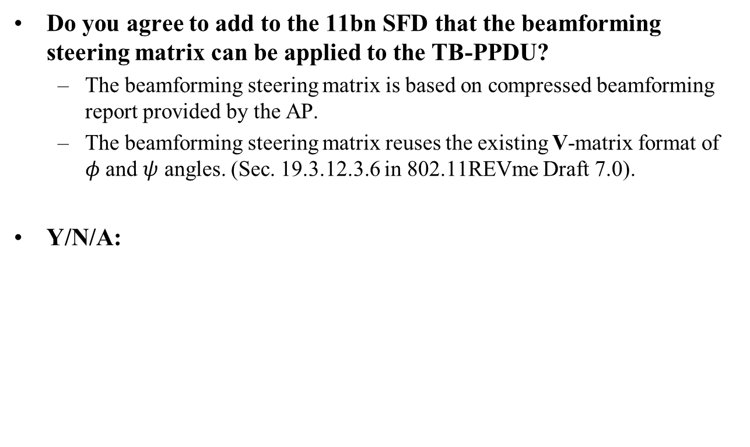
SP #1
Do you agree to add to the 11bn SFD that the beamforming steering matrix can be applied to the TB-PPDU?
  The beamforming steering matrix is based on compressed beamforming report provided by the AP.
  The beamforming steering matrix reuses the existing V-matrix format of $φ$ and $ψ$ angles. (Sec. 19.3.12.3.6 in 802.11REVme Draft 7.0).
Y/N/A:

Slide 14
Reference
[1] 802.11-20/1672r0, UL Beamforming for TB PPDUs in 11be.
[2] 802.11-24/108r0, Triggered Beamforming in TGbn - Follow Up.
[3] 802.11-24/1265r0, Triggered Beamforming in TGbn - More Insights.
[4] 802.11-24/1158r0, Uplink MU MIMO Precoding Precoder Message Format.
[5] 802.11-23/0027r1, Uplink MU MIMO Improvements.
[6] 802.11-23/0725r0, Uplink MU MIMO Precoding - Follow-up.
[7] 802.11-24/0869r0, Beamforming Feedback for UL Beamforming.

Slide 15
Appendix

Slide 16
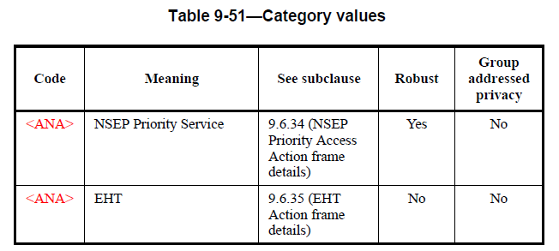
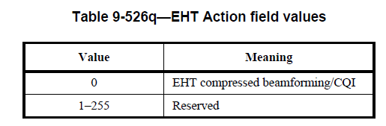
Category and EHT Action Field
Category
EHT Action Field

Slide 17
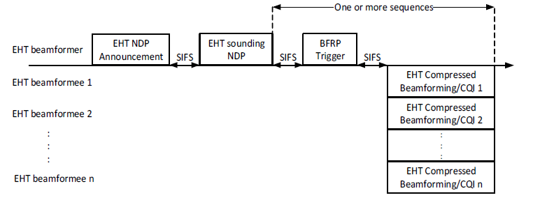
EHT TB Sounding Procedure

Slide 18
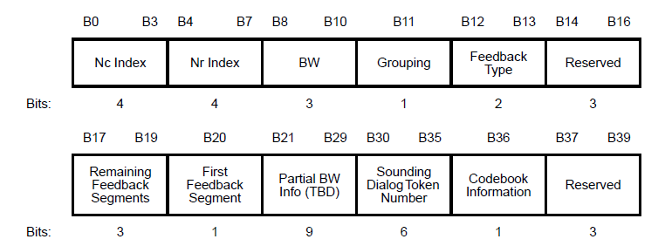
EHT MIMO Control Filed Format

