Slide 1
1st Vice Chair Report – 2024 March Plenary - Denver
Date: 2024-03-11
Authors:
Notes:
.R0 has an error on the upper right header.
R1 corrects that. And adds 802Wireless interim information

Slide 2
Abstract
Agenda Items for 1st Vice Chair –
Monday March 11:
M3.3 II Session Information
M3.4 II Meeting room locations
M3.5 II Meeting registration
M3.6 II Recording attendance
M3.7 II Local File Server Access
M3.8 II Breakfast, breaks, Social logistics
Friday March 15:
F3.1.2 DT WG Straw Poll
F3.1.3 DT Future venues Insight

Slide 3
Monday, March 11, 2024 802.11 WG Opening Plenary
M3.3 II Session Information
M3.4 II Meeting room locations
M3.5 II Meeting registration
M3.6 II Recording attendance
M3.7 II Local File Server Access
M3.8 II Breakfast, breaks, Social logistics

Slide 4
Successful Mixed-mode Meeting Protocol
In-room Attendees:
In Webex choose connect without audio before you join
Use the Webex queue to indicate you want to speak
Wait to be called on while standing/holding a microphone to make a comment
Repeat any questions that are inadvertently asked away from the microphone
Remote Attendees:
Join Webex and set Webex audio as ‘music’
Use the Webex chat window to indicate you want to speak (“q”)
Wait to be called on to speak

Slide 5
March 2024 IEEE 802 Plenary Session
Event Summary and Important Information
Prepared By: Face to Face Events, February 28, 2024

Slide 6
Meeting Planner Contact Information
Dawn Slykhouse, Face to Face Events
Mobile: +1 (408) 594-1342
Email: dawns@facetoface-events.com
Lisa Ronmark, Face to Face Events
Mobile: +1 (604) 316-4947
Email: lisa@facetoface-events.com
Stephanie Williams, Face to Face Events
Mobile: +1 (408) 497-9613
Email: stephanie@facetoface-events.com
Meeting Planner Office: Agate A
Registration: Centennial Foyer

Slide 7
Network Access and Support Information
SSID: IEEE802
Password: ieeeieee
Encryption Type: WPA2/WPA3
Supports 2.4 GHz & 5 GHz Wi-Fi
SSID: IEEE802-WPA3
Password: ieeeieee
Encryption Type: WPA3
Supports 2.4 GHz, 5 GHz & 6Ghz Wi-Fi
IEEE 802 Documents: Local Document Server
http://ieee802.linespeed.com/
Onsite Network Support: Linespeed Events
Members of the Linespeed team can be dispatched by contacting the Meeting Planner directly or by placing a request at the event registration desk.
Linespeed Events
Richard Alfvin
Mobile: +1 (585) 781-0952
Email: rick@linespeed.com
Network Office: Agate B
If the Network Office is closed, please check in with Meeting Planner at the Registration Desk (Centennial Foyer) or Meeting Planner Office (Agate A).

Slide 8
In Person Registration Times and Location
Sunday
Registration Counter, Centennial Foyer 3rd Floor Hyatt Regency Denver
5:00 PM - 7:30 PM
Monday - Wednesday
Registration Counter, Centennial Foyer 3rd Floor Hyatt Regency Denver
7:30 AM - 5:00 PM
Thursday
Event Office, Agate A, 3rd Floor Hyatt Regency Denver
8:00 AM - 5:00 PM

Slide 9
IEEE 802 Newcomer Orientation
Monday March 11th at 9:00 AM
WHO: IEEE 802 Newcomers (and all others!)
WHAT: IEEE 802 Orientation Program, Details at <https://tinyurl.com/yurnwntr>
WHEN: Monday 11 March, 9-10 MT
WHERE: Granite BC II or online at IEEE 802 Calendar https://ieee802.org/802tele_calendar.html
HOW TO PREPARE: Please take an hour and get to up speed with a high-level view of IEEE 802 and how it works before you plunge into the session. IEEE 802.15 First Vice Chair Phil Beecher will lead the program. Your questions will be answered.
REGISTRATION FEE: Registration for the IEEE 802 Plenary Session (with fee) is required, whether attending in-person or remotely.

Slide 10
Schedule of Meetings and Attendance
In Person Room Assignments: Schedule QR codes posted outside each meeting room and on back of your badge. http://schedule.802world.com/schedule/schedule/show
Virtual Participation details: https://ieee802.org/802tele_calendar.html
ATTENDANCE TOOL (IMAT)
https://imat.ieee.org/my-site/home
REGISTRATION FEE REQUIREMENT REMINDER
Payment of the session registration fee is required for all individuals who participate in any meetings associated with the March 2024 IEEE 802 Plenary Session.
Registration Link: https://cvent.me/vKY5P4

Slide 11
Audio Visual Support – Onsite support
WHO TO CONTACT IF AUDIO VISUAL EQUIPMENT ISN’T WORKING IN YOUR ONSITE MEETING ROOM
Please contact the Meeting Planner directly if you have any issues with the audio visual equipment in your meeting room. The Meeting Planner will contact support and the appropriate technician will be sent to assist as soon as possible.
Meeting Planner can be reached at:
Registration and Information Desk: Centennial Foyer, 3rd Floor Hyatt Regency Denver
Event Office: Agate A
Via Text or Call: Lisa Ronmark: +1 (604) 316-4947, Stephanie Williams +1 (408) 497-9613
WEBEX AUDIO IN THE ONSITE MEETING ROOM
If you are a local participant, PLEASE, select “Don’t connect to audio” when joining WebEx.
Connecting to the audio, may cause an audio interference or a feedback loop that will disrupt the meeting.

Slide 12
Food and Beverage Breaks
FOR REGISTERED ATTENDEES ONLY
Light Breakfast
Centennial Foyer, 3rd Floor
Monday - Friday
7:15 AM - 8:30 AM
Morning Coffee & Tea Break
Centennial Foyer, 3rd Floor
Monday - Thursday
9:50 AM - 10:35 AM
Lunch
Centennial D, 3rd Floor
Monday - Thursday
12:00 PM - 1:15 PM
Afternoon Break
Centennial Foyer, 3rd Floor
Monday - Thursday
3:15 PM - 4:00 PM

Slide 13
IEEE 802 Milestone Preview & Social
Wednesday March 13th at 6:30 PM
WHO: Registered Attendee & Guests who purchased tickets.*
*Tickets were sold online until Friday March 8, 2024 for $24.99 each.
WHAT: Networking Reception and Celebration to acknowledge the IEEE 802 Milestone.
A buffet dinner will be followed by special guest speeches and a preview of the IEEE 802 Milestone plaque.
WHERE: Centennial D Ballroom, 3rd Floor Hyatt Regency Denver
SOCIAL EVENT NAME BADGE
All individuals attending the event must wear a Social Event Name Badge.
Social Event Name Badges will be distributed at the Plenary Session registration desk.
You must purchase a Social Event Badge for you and your guests attending.
All Social Event Name Badges must be picked up before 12:00 PM Wednesday March 13th.
Late requests may not be accommodated.
Please contact the Meeting Planner if have any questions.

Slide 14
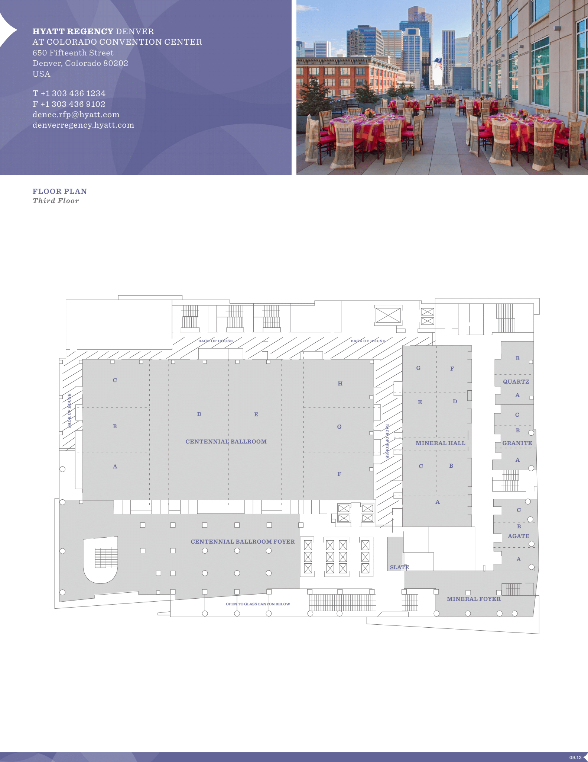
Hyatt Regency Denver 3rd Floor Meeting Space Map
Centennial Foyer
Registration
Light Breakfast
AM and PM Breaks
Centennial BCD
Lunch
Centennial AB
Executive Committee Opening/Closing Session
Centennial E, F, G, H
802.11 Sessions
Mineral Hall A,BC,D,E
802.15 Sessions
Mineral FG
802.11 Sessions
Quartz AB
Executive Committee Boardroom
Granite BC
802.18/.19./24 Sessions

Slide 15
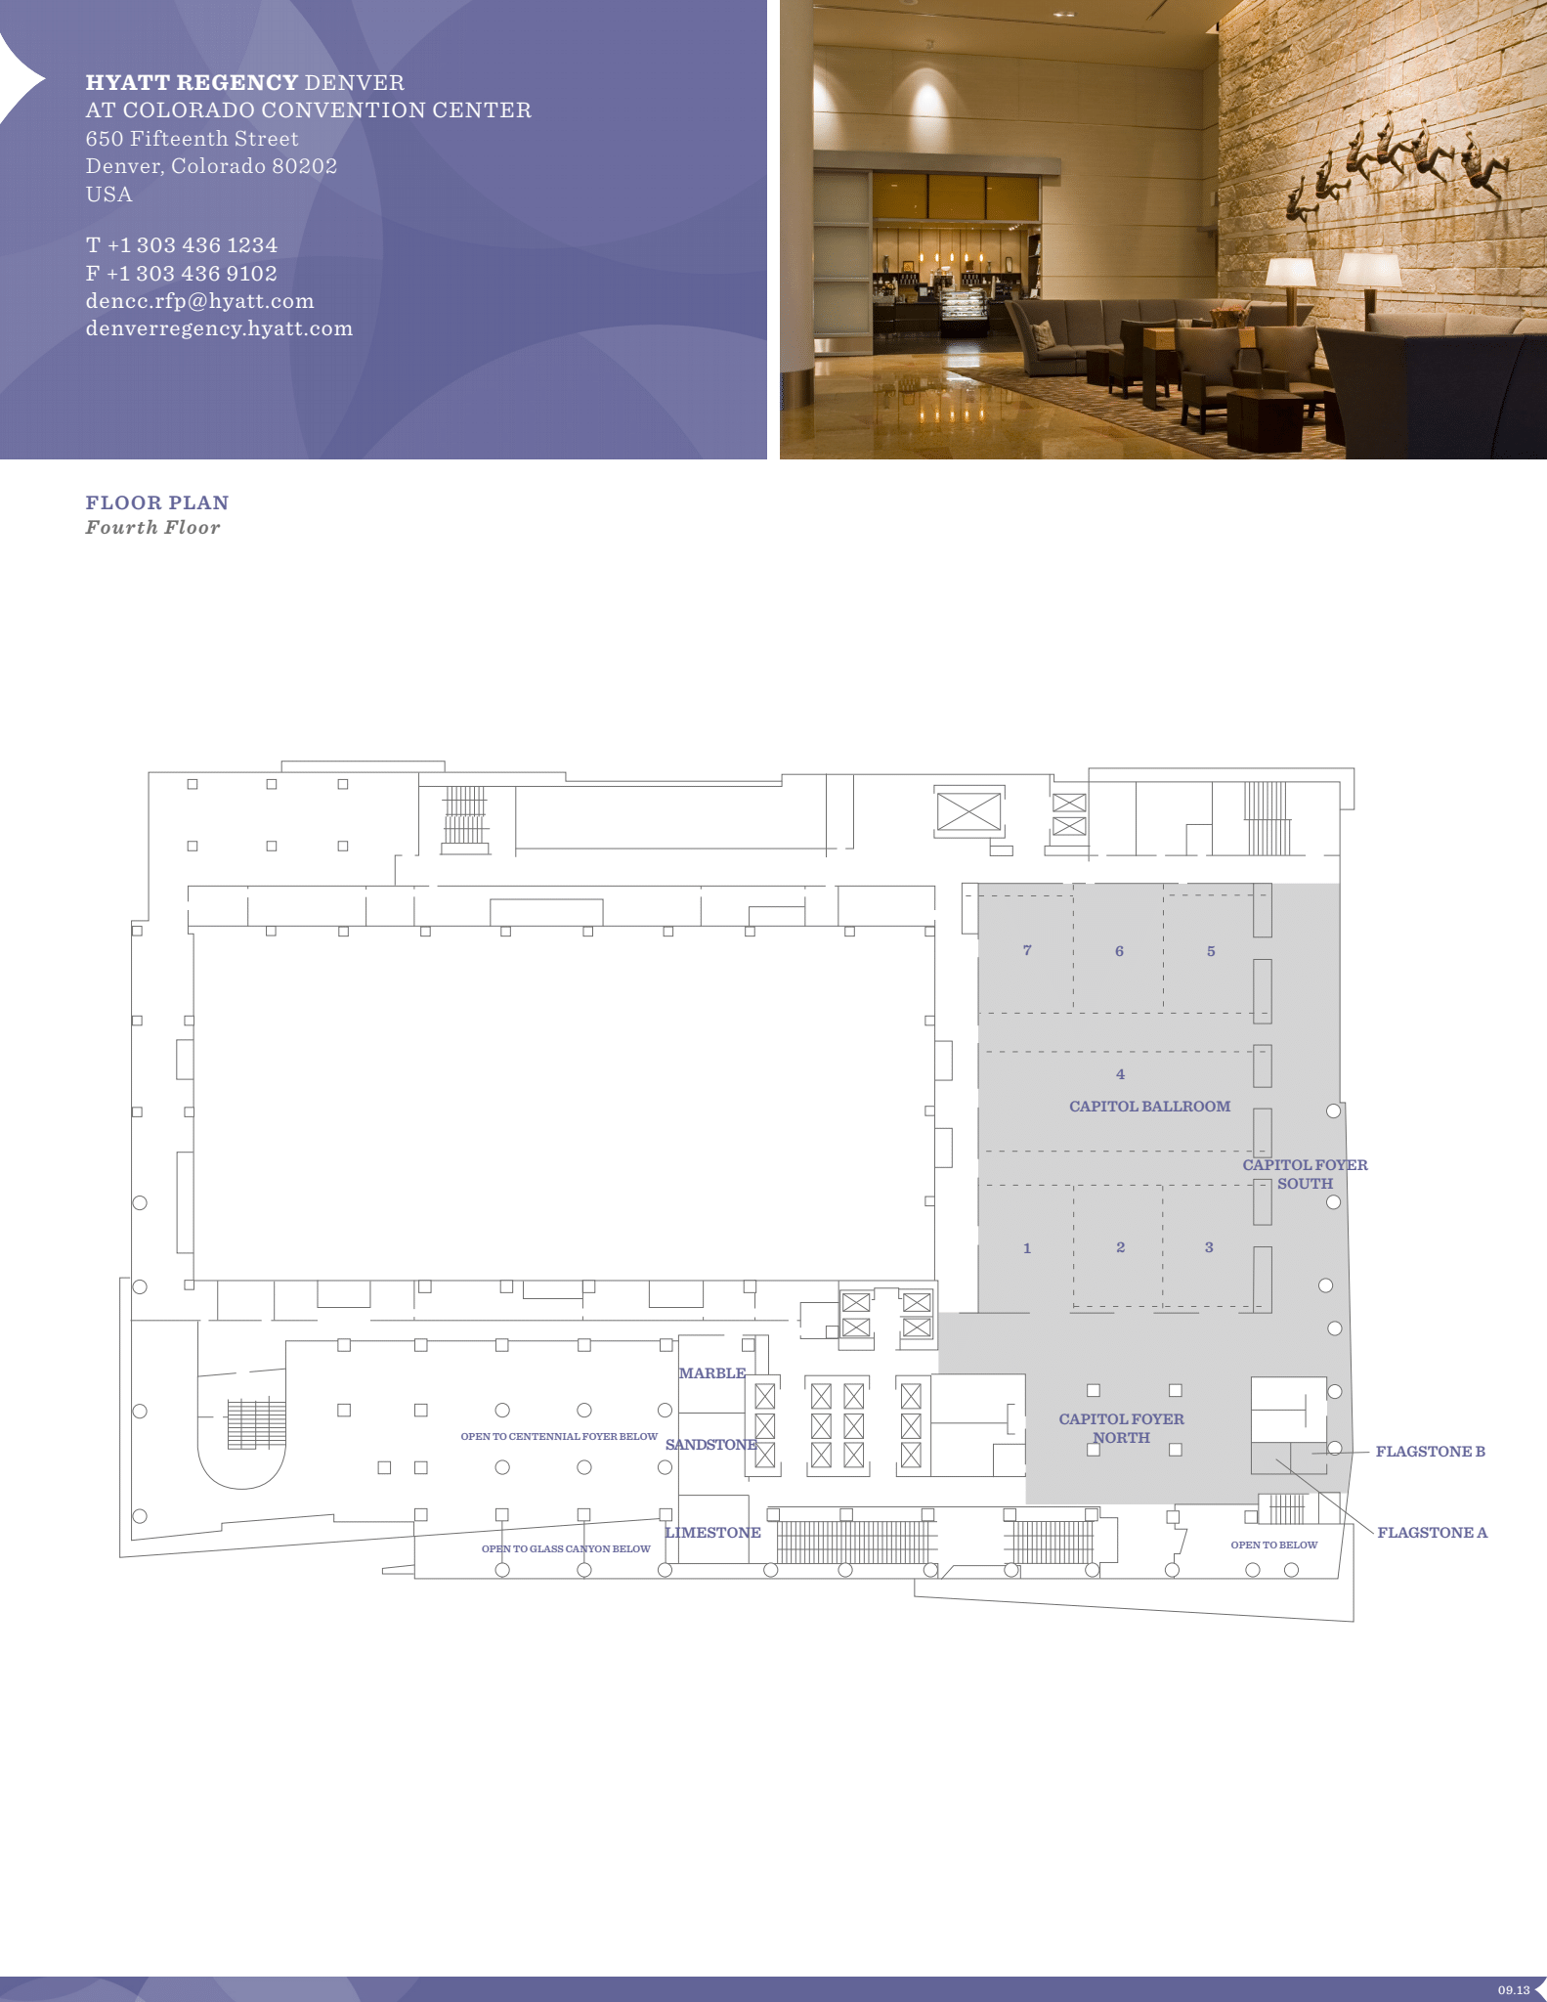
Hyatt Regency Denver 4th Floor Meeting Space Map
Capitol 1,2,3,4
802.3 Sessions
Capitol 5,6,7
802.1 Sessions

Slide 16
Quick Start Guide to Local information in Denver
Weather Forecast
Denver, CO Weather Forecast | AccuWeather
Time Zone - Time Change
Sunday, March 10, 2024 — Daylight Saving Time Starts. Clocks move forward 1 hour.
Time Zone Tool (What time is at home or where virtual attendees are logging in?) https://www.timeanddate.com/worldclock/meeting.html
Denver Airport - Flight Status
https://www.flydenver.com/departures/
Getting the Train Back to the Airport
https://youtu.be/Hj6PYgvu7zg?feature=shared
Places to Eat
Visit Denver
Free Things to Do In Denver, When You’re Not in a Meeting
https://www.denver.org/things-to-do/tours/free-tours/

Slide 17
Health and Safety Options Close to Hyatt Regency
Nearby Hospitals:
Denver Health, 777 Bannock St, 303.436.6000
Saint Joseph Hospital, 1375 E 19th Ave, 303-812-2000
Kindred Hospital Denver, 1920 N High St, 303-320-5871
Rose Medical, 4567 E 9th Ave, 303-320-2121
Walk-in/Non-Emergency Medical Facility:
Denver Health Downtown Urgent Care, 1545 California St, 303-602-6500
Pharmacies:
Walgreens, 801 16th St, Denver, CO 80202. 303.571.5314 (8:00 AM – 11:00 PM)
CVS Pharmacy, 750 16th St, Denver, CO 80202. 303-534-1182
CVS Pharmacy @ Target, 1600 California St, Ste 14, Denver, CO 80202

Slide 18
Thanks for helping us make this session a success, we look forward to working with you again!
The next IEEE 802 Plenary Session will be July 14-19, 2024. In-Person participation at the Le Centre Sheraton Montreal in Montreal Quebec, Canada with remote participation available.
If you have any questions please email: 802info@facetoface-events.com
We are preparing to make Hotel Reservations and Registration available on Monday April 8, 2024
Early Registration Deadline
Friday May 17, 2024
Group Hotel Reservations: Le Centre Sheraton Montreal
Available Soon
Hotel Reservation Booking Cut Off Date:
Friday June 14, 2024 5:00 PM Eastern Time
Note Joint IEEE 802 – ITU SG15 Workshop – July 13, 2024

Slide 19
2024 May IEEE 802 Wireless Interim Session
May 12-17, 2024
Registration Announcement
Warsaw Marriott Hotel
Al. Jerozolimskie 65/79 Warsaw 00-697 Poland
Reservations Tel: +48 22 630 55 28
Main Hotel Tel: +48 22 630 63 06
Hotel website: Warsaw Marriott Hotel
APRIL 05, 2024 - Early Registration Deadline:
Registration for the 2024 May IEEE 802 Wireless Interim Session is now open!!
Information about the Session, registration and accommodation can be found at the 2024 May IEEE 802 Wireless Interim Session website and in the attached announcement document.
Please don’t hesitate to reach out to us via 802wireless@mtgevents.com.au if you require any assistance or have any questions.

Slide 20
M3.6 Recording attendance
It is a requirement that attendees record their participation at an 802.11 session and declare their affiliation. This record is usually made using the IMAT attendance system.
If you wish to participate without recording attendance, send an email per session to the WG 2nd vice chair declaring your participation and affiliation. You cannot gain or maintain 802.11 voting membership using this method.
You must record 75% attendance of required 802.11 slots in a session for that session to count towards gaining or maintaining 802.11 voting membership
You need a single IEEE-SA web account
The IEEE SA web account requires a working email address
do not remove your email address from the account
Use the email address associated with that web account when registering attendance
If you change email addresses, update the web account, don’t create a new web account, or your membership status may not be calculated properly
Record attendance using this URL: IMAT.IEEE.ORG/

Slide 21
Friday, January 19, 2024 802.11 WG Closing Plenary
Agenda Items:
3.1.2 DT Straw Poll regarding meetings
3.1.3 DT Future venues status and discussion

Slide 22
Straw Poll: Return to This Venue: (Hilton Panama, Panama City, Panama)
1. How many people would like to come back to this venue?
Yes –
No –
2. Did you go to the social?
Yes –
No –
3. If you attended the Social, did you like the social?
Yes –
No –
Notes:
Show of Hands of those in the room.

Slide 23
Future Interim Venue Status
As of Nov 12, 2023
2024-01 (14-19) Hilton Panama, Panama, Panama (Rebooked from Jan 2022)
2024-05 (12-17) Marriott Warsaw, Warsaw, Poland – (Rebook from May 2022)
2024-09 (8-13) Hilton Waikoloa, Waikoloa, HI, USA
2025-01 (12-17) Kobe, Japan – TBC (Moved from May 2023)
2025-05 (11-16) – Hilton Prague, Prague, Czech Republic (Contract TBC)
2025-09 (14-19) Hilton Waikoloa, Waikoloa, HI, USA
2026-01 (11-16) – RFP - Americas
2026-05 (10-15) – RFP - Europe
2026-09 (13-18) Hilton Waikoloa, Waikoloa, HI, USA
2027-01 (10-15) – RFP - Americas (could rotate J-M)
2027-05 (9-14) – RFP - Asia (could rotate J-M)
2027-09 (12-17) – Grand Hyatt Atlanta, Buckhead, GA, USA (Contract TBC)
Meeting Planner:
Dotted Venues: Face to Face Events
Starred Venues :MTG Events
Notes:
Future Wireless Interim Meetings: review and status Sept 1, 2023
In General, Each year one Session must be Non-NA/US – Odd years Asia – Even Years Europe
2023 September 10-15 – Grand Hyatt, Atlanta Buckhead – Contract executed (802WFIN-21/1r0)
2024 January 14-19 – Hilton Panama, Panama – Contract executed (802WFIN-21/31r0)
2024 May 12-17 - Warsaw Marriott, Warsaw, Poland– Contract executed (802WFin-23/59r0)
2024 Sept 8-13 - Hilton Waikoloa Village – Contract executed (802WFIN-20/12r0)
2025 Jan 12-17 – Kobe, Japan – in negotiations
2025 May 11-16 – Hilton Prague, Prague, Czech Republic Contract TBC
2025 Sept 9-14 - Hilton Waikoloa Village, Waikoloa, HI – Contract executed (802WFIN-22-0007r0)
2026 Jan 11-16 – RFP – Open (NA/Asia)
2026 May 10-15– RFP – Open (Asia/NA)
2026 Sept 13-18 Hilton Waikoloa Village, Waikoloa, HI – Contract executed (802WFIN-22-0008r0)
2027 Jan 10-15 – RFP – Open (NA/Asia)
2027 May 9-14 – RFP – Open (Asia/NA)
2027 Sept 12-17 – Grand Hyatt Atlanta, Buckhead, GA, USA – Contract TBC

Slide 24
Future 802 Plenary Venue Contract Status
2024 March 10-15 – Hyatt Regency Denver at Colorado Convention Center, Denver, CO, (March 2021)
2024 July 14-19 – Sheraton Le Centre Montreal, Montreal, Quebec, Canada (July 2020)
2024 November 10-15 –Hyatt Regency Vancouver, Vancouver, Canada (Nov 2021)
2025 March 9-14 –Hilton Atlanta, Atlanta, GA, United States (2 of 2 – March 2020).
2025 July 27-August 1 –Melia Castilla Madrid, Madrid, Spain (Changing Week to July 27)
2025 November 9-14 – Marriott Marquis Queen’s Park, Bangkok, Thailand
2026 March 8-13 - Hyatt Regency Vancouver, Vancouver, Canada (Change from Chicago)
2026 July 13-18 – Le Centre Sheraton Montreal, Montreal (July 2022 attrition offset)
2026 November 8-13 - Marriott Marquis Queen’s Park, Bangkok, Thailand
2027 March 14-19 – Hilton Atlanta, Atlanta, GA, United States ( offset potential shortfall 2023/2025)
2027 July 11-16 - Gothia Towers, Gothenburg, Sweden
2027 November 14-19 – Hawaiian Village, Oahu, Hawaii, United States
802 EC Approved – Contract is being Negotiated.
Contracts Executed
As of Dec 13, 2023

Slide 25
References
1. Plenary Meeting Status File: 802 EC-22/0003r0
https://mentor.ieee.org/802-ec/dcn/22/ec-22-0003-00-00EC-future-802-plenary-venue-contract-status.xlsx
2. IEEE 802WCSC Meeting Venue Manager Report: 802 EC-23/0001r05
https://mentor.ieee.org/802-ec/dcn/23/ec-23-0001-05-WCSG-ieee-802wcsc-meeting-venue-manager-report-2023.pptx

