Slide 1
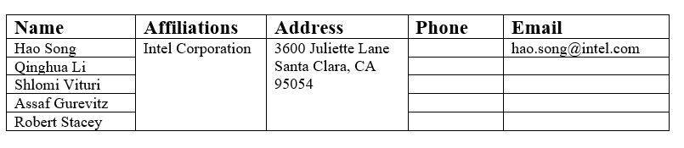
Unequal Modulation over Spatial Streams
Date: 2024-xx-xx
Authors:

Slide 2
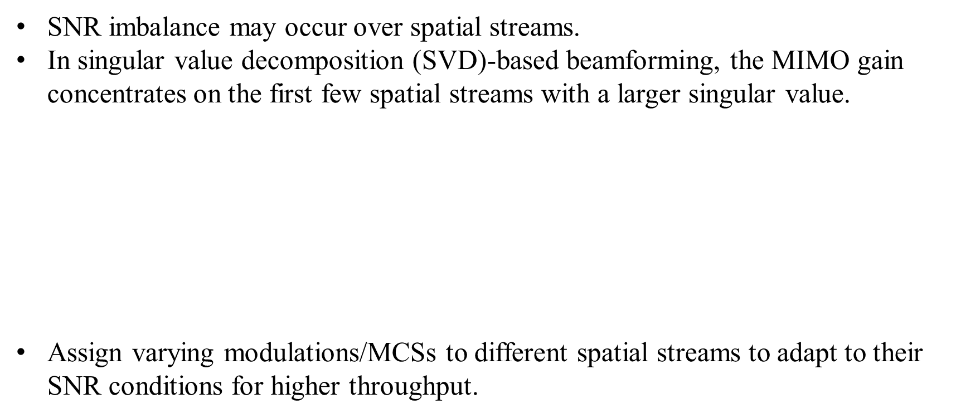

SNR Imbalance over Spatial Streams
SNR imbalance may occur over spatial streams.
In singular value decomposition (SVD)-based beamforming, the MIMO gain concentrates on the first few spatial streams with a larger singular value.
$$>······{>λ}_{n}$$
Assign varying modulations/MCSs to different spatial streams to adapt to their SNR conditions for higher throughput.
$$H=U\left(\begin{matrix}λ_{1} & & \\ & ⋱ & \\ & & λ_{n}\end{matrix}\right)V^{∗}$$
$$λ_{1}>λ_{2}>······{>λ}_{n}$$
Non-zero singular values are in a decreasing order
Hao Song, Intel Corporation

Slide 3
Equal Modulation
Data transmitted on spatial streams share the same MCS and encode together.
The same number of bits in a LDPC codeword are transmitted on different spatial streams.
Hao Song, Intel Corporation

Slide 4
Unequal Modulation
Data transmitted on spatial streams share the same code rate and encode together.
Only modulations are different.
The majority of bits in a LDPC codeword are transmitted on strong spatial streams with high MIMO gains and high-order modulations.
Unequal modulation is compatible with the current EHT specifications in joint encoding between spatial streams.
Hao Song, Intel Corporation

Slide 5
Unequal MCS
LDPC encoding and decoding operate individually on different spatial streams.
Spatial streams have varying modulation and coding schemes (MCSs).
Strong spatial streams transmit more LDPC codewords compared to weak spatial streams.
Hao Song, Intel Corporation

Slide 6
Unequal Modulation vs Unequal MCS
Unequal modulation:
  Strong spatial streams can help weak spatial steams in LDPC decoding, as they encode together.
  The current transmitter and receiver in the EHT specifications are still applicable.
  Minor changes are needed for stream parsers and segment parsers.
Unequal MCS:
  It has more freedom on coding rates of spatial streams compared to Unequal modulation.
  Major changes are required to the current transmitter and receiver.
  Each spatial stream has independent scrambling, encoding, and padding.
  High complexity and high cost in hardware.
Unequal modulation is preferred and recommended.
Hao Song, Intel Corporation

Slide 7
Simulation setup
SVD precoding at transmitter
MMSE at receiver
4 × 2 MIMO
Bandwidth: 80 MHz
IEEE model D NLOS
LDPC codeword length: 1944;
10 channel realizations considered
Exhaustive search used to obtain optimal MCS given a channel realization
Investigated schemes:
  Equal MCS with standard MCSs (existing14 MCSs listed in the current EHT-MCSs);
  Unequal modulation with standard MCSs (existing14 MCSs listed in the current EHT-MCSs);
  Unequal modulation with all possible MCSs (all 28 possible MCSs; used as optimum scheme)
Hao Song, Intel Corporation

Slide 8
Simulation results
With standard MCSs, 2.5 dB gain can be achieved by Unequal modulation compared to Equal MCS.
The performance of Unequal modulation with standard MCSs is close to that of Unequal modulation with all possible MCSs, demonstrating that Unequal modulation can work well with the existing standard MCSs.
Hao Song, Intel Corporation

Slide 9
Summary
Unequal modulation is recommended with the following reasons:
  Around 2.5 dB gain can be obtained by Unequal modulation in the MIMO 4×2 scenario;
  Unequal modulation is compatible to the current EHT specifications, and only minor changes are required with low complexity and low cost;
  Unequal modulation can work well and has excellent performance with the existing EHT-MCSs.
Hao Song, Intel Corporation

Slide 10
Thank you !
Hao Song, Intel Corporation

