Slide 1
TGbn Motions List - Part 1
Date: 2024-01-18
Authors:

Slide 2
IEEE 802.11 TGbn: Enhancements for Ultra High Reliability (UHR) WLAN Task Group
Motions List from January 2024
Chair: Alfred Asterjadhi (Qualcomm Inc.)
Vice Chairs: Laurent Cariou (Intel), Jianhan Liu (Mediatek), Kiseon Ryu (NXP)
Secretary: Yusuke Asai (NTT)
Technical Editor: Ross Jian Yu (Huawei)
PHY Ad-hoc chairs: Dongguk Lim (LGE), Sigurd Schelstraete (MaxLinear), Tianyu Wu (Apple)
MAC Ad-hoc chairs: Srinivas Kandala (Samsung), Jeongki Kim (Ofinno), Xiaofei Wang (Interdigital)

Slide 3
Motions on January 18th

Slide 4
Motion 1 (PHY)
Move to add the following text to the TGbn SFD
11bn supports a distributed-tone RU (DRU) for a TB PPDU transmission
  The DRU means an RU which consists of subcarriers spreading across a certain bandwidth
Move: Eunsung Park Second: Jianhan Liu
Discussion: Some discussion.
Preliminary Result: 116Y, 6N, 48A (pass)
Result: 113Y, 6N, 47A (pass)
Note: Discussed in one of the PHY ad-hoc sessions (ref: 11-23/1919r1) during which a similar SP was run. The SP did not receive any objections.

Slide 5
Motion 2 (MAC)
Move to add the following text to the TGbn SFD
  11bn defines a mechanism that enables a non-AP MLD to roam from one AP MLD to another AP MLD and the non-AP MLD remains in state 4 (see 11.3) during and after roaming to the other AP MLD
Move: Po-Kai Huang Second: Binita Gupta
Discussion: None.
Result: Approved with unanimous consent.
Note: Discussed in one of the MAC ad-hoc sessions (several submissions were discussing similar concept, ref: 23/1884r2, 23/1898r1, 23/1908r2, 23/1937r1, 23/1971r2, 23/1996r0, 23/2157r2) during which a similar SP was run. The SP result was 83Y, 22N, 22A.

Slide 6
Motions on March 14th

Slide 7
Motion 3 (PHY)
Move to add the following text to the TGbn SFD
  11bn will define distributed tone RU (“DRU”) transmission
Move: Bin Tian Second: Lin Yang
Discussion: Some.
Preliminary Result: 136Y, 37N, 46A.
Result: 133Y, 36N, 43A (pass).
Note: Discussed in one of the PHY ad-hoc sessions of the January Interim, (ref: 11-23/1988r2) during which a similar SP was run. The SP did not receive any objections.

Slide 8
Motion 4 (PHY)
Move to include the following into the 11bn SFD
DRU is allowed in a punctured UHR TB transmission.
Move: Ross J. Yu Second: Eunsung Park
Discussion: None.
Result: Approved with unanimous consent.
Note: Discussed in one of the PHY ad-hoc sessions of the March plenary, (ref: 11-23/2200r3) during which a similar SP was run. The SP did not receive any objections.

Slide 9
Motion 5 (PHY)
Move to add the following text to the TGbn SFD:
11bn supports hierarchical pilot structure for DRU
  Pilot locations of a larger DRU is a subset of pilot locations of smaller component DRUs within the same PPDU BW
Move: Lin Yang Second: Eunsung Park
Discussion: None.
Result: Approved with unanimous consent.
Note: Discussed in one of the PHY ad-hoc sessions of the March plenary, (ref: 11-24/0501r2) during which a similar SP was run. The SP did not receive any objection.

Slide 10
Motion 6 (PHY)
Move to add the following text to the TGbn SFD
The number of pilot tones for the same size DRU and RRU (regular RU) is the same
  The RRU means the existing RU defined in 11ax and 11be
Move: Eunsung Park Second: Stephen Palm
Discussion: Some.
Preliminary Result: 133Y, 23N, 49A
Result: 129Y, 23N, 47A (pass)
Note: Discussed in one of the PHY ad-hoc sessions of the March plenary, (ref: 11-24/0402r1) during which a similar SP was run. The SP did not receive any objection.

Slide 11
Motion 7 (PHY)
Move to add the following text to the 11bn SFD:
11bn supports the hybrid mode with DRUs (Distributed tone RU) and RRUs (Regular RU as existing RU defined in 11ax/be) in UHR UL TB OFDMA transmissions
  Minimum PPDU BW for hybrid mode is TBD
Move: Shengquan Hu Second: Ross J. Yu
Discussion: None.
Result: Approved with unanimous consent.
Note: Discussed in one of the PHY ad-hoc sessions of the March plenary, (ref: 11-24/477r2) during which a similar SP was run. The SP did not receive any objection.

Slide 12
Motion 8 (MAC)
Move to add the following text to the TGbn SFD
11bn defines a mechanism that when a non-AP MLD roams from one AP MLD to another AP MLD, the context related to the non-AP MLD is transferred from the one AP MLD to the other AP MLD such that it preserves the data exchange context for the non-AP MLD.
  Details of the context (e.g., security association context) that can be transferred are TBD
  Framework to transfer the context is TBD.
Move: Po-Kai Huang Second: Gaurav Patwardhan
Discussion: Some.
Preliminary Result: 122Y, 71N, 34A
Result: 121Y, 71N, 34A (fails)
Note: Discussed in one of the MAC ad-hoc sessions (several submissions were discussing similar concept, ref: 23/0322r0, 23/1884r2, 23/1897r0, 23/1908r2, 23/1937r1, 23/1971r2, 23/1996r0, 23/2157r2) during which a similar SP was run. SP result was 100Y, 28N, 18A.

Slide 13
Motion 9 (MAC)
Move to add to the TGbn SFD:
TGbn defines a power save mode for a STA that is a UHR Mobile AP or a UHR non-AP STA wherein the STA may transition from a lower capability mode to a higher capability mode upon reception of an initial control frame
  Lower capability mode (e.g., 20 MHz BW, one SS, limited data rates, PPDU format)
  Higher capability mode (e.g., operating BW, NSS and MCSs, with at least one higher capability than that in the lower power capability mode)
  Initial Control frame is TBD
  Whether that applies for a non-mobile AP is TBD
Move: Laurent Cariou Second: Ming Gan
Discussion: None.
Result: Approved with unanimous consent.
Note: Discussed in one of the MAC ad-hoc sessions (several submissions were discussing similar concept, ref: 23/10, 23/1875, 23/1936, 23/1965, 23/2003). SP result was: 101Y/11N/23A.

Slide 14
Motion 10 (MAC)
Move to add to the TGbn SFD:
TGbn defines cross link power save signaling mechanism
  Allowing a non-AP MLD to indicate to its associated AP MLD that supports the mechanism, in a frame sent on one enabled link, the power management mode for one or more of its affiliated non-AP STAs
  Whether support for the mechanism is mandatory or optional is TBD
Move: Laurent Cariou Second: Rakesh Taori
Discussion: None.
Result: Approved with unanimous consent.
Note: Discussed in one of the MAC ad-hoc sessions (several submissions were discussing similar concept, ref:11-23/2003, 11-24/0602). SP result was: 122Y/23N/32A

Slide 15
Motions on May 16th

Slide 16
Motion 11 (MAC)
Move to add the following text to the TGbn SFD:
TGbn defines a mode of operation that enables a STA to access the secondary channel while the primary channel is known to be busy due to OBSS traffic or other TBD conditions.
  The mode of operation shall not assume that the STA is capable to detect or decode a frame and obtain NAV information of the secondary channel concurrently with the primary channel.
  A BSS shall only have a single NPCA primary channel (name TBD) on which the STA contends while the primary channel of the BSS is known to be busy due to OBSS traffic or other TBD conditions.
Move: Minyoung Park Second: Yunbo Li
Discussion: Some discussion. Recorded vote requested.
Preliminary Result: 209 (+1)Y, 7N, 31A.
Result: 199(+1)Y, 7N, 28A (pass).
Note: Discussed in several sessions and several submissions discuss similar concept, ref: [23/1911r0, 23/1913r2, 23/1935r1, 23/2005r1, 23/2023r1, 24/0070r1, 24/458r0, 24/486r0, 24/538r0, 24/670]. No objection to the SP.

Slide 17
Motion 12 (MAC)
Move to add the following text to the TGbn SFD:
Define a way in 11bn to include in an initial control frame an intermediate FCS for UHR STA(s) that precedes padding and the FCS field
Move: Laurent Cariou Second: Ming Gan
Discussion: None.
Result: Approved with unanimous consent.
Note: Reference documents are [11-23/1873, 11-23/2003] No objection to the SP.

Slide 18
Motion 13 (MAC)
Move to add the following text to the TGbn SFD:
TGbn enables per-TID buffer size reporting of a larger queue in UHR
  Note: It is an optional feature.
  Note: In the baseline, the maximum approximate per-TID queue size to report is 2,147,328 octets
Move: Frank Hsu Second: Bruce Kang
Discussion: Some clarificatory discussion.
Result: Approved with unanimous consent.
Note: Reference document is 11-23/2007r2. No objection to the SP.

Slide 19
Motion 14 (PHY)
Move to add the following text to the TGbn SFD:
DRUs tone plan design on distribution BW 20MHz and 40MHz is 26-tone RU based DRU method (using 26-tone DRUs as basic building blocks).
  DRUs tone plan design on other distribution BWs is TBD.
Move: Shengquan Hu Second: Jianhan Liu
Discussion: None.
Result: Approved with unanimous consent.
Note: Reference document is 11-24/468r2. No objection to the SP.

Slide 20
Motion 15 (PHY)
Move to add the following text to the TGbn SFD:
Global CSD is used for DRU UHR-STF transmission to solve unintentional beamforming issue
Global CSD is applied in each distribution BW
Move: Lin Yang Second: Sameer Vermani
Discussion: Some clarificatory questions.
Result: Approved with unanimous consent.
Note: Reference document is 11-24/752r2. No objection to the SP.

Slide 21
Motion 16 (PHY)
Move to add the following text to the TGbn SFD:
DRU transmission reuses the 8 CSD table/values in 11ax/be for global CSD allocation
Move: Lin Yang Second: Bo Gong
Discussion: None.
Result: Approved with unanimous consent.
Note: Reference document is 11-24/752r2. No objection to the SP.

Slide 22
Motion 17 (PHY)
Move to add the following text to the TGbn SFD:
11bn defines frequency domain aggregation of PPDUs. A frequency domain aggregated PPDU consists of multiple PPDUs.
  The PPDU format combinations are TBD.
  The number of PPDUs is TBD.
Move: Ross J. Yu Second: Yan Xin
Discussion: Some discussion. Recorded vote requested.
Preliminary Result: 120Y, 75N, 57A.
Result: 115Y, 72N, 55A (fails).
Note: Reference document is 11-24/224r2. SP result: 68Y/20N/8A.

Slide 23
Motion 18 (PHY)
Move to add the following text to the TGbn SFD:
The UHR-STF for DRU in a TB PPDU uses 11ax/11be trigger based STF sequences.
Move: Bo Gong Second: Lin Yang
Discussion: None.
Result: Approved with unanimous consent.
Note: Reference document is 11-24/749r2. No objection to the SP.

Slide 24
Motion 19 (PHY)
Move to add the following text to the TGbn SFD:
For UHR-STF corresponding to distribution bandwidth for DRU,
  STF sequence depends on PPDU BW.
  Occupied STF tones are the same as that of the largest RRU corresponding to the distribution BW within PPDU BW.
Move: Bo Gong Second: Lin Yang
Discussion: None.
Result: Approved with unanimous consent.
Note: Reference document is 11-24/749r2. No objection to the SP.

Slide 25
Motion 20 (PHY)
Move to add the following text to the TGbn SFD:
In a non-punctured 80 MHz PPDU, the following distribution bandwidth modes are allowed for DRU
  80 MHz
  20 MHz + 20 MHz + 40 MHz (or 40 MHz + 20 MHz + 20 MHz)
Move: Eunsung Park Second: Dongguk Lim
Discussion: None.
Result: Approved with unanimous consent.
Note: Reference document is 11-24/766r2. No objection to the SP.

Slide 26
Motions on July 18th

Slide 27
Motion 21 (PHY)
Move to add the following text to the TGbn SFD:
If a DRU for a PPDU occupies more than one 20 MHz channel, then the L-STF, L-LTF, L-SIG, and RL-SIG fields are duplicated over all the 20 MHz channels which are occupied by the DRU.
Move: Yapu Li Second: Ross J. Yu
Discussion: None.
Result: Approved with unanimous consent.
Reference documents: [24/0736r1]. SP result: 51Y, 2N, 15A.

Slide 28
Motion 22 (PHY)
Move to add the following text to the TGbn SFD:
“PHY version identifier” is set to 1 in U-SIG for UHR PPDUs
Move: Jianhan Liu Second: Ross J. Yu
Discussion: Some discussion.
Preliminary Result: 169Y (+5), 16N, 64A
Result: Y:167, N:16, A:59 (passes)
Reference documents: [24/0876r0]. SP result: 112Y, 4N, 17A.

Slide 29
Motion 23 (PHY)
Move to add the following text to the TGbn SFD:
Define unequal modulation over different spatial streams
Move: Rui Cao Second: Rethna Pulikkoonattu
Discussion: None.
Result: Approved with unanimous consent.
Reference documents: [24/0474r2]. SP result: 116Y, 4N, 9A.

Slide 30
Motion 24 (PHY)
Move to include the following in the 11bn SFD:
Define Enhanced Long Range (ELR) PPDU and potentially other Range Extension mechanisms.
Move: Wook Bong Lee Second: Shengquan Hu
Discussion: None.
Preliminary Result: 150Y (+27), 11N (+1), 44A
Result: 174Y, 11N, 41A (pass)
Reference documents: [24/0873r2]. SP result: 118Y, 7N, 16A.

Slide 31
Motion 25 (PHY)
Move to include the following in the 11bn SFD:
Define LDPC codeword length larger than 1944, including 2x1944
Move: Rethna Pulikkoonattu Second: Sameer Vermani
Discussion: None.
Result: Approved with unanimous consent.
Reference documents: [23/1985r5]. SP result: 113Y, 3N, 20A.

Slide 32
Motion 26 (MAC)
Move to add the following text to the TGbn SFD:
Define in 11bn that when a non-AP MLD is in the process of roaming from the current AP MLD to a target AP MLD, the context related to the non-AP MLD is transferred to the target AP MLD such that it preserves the data exchange context for the non-AP MLD or the context can be renegotiated with the target AP MLD
  Details on what context can be transferred and what context can be renegotiated are TBD
  How to transfer the context is TBD.
Move: Giovanni Chisci Second: Binita Gupta
Discussion: None.
Preliminary Result: 179Y (+18), 6N, 26A
Result: 193Y, 6N, 25 (passes)
Note: Reference documents:[23/1971, 23/1996, 24/0052, 24/0083, 24/0101, 24/0396, 24/0412, 24/0679]. SP result: 153Y, 22N, 37A.

Slide 33
Motion 27 (MAC)
Move to add the following text to the TGbn SFD:
As part of the seamless roaming procedure, during roaming,
  after the request/response exchange that initiates notification of the DS mapping change from the current AP MLD to the target AP MLD,
    The current AP MLD may deliver buffered DL data frames for a TBD period of time.
    The non-AP MLD may retrieve buffered DL data frames from the current AP MLD
    The non-AP MLD may send UL data to target AP MLD.
    It is assumed that the target AP MLD is able to deliver data frames to non-AP MLD after the DS mapping change
  The current AP MLD may forward DL data to the target AP MLD.
    When and how to initiate the forwarding of DL data is TBD
Move: Po-Kai Huang Second: Jay Yang
Discussion: None.
Result: Approved with unanimous consent.
Reference documents:[23/1971, 23/1996, 24/0052, 24/0083, 24/0101, 24/0396, 24/0412, 24/0679 , 23/1884, 24/934]]. SP result: Y:136, N:11, and A:32.

Slide 34
Motion 28 (MAC)
Move to add the following text to the TGbn SFD:
Define in 11bn that a non-AP MLD can gather information on candidate AP MLD(s) over the DS via the current AP MLD
Move: Guogang Huang Second: Jay Yang
Discussion: Some discussion.
Preliminary Result: 133 (+13)Y, 54 (4)N, 40A
Result: 143Y, 55N, 39A (fails)
Reference documents:[24/0349r3, 24/0679r1, 24/0934]. SP result: 125Y, 34N, 38A.

Slide 35
Motion 29 (MAC)
Move to add the following text to the TGbn SFD:
• Define a multi-AP Coordinated Spatial Reuse at TxOP-level with power control
• Define multi-AP Coordinated Beamforming
• Other multi-AP coordination modes are TBD
Move: Jason Y. Guo Second: Okan Mutgan
Discussion: None. Recorded Requested (granted if possible).
Preliminary Result: 185 (+14)Y, 17N, 23 (+1)A
Result: 195Y, 17N, 22A (passes)
Reference documents:[22/1822r0, 23/0325r0, 23/0776r1, 23/1023r2, 23/1037r0, 23/1832r0, 23/1917r0, 24/0095r0, 24/0529r0, 24/0577r0, 24/0635r0, 24/0639r0, 24/0640, 24/0839r1, 24/0880r0, 24/1204r0, 24/1211r1,]. SP result: 173Y, 27N, 28A.

Slide 36
Motion 30 (MAC)
Move to include in the 11bn SFD:
define a mechanism for a non-AP STA to report unavailability at TxOP level and define or reuse/update existing mechanism for a non-AP STA to report long term (periodic) unavailability
Move Abdel K. Ajami: Second: Yong Liu
Discussion: None.
Result: Approved with unanimous consent.
Reference documents: [23/0816, 23/1934, 23/1964, 23/2002, 23/2078, 24/0094, 24/0420, 24/509, 24/0543, 24/0675, 24/0676, 24/0831, 24/0834, 24/0856, 24/1109, 24/1170, 24/1247]. SP result: 164Y, 24N, 33A.

Slide 37
Motion 31 (MAC)
Move to add to the TGbn SFD the following:
11bn defines a mechanism that enables a non-AP STA to indicate that it does not have pending traffic to deliver during the current ongoing TWT SP.
  NOTE 1 – The exact signaling mechanism is TBD
  NOTE 2 – This does not propose changing the SP termination mechanism/signaling itself. As per current spec, a TWT SP may be terminated by an AP as specified in 26.8.5
  NOTE 3 – It is optional for the non-AP STA to provide such an indication
Move: Kumail Haider Second: George Cherian
Discussion: None.
Result: Approved with unanimous consent.
Reference documents:[24/408r0]. SP result: 147Y, 46N, 67A.

Slide 38
Motions on September 12th

Slide 39
Motion 32 (PHY)
Move to add to the TGbn SFD the following:
ELR PPDU starts with a legacy preamble in the PPDU for the ELR transmission
  The legacy preamble contains the L-STF, L-LTF, L-SIG, RL-SIG, and U-SIG
Move: Dongguk Lim Second: Ross J. Yu
Discussion: None.
Result: Approved with unanimous consent.
Reference documents:[24/1184r1]. SP result: No objection.

Slide 40
Motion 33 (PHY)
Move to add to the TGbn SFD the following:
In the U-SIG field of a UHR ELR PPDU, the PHY Version Identifier is set to 1. And the PPDU Type And Compression Mode is used to indicate ELR PPDU.
Move: Ross J. Yu Second: Dongguk Lim
Discussion: None.
Result: Approved with unanimous consent.
Reference documents:[24/1410r0]. SP result: no objection.

Slide 41
Motion 34 (PHY)
Move to add to the TGbn SFD the following:
Introduce new MCSs which are applicable to single spatial stream transmissions, as well as to equal modulation and unequal modulation cases in multiple spatial stream transmissions.
Move: Shengquan Hu Second: Stephen McCann
Discussion: Some minor clarification.
Result: Approved with unanimous consent.
Reference documents:[24/1186r1]. SP result: No objection.

Slide 42
Motion 35 (PHY)
Move to add to the TGbn SFD the following:
Define a mode with additional pilots, located within the data portion of the PPDU, which are used for interference estimation & mitigation
  Note: zero-energy pilots alternative to be considered as well
Move: Shimi Shilo Second: Genadiy Tsodik
Discussion: Some discussion. Recorded vote requested.
Preliminary Result: 148Y, 39N, 81A (passes).
Result: 148Y, 39N, 81A (passes)*
Reference documents:[24/1264r0]. SP result: 60Y, 17N, 34A.
* The result is the same as the preliminary result as the validation data was not saved. In addition, the member that requested the recorded vote relinquished such a request.

Slide 43
Motion 36 (PHY)
Move to add to the TGbn SFD the following:
ELR-SIG is located right after ELR-LTF in ELR PPDU
  Note that ELR-LTF is the short name of UHR-LTF for ELR PPDU
Move: Lin Yang Second: Rethna Pulikkoonattu
Discussion: None.
Result: Approved with unanimous consent.
Reference documents:[24/1478r2]. SP result: 64Y, 3N, 15A.

Slide 44
Motion 37 (PHY)
Move to add to the TGbn SFD the following:
UL MU-MIMO is not applicable to DRU
Move: Lin Yang Second: Bin Tian
Discussion: None.
Result: Approved with unanimous consent.
Reference documents:[24/1510r0]. SP result: No objection.

Slide 45
Motion 38 (PHY)
Move to add to the TGbn SFD the following:
DRU only supports up to 2ss
Move: Lin Yang Second: Bin Tian
Discussion: None.
Result: Approved with unanimous consent.
Reference documents:[24/1510r1]. SP result: No objection.

Slide 46
Motion 39 (PHY)
Move to add to the TGbn SFD the following:
For 4 SS, the UEQM patterns only include:
  1st ss, 2nd ss, 3rd ss, 4th ss,
  [M, M, M, M-1]
  [M,M,M,M-2]
  [M,M,M-1,M-2]
  [M,M-1,M-1,M-2]
Note: M is the constellation index; M-1 refers to the constellation that is one order lower than M; M-2 refers to the constellation that is two orders lower than M.
Move: Ross J. Yu Second: Rui Cao
Discussion: No discussion but count.
Preliminary Result: 175Y, 8N, 69A
Result: 175Y, 8N, 69A (passes)*
Reference documents:[24/1409r0]. SP result: No objection.
* The result is the same as the preliminary result as the validation data was not saved.

Slide 47
Motion 40 (PHY)
Move to add to the TGbn SFD the following:
For a (non-ELR) UHR MU PPDU, there exists a 1-bit EQM/UEQM indication in a User field for non-MU-MIMO in the UHR-SIG field.
Move: Ross J. Yu Second: Shengquan Hu
Discussion: Some discussion.
Preliminary Result: 176Y, 37N, 53A (passes)
Result: 159Y, 34N, 50A (passes)
Reference documents:[24/1411r0]. SP result: 88Y, 6N, 12A.

Slide 48
Motion 41 (PHY)
Move to add to the TGbn SFD the following:
For a (non-ELR) UHR MU PPDU, when EQM/UEQM indicates UEQM in a User field for non-MU-MIMO, there exists a MCS field, a NSS field and a 2 bit field indicating UEQM patterns.
Move: Ross J. Yu Second: Hongyuan Zhang
Discussion: Some discussion.
Preliminary Result: 151Y, 57N, 56A
Result: 137Y, 54N, 52A (fails)
Reference documents:[24/1411r0]. SP result: 64Y, 10N, 12A.

Slide 49
Motion 42 (PHY)
Move to add to the TGbn SFD the following:
Add the following modulation and code rate combinations as the new MCSs for 11bn:
  Modulations of {QPSK, 16QAM, 256QAM} with code rate R=2/3
  Modulation of 16QAM with code rate R=5/6
Move: Shengquan Hu Second: Jianhan Liu
Discussion: None.
Result: Approved with unanimous consent.
Reference documents:[24/1186r1]. SP result: No objection.

Slide 50
Motion 43 (PHY)
Move to add to the TGbn SFD the following:
UEQM patterns for Nss=3 are limited to three:
  [M, M, M-1]
  [M, M, M-2]
  [M, M-1, M-2]
Note: M is the constellation index; M-1 refers to the constellation that is one order lower than M; M-2 refers to the constellation that is two orders lower than M.
Move: Alice Chen Second: Sameer Vermani
Discussion: None.
Result: Approved with unanimous consent.
Reference documents:[24/498]. SP result: 77Y, 3N, 14A.

Slide 51
Motion 44 (MAC)
Move to add to the TGbn SFD the following:
Define a request frame sent by a non-AP MLD in state 4 to initiate the roaming procedure
The roaming procedure performs context transfer to the target AP MLD and perform the necessary changes of the DS mapping from the current AP MLD to the target AP MLD
Define a response frame sent to the non-AP MLD to indicate readiness for the non-AP MLD to send class 3 frames to the target AP MLD
TBD on data transmission from non-AP MLD to current AP MLD during the request/response frame exchange
NOTE – What context is transferred is TBD.
NOTE – TBD on which request/response frame to use
Move: Po-kai Huang Second: Giovanni Chisci
Discussion: None.
Result: Approved with unanimous consent.
Reference documents:[23/1884, 23/1971, 23/1996, 24/0052, 24/0083, 24/0101, 24/0396, 24/0412, 24/0679, 24/0830]. SP result: 77Y, 19N, 42A.

Slide 52
Motion 45 (MAC)
Move to add to the TGbn SFD the following:
An UHR STA that uses the power save mode to transition from lower capability (LC) mode to higher capability (HC) mode, advertises the amount of padding it needs in a received initial control frame
  Padding values range between 0 and a maximum value that is TBD with a TBD resolution .
Move: Sherief Helwa Second: Abhishek Patil
Discussion: None.
Result: Approved with unanimous consent.
Reference documents:[23/1873, 23/1875, 24/450, 24/451, 24/503, 24/544, 24/671, 24/1129, 24/1227, 24/1261]. SP result: 130Y, 35N, 26A.

Slide 53
Motion 46 (MAC)
Move to add to the TGbn SFD the following:
TGbn shall define a Coordinated TDMA (C-TDMA) procedure for an AP to share its time resources of an obtained TXOP with a set of APs.
  Set of APs is TBD.
  The set can consist of one AP.
Move: Abhishek Patil Second: Binita Gupta
Discussion: None.
Result: Approved with unanimous consent.
Reference documents:[23/0041, 23/249, 23/0261, 23/739, 23/1085, 23/1692, 23/1895, 23/1910, 23/1912, 24/93, 24/227, 24/382, 24/411, 24/423, 24/462, 24/842, 24/843, 24/866, 24/887, 24/941, 24/1016, 24/1017, 24/1225, 24/1250 ]. SP result: No objection.

Slide 54
Motion 47 (MAC)
Move to add to the TGbn SFD the following:
If an initial control frame includes an intermediate FCS for UHR STA(s) that precedes padding and the FCS field, the intermediate FCS has the size of 32 bits.
Move: SunHee Baek Second: Insun Jang
Discussion: None.
Result: Approved with unanimous consent.
Reference documents: [24/1129, 23/1873, 24/485, 24/497, 24/544, 24/1227, 24/1246, 24/1256]. SP result: No objection.

Slide 55
Motion 48 (MAC)
Move to add to the TGbn SFD the following:
Define mechanisms that enable APs to coordinate their rTWT schedule(s) and/or to ensure that one AP provides the protection of the rTWT schedule(s) of the other AP.
NOTE – TBD mechanisms including negotiation between 2 APs and advertisement.
Move: Giovanni Chisci Second: Liuming Lu
Discussion: None
Result: Approved with unanimous consent.
Reference documents:[22/1530, 23/0250, 23/860, 23/1871, 23/1887, 23/1916, 23/1932, 23/1952, 23/1962, 23/2212, 23/2022, 23/2084, 24/0160, 24/0161, 24/0388, 24/0407, 24/0678, 24/827]. SP result: 134Y, 19N, 26A.

Slide 56
Motion 49 (MAC)
Move to add to the TGbn SFD the following:
Define a new mechanism and/or enhance existing mechanism for AP power save
Move: Laurent Cariou Second: Binita Gupta
Discussion: None.
Result: Approved with unanimous consent.
Reference documents:[11-23/10, 11-23/2002, 11-23/2040, 11-24/659, 11-24/450, 24/544, 24/671, 24/451]. SP result: 133Y, 8N, 26A.

Slide 57
Motion 50 (Joint)
Move to add to the TGbn SFD the following:
11bn defines a common framework of a M-AP Coordination for various coordination schemes.
  Note - Coordination schemes such as (but not limited to): Co-SR (TXOP-based with power control), Co-BF, TBD Co-TDMA , TBD C-RTWT, etc.
Move: Arik Klein Second: Genadiy Tsodik
Discussion: None.
Result: Approved with unanimous consent.
Reference documents:[22/1530r1, 23/293r0, 23/1871r5, 23/1932r3, 23/2022r1, 24/0072r0, 24/453r0, 24/511r1, 24/512r0, 24/719r0, 24/842r0, 24/1217r2, 24/1220r0]. SP result: 170Y, 30N, 42A.

Slide 58
Motion 51 (Joint)
Move to add to the TGbn SFD the following:
11bn defines a common framework of a M-AP Coordination that can enable the following procedures:
  M-AP Coordination Discovery procedure
  M-AP Coordination agreement negotiation procedure
Note: Details of the procedures and whether the above procedures are mandatory/optional - TBD
Move: Arik Klein Second: Shimi Shilo
Discussion: None.
Result: Approved with unanimous consent.
Reference documents:[22/1530r1, 23/293r0, 23/1871r5, 23/1932r3, 23/2022r1, 24/0072r0, 24/453r0, 24/511r1, 24/512r0, 24/719r0, 24/842r0, 24/1217r2, 24/1220r0]. SP result: 199Y, 8N, 46A.

Slide 59
Motion 52 (PHY)
Move to add to the TGbn SFD the following:
UEQM patterns for Nss=2 are limited to two as:
  [M, M-1]
  [M, M-2]
Note: M is the constellation index; M-1 refers to the constellation that is one order lower than M; M-2 refers to the constellation that is two orders lower than M.
Move: Rui Cao Second: Wookbong Lee
Discussion: None
Result: Approved with unanimous consent.
Reference documents:[24/474r3]. SP result: No objection.

Slide 60
Motion 53 (PHY)
Move to add to the TGbn SFD the following:
UHR defines unequal modulation only for LDPC
Move: Rui Cao Second: Hongyuan Zhang
Discussion: None.
Result: Approved with unanimous consent.
Reference documents:[24/474r3]. SP result: No objection.

Slide 61
Motions on November 14th

Slide 62
Motion 54 (PHY)
Move to add to the TGbn SFD the following:
802.11bn specification will support LDPC codes with block-length of 3888 bits
  The supported code rates will be 1/2, 2/3, 3/4 and 5/6
  The parity matrix representation of these LDPC codes will be as described in the slides 22-31 of document 11-23/1985r6
Move: Rethna Pulikkoonattu Second: Sameer Vermani
Discussion: None.
Result: Approved with unanimous consent.
Reference documents:[23/1985r6]. SP result: No objection.

Slide 63
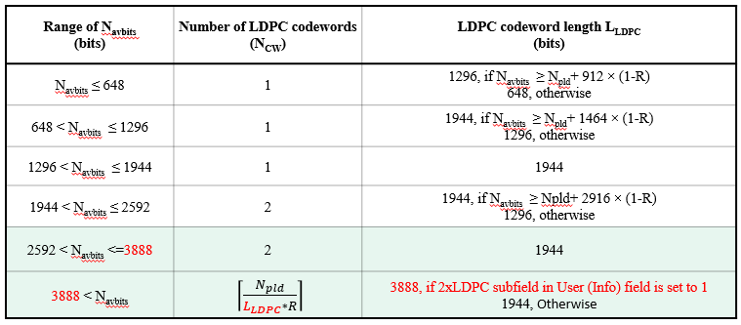
Motion 55 (PHY)
Move to add to the TGbn SFD the following:
Update the LDPC PPDU encoding parameter table for UHR as below:
  If FEC coding scheme is LDPC and Navbits ≤ 3888, the 2xLDPC subfield shall be set to 0 and the LDPC codeword length selection shall follow the pre-UHR LDPC procedure, specifically using codeword lengths (648, 1296, or 1944) bits based on the table below
Move: Shengquan Hu Second: Juan Fang
Discussion: None.
Result: Approved with unanimous consent.
Reference documents:[24/1828r1]. SP result:80Y/9N/27A.

Slide 64
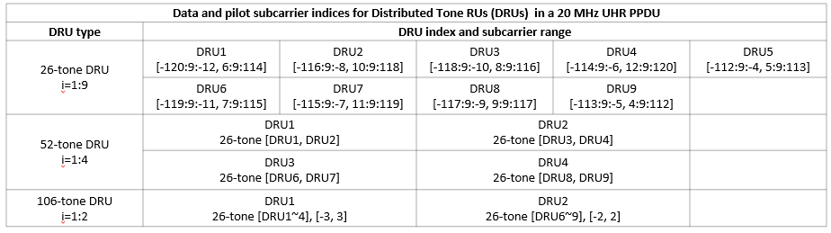
Motion 56 (PHY)
Move to add to the TGbn SFD the following:
Data and pilot subcarrier indices for DRUs in a 20 MHz UHR PPDU are defined in following table:
Move: Shengquan Hu Second: Lin Yang
Discussion: None.
Result: Approved with unanimous consent.
Reference documents:[24/0468r2]. SP result:51Y/11N/23A.

Slide 65
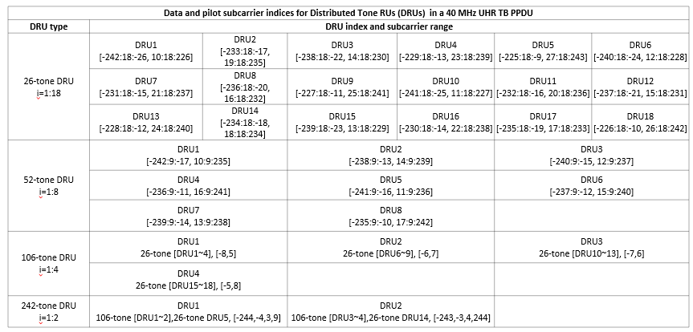
Motion 57 (PHY)
Move to add to the TGbn SFD the following:
Data and pilot subcarrier indices for DRUs in a 40 MHz UHR PPDU are defined in following table:
Move: Shengquan Hu Second: Lin Yang
Discussion: None.
Result: Approved with unanimous consent.
Reference documents:[24/0468r2]. SP result: No objection.

Slide 66
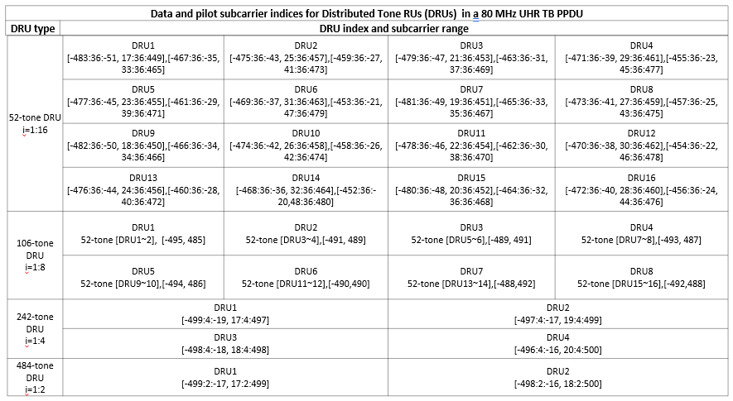
Motion 58 (PHY)
Move to add to the TGbn SFD the following:
Data and pilot subcarrier indices for DRUs in an 80 MHz UHR PPDU are defined in following table:
Move: Shengquan Hu Second: Lin Yang
Discussion: None.
Result: Approved with unanimous consent.
Reference documents:[24/0468r2]. SP result: No objection.

Slide 67
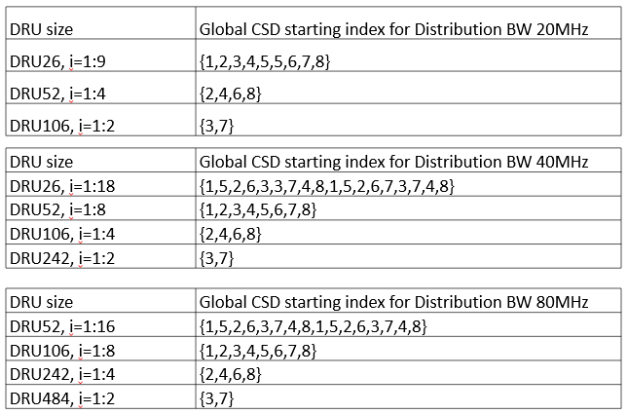
Motion 59 (PHY)
Move to add to the TGbn SFD the following:
DRU index based global CSD start index assignment will be used for DRU UHR-STF transmission
Global CSD start index assignment for DRU UHR-STF transmission will be based on the following table
Move: Shengquan Hu Second: Lin Yang
Discussion: None.
Result: Approved with unanimous consent.
Reference documents:[24/1188r2]. SP result: No objection.

Slide 68
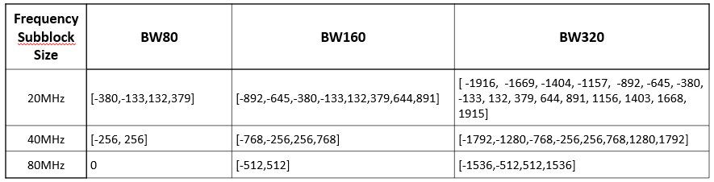
Motion 60 (PHY)
Move to add to the TGbn SFD the following:
DRUs on frequency subblocks of wide bandwidth PPDU should be defined as DRUs on 20MHz, 40MHz and 80MHz PPDU with the following constant shifts
Move: Shengquan Hu Second: Jianhan Liu
Discussion: None.
Result: Approved with unanimous consent.
Reference documents:[24/1189r1]. SP result: No objection.

Slide 69
Motion 61 (PHY)
Move to add to the TGbn SFD the following:
Use 4-bit bitmap in Common Info field (B56-B59) for DRU indication
  1 bit/80MHz to indicate each 80MHz is used for DRU or RRU
Move: Shengquan Hu Second: Lin Yang
Discussion: None.
Result: Approved with unanimous consent.
Reference documents:[24/1489r1]. SP result: No objection.

Slide 70
Motion 62 (PHY)
Move to add to the TGbn SFD the following:
Re-purpose 2 bits of SS Allocation subfield in User Info field for distribution bandwidth indication if DRU
Move: Shengquan Hu Second: Lin Yang
Discussion: None.
Result: Approved with unanimous consent.
Reference documents:[24/1489r1]. SP result: No objection.

Slide 71
Motion 63 (PHY)
Move to add to the TGbn SFD the following:
Minimum size of RRU in hybrid mode in 160MHz and 320MHz is 242
Move: Shengquan Hu Second: Lin Yang
Discussion: None.
Result: Approved with unanimous consent.
Reference documents:[23/2020r3]. SP result: No objection.

Slide 72
Motion 64 (PHY)
Move to add to the TGbn SFD the following:
DRU distribution bandwidth of 60 MHz is defined in an 80 MHz frequency subblock (with the highest 20 MHz subchannel unallocated) in a UHR TB PPDU
No allocation is made in the highest 20 MHz subchannel
Move: Yan Xin Second: Ross J. Yu
Discussion: None.
Result: Approved with unanimous consent.
Reference documents:[24/1856r1]. SP result: No objection.

Slide 73
Motion 65 (PHY)
Move to add to the TGbn SFD the following:
11bn supports the following DBW dependent DRU size support to maximize BW and power efficiency
  No MRU in distributed transmission
  20MHz: RU26, RU52, RU106
  40MHz: RU26, RU52, RU106, RU242
  80MHz: RU52, RU106, RU242, RU484
Move: Lin Yang Second: Shengquan Hu
Discussion: None.
Result: Approved with unanimous consent.
Reference documents:[24/1510r2]. SP result: No objection.

Slide 74
Motion 66 (PHY)
Move to add to the TGbn SFD the following:
11bn supports per 80MHz DRU/RRU switch if PPDU BW >80MHz and no hybrid DRU and RRU mode for up to 80MHz
Move: Lin Yang Second: Shengquan Hu
Discussion: None.
Result: Approved with unanimous consent.
Reference documents:[24/1510r2]. SP result: No objection.

Slide 75
Motion 67 (PHY)
Move to add to the TGbn SFD the following:
In mixed RRU and DRU transmission the RRU LTF follows the exact same rule as if there is no DRU. The DRU LTF sequence depends on the distribution BW
Move: Lin Yang Second: Shengquan Hu
Discussion: None.
Result: Approved with unanimous consent.
Reference documents:[24/1510r2]. SP result: No objection.

Slide 76
Motion 68 (PHY)
Move to add to the TGbn SFD the following:
DRU transmission uses single stream pilots in both LTF and data portion
Move: Lin Yang Second: Ross J. Yu
Discussion: None.
Result: Approved with unanimous consent.
Reference documents:[24/1510r2]. SP result: No objection.

Slide 77
Motion 69 (PHY)
Move to add to the TGbn SFD the following:
DRU only uses 4x LTF
Move: Lin Yang Second: Bin Tian
Discussion: None.
Result: Approved with unanimous consent.
Reference documents:[24/1510r2]. SP result: No objection.

Slide 78
Motion 70 (PHY)
Move to add to the TGbn SFD the following:
In DRU transmission, global CSD provides CSD start index i for each DRU. If Nss for this DRU is larger than 1, then it will use CSD[mod(i: i+Nss-1, 8)] for each ss
Move: Lin Yang Second: Shengquan Hu
Discussion: None.
Result: Approved with unanimous consent.
Reference documents:[24/1510r2]. SP result: No objection.

Slide 79
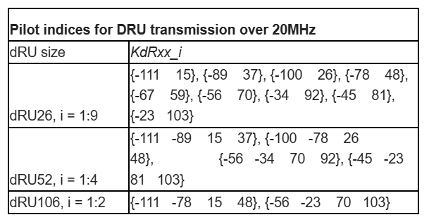
Motion 71 (PHY)
Move to add to the TGbn SFD the following:
The following pilot index table from hierarchical uniform pilot structure of distance of 11 will be used for distributed transmission over 20MHz
Move: Lin Yang Second: Shengquan Hu
Discussion: None.
Result: Approved with unanimous consent.
Reference documents:[24/1510r2]. SP result: No objection.

Slide 80
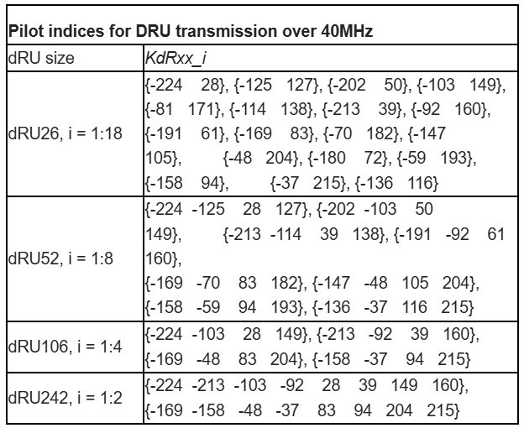
Motion 72 (PHY)
Move to add to the TGbn SFD the following:
The following pilot index table from hierarchical uniform pilot structure of distance of 11 will be used for distributed transmission over 40MHz
Move: Lin Yang Second: Shengquan Hu
Discussion: None.
Result: Approved with unanimous consent.
Reference documents:[24/1510r2]. SP result: No objection.

Slide 81
Motion 73 (PHY)
Move to add to the TGbn SFD the following:
The following pilot index table from hierarchical uniform pilot structure of distance of 11 will be used for distributed transmission over 80MHz
Move: Lin Yang Second: Shengquan Hu
Discussion: None.
Result: Approved with unanimous consent.
Reference documents:[24/1510r2]. SP result: No objection.
Pilot indices for DRU transmission over 80MHz
dRU size | KdRxx_i
dRU52, i = 1:16 | {-447 -359 53 141}, {-403 -315 97 185}, {-227 -139 273 361}, {-183 -95 317 405}, {-425 -117 75 383}, {-381 -73 119 427}, {-337 -249 163 251}, {-293 -205 207 295}, {-194 -106 306 394}, {-150 -62 350 438}, {-370 -282 130 218}, {-326 -238 174 262}, {-260 -172 240 328}, {-216 -128 284 372}, {-392 -84 108 416}, {-436 -348 64 152}
dRU106, i = 1:8 | {-403 -315 97 185}, {-227 -139 273 361}, {-381 -117 119 383}, {-293 -205 207 295}, {-150 -62 350 438}, {-326 -238 174 262}, {-260 -172 240 328}, {-348 -84 152 416}
dRU242, i = 1:4 | {-403 -315 -227 -139 97 185 273 361}, {-381 -293 -205 -117 119 207 295 383}, {-326 -238 -150 -62 174 262 350 438}, {-348 -260 -172 -84 152 240 328 416}
dRU484, i = 1:2 | {-403 -381 -315 -293 -227 -205 -139 -117 97 119 185 207 273 295 361 383}, {-348 -326 -260 -238 -172 -150 -84 -62 152 174 240 262 328 350 416 438}

Slide 82
Motion 74 (PHY)
Move to add to the TGbn SFD the following:
Define an enhanced long range (ELR) PPDU in IEEE 802.11bn with the following targets
  Downlink and Uplink in 2.4 GHz (within BSS range with 11b beacon)
  Uplink only in 5 GHz and 6 GHz bands
  Minimum data rate is greater than or equal to 1.5 Mbps
Move: Wook Bong Lee Second: Tianyu Wu
Discussion: None.
Result: Approved with unanimous consent.
Reference documents:[24/1573r1]. SP result: No objection.

Slide 83
Motion 75 (PHY)
Move to add to the TGbn SFD the following:
In ELR PPDU, STA boosts L-STF and L-LTF by 3 dB
  For UL, non-AP STA corrects CFO before transmission
  Note: Non-AP STA pre-correction CFO requirement for residual CFO is TBD
Move: Wook Bong Lee Second: Anuj Batra
Discussion: None.
Result: Approved with unanimous consent.
Reference documents:[24/1573r1]. SP result:51Y/6N/23A.

Slide 84
Motion 76 (PHY)
Move to add to the TGbn SFD the following:
ELR PPDU only supports the following two modulation and coding schemes:
  BPSK with coding rate R=1/2
  QPSK with coding rate R=1/2
Move: Shengquan Hu Second: Wook Bong Lee
Discussion: None.
Result: Approved with unanimous consent.
Reference documents:[24/1488r0]. SP result:61Y/6N/9A.

Slide 85
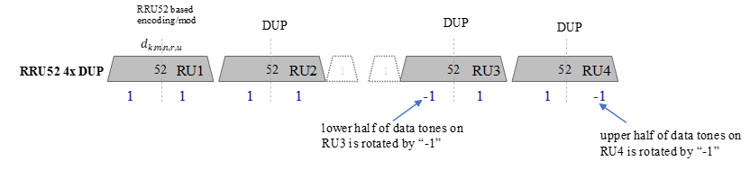
Motion 77 (PHY)
Move to add to the TGbn SFD the following:
ELR transmission shall apply the phase rotations as below for both BPSK and QPSK modulations
  The rotation of -1 will be applied on data subcarriers of lower half of RU3 and upper half of RU4 for 52-tone regular RU (RRU52) on 20MHz
Move: Shengquan Hu Second: Lin Yang
Discussion: None.
Result: Approved with unanimous consent.
Reference documents:[24/1488r0]. SP result: No objection.

Slide 86
Motion 78 (PHY)
Move to add to the TGbn SFD the following:
ELR packet detection is done at L-STF, which has same length as legacy with 3dB power boosting
  L-LTF also has same length as legacy with same power boosting as L-STF
Move: Lin Yang Second: Wook Bong Lee
Discussion: None.
Result: Approved with unanimous consent.
Reference documents:[24/1478r4]. SP result: 49Y, 8N, 14A.

Slide 87
Motion 79 (PHY)
Move to add to the TGbn SFD the following:
U-SIG carries STA-ID in ELR PPDU
Move: Lin Yang Second: Wook Bong Lee
Discussion: None.
Result: Approved with unanimous consent.
Reference documents:[24/1478r4]. SP result: No objection.

Slide 88
Motion 80 (PHY)
Move to add to the TGbn SFD the following:
Define two ELR-Mark symbols for ELR mode classification
  ELR-Mark symbols carry a known sequence to receiver
  ELR-Mark symbols carry BSS color info in ELR-Mark sequence
  No power boosting on ELR-Mark symbols
  Two ELR-Mark symbols are both QBPSK modulated on data subcarriers
  ELR-Mark symbols use the following tone plan
    4 regular pilots as EHT-SIG + 48 data tones
Move: Lin Yang Second: Leo Montreuil
Discussion: None.
Result: Approved with unanimous consent.
Reference documents:[24/1478r4]. SP result: No objection.

Slide 89
Motion 81 (PHY)
Move to add to the TGbn SFD the following:
11bn defines the following PPDU frame format for ELR
  PE TBD
Move: Lin Yang Second: Wook Bong Lee
Discussion: None.
Result: Approved with unanimous consent.
Reference documents:[24/1478r4]. SP result: No objection.

Slide 90
Motion 82 (PHY)
Move to add to the TGbn SFD the following:
ELR PPDU has 3dB boosting applied on both ELR-STF and ELR-LTF
  ELR PPDU has ELR-STF duration and sequence same as that of UHR DL SU/MU PPDU
    4us using EHT-STF sequence for 20MHz
ELR PPDU defines a fixed/single mode of LTF+GI
  11bn supports 2x LTF+1.6us GI only for ELR PPDU
  11bn uses two UHR-LTF symbols for ELR PPDU
Note that ELR-STF/ELR-LTF are the short names of UHR-STF/UHR-LTF for ELR PPDU
Move: Lin Yang Second: Wook Bong Lee
Discussion: None.
Result: Approved with unanimous consent.
Reference documents:[24/1478r4]. SP result: No objection.

Slide 91
Motion 83 (PHY)
Move to add to the TGbn SFD the following:
ELR PPDU defines two symbols for ELR-SIG, specifically
  ELR PPDU defines separately encoded two symbols for ELR-SIG
    Each symbol has separate CRC and tail bits (6 bits)
  ELR-SIG has same tone plan and duplication scheme as ELR-data and BCC encoded with MCS0
Move: Lin Yang Second: Shengquan Hu
Discussion: None.
Result: Approved with unanimous consent.
Reference documents:[24/1478r4]. SP result: No objection.

Slide 92
Motion 84 (PHY)
Move to add to the TGbn SFD the following:
For a (non-ELR) UHR MU PPDU, when EQM/UEQM indicates UEQM in a User field for non-MU-MIMO, there exists a MCS field, a NSS field and a 2 bit field indicating UEQM patterns.
Move: Ross J. Yu Second: Jianhan Liu
Discussion: None.
Result: Approved with unanimous consent.
Reference documents:[24/1772r0]. SP result:64Y, 10N, 12A.

Slide 93
Motion 85 (PHY)
Move to add to the TGbn SFD the following:
For a DRU transmission, a new 4x UHR-LTF sequence is defined in each distribution bandwidth
  A 4x UHR-LTF sequence has coefficients on all tones overlapped with DRU tones defined in each distribution bandwidth
Move: Eunsung Park Second: Shengquan Hu
Discussion: None.
Result: Approved with unanimous consent.
Reference documents:[24/1097r1]. SP result: no objection.

Slide 94
Motion 86 (PHY)
Move to add to the TGbn SFD the following:
In a PPDU using DRUs, a UHR-LTF sequence corresponding to the distribution bandwidth of the DRUs is used regardless of the PPDU bandwidth
Move: Eunsung Park Second: Lin Yang
Discussion: None.
Result: Approved with unanimous consent.
Reference documents:[24/1097r1]. SP result: no objection.

Slide 95
Motion 87 (PHY)
Move to add to the TGbn SFD the following:
For 80 MHz PPDU where one of the 20 MHz channels is punctured, the following distribution bandwidth mode is allowed for DRU
  20 MHz + 40 MHz (or 40 MHz + 20 MHz) mode
Move: Eunsung Park Second: Lin Yang
Discussion: None.
Result: Approved with unanimous consent.
Reference documents:[24/1471r3]. SP result: no objection.

Slide 96
Motion 88 (PHY)
Move to add to the TGbn SFD the following:
For 160 MHz and 320 MHz PPDUs, in an 80 MHz frequency subblock where one of the 20 MHz channels is punctured, the following distribution bandwidth mode is allowed for DRU
  20 MHz + 40 MHz (or 40 MHz + 20 MHz) mode
Move: Eunsung Park Second: Ross J. Yu
Discussion: None.
Result: Approved with unanimous consent.
Reference documents:[24/1471r3]. SP result: no objection.

Slide 97
Motion 89 (PHY)
Move to add to the TGbn SFD the following:
For 160 MHz and 320 MHz PPDUs, in an 80 MHz frequency subblock where one of the 40 MHz channels is punctured (i.e., either 1100 or 0011 case), the following distribution bandwidth mode is allowed for DRU
  40 MHz mode
Move: Eunsung Park Second: Yan Xin
Discussion: None.
Result: Approved with unanimous consent.
Reference documents:[24/1471r3]. SP result: 46Y/12N/16A.

Slide 98
Motion 90 (PHY)
Move to add to the TGbn SFD the following:
For a 40 MHz PPDU, the following distribution bandwidth mode is allowed for DRU
  Only 40 MHz mode
Move: Eunsung Park Second: Lin Yang
Discussion: None.
Result: Approved with unanimous consent.
Reference documents:[24/1471r3]. SP result: no objection.

Slide 99
Motion 91 (PHY)
Move to add to the TGbn SFD the following:
The U-SIG field in ELR PPDU consists of 2 OFDM symbols and includes the same version independent fields defined in the U-SIG field of EHT PPDU
The details for the version dependent fields are TBD.
Move: Dongguk Lim Second: Wook Bong Lee
Discussion: None.
Result: Approved with unanimous consent.
Reference documents:[24/1485r2]. SP result: No objection.

Slide 100
Motion 92 (PHY)
Move to add to the TGbn SFD the following:
The BW of ELR PPDU is 20MHz and one Spatial stream is used for ELR transmission.
Move: Dongguk Lim Second: Lin Yang
Discussion: None.
Result: Approved with unanimous consent.
Reference documents:[24/1486r1]. SP result: No objection.

Slide 101
Motion 93 (PHY)
Move to add to the TGbn SFD the following:
In the ELR transmission, a repeating of 52-tone RRU is used in 20MHz.
  The same data is repeated in four 52-tone RRUs in 20 MHz.
  The subcarrier allocation of 52-tone RRU equals the 52-tone RU defined in 11be.
Move: Dongguk Lim Second: Shengquan Hu
Discussion: None.
Result: Approved with unanimous consent.
Reference documents:[24/1486r1]. SP result: No objection.

Slide 102
Motion 94 (PHY)
Move to add to the TGbn SFD the following:
ELR LDPC rate matching will reuse the existing 802.11ac LDPC rate matching with 1-bit LDPC extra OFDM symbol indication.
Move: Juan Fang Second: Eunsung Park
Discussion: None.
Result: Approved with unanimous consent.
Reference documents:[24/1590r1]. SP result: no objection.

Slide 103
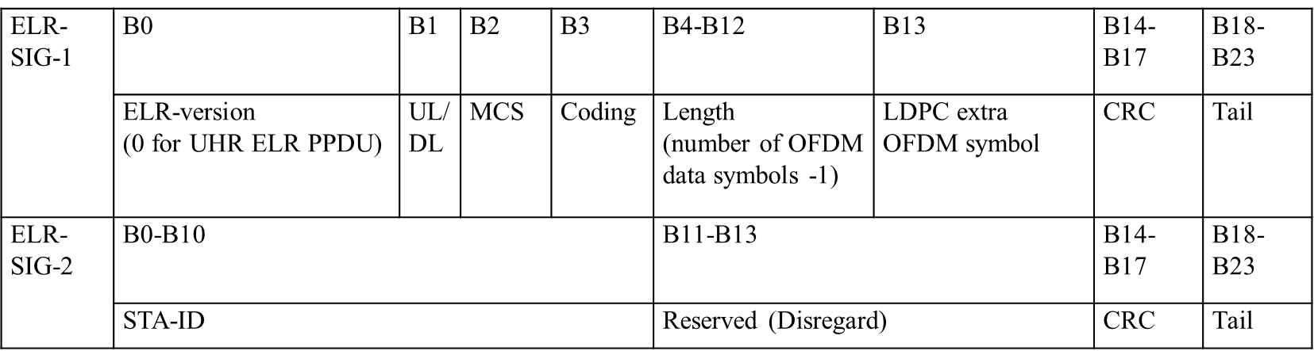
Motion 95 (PHY)
Move to add to the TGbn SFD the following:
ELR-SIG will use the following two OFDM symbols design.
Move: Juan Fang Second: Ross J. Yu
Discussion: None.
Result: Approved with unanimous consent.
Reference documents:[24/1590r1]. SP result: No objection.

Slide 104
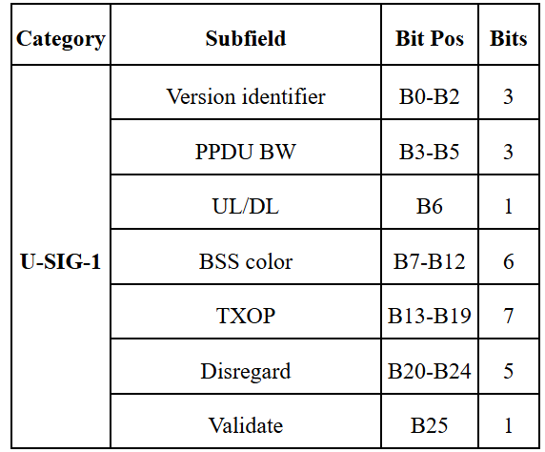
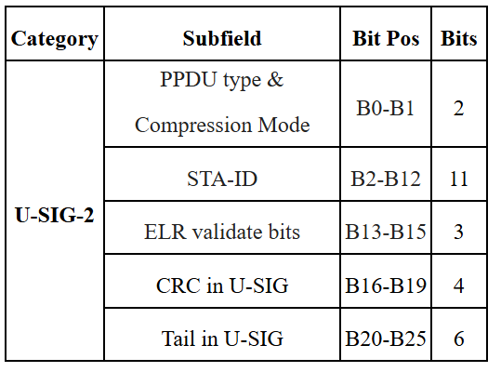
Motion 96 (PHY)
Move to add to the TGbn SFD the following:
The contents of the U-SIG field in ELR PPDU is defined as follows.
  ELR PPDU indication: PPDU type & compression mode set to ‘11’.
  STA-ID (11 bit): B2-B12 bit in USIG-2.
  ELR validate bits (B13-B15 of USIG-2): Set to all ‘1’ for ELR PPDU.
  Note: B11-B15 – in EHT MU PPDU indicates “Number of EHT-Sig symbols”, and in UHR MU PPDU indicates “Number of UHR-Sig symbols”
Move: Hari Ram Balakrishnan Second: Lin Yang
Discussion: None.
Result: Approved with unanimous consent.
Reference documents:[24/1592r1]. SP result: No objection.

Slide 105
Motion 97 (PHY)
Move to add to the TGbn SFD the following:
Both sequential NDP based and joint NDP based sounding options will be supported for COBF in 802.11bn.
Move: Rethna Pulikkoonattu Second: Sameer Vermani
Discussion: None.
Result: Approved with unanimous consent.
Reference documents:[24/1568r1]. SP result: No objection.

Slide 106
Motion 98 (PHY)
Move to add to the TGbn SFD the following:
Two separate capabilities shall be defined for the maximum number of spatial streams supported for reception of a sounding NDP in UHR and the maximum total number of streams (across all users) supported for reception in UHR DL MU-MIMO and CoBF PPDUs
  The only possible values for each capability are 4 and 8.
Move: Rethna Pulikkoonattu Second: You-Wei Chen
Discussion: None.
Result: Approved with unanimous consent.
Reference documents:[24/1568r1]. SP result: No objection.

Slide 107
Motion 99 (PHY)
Move to add to the TGbn SFD the following:
The Coordinated beamforming (COBF) transmission phase in 802.11bn shall be limited to 2 APs.
Move: Sameer Vermani Second: Tianyu Wu
Discussion: None.
Result: Approved with unanimous consent.
Reference documents:[24/1542r5]. SP result: No objection.

Slide 108
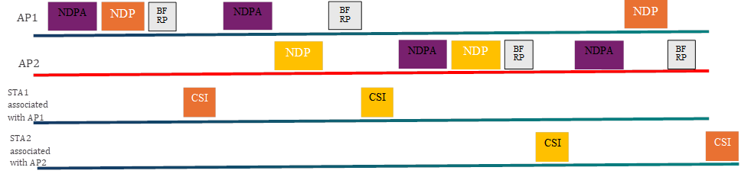
Motion 100 (PHY)
Move to add to the TGbn SFD the following:
The sequential NDP based sounding protocol will be as shown below for COBF
  Sounding happens one BSS at a time
  NDPA only addresses the in-BSS STAs
  MAC related additional frames are TBD.
Move: Sameer Vermani Second: You-Wei Chen
Discussion: Some discussion.
Preliminary Result: 199Y, 24N, 47A.
Result: 193Y, 24N, 43A (pass)
Reference documents:[24/1542r5]. SP result:60Y/12N/23A.

Slide 109
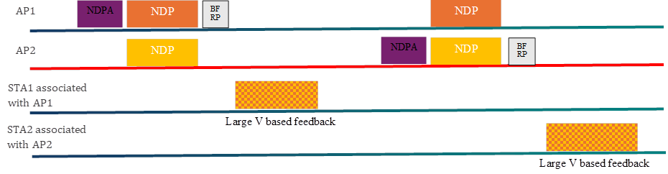
Motion 101 (PHY)
Move to add to the TGbn SFD the following:
The joint NDP based sounding protocol will be as shown below for COBF
  Sounding happens for one BSS’s STAs at a time
  NDPA only addresses the in-BSS STAs
  MAC related additional frames are TBD
  Joint NDP based feedback will be based on large V-based feedback where the eigen-vectors span the antennas across both Aps .
Move: Sameer Vermani Second: Rethna Pulikkoonattu
Discussion: Minor clarifications.
Result: Approved with unanimous consent.
Reference documents:[24/1542r5]. SP result: No objection.

Slide 110
Motion 102 (PHY)
Move to add to the TGbn SFD the following:
For joint NDP based sounding, one AP will frequency synchronize to the other for both of its NDP transmissions
  For both the NDPs, the AP doing the correction brings its frequency within a certain TBD range of the reference AP.
Move: Sameer Vermani Second: Alice J. Chen
Discussion: None.
Result: Approved with unanimous consent.
Reference documents:[24/1542r5]. SP result:56Y, 7N, 27A.

Slide 111
Motion 103 (PHY)
Move to add to the TGbn SFD the following:
In the UHR sounding process for COBF, for the joint sounding case as well as for the sequential sounding case, the NDP shall always carry the BSS color of the AP which transmitted the NDPA.
Move: Sameer Vermani Second: Juan Fang
Discussion: None.
Result: Approved with unanimous consent.
Reference documents:[24/1542r5]. SP result: No objection.

Slide 112
Motion 104 (PHY)
Move to add to the TGbn SFD the following:
ELR Mark symbols will be composed of two 1x OFDM symbols. Each symbol will have a duration of 4μS (3.2μS + GI=0.8μS).
Move: Rethna Pulikkoonattu Second: Wook Bong Lee
Discussion: None.
Result: Approved with unanimous consent.
Reference documents:[24/1571r2]. SP result: No objection..

Slide 113
Motion 105 (PHY)
Move to add to the TGbn SFD the following:
ELR Mark symbols will have the following tone mapping:
  The 48 data tones are Q-BPSK mapped
  The pilots follow BPSK mapping (polarity -1 applied to [1,1,1,-1]).
Move: Rethna Pulikkoonattu Second: Lin Yang
Discussion: None.
Result: Approved with unanimous consent.
Reference documents:[24/1571r2]. SP result: No objection.

Slide 114
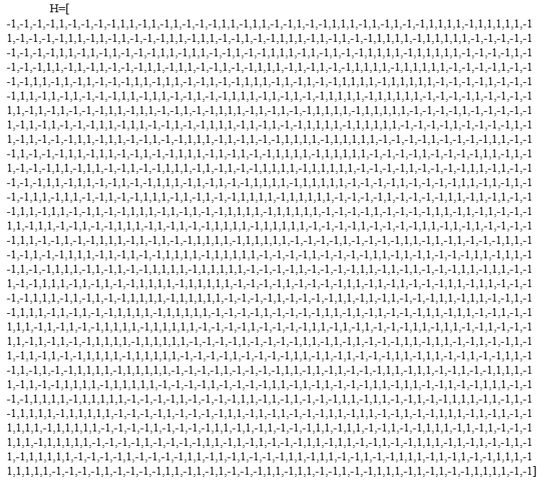
Motion 106 (PHY)
Move to add to the TGbn SFD the following:
Adopt the ELR Mark sequence design as described by the matrix H in 24/1571r2. The detailed design is as described in the slides 8-9 of 24/1571r2.
  𝐻́ = [𝐻 𝐻𝕁; 𝐻 -𝐻𝕁], where 𝕁 is the exchange matrix of size 48x48
Move: Rethna Pulikkoonattu Second: Lin Yang
Discussion: None.
Result: Approved with unanimous consent.
Reference documents:[24/1571r2]. SP result: No objection.

Slide 115
Motion 107 (PHY)
Move to add to the TGbn SFD the following:
The following design for 20MHz 4xLTF for DRU:
  LTF-122:122 = [ ...
  0 0 -1 +1 -1 +1 -1 +1 +1 +1 -1 +1 +1 -1 +1 -1 -1 -1 -1 +1 -1 -1 +1 -1 -1 +1 +1 -1 -1 -1 -1 -1 -1 -1 +1 ...
  +1 -1 +1 -1 +1 +1 -1 +1 -1 +1 -1 -1 -1 -1 -1 +1 +1 +1 -1 +1 +1 -1 -1 +1 +1 -1 +1 -1 +1 -1 +1 -1 -1 +1 -1 ...
  +1 +1 +1 +1 -1 +1 +1 -1 +1 -1 -1 -1 +1 +1 -1 +1 -1 -1 +1 -1 -1 -1 -1 -1 -1 +1 -1 +1 -1 -1 +1 +1 -1 +1 +1 ...
  -1 +1 +1 -1 +1 +1 -1 +1 -1 +1 -1 +1 -1 -1 +1 -1 0 0 0 -1 +1 -1 +1 -1 -1 +1 -1 -1 -1 +1 -1 +1 -1 -1 -1 ...
  +1 +1 +1 -1 +1 -1 -1 -1 -1 -1 -1 -1 -1 -1 -1 -1 +1 +1 -1 +1 -1 -1 -1 -1 +1 +1 +1 +1 +1 -1 -1 +1 -1 -1 +1 ...
  +1 -1 -1 -1 -1 +1 -1 +1 +1 -1 -1 +1 +1 +1 -1 -1 +1 -1 -1 -1 -1 +1 -1 +1 +1 -1 -1 +1 -1 +1 +1 -1 +1 +1 -1 ...
  +1 +1 -1 +1 +1 -1 +1 -1 +1 -1 -1 +1 +1 -1 -1 -1 -1 +1 +1 +1 -1 -1 -1 -1 +1 -1 -1 -1 +1 +1 +1 -1 +1 0 0 ];
Move: Rethna Pulikkoonattu Second: Shengquan Hu
Discussion: None.
Result: Approved with unanimous consent.
Reference documents:[24/1567]. SP result:59Y, 13 N, 21A.

Slide 116
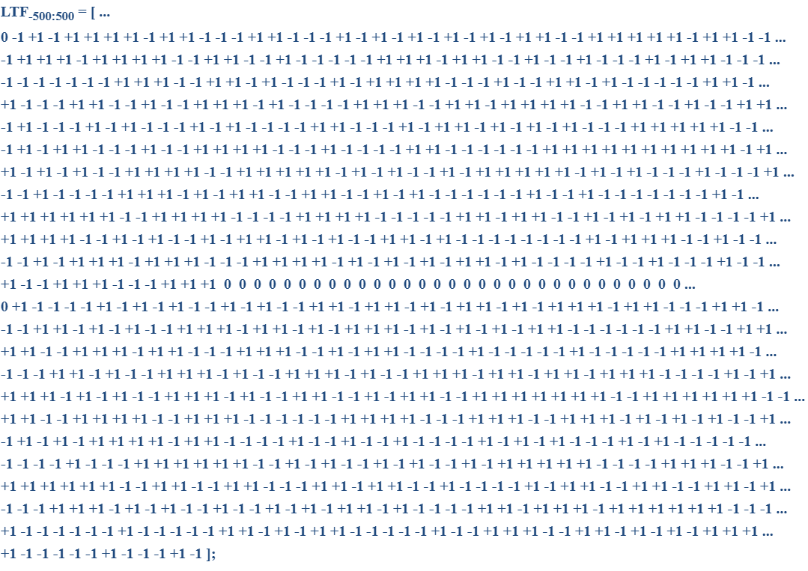
Motion 108 (PHY)
Move to add to the TGbn SFD the following:
The following design for 80MHz 4xLTF for DRU
Move: Rethna Pulikkoonattu
Second: Shengquan Hu
Discussion: None.
Result: Approved with unanimous consent.
Reference documents:[24/1567]. SP result:74Y 8N, 30A.

Slide 117
Motion 109 (PHY)
Move to add to the TGbn SFD the following:
The 40MHz DBW 4xLTF sequence design for DRU is the following.
  LTF_{-244:244}=[-1 1 -1 -1 -1 1 -1 -1 1 1 1 -1 1 1 1 1 1 1 1 -1 -1 1 1 -1 1 -1 -1 1 1 -1 -1 1 -1 1 -1 1 1 -1 1 1 1 1 -1 -1 1 -1 -1 1 1 1 -1 -1 -1 -1 -1 1 1 1 1 -1 1 -1 -1 1 -1 1 -1 1 -1 1 1 1 1 1 1 -1 1 -1 -1 1 -1 -1 -1 -1 1 -1 -1 -1 1 -1 -1 1 -1 -1 -1 -1 -1 1 -1 1 -1 1 -1 1 1 -1 -1 -1 1 1 -1 -1 1 1 -1 -1 1 -1 1 -1 1 -1 1 1 1 1 -1 -1 -1 -1 -1 -1 -1 -1 -1 -1 1 1 1 1 1 1 1 -1 -1 1 -1 -1 1 -1 -1 -1 -1 1 1 -1 -1 1 -1 1 -1 1 -1 -1 1 -1 1 1 1 1 1 1 1 1 -1 -1 1 -1 -1 1 -1 1 1 -1 1 1 1 1 1 -1 1 1 1 -1 1 -1 1 1 -1 -1 -1 -1 1 -1 -1 1 -1 1 1 1 -1 -1 -1 -1 1 -1 -1 1 1 -1 1 1 1 1 1 1 1 1 1 -1 1 1 1 1 -1 -1 1 -1 1 -1 1 -1 0 0 0 0 0 -1 -1 -1 -1 1 -1 1 -1 -1 1 -1 1 1 -1 -1 1 1 -1 1 1 1 -1 1 1 -1 1 1 -1 -1 -1 -1 1 -1 -1 -1 -1 -1 1 1 -1 1 1 1 -1 -1 -1 -1 -1 -1 -1 -1 1 -1 -1 1 -1 1 1 1 -1 1 -1 1 -1 -1 -1 -1 1 -1 1 1 -1 1 1 1 -1 -1 -1 -1 -1 1 1 -1 1 1 1 1 -1 -1 -1 1 1 1 1 -1 -1 1 -1 -1 -1 -1 1 -1 1 -1 -1 1 -1 -1 -1 -1 -1 1 -1 1 -1 1 1 1 -1 -1 1 -1 1 1 -1 -1 -1 1 -1 1 -1 1 -1 -1 -1 1 1 1 -1 -1 -1 -1 1 1 1 -1 1 -1 1 1 1 -1 -1 -1 1 1 1 1 -1 -1 1 1 -1 1 -1 -1 1 1 -1 1 -1 -1 -1 1 1 1 -1 1 1 -1 1 -1 1 -1 -1 1 1 1 1 -1 1 -1 1 1 1 1 -1 -1 -1 -1 -1 1 -1 -1 -1 -1 1 1 1 1 -1 -1 1 1 -1 1 1 1 1 -1 1 -1 1 1 -1 1 1 -1 -1 -1 -1 -1 1 -1 1 1 1 -1 -1 1 -1]
Move: Chenchen Liu Second: Lin Yang
Discussion: None.
Result: Approved with unanimous consent.
Reference documents:[24/1901r0]. SP result: No objection.

Slide 118
Motion 110 (PHY)
Move to add to the TGbn SFD the following:
Pilot values and mapping rules of ELR-SIG and Data symbols in ELR PPDU are the same as that of four RRU52 in DL OFDMA
Move: Shengquan Hu Second: Lin Yang
Discussion: None.
Result: Approved with unanimous consent.
Reference documents:[24/1488r1]. SP result: No objection.

Slide 119
Motion 111 (PHY)
Move to add to the TGbn SFD the following:
The pre-UHR portion (the portion up-to and including UHR-SIG) of the COBF PPDU shall be transmitted in a non-beamformed (omni) manner.
Move: Sameer Vermani Second: You-Wei Chen
Discussion: None.
Result: Approved with unanimous consent.
Reference documents:[24/1822r3]. SP result: No objection.

Slide 120
Motion 112 (PHY)
Move to add to the TGbn SFD the following:
The pre-UHR portion of a COBF PPDU shall have identical content across two APs.
Move: Sameer Vermani Second: Juan Fang
Discussion: None.
Result: Approved with unanimous consent.
Reference documents:[24/1822r3]. SP result: No objection.

Slide 121
Motion 113 (PHY)
Move to add to the TGbn SFD the following:
COBF data transmission shall be indicated in the U-SIG for IEEE802.11bn .
Move: Sameer Vermani Second: Alice J. Chen
Discussion: None.
Result: Approved with unanimous consent.
Reference documents:[24/1822r3]. SP result: No objection.

Slide 122
Motion 114 (PHY)
Move to add to the TGbn SFD the following:
In a COBF transmission, the maximum number of spatial streams given to one user will be 2.
Move: Sameer Vermani Second: Juan Fang
Discussion: None.
Result: Approved with unanimous consent.
Reference documents:[24/1822r3]. SP result: No objection.

Slide 123
Motion 115 (PHY)
Move to add to the TGbn SFD the following:
For the maximum number of spatial streams supported for reception of sounding NDP in UHR and the maximum total number of streams (across all users) supported for reception in UHR DL MU-MIMO and COBF PPDUs:
  4 is mandatory except for a non-AP STA with 20 MHz-Only Limited Capabilities Support subfield equal to 1.
  8 is optional for DL MU-MIMO and sounding NDP (Note: More than 4 is not allowed for COBF PPDUs
Move: You-Wei Chen Second: Sameer Vermani
Discussion: None.
Result: Approved with unanimous consent.
Reference documents:[24/1582r2]. SP result: No objection.

Slide 124
Motion 116 (PHY)
Move to add to the TGbn SFD the following:
The COBF sequential sounding support to be conditional mandatory if the device supports COBF.
Move: You-Wei Chen Second: Sameer Vermani
Discussion: None.
Result: Approved with unanimous consent.
Reference documents:[24/1582r2]. SP result: No objection.

Slide 125
Motion 117 (PHY)
Move to add to the TGbn SFD the following:
UHR defines unequal modulation which uses joint LDPC encoding across multiple spatial streams while at least one spatial stream uses a different modulation order compared to the first spatial stream, and is applicable only to non-MU-MIMO beamformed transmissions using 2 to 4 spatial streams in a UHR MU PPDU.
Move: Alice Chen Second: Shengquan Hu
Discussion: None.
Result: Approved with unanimous consent.
Reference documents:[11-24/474, 11-24/498r4, 11-24/507]. SP result: No objection.

Slide 126
Motion 118 (PHY)
Move to add to the TGbn SFD the following:
For sequential NDP based sounding, one AP will frequency synchronize to the other for both of its NDP transmissions
For both its NDPs, the AP doing the correction brings its frequency within a certain TBD range of the reference AP.
Move: Sameer Vermani Second: Rethna Pulikkoonattu
Discussion: None.
Result: Approved with unanimous consent.
Reference documents:[24/1542r5]. SP result: No objection.

Slide 127
Motion 119
This page is left intentionally blank

Slide 128
Motion 120 (MAC)
Move to add to the TGbn SFD the following:
A UHR AP shall indicate to another AP its capability to respond in a TB PPDU or not
Move: Sanket Kalamkar Second: George Cherian
Discussion: None.
Result: Approved with unanimous consent.
Reference documents:[23/1895, 24/0423, 24/1016, 24/1017, 24/1225]. SP result:120(Y)/33(N)/44(A).

Slide 129
Motion 121 (MAC)
Move to add to the TGbn SFD the following:
As part of the C-TDMA procedure, a sharing AP may solicit a poll response in a TB PPDU from another AP only if the other AP has indicated support for responding via a TB PPDU
Move: Sanket Kalamkar Second: Abhishek Patil
Discussion: None.
Result: Approved with unanimous consent.
Reference documents:[23/1895, 24/0423, 24/1016, 24/1017, 24/1225]. SP result:137(Y)/21(N)/42(A).

Slide 130
Motion 122 (MAC)
Move to add to the TGbn SFD the following:
If a UHR STA (UHR non-AP STA or UHR Mobile AP) operates with the power save mode where the STA transitions from a lower capability mode to a higher capability mode upon reception of an initial control frame (that we call power save mode DPS), then its associated peer UHR STA shall include an intermediate FCS, if needed by the STA, in the initial control frame that it transmits to the STA.
  Note: intermediate FCS may not be needed, for instance, if the STA requires no padding.
Move: Sherief Helwa Second: Abhishek Patil
Discussion: None.
Result: Approved with unanimous consent.
Reference documents:[11-23/1873, 11- 23/1875, 11- 23/1965, 11- 23/2003, 11-24/544, 11-24/1129, 11-24/1227, 11-24/1246, 11-24/1256]. SP result: 129Y / 21N / 58A.

Slide 131
Motion 123 (MAC)
Move to add to the TGbn SFD the following:
TGbn improves EDCA to reduce tail access delay of Low Latency traffic in multi-BSS dense scenarios in presence of best effort traffic
  The solution to improve EDCA is distributed
  The impact on legacy device has to be balanced
  Low Latency traffic is treated as AC_VO traffic. Other cases are TBD
Move: Dmitry Akhmetov Second: Peshal Nayak
Discussion: None.
Result: Approved with unanimous consent.
Reference documents:[11-24/114r1, 11-23/2126r0, 11-23/1065r0, 11-24/0467r1 and 11-24/0840r0, 24/0864r1, 24/733r1]. SP result:152Y, 39N, 36A.

Slide 132
Motion 124 (MAC)
Move to add to the TGbn SFD the following:
An NPCA STA shall indicate the following to its peer NPCA STA
  NPCA switching delay
    time it needs to switch from the BSS Primary channel to the NPCA Primary channel
  NPCA switch back delay
    time it needs to switch from the NPCA Primary channel to the BSS Primary channel
  Delay values range between 0 and 256 us with a 4 us resolution
Move: Gaurang Naik Second: Liwen Chu
Discussion: None.
Result: Approved with unanimous consent.
Reference documents: [11-24/1218r1, 11-24/1155r0, 11-24/1260r1, 11-24/1104r3, 23/1913r2]. SP result: No objection.

Slide 133
Motion 125 (MAC)
Move to add to the TGbn SFD the following:
An NPCA STA shall initiate frame exchange on the NPCA Primary channel with an NPCA Initial Control Frame in the non-HT PPDU or non-HT duplicate PPDU format using a rate of 6 Mb/s, 12 Mb/s, or 24 Mb/s
  Details on NPCA ICF are TBD
Move: Gaurang Naik Second: Insun Jang
Discussion: None.
Result: Approved with unanimous consent.
Reference documents: [24/1218r1, 24/1155r0, 24/1093r0, 24/1260r1, 24/1104r3, 23/1913r2]. SP result:148Y/12N/50A.

Slide 134
Motion 126 (MAC)
Move to add to the TGbn SFD the following:
An NPCA STA shall initiate a TXOP on the NPCA Primary channel following the rules defined in 10.23.2.2 (EDCA backoff procedure) and 10.23.2.4 (Obtaining an EDCA TXOP) with the following exception:
  Every time the STA switches to the NPCA Primary channel, it shall initialize CW_NPCA[AC] to TBD value and pick a new backoff counter (BO_NPCA) randomly between 0 and CW_NPCA[AC]. QSRC_NPCA[AC] shall be set to 0.
  NOTE – Baseline EDCA procedure is followed on the BSS Primary channel. The values of CW_NPCA and BO_NPCA are discarded by the NPCA STA when it switches back to the BSS Primary channel.
Move: Gaurang Naik Second: George Cherian
Discussion: Minor clarification.
Result: Approved with unanimous consent.
Reference documents: [11-24/1218r1, 11-24/1155r0, 11-24/1260r1, 11-24/1104r3, 24/0426r0]. SP result: No objection.

Slide 135
Motion 127 (MAC)
Move to add to the TGbn SFD the following:
After an NPCA STA has gained the right to initiate a TXOP on the NPCA Primary channel, it can transmit on a set of channels that:
  Includes the NPCA Primary channel, and
  are within the AP’s BSS bandwidth, and
  do not include the channels in the bandwidth occupied by the OBSS traffic that caused the NPCA STA to switch from the BSS primary channel to the NPCA primary channel, and
  do not include the channels that are indicated as punctured in the Disabled Subchannel Bitmap subfield in the EHT Operation element,
  It is TBD whether a frame that does not solicit TB PPDUs can puncture 20 MHz subchannels not indicated as punctured in the Disabled Subchannel Bitmap subfield of the EHT Operation element
Move: Gaurang Naik Second: Sindhu Verma
Discussion: None.
Result: Approved with unanimous consent.
Reference documents:[11-24/1218r1, 11-24/1155r0, 11-24/1260r1]. SP result: No objection.

Slide 136
Motion 128 (MAC)
Move to add to the TGbn SFD the following:
When transmitting a Trigger frame on the NPCA Primary channel, the NPCA AP shall signal the RU index considering the NPCA Primary channel as the reference primary channel
  The Trigger frame shall explicitly indicate that it is transmitted via the NPCA Primary channel (details TBD)
Move: Gaurang Naik Second: Shawn Kim
Discussion: None.
Result: Approved with unanimous consent.
Reference documents:[24/1218r1, 24/1155r0, 24/1093r0, 24/1260r1, 24/1104r3, 24/1842r1]. SP result: No objection.

Slide 137
Motion 129 (MAC)
Move to add to the TGbn SFD the following:
TGbn defines a mode of operation in NPCA where the NPCA non-AP does not use untriggered UL transmissions on the NPCA primary channel
  This mode can be enabled/disabled by the AP
  Whether the mode is for all associated non-APs or per non-AP is TBD
  TBD whether MU EDCA parameters mechanism is used for this or not
Move: Gaurang Naik Second: Xiangxin Gu
Discussion: None.
Result: Approved with unanimous consent.
Reference documents:[24/1218r1, 24/1155r0, 24/1093r0, 24/1842r1, 24/1842r1]. SP result: No objection.

Slide 138
Motion 130 (MAC)
Move to add to the TGbn SFD the following:
An AP that is capable of Non-Primary Channel Access (NPCA) announces at most one NPCA Primary channel
  NPCA Primary channel is in AP's BSS operating channel width
  NPCA Primary channel is not a punctured 20 MHz subchannel (as indicated in EHT Operation element)
  Details on signaling is TBD
Move: DongJu Cha Second: Guarang Naik
Discussion: None.
Result: Approved with unanimous consent.
Reference documents:[23/1913, 23/2005, 23/2023, 24/0070, 24/0495, 24/0538, 24/1104, 24/1115, 24/1155, 24/1218]. SP result:109Y, 10N, 54A.

Slide 139
Motion 131 (MAC)
Move to add to the TGbn SFD the following:
All the APs in a multiple BSSID set that enable NPCA announce the same NPCA primary channel
Move: Liwen Chu Second: Gaurang Naik
Discussion: None.
Result: Approved with unanimous consent.
Reference documents:[24/858r0]. SP result: No objection.

Slide 140
Motion 132 (MAC)
Move to add to the TGbn SFD the following:
When an NPCA STA switches to the NPCA Primary channel, it shall not initiate a transmission to its peer NPCA STA until the peer STA’s switching delay has elapsed since TBD switch start time
Move: Liwen Chu Second: Gaurang Naik
Discussion: None.
Result: Approved with unanimous consent.
Reference documents:[24/1222r1, 24/1218r1, 23/1913r2]. SP result: No objection.

Slide 141
Motion 133 (MAC)
Move to add to the TGbn SFD the following:
An AP that enables NPCA announces the minimum duration threshold of the BSS primary channel busyness because of OBSS activity for switching to NPCA primary channel
  If the duration of the OBSS activity that makes the primary channel busy is smaller than the duration threshold, the NPCA STAs (AP and non-AP) do not switch to the NPCA primary channel.
Move: Liwen Chu Second: Vishnu Ratnam
Discussion: None.
Result: Approved with unanimous consent.
Reference documents:[24/1222r1, 24/1218r1, 24/1104r3, 11-24/1115r1]. SP result: No objection.

Slide 142
Motion 134 (MAC)
Move to add to the TGbn SFD the following:
An AP shall not allow the use of NPCA within its BSS if the BSS operating bandwidth is less than or equal to TBD MHz, where TBD = 40 MHz or 80 MHz
Move: Liwen Chu Second: Shawn Kim
Discussion: None.
Result: Approved with unanimous consent.
Reference documents:[24/1563r2]. SP result: No objection.

Slide 143
Motion 135 (MAC)
Move to add to the TGbn SFD the following:
The sharing AP, that transmits a Trigger frame as part of a transmission sequence in a M-AP coordinated transmission scheme, identifies the shared AP via an AP ID carried in the AID12 field of the User Info field of the frame
  Note: the name of "sharing AP" and "shared AP" are TBD
  Note: M-AP coordinated transmission schemes are C-SR, COBF and C-TDMA
Move: Jay Yang Second: Giovanni Chisci
Discussion: None.
Result: Approved with unanimous consent.
Reference documents:[23/1837r2, 24/1389r0, 24/1217r2 ,24/842r0, 24/843r0, 24/1016r2, 24/1017, 23/1895, 24/0423, 24/1225, 24/1220]. SP result:110Y, 13N, 25A .

Slide 144
Motion 136 (MAC)
Move to add to the TGbn SFD the following:
TGbn defines a mechanism that allows a STA to provide an update to its peer STA of specific operational Tx/Rx parameters using management frame exchanges (which parameters is TBD, focusing generally on local constraints (for example, coexistence constraints))
Move: Sherief Helwa Second: Abdel K. Ajami
Discussion: None.
Result: Approved with unanimous consent.
Reference documents:[23/1934, 23/1964, 23/2002, 23/2078 ]. SP result: No objection.

Slide 145
Motion 137 (MAC)
Move to add to the TGbn SFD the following:
The parameter update mechanism, done using management frame exchanges, allows a non-AP STA to transition in/out of a limited operation/capability mode
  A STA in limited operation/capability mode changes one or more of the following TX/RX parameters: Maximum PPDU duration, Maximum MCS, use of LDPC, use of HT-immediate BlockAck, Disabled Subchannel bitmap, etc.
  Optional/mandatory TBD
Move: Sherief Helwa Second: Abdel K. Ajami
Discussion: None.
Result: Approved with unanimous consent.
Reference documents:[23/1934, 23/1964, 23/2002, 23/2078 ]. SP result: 112Y / 8N / 67A.

Slide 146
Motion 138 (MAC)
Move to add to the TGbn SFD the following:
TGbn uses Multi-STA BA for Initial Control Response frame (ICR) for DL and UL, at least when carrying the unavailability information
Move: Liwen Chu Second: Qi Wang
Discussion: None.
Result: Approved with unanimous consent.
Reference documents:[24/857r1, 24/494r2, 24/1226r0, 24/1558r1, 24/1504, 24/543, 24/834, 24/1490]. SP result:108Y, 13N, 42A.

Slide 147
Motion 139 (MAC)
Move to add to the TGbn SFD the following:
TGbn uses BSRP Trigger frame as a UHR Initial Control frame (ICF) sent:
  From an AP for soliciting response in TB PPDU format from one or more scheduled STAs to allow a Multi-STA BA frame to be included in the TB PPDU sent by the UHR scheduled STAs in response, when carrying unavailability information
    BSRP Trigger frame follows baseline rules for the solicited TB PPDU
Move: Liwen Chu Second: Abdel K. Ajami
Discussion: None.
Result: Approved with unanimous consent.
Reference documents:[24/494r2, 24/1226r0, 24/1558r1, 24/1562r0 ]. SP result:138Y, 7N, 52A.

Slide 148
Motion 140 (MAC)
Move to add to the TGbn SFD the following:
TGbn defines the following fields for unavailability indication in M-STA BA frames:
  an Unavailability Target Start Time field defined as the TSF time at which the STA becomes unavailable (range and resolution TBD, expectation is to use a portion of the TSF)
  an Unavailability Duration field defined as the time during which the STA is unavailable (field may be not present or set to an unknown value)
Move: Sherief Helwa Second: Peshal Nayak
Discussion: None
Result: Approved with unanimous consent.
Reference documents:[24/543, 24/857, 24/1226, 24/1247, 24/1558, 24/1848]. SP result:121Y / 9N / 45A.

Slide 149
Motion 141 (MAC)
Move to add to the TGbn SFD the following:
TGbn defines a special Feedback Per AID TID Info field (name TBD) that carries control feedback in the Multi-STA BA frame
  The control feedback (i.e., unavailability indication) is carried instead of the BlockAck Bitmap in that Feedback Per AID TID Info field
  The Ack Type subfield of the Per AID TID Info field is set to 0 and the TID subfield of the Per AID TID Info field is set to a reserved value
  The AID11 subfield of this Per AID TID Info field is set to a reserved TBD value if the control feedback is addressed to all STAs or to the AID11 that identifies the intended recipient STA
  The Starting Sequence Number field of this Per AID TID Info field is reserved
Move: Sherief Helwa Second: Abdel K. Ajami
Discussion: None.
Result: Approved with unanimous consent.
Reference documents:[24/543, 24/857, 24/1226, 24/1247, 24/1558, 24/1848, 24/834, 24/1490]. SP result:114Y / 17N / 63A.

Slide 150
Motion 142 (MAC)
Move to add to the TGbn SFD the following:
TGbn defines the following:
  Unavailability Target Start Time is indicated using 9 bits with a granularity of 64us
  Unavailability Duration is indicated using 9 bits with a granularity of 64us
Move: Sherief Helwa Second: Abdel K. Ajami
Discussion: Some discussion.
Preliminary Result: 134Y, 7N, 63A (pass).
Result: 131Y, 7N, 60A (pass)
Reference documents:[24/543, 24/857, 24/1226, 24/1247, 24/1558, 24/1848]. SP result: No objection.

Slide 151
Motion 143 (MAC)
Move to add to the TGbn SFD the following:
The AP maintains up to one dynamic unavailability report per STA
And the most recent dynamic unavailability report is the valid one
Move: Sindhu Verma Second: Qi Wang
Discussion: None.
Result: Approved with unanimous consent.
Reference documents:[11-24/1559r1]. SP result:95Y, 23N, 41A.

Slide 152
Motion 144 (MAC)
Move to add to the TGbn SFD the following:
The event that triggers switching to the NPCA primary channel shall be
  OBSS Control frame exchange (e.g., (MU-)RTS/CTS) or
  OBSS HE/EHT/UHR PPDU
  Note: Other conditions TBD
Move: Laurent Cariou Second: Gaurang Naik
Discussion: None.
Result: Approved with unanimous consent.
Reference documents:[24/0495r0, 11-24/1218r1]. SP result: No objections.

Slide 153
Motion 145 (MAC)
Move to add to the TGbn SFD the following:
The NPCA operation shall use the same EDCA parameters ((MU) EDCA Parameter Set, EPCS EDCA Parameters), on both the BSS primary channel and the NPCA primary channel.
Move: Laurent Cariou Second: Gaurang Naik
Discussion: None.
Result: Approved with unanimous consent.
Reference documents:[24/0495r0, 24/1218r1]. SP result: no objections.

Slide 154
Motion 146 (MAC)
Move to add to the TGbn SFD the following:
A non-AP STA that is a TXOP responder can indicate in a response frame 1) for how long it will be available, if known and/or 2) whether it will be unavailable after a specific point in time and, if known, for how long
  The response frame is a multi-STA BlockAck frame sent by the non-AP STA in response to the initial control frame or to MPDUs that solicit an immediate response
Move: Laurent Cariou Second: Matthew Fischer
Discussion: None.
Result: Approved with unanimous consent.
Reference documents:[23-2002, 23/816, 24/834, 24/1490, 23/1964, 24/543, 24/1558, 24/0094]. SP result: no objections.

Slide 155
Motion 147 (MAC)
Move to add to the TGbn SFD the following:
APs that intend to participate in M-AP coordination can use management frames to advertise/discover the capabilities and/or parameters of individual schemes.
Move: Giovanni Chisci Second: George Cherian
Discussion: None.
Result: Approved with unanimous consent.
Reference documents:[23/1871, 23/1912, 24/0842, 24/1217, 24/1220, 24/1849r0]. SP result:137Y, 4N, 15A.

Slide 156
Motion 148 (MAC)
Move to add to the TGbn SFD the following:
APs that discovered each other and want to establish agreement(s) for M-AP coordination scheme(s), can use individually addressed management frames to establish the agreement(s) and negotiate parameters
  Note: The management frame can be a Public Action and/or new Action frames, and so on.
Move: Giovanni Chisci Second: GeonHwan Kim
Discussion: None.
Result: Approved with unanimous consent.
Reference documents:[23/1871, 23/1912, 24/0842, 24/1217, 24/1220, 24/1849]. SP result: No objection.

Slide 157
Motion 149 (MAC)
Move to add to the TGbn SFD the following:
If an AP extends the protection of the rTWT schedule of another AP, following negotiation or through other means, then:
  The AP shall ensure its TXOP ends before the start time of the corresponding OBSS rTWT SP(s)
  The AP, if it has at least one associated STA that is capable of rTWT, shall advertise in the beacon frames it transmits the OBSS rTWT schedule so that its associated STAs supporting rTWT follow the baseline rTWT rules for the OBSS rTWT schedule.
Move: Giovanni Chisci Second: Binita Gupta
Discussion: Some discussion. Recorded vote requested.
Preliminary Result: 161Y, 21N, 58A.
Result: 156Y, 20N, 55A (pass)
Reference documents:[22/1530, 23/0250, 23/860, 23/1871, 23/1887, 23/1932, 23/1962, 23/2022, 24/0407, 24/0678, 22/1556, 22/1899, 23/0046, 23/1916, 24/0160, 24/0161, 24/1220, 23/0226]. SP result:89Y, 29N, 43A.

Slide 158
Motion 150 (MAC)
Move to add to the TGbn SFD the following:
11bn defines or reuses/updates existing mechanism for a UHR AP to report long term (periodic) unavailability
  Applies when non-AP STA(s) support the mechanism
Move: Hongwon Lee Second: Sherief Helwa
Discussion: None.
Result: Approved with unanimous consent.
Reference documents:[24/1108, 23/1964, 23/2040, 23/2078, 24/2002]. SP result: 99Y, 22N, 57A.

Slide 159
Motion 151 (MAC)
Move to add to the TGbn SFD the following:
11bn allows Multi-STA BA to carry one or more types of feedback (e.g., unavailability) information
  How to include feedback information is TBD.
Move: Hongwon Lee Second: Sindhu Verma
Discussion: Some discussion.
Preliminary Result: 144Y, 10N, 35A.
Result: 139Y, 10N, 35A (pass)
Reference documents:[24/834, 24/1490, 24/543, 24/1558, 24/1247]. SP result: No objection.

Slide 160
Motion 152 (MAC)
Move to add to the TGbn SFD the following:
An individually addressed BSRP Trigger, used as an ICF, can indicate whether the responding PPDU is a non-HT (duplicate) PPDU and contains a multi-STA BA?
  The indication (TBD whether reserved value or a reserved bit) is carried in the Common Info field of the BSRP Trigger frame
Move: Abdel K. Ajami Second: Sherief Helwa
Discussion: None.
Result: Approved with unanimous consent.
Reference documents:[24/1550, 24/1558]. SP result: No objection.

Slide 161
Motion 153 (MAC)
Move to add to the TGbn SFD the following:
A non-AP STA can request its associated AP to initiate TXOPs/frame exchanges with the STA with an initial control frame that enables the non-AP STA to include unavailability feedback in the initial response frame.
Move: Laurent Cariou Second: Qi Wang
Discussion: Some discussion.
Preliminary Result: 144Y, 12N, 49A.
Result: 140Y, 12N, 48A (pass).
Reference documents:[23/2002, 24/094r0, 23/1964, 24/543, 24/1558, 24/834, 24/1490, 24/1504r0]. SP result: 101Y, 20N, 35A.

Slide 162
Motion 154 (MAC)
Move to add to the TGbn SFD the following:
If a UHR non-AP MLD operates in the eMLSR mode, then its associated UHR AP MLD, that supports transmitting intermediate FCS, shall include an intermediate FCS, if needed by the non-AP MLD, in every Initial Control Frames for eMLSR transmitted to the non-AP MLD through its affiliated APs on the eMLSR links
  Mandatory/optional support for transmitting intermediate FCS is TBD
  The field that carries the Intermediate FCS shall be designed to be ignored by legacy STAs if they are scheduled in the same initial control frame
  Note: intermediate FCS may not be needed, for instance, if the STA requires no padding.
Move: Laurent Cariou Second: Sherief Helwa
Discussion: None.
Result: Approved with unanimous consent.
Reference documents:[23/1873, 24/1227r1]. SP result: No objection.

Slide 163
Motion 155 (MAC)
Move to add to the TGbn SFD the following:
Periodic unavailability announcements from a non-AP STA are performed in UHR by enhancing the P2P TWT mechanism.
Move: Laurent Cariou Second: Peshal Nayak
Discussion: Minor clarification.
Result: Approved with unanimous consent.
Reference documents:[23/2002, 23/2078, 23/1964, 23/2040, 24/1558, 24/831]. SP result: No objection.

Slide 164
Motion 156 (MAC)
Move to add to the TGbn SFD the following:
A TXOP owner AP announces its intention of sharing a portion of the time resource of its TXOP for C-TDMA operation, in an Initial Control frame (exact ICF and name TBD) sent at the beginning of the TXOP. The frame polls AP(s) with whom it may share the TXOP to determine their interest
  A TXOP owner AP that intends to share its TXOP is referred to as a sharing AP.
  A candidate AP identified (polled) in the Initial Control frame is referred to as a polled AP.
  The Duration field of the frame is set to the length of time required to transmit the solicited response frame plus one SIFS.
  Whether or not the sharing AP is mandated to send the Initial Control frame that announces that intention is TBD.
Move: Sanket Kalamkar Second: Brian Hart
Discussion: None.
Result: Approved with unanimous consent.
Reference documents:[11-23/1895, 11-23/1912, 11-24/227, 11-24/411, 11-24/0423, 11-24/842, 11-42/843, 11-24/1016, 11-24/1017, 11-24/1225]. SP result:134Y/29N/49A.

Slide 165
Motion 157 (MAC)
Move to add to the TGbn SFD the following:
As part of the C-TDMA procedure, a candidate AP that is polled by the sharing AP shall provide, via a response,
  Its intention not to participate in TXOP sharing during the current TXOP.
    Note: If the sharing AP doesn’t receive a response from a polled AP, it assumes that the polled AP is not interested in TXOP sharing during the current TXOP.
  Its intention to participate in TXOP sharing during the current TXOP.
  Signaling details (including traffic indication) are TBD.
Move: Sanket Kalamkar Second: Brian Hart
Discussion: None.
Result: Approved with unanimous consent.
Reference documents:[11-23/1895, 11-23/1912, 11-24/227, 11-24/411, 11-24/0423, 11-24/842, 11-42/843, 11-24/1016, 11-24/1017, 11-24/1225]. SP result: No objection.

Slide 166
Motion 158 (MAC)
Move to add to the TGbn SFD the following:
Define a mechanism so that a non-AP STA as a TXOP holder can indicate in a BSRP as the ICF frame 1) for how long it will be available, if known and/or 2) whether it will be unavailable after a specific point in time and, if known, for how long
  There are conditions under which such a BSRP can be sent, and those conditions are TBD.
Move: Sherief Helwa Second: Stephen Palm
Discussion: None.
Result: Approved with unanimous consent.
Reference documents:[11-24/1550, 11-24/1558, 24/834, 24/1490]. SP result: No objection.

Slide 167
Motion 159 (MAC)
Move to add to the TGbn SFD the following:
As part of the C-TDMA procedure, to share a time portion of its TXOP, a sharing AP shall send a MU-RTS TXS Trigger frame to another non-collocated AP.
  The Allocation Duration field of the frame indicates the duration of that time portion.
  The Duration field of the frame is set to the time required to transmit the solicited response frame plus one SIFS.
Move: GeonHwan Kim Second: Sanket Kalamkar
Discussion: None.
Result: Approved with unanimous consent.
Reference documents:[11-23/261, 11-23/1895, 11-23/1910, 11-23/1912, 11-24/0227, 11-24/0382, 11-24/0411, 11-24/0423, 11-24/0719, 11-24/0842, 11-24/0843, 11-24/1016, 11-24/1017, 11-24/1250, 11-24/1225, 11-23/1327r0, 11-23/1846, 11-24/375, 11-24/1701]. SP result: No objection.

Slide 168
Motion 160 (MAC)
Move to add to the TGbn SFD the following:
As part of the C-TDMA procedure, TGbn defines a mechanism for an AP, that received a time portion of a TXOP from a sharing AP, to return the remainder of the allocated time (if any) back to the sharing AP.
  Signaling details and the condition(s) for TXOP return are TBD.
Move: GeonHwan Kim Second: Sanket Kalamkar
Discussion: None.
Result: Approved with unanimous consent.
Reference documents:[11-23/1895, 11-23/1910, 11-23/1912, 11-24/0227, 11-24/0382, 11-24/0411, 11-24/0423, 11-24/0719, 11-24/0842, 11-24/0843, 11-24/1016, 11-24/1017, 11-24/1250, 11-24/1225, 11-23/1327r0, 11-23/1846, 11-24/375, 11-24/1701, 11-24/0941]. SP result: No objection.

Slide 169
Motion 161 (MAC)
Move to add to the TGbn SFD the following:
Scheduled periodic power save on AP side is performed in UHR using Broadcast TWT with TWT ID=0 with Responder PM=1 as described in 26.8.3.2 (Rules for TWT scheduling AP)
Move: Sherief Helwa Second: Neel Krishnan
Discussion: Minor clarification.
Result: Approved with unanimous consent.
Reference documents:[11-23/1934, 11-23/1964, 11-23/2002, 11-23/2040, 11-23/2078, 11-24/0509, 11-24/659, 11-24/1558 , 11-23/1835, 11-24/0097, 11-24/0813]. SP result: No objection.

Slide 170
Motion 162 (MAC)
Move to add to the TGbn SFD the following:
As part of the seamless roaming procedure, before the request/response exchange requesting the roaming transition from a current AP MLD to a target AP MLD, a roaming preparation procedure can be performed that includes:
  Transfer or renegotiation of the context to a target AP MLD, and
  Setting up the link(s) with a target AP MLD.
Details on what context can be transferred or renegotiated is TBD
Move: Binita Gupta Second: Peshal Nayak
Discussion: None.
Result: Approved with unanimous consent.
Reference documents:[24/0052, 23/1884, 23/1937, 23/1996, 24/830, 24/0083, 24/0101, 24/0396, 24/0412, 24/0655, 23/2157, 24/679, 24/1425, 24/881, 24/1882, 24/1883, 24/1897, 24/0349, 24/0480]. SP result:187Y, 12N, 28A.

Slide 171
Motion 163 (MAC)
Move to add to the TGbn SFD the following:
A non-AP MLD in state 4 can initiate request/response exchange for roaming transition through the current AP MLD or with a target AP MLD
Move: Binita Gupta Second: Jarkko Kneckt
Discussion: Some discussion.
Preliminary Result: 145Y, 64N, 30A.
Result: 141Y, 64N, 28A (fail).
Reference documents:[24/0398, 24/0052, 23/1884, 23/1937, 23/1996, 24/830, 24/0083, 24/0101, 24/0396, 24/0412, 24/0655, 23/2157, 24/679, 24/1425, 24/1883]. SP result:120Y, 35N, 24A.

Slide 172
Motion 164 (MAC)
Move to add to the TGbn SFD the following:
If an NPCA STA receives an OBSS RTS frame in a non-HT duplicate PPDU that does not include the bandwidth signaling TA, the NPCA STA shall not switch to the NPCA Primary channel,
If an NPCA STA receives an OBSS RTS frame in a non-HT duplicate PPDU that includes the bandwidth signaling TA and the signaled PPDU bandwidth is 320 MHz, the NPCA STA shall not switch to the NPCA Primary channel,
If an NPCA STA receives a CTS frame in a non-HT duplicate PPDU without receiving the soliciting OBSS RTS or MU-RTS frame, the NPCA STA shall not switch to the NPCA Primary channel
Move: Shubhodeep Adhikari Second: Seongho Byeon
Discussion: None.
Result: Approved with unanimous consent.
Reference documents:[11-24/1093r3, 11-24/1115r1, 11-24/1878, 11-24/1394r1]. SP result: No objection.

Slide 173
Motions on December 19th

Slide 174
Motion 165 (PHY)
Move to add to the TGbn SFD the following:
Keep other fields except the Disregard bits in Common field for non-OFDMA transmission in UHR-SIG to be the same as that in Common field for non-OFDMA transmission in EHT-SIG as following
Move: Juan Fang Second: You-Wei Chen
Discussion: None.
Result: Approved with unanimous consent.
Reference documents:[12-24/1831r2, 11-24/1840r0]. SP result: No objection.
B0-B3 | B4-B5 | B6-B8 | B9 | B10-B11 | B12 | B13-B15 | B16-B18
Spatial Reuse | GI+LTF Size | Number of UHR-LTF Symbols | LDPC Extra Symbol Segment | Pre-FEC padding Factor | PE Disambiguity | Disregard | Number of non-OFDMA Users

Slide 175
Motion 166 (PHY)
Move to add to the TGbn SFD the following:
Keep the Common field format of UHR-SIG for OFDMA transmission adheres to the Table 36-33 of 11be D7.0
Note: The entries defined for OFDMA + MU-MIMO in RU Allocation table may be updated
Move: Juan Fang Second: Alice Chen
Discussion: None.
Result: Approved with unanimous consent.
Reference documents:[12-24/1831r2]. SP result: No objection.
Common field for OFDMA transmission
B0-B3 | B4-B5 | B6-B8 | B9 | B10-B11 | B12 | B13-B16 | B17-B16+9N | B17+9N-B20+9N | B21+9N-B26+9N | B27+9N-B26+9N+9M | B27+9N+9M-B30+9N+9M | B31+9N+9M-B36+9N+9M
Spatial Reuse | GI+LTF Size | Number of UHR-LTF Symbols | LDPC Extra Symbol Segment | Pre-FEC padding Factor | PE Disambiguity | Disregard | RU Allocation-A | CRC | Tail | RU Allocation-B | CRC | Tail

Slide 176
Motion 167 (PHY)
Move to add to the TGbn SFD the following:
Signaling design for MU MIMO User field in UHR-SIG field as shown in the below figure.
  Also, when Coding field indicates LDPC, then 2xLDPC indication:
    Bit22 set to 1: TX encode LDPC using code size as 2x1944
    Bit22 set to 0: TX encode LDPC using code size of 648, 1296, or 1944.
Move: You-Wei Chen Second: Shengquan Hu
Discussion: None.
Result: Approved with unanimous consent.
Reference documents:[11-24/1695r1, 11-24/1840r0]. SP result: No objection.

Slide 177
Motion 168 (PHY)
Move to add to the TGbn SFD the following:
Signaling design for non-MU MIMO User field in UHR-SIG field as shown in the below figure.
  UEQM indication
    Bit19 set to 1: UEQM is applied, B20-21 are redefined to indicate UEQM patterns.
    Bit19 set to 0: EQM is applied. (B20 and B21 are Bfed and Coding bits)
  Also, when Coding field indicates LDPC, then 2xLDPC indication:
    Bit22 set to 1: TX encode LDPC using code size as 2x1944
    Bit22 set to 0: TX encode LDPC using code size of 648, 1296, or 1944
Move: You-Wei Chen Second: Shengquan Hu
Discussion: None.
Result: Approved with unanimous consent.
Reference documents:[11-24/1695r1, 11-24/1840r0]. SP result: No objection.
Note to Editor: In the figure change “Bfed” to “BFed” and “patterns” with “Patterns”

Slide 178
Motion 169 (PHY)
Move to add to the TGbn SFD the following:
The UEQM patterns indication for NSS=2, 3 and 4 are as follows:
  NSS=2: NSS=3:
  NSS=4:
Note: Reserved entries will be further categorized as Validate or Disregard, following principles in IEEE 802.11be
Move: Ross J. Yu Second: Jianhan Liu
Discussion: None.
Preliminary Result: 95Y, 5N, 45A.
Reference documents:[11-24/1772r0]. SP result: No objection.
Note to Editor: Capitalize “ss” in the tables.
Index | 1st ss | 2nd SS
0 | M | M-1
1 | M | M-2
2-3 | Reserved
Index | 1st ss | 2nd SS | 3rd SS
0 | M | M | M-1
1 | M | M | M-2
2 | M | M-1 | M-2
3 | Reserved
Index | 1st ss | 2nd SS | 3rd SS | 4th SS
0 | M | M | M | M-1
1 | M | M | M | M-2
2 | M | M | M-1 | M-2
3 | M | M-1 | M-1 | M-2

Slide 179
Motion 170 (PHY-PDT)
Move to incorporate the proposed text changes in 11-24/1981r3 to the latest TGbn draft
Move: Lin Yang Second: Wook Bong Lee
Discussion: None.
Result: Approved with unanimous consent.
Reference documents:[11-24/1981r3]. SP result: No objection.

Slide 180
Motion 171 (PHY)
Move to add to the TGbn SFD the following:
The Spatial Configuration field in User field of UHR-SIG field in PPDUs for COBF transmission re-uses the same design as in UHR DL MU-MIMO.
  Encoding table will be same as 11ax
Move: Sameer Vermani Second: Jianhan Liu
Discussion: None.
Result: Approved with unanimous consent.
Reference documents:[11-24/1822r3]. SP result: No objection.

Slide 181
Motion 172 (PHY)
Move to add to the TGbn SFD the following:
In a PPDU of COBF transmission, all the User fields of UHR-SIG belonging to an AP and the corresponding spatial streams are contiguous.
  The user fields of one AP are together followed by the ones of the other AP and the same holds for spatial streams
Move: Sameer Vermani Second: Jianhan Liu
Discussion: None.
Result: Approved with unanimous consent.
Reference documents:[11-24/1822r3]. SP result: No objection.

Slide 182
Motion 173 (PHY)
Move to add to the TGbn SFD the following:
LDPC is the only coding mode for COBF.
Move: Shengquan Hu Second: Jianhan Liu
Discussion: None.
Result: Approved with unanimous consent.
Reference documents:[11-24/1829r1]. SP result: No objection.

Slide 183
Motion 174 (PHY)
Move to add to the TGbn SFD the following:
Add a 1-bit 2xLDPC subfield in the UHR variant User Info field in Trigger Frame, MU-MIMO and non-MU-MIMO User field formats in UHR-SIG
The 2xLDPC subfield is set to 1 to indicate 2xLDPC (nominal codeword size of 3888) is used, or set to 0 to indicate it’s not used, if the coding scheme is LDPC
In the MU-MIMO or non-MU-MIMO User field formats, the 2xLDPC subfield is set to 1 and treat as Validate if Coding is BCC (0)
In the UHR Variant User Info field in Trigger Frame, the 2xLDPC subfield is set to 1 and reserved if UL FEC Coding Type is BCC (0)
Move: Alice Chen Second: Rethna Pulikkoonattu
Discussion: None.
Result: Approved with unanimous consent.
Reference documents:[11-24/1833r4, 11-24/1834r4]. SP result: No objection.

Slide 184
Motion 175 (PHY)
Move to add to the TGbn SFD the following:
The UHR TB PPDU, and UHR MU PPDU with DL OFDMA transmission, SU transmission, and DL non-OFDMA MU-MIMO use same combinations of the UL/DL subfield and PPDU Type And Compression Mode subfield values for indication as in EHT
Move: Alice Chen Second: Juan Fang
Discussion: None.
Result: Approved with unanimous consent.
Reference documents:[11-24/1834r4]. SP result: No objection.

Slide 185
Motion 176 (PHY)
Move to add to the TGbn SFD the following:
Reuse the U-SIG field structure in EHT TB PPDUs for the U-SIG in UHR TB PPDUs
  PHY Version Identifier is set to 0 or 1 to differentiate EHT or UHR
  How to set Disregard and Validate bits is TBD
Move: Alice Chen Second: Juan Fang
Discussion: None.
Result: Approved with unanimous consent.
Reference documents:[11-24/1834r4]. SP result: No objection.

Slide 186
Motion 177 (PHY)
Move to add to the TGbn SFD the following:
Use B13 in the Common field of UHR-SIG in non-OFDMA to indicate Interference Mitigation (IM) ON/OFF
  Value 0 indicates IM enabled
  Value 1 indicates IM disabled (because B13 was originally “set to 1 and Disregard at RX’)
Move: Alice Chen Second: Juan Fang
Discussion: Some discussion.
Preliminary Result: 68Y, 4N, 50A.
Reference documents:[11-24/1834r4]. SP result: No objection.

Slide 187
Motion 179 (PHY)
Move to add to the TGbn SFD the following:
There is no UHR sounding sequence for SU TxBF or DL MU-MIMO. UHR SU TxBF and UHR DL MU-MIMO uses EHT sounding sequence.
Move: You-Wei Chen Second: Sameer Vermani
Discussion: None.
Result: Approved with unanimous consent.
Reference documents:[11-24/1822r4]. SP result: No objection.

Slide 188
Motion 180 (PHY)
Move to add to the TGbn SFD the following:
UHR sounding sequence uses EHT NDP. I.e., there is no UHR NDP.
  UHR COBF sounding sequence is the only UHR sounding sequence
Move: You-Wei Chen Second: Sameer Vermani
Discussion: None.
Result: Approved with unanimous consent.
Reference documents:[11-24/1822r4, 11-24/1835r3, 11-24/1865r3]. SP result: No objection.

Slide 189
Motion 181 (PHY)
Move to add to the TGbn SFD the following:
The first 16 entries of the 5 bit MCS table (MCS0 to MCS15) are identical to 11be
Move: Rethna Pulikkoonattu Second: Juan Fang
Discussion: None.
Result: Approved with unanimous consent.
Reference documents:[24/1826r1]. SP result: No objection.

Slide 190
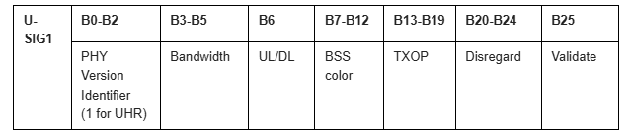
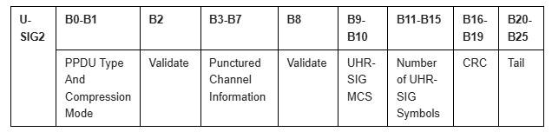
Motion 182 (PHY)
Move to add to the TGbn SFD the following:
Keep all the fields in U-SIG for UHR MU PPDU to be the same as that in U-SIG for EHT MU PPDU as following, and PHY version is set to 1 for UHR, UHR-SIG MCS and Number of UHR-SIG Symbols subfields replace the EHT-SIG MCS and Number of EHT-SIG Symbols subfields
Note- The disregard and validate bits may be updated for new features.
Move: Juan Fang Second: Alice Chen
Discussion: None.
Result: Approved with unanimous consent.
Reference documents:[11-24/1833r4, 11-24/1834r4]. SP result: No objection.

Slide 191
Motion 183 (PHY)
Move to add to the TGbn SFD the following:
11bn defines an indication to identify the BSS color for COBF transmissions.
Move: Shengquan Hu Second: You-Wei Chen
Discussion: None.
Result: Approved with unanimous consent.
Reference documents:[11-24/1829r2, 11-24/1822r3]. SP result: No objection.

Slide 192
Motion 184 (MAC)
Move to add to the TGbn SFD the following:
11bn enhances existing mechanism(s) to improve latency for a non-AP STA communication with another non-AP STA on the base channel and off-channel, respectively, by
  enhancing mechanism(s) to allow an AP to share a TXOP with multiple peer-to-peer (p2p) non-AP STAs(s)
  enhancing the baseline Channel Usage procedure to provide better recommendation on channel selection for P2P by enabling coordination between APs that do not belong to the same ESS so that the channels recommended for P2P operation sent by those APs are the same.
Note 1: the coordinated channel recommendation is an optional feature. Also, the responding AP has an option to reject the request for such coordination.
Note 2:
Base channel is the channel where the AP associated with the non-AP STA is operating.
A channel outside its associated AP’s operating BW is an off-channel for the non-AP STA.
Move: Rubayet Shafin Second: Pascal Viger
Discussion: None.
Result: Approved with unanimous consent.
Reference documents:[22/1528r2, 23/294r1, 23/1424r0, 23/1929r0, 24/392r2, 24/393r3, 24/0403r2]. SP result: No objection.

Slide 193
Motion 185 (MAC)
Move to add to the TGbn SFD the following:
Define a mechanism in 11bn that defines:
  AP-to-AP frame formats to enable interoperable MAPC across APs and including MLME primitive(s) so that a pair of AP’s SMEs can orchestrate the over-the-air transmission and reception of these frames
  MLME primitive(s) so that a pair of AP’s SMEs may send the content of the non-real-time instances of such AP-to-AP frames over-the-DS between peer AP-MLMEs (rather than over-the-air via peer AP MACs)
Move: Brian Hart Second: Steve Rodriguez
Discussion: None.
Result: Approved with unanimous consent.
Reference documents:[24/1595r1, 24/0838r1]. SP result: 66Y, 13N, 40A.

Slide 194
Motion 186 (Joint)
Move to add to the TGbn SFD the following:
TGbn defines the UHR variant of Trigger Frame.
  Reuse the EHT variant of Trigger Frame format for the UHR variant of Trigger Frame, with one Special User Info field immediately after the Common Info field
Differentiate EHT and UHR variant by the value of the PHY Version Identifier in the Special User Info field being 0 or 1
Reuse the EHT variant Common Info field and Special User Info field for UHR
  B60-B62 in the UHR variant common info field are “UHR Reserved”
Reserved bits in the UHR variant Common Info field and Special User Info field may be used for other UHR features
The UHR variant of Trigger frame includes the UHR variant User Info field.
  It has the same length as the EHT variant User Info field
Move: Alice Chen Second: You-Wei Chen
Discussion: None.
Result: Approved with unanimous consent.
Reference documents:[24/1833r4, 24/1765r0, 24/1507r3]. SP result: 89Y, 21N, 43A.

Slide 195
Motion 187 (Joint)
Move to add to the TGbn SFD the following:
For a UHR TB PPDU transmission, there exists a 5-bit UL UHR MCS in a User Info field for UHR variant of Trigger frame.
Move: Dongguk Lim Second: Hongwon Lee
Discussion: None.
Result: Approved with unanimous consent.
Reference documents:[24/1765r0]. SP result: No objection.

Slide 196
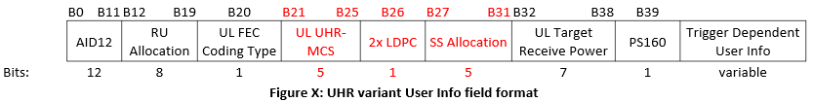
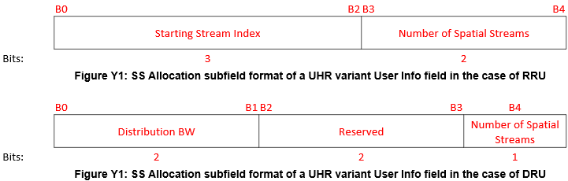
Motion 188 (Joint)
Move to add to the TGbn SFD the following:
Use the following UHR variant User Info field design
The SS Allocation subfield design depends on RRU or DRU
  Repurpose 1 bit in the SS Allocation subfield in the UHR variant User Info field to indicate Nss (1ss or 2ss) in the case of DRU
Move: Alice Chen Second: You-Wei Chen
Discussion: None.
Result: Approved with unanimous consent.
Ref. docs:[11-24/1833r4]. SP result: No objection. Note to editor: Change “of” to “Of” in the figures and 2nd figure is Y2.

Slide 197
Motion 189 (PHY)
Move to add to the TGbn SFD the following:
NDP Announcement Variant subfield shall be set to 3 for COBF NDPA in UHR.
Move: You-Wei Chen Second: Juan Fang
Discussion: None.
Result: Approved with unanimous consent.
Reference documents:[11-24/1822r3, 11-24/1835r3, 11-24/1865r3]. SP result: No objection.

