Slide 1
R-TWT Coordination Negotiation in Multi-BSS
Date: 2024-03-10
Authors:
Name | Affiliation | Address | Phone | Email
SunHee Baek | LG Electronics | 19, Yangjae-daero 11gil, Seocho-gu, Seoul 137-130, Korea |  | sunhee.baek@lge.com
Jinsoo Choi |  |  |  | js.choi@lge.com
Insun Jang |  |  |  | insun.jang@lge.com
Yelin Yoon |  |  |  | yl.yoon@lge.com
Geonhwan Kim |  |  |  | geonhwan.kim@lge.com
DongJu Cha |  |  |  | dongju.cha@lge.com
Eunsung Park |  |  |  | esung.park@lge.com
Dongguk Lim |  |  |  | dongguk.lim@lge.com
Jinyoung Chun |  |  |  | jiny.chun@lge.com
Insik Jung |  |  |  | insik0618.jung@lge.com
HanGyu Cho |  |  |  | hg.cho@lge.com
Sanggook Kim |  | 10225 Willow Creek Rd, San Diego, CA, USA |  | sanggook.kim@lge.com

Slide 2
Introduction
The R-TWT coordination in Multi-BSS is related to expanding the operation and protection of the R-TWT schedule in the existing single BSS, which is discussed in TGbn, [1] ~ [13].
Since the R-TWT coordination is an operation on Multi-BSS, AP and OBSS AP can agree/negotiate their R-TWT schedule(s) to minimize the interference from the other schedule(s) of the other BSSs.
  For example, when an AP and OBSS AP aren’t located in the same ESS, they can operate a negotiation for the R-TWT coordination.
In this contribution, we suggest how to negotiate R-TWT schedule(s) between APs.

Slide 3
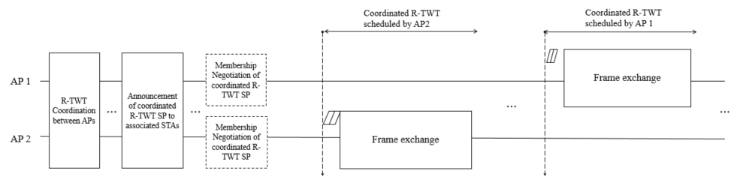
Overview
In Multi-BSS, if a coordinated R-TWT schedule(s) is set through negotiation between APs, the influence between the R-TWT schedules of each AP can be minimized.
  During the R-TWT coordination, APs exchange schedule information for R-TWT to coordinate it.
    The coordination for R-TWT schedule between APs is carried out through the frames containing the TWT Parameter set(s) for the coordination request and/or the coordination response.
    The frame containing the TWT Parameter set(s) for coordination request can be initialized from an AP to the other AP located within the range of transmitting/receiving the Beacon frame.
  As the result of the R-TWT coordination, APs obtain the coordinated R-TWT schedule(s).
Main Point
Notes:
*가출원 업데이트) 위의 도안의 C-SR(예: overlappe된 SP동안 동시에 프레임 교환), C-OFDMA, C-TDMA의 동작 예시 추가하기

Slide 4
Signaling Method for R-TWT Coordination
The information within the Broadcast TWT Parameter Set field in the TWT element defined in baseline for R-TWT coordination is used as it is, and the other information not used in the R-TWT coordination may be replaced with the reserved or the new one(s).
  The fields related to the schedule information within the TWT element shall be used in R-TWT coordination.
    Target Wake Time, Nominal Minimum TWT Wake Duration, TWT Wake Interval Mantissa, TWT Wake Interval Exponent, Broadcast TWT Persistence
    The schedule information of R-TWT can be set based on the neighboring AP’s TSF.
      The neighboring AP’s TSF can be obtained from the overhearing Beacon frame.
  Also, the (sub)fields related to indicating a purpose of transmitted information remain to be used or enhance its usage for the R-TWT coordination between APs.
    The TWT Request subfield will indicate whether the TWT Parameter Set field is to request or not.
    The TWT Setup Command subfield will indicate the purpose of TWT coordination between APs.
      The original values of the TWT Setup Command subfield can be used as it is.
      Or, the new values of the TWT Setup Command subfield can be redefined like Request, Accept, and Reject.
    The Broadcast TWT Recommendation subfield can indicate the schedule information is for the R-TWT.

Slide 5
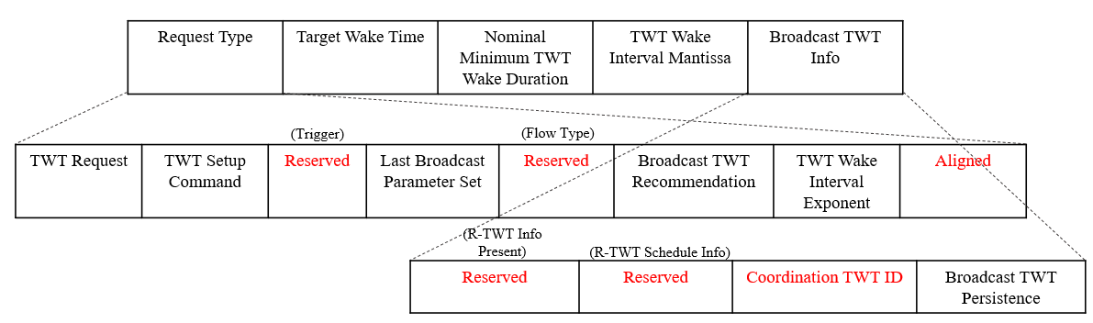
Signaling Method for R-TWT Coordination
  The other subfields not to be used between APs are replaced to the reserved or new subfield(s).
    Ex1) The Trigger, Flow Type, Restricted TWT Traffic Info Present, and Restricted TWT Schedule Info subfields can be changed to the reserved subfields.
    Ex2) The Aligned subfield can be interpreted to the Overlapped TWT subfield to indicate whether the R-TWT schedule is coordinated to overlapped with an OBSS R-TWT schedule.
    Ex3) The Broadcast TWT ID subfield can be replaced with the Coordinated TWT ID subfield to indicate the schedule information of R-TWT to coordinate between APs as an ID.
  If needed, the additional information can be added in R-TWT coordination. (e.g., AP coordination scheme, EDCA Parameter Set of AP(/STA)).

Slide 6
Alternative Approach of Signaling Method
Another new TWT Parameter Set field can be defined to negotiate the R-TWT schedule(s) between APs.
  The (sub)fields in the new TWT Parameter Set field can include only necessary information for R-TWT coordination between APs.
    The fields can be constructed based on the Broadcast TWT Parameter Set field.
  If the transmitting STA is an AP and the recipient STA is a neighboring AP, the frame for the R-TWT Coordination can include the new TWT Parameter Set field in the TWT element with the modified negotiation type.
Discussion about defining new element and frame for R-TWT coordination between APs is shown in the Appendix 1.

Slide 7
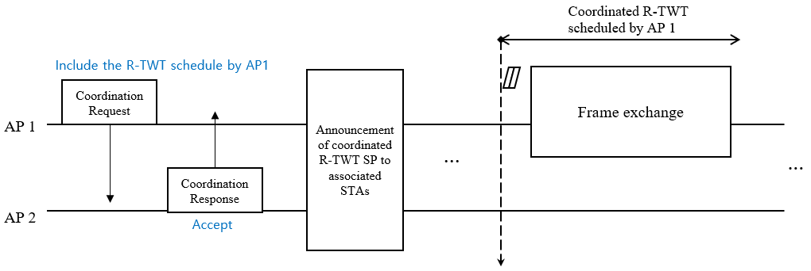
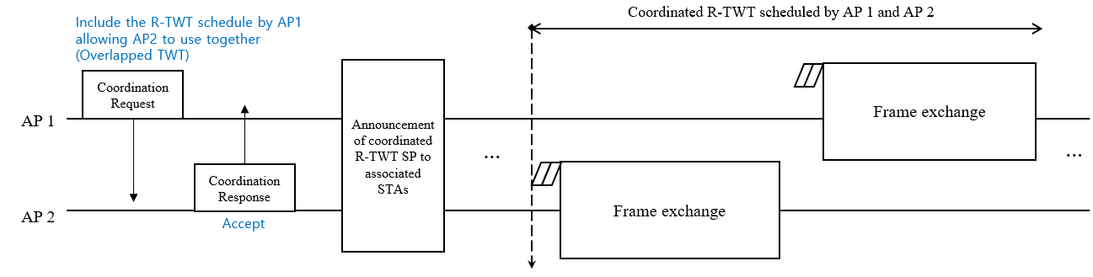
R-TWT Coordination: Example 1
The frame for R-TWT coordination can be exchanged by including the TWT Parameter set(s) for Coordination Request or Coordination Response.
  AP 1 → AP 2: Coordination Request for the schedule information of R-TWT of AP 1
  AP 2 → AP 1: Coordination Response to accept the received Coordination Request
  AP 1 → AP 2: Coordination Request for the schedule information of R-TWT of AP 1 and AP 2
  AP 2 → AP 1: Coordination Response to accept the received Coordination Request
[Case 1]
[Case 2]

Slide 8
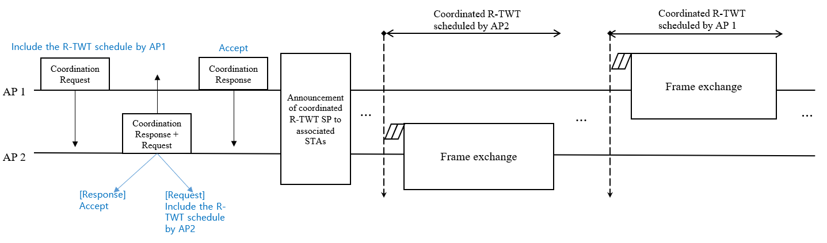
R-TWT Coordination: Example 2
The frame for R-TWT coordination can be exchanged by including the TWT Parameter set(s) for Coordination Request and/or Coordination Response.
  AP 1 → AP 2: Coordination Request for the schedule information of R-TWT of AP 1
  AP 2 → AP 1: Coordination Response to accept the received Coordination Request & Coordination Request for the schedule information of R-TWT of AP 2
  AP 1 → AP 2: Coordination Response to accept the received Coordination Request

Slide 9
Conclusion
In this contribution, we propose a negotiation singling methods and procedures for R-TWT schedule(s) coordination between an AP and neighboring AP.
  Signaling Method for R-TWT coordination between APs
    Use the TWT element
      Use the Broadcast TWT Parameter Set field
      Use the new TWT Parameter Set field
    Define new element/frame
  Procedure of R-TWT coordination between APs
    Ex1) The exchanged frame includes the TWT Parameter set(s) corresponding to the Coordination Request(s) or the Coordination Response(s)
    Ex2) The exchanged frame includes the TWT Parameter set(s) corresponding to the Coordination Request(s) and/or the Coordination Response(s)
      It should need to be limited to more than 3 steps.

Slide 10
Straw Poll 1
Do you agree to add the following text to the TGbn SFD?
  The TWT setup frame is used to coordinate R-TWT schedule(s) between an AP and another AP.

Slide 11
Straw Poll 2
Do you agree to add the following text to the TGbn SFD?
  The TWT element is used to specify R-TWT schedule(s) to be coordinated between an AP and another AP.

Slide 12
Straw Poll 3
Do you agree to add the following text to the TGbn SFD?
  The TWT element to specify R-TWT schedule(s) to be coordinated between an AP and another AP shall include one or more Broadcast TWT Parameter Set field(s).
    How to configure the field is TBD.

Slide 13
Straw Poll 3-1
Do you agree to add the following text to the TGbn SFD?
  A new TWT Parameter Set field included in the TWT element to specify R-TWT schedule(s) to be coordinated between an AP and another AP is defined.
    The detailed (sub)field is TBD.

Slide 14
Straw Poll 4
Do you agree to add the following text to the TGbn SFD?
  The TWT element to specify R-TWT schedule(s) to be coordinated between an AP and another AP shall include an ID to identify a coordinated R-TWT schedule.

Slide 15
Straw Poll 5
Do you agree to add the following text to the TGbn SFD?
  The TWT element to specify R-TWT schedule(s) to be coordinated between an AP and another AP shall include information about whether STA(s) in that another AP’s BSS and STA(s) in the AP’s BSS are allowed to use the schedule together.

Slide 16
Straw Poll 6
Do you agree to add the following text to the TGbn SFD?
  The TWT element in the TWT setup frame exchanged between APs allows to include both the TWT Parameter set having a TWT Request subfield is set to 1 and the TWT Parameter set having a TWT Request subfield is set to 0 in TWT element.

Slide 17
References
[1] 23/771 Coordinated of R-TWT Protection in Multi-BSS
  [2] 23/226 Coordination of R-TWT for Multi-AP Deployment
  [3] 23/250 AP coordination with R-TWT
[4] 23/291 R-TWT Multi-AP Coordination
[5] 23/293 Follow-up on TWT-based Multi-AP Coordination
[6] 23/297 rTWT for Multi-AP
[7] 23/355 Enhanced R-TWT and M-AP operation
[8] 23/771 Coordinated R-TWT Protection in Multi-BSS
[9] 23/860 Further thoughts on coordinated TWT
[10] 23/1087 Announcement for R-TWT Coordination
[11] 23/1424 Follow-up on peer-to-peer(P2P) communication for UHR
[12] 23/1929 Further considerations on coordinated TWT
[13] 23/2022 R-TWT for multi-AP follow up

Slide 18
Appendix 1. Discussion on New element/frame for R-TWT Coordination
Even though a new element/frame can be defined to clearly have necessary /compact information, we already had well-defined TWT setup frame/TWT element to describe TWT Info.
  If too much information needs to be changed when the TWT element is used to coordinate the R-TWT schedule, it seems to be enough to have a new parameter set in the TWT element.
  It would consume ID space for new element/frame.
  We can discuss further whether it is really needed.

Slide 19
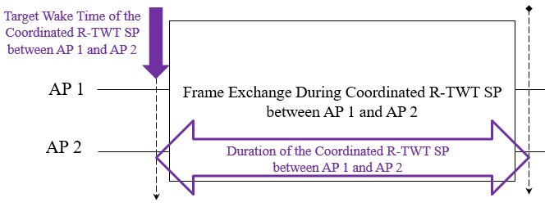
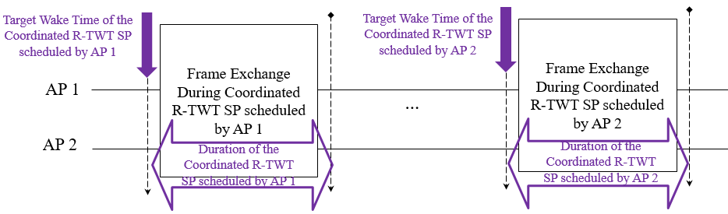
Appendix 2. R-TWT Coordination Types
Overlapped coordinated R-TWT schedule
  If the R-TWT schedules in R-TWT coordination request/response have the same values of TWT interval, TWT SP duration, and target wake time(TWT) based on the different TSFs of APs, APs coordinate them regarding as overlapped coordinated R-TWT schedule.
Non-overlapped coordinated R-TWT schedule
  If the R-TWT schedules in R-TWT coordination request/response have different values of TWT interval and target wake time(TWT) based on the different TSFs of APs, APs coordinate them as non-overlapped coordinated R-TWT schedule.
*The overlapped coordinated R-TWT schedule means fully overlapped schedule, so partially overlapped schedule doesn’t considered in this contribution.

