Slide 1
Establishment of Security Key for Control Frame
Date: 2024-03-10
Authors:
Name | Affiliation | Address | Phone | Email
SunHee Baek | LG Electronics | 19, Yangjae-daero 11gil, Seocho-gu, Seoul 137-130, Korea |  | sunhee.baek@lge.com
Insun Jang |  |  |  | insun.jang@lge.com
Jinsoo Choi
 |  |  |  | js.choi@lge.com
Yelin Yoon |  |  |  | yl.yoon@lge.com
Geonhwan Kim |  |  |  | geonhwan.kim@lge.com
Dongju Cha |  |  |  | dongju.cha@lge.com
Eunsung Park |  |  |  | esung.park@lge.com
Dongguk Lim |  |  |  | dongguk.lim@lge.com
Jinyoung Chun |  |  |  | jiny.chun@lge.com
Insik Jung |  |  |  | insik0618.jung@lge.com
HanGyu Cho |  |  |  | hg.cho@lge.com
Sanggook Kim |  | 10225 Willow Creek Rd, San Diego, CA, USA |  | sanggook.kim@lge.com

Slide 2
Introduction
The previous contributions, [1] and [2], shared the vulnerability of control frame that doesn’t get the protection unlike other frames(data frame and management frame) and several example formats of the control frame applied security protocols.
The method of checking integrity is kept discussing to protect the control frame(Trigger, BlockAck, BlockAckReq frame) in TGbn [1] ~ [6].
However, in the current spec, there is no establishment/usage method of the security key(s) for the control frame.
Ex 1) Method for establishing/generating the security key(s) for the control frame.
Ex 2) Method for calculating the value of MIC about the received control frame based on the security key(s) for the control frame.
In this contribution, we suggest an establishment method of the security key for the control frame in 11bn.

Slide 3
Background
In the current baseline, the RSNA security protocol establishes following security keys through 4-way handshakes;
PTK based on message 1 and message 2
GTK/IGTK/BIGTK based on message 3
The TKs of IGTK or BIGTK are used in the integrity check method(BIP) for the each of the management frame and the Beacon frame.
In the result of BIP, values of Key ID, IPN/BIPN, and MIC within MME(Management MIC element) are included at the end of the management frame body without the encryption/decryption.
The TKs of PTK or GTK are used in the encryption/decryption method(CCMP/GCMP) for the each of the individual/group addressed data frame
In the result of CCMP/GCMP, values of Key ID and PN are located within the CCMP/GCMP header, and the value of MIC is located before the FCS.

Slide 4
PN/Security Keys for Control frame
The packet number spaces are differently assigned depending on the PTK/GTK, IGTK, and BIGTK.
When the PTK/GTK is used to protect the individually/group addressed data frame, the PN shall use to provide the replay protection during CCMP/GCMP.
When the IGTK is used to protect the management data frame, the IPN shall use to provide the replay protection during BIP.
When the BIGTK is used to protect the Beacon frame, the BIPN shall use to provide the replay protection during BIP.
Therefore, the new packet number space for the control frame shall use to provide the replay protection when the security keys for the control frame is used as follows;
New PTK is used to the integrity check for the individually addressed control frame.
The new PTK is different key with PTK for data frame and names cPTK(control PTK).
New GTK is used to the integrity check for the group addressed control frame.
The new GTK is different key with GTK/IGTK/BIGTK and names cGTK(control GTK).

Slide 5
Establishment of Security Keys for Control frame
During (re)association, AP/STA(s) shall check each other whether they support the integrity check method for the control frame.
Only if both STAs support the integrity check method for control frame, the security key for control frame can be established/generated.
The STAs shall generate the security keys for the control frame during 4-way handshakes.
To establish the security key for the control frame, the messages of the existing 4-way handshake have to include parameters to generate the same cPTK and share the cGTK.
The STAs should share the each nonces of STA/AP for the cPTK on the messages.
If the nonces are included in the Message 1 and Message 2, the length of the Key Nonce field should be extended from 32 octets to 64 octets, which leads to huge overhead.
If the nonces are included in the Message 3 and Message 4, AP/STA can generate cPTK, and AP can validate its cPTK through comparing KCK of its cPTK with KCK of STA’s cPTK included in the Message 4.
AP should share the cGTK through the Message 3 with the other group keys(GTK/IGTK/BIGTK).
If the STAs don’t generate the security keys for the control frame during the existing 4-way handshakes, the STAs have to operate the other 4-way handshakes for the PTK/GTK of the control frame to generate.

Slide 6
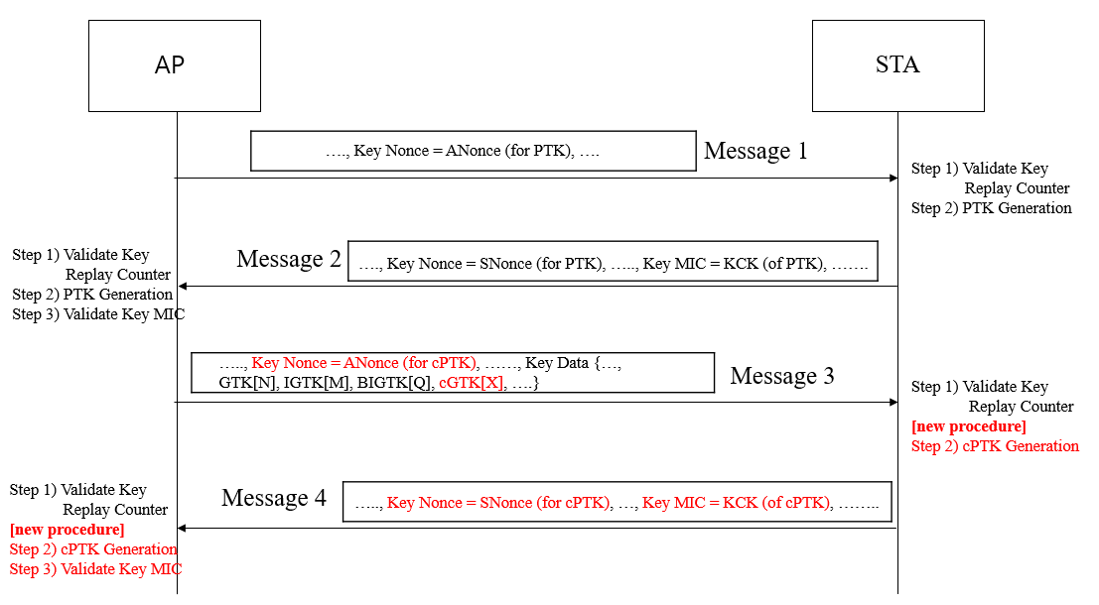
Establishment of Security Keys for Control frame during 4-way handshake

Slide 7
Security Key’s Usage in Integrity Check method
The transmitter STA will derive to the MIC value about control frame body by using the TK of the security key for control frame.
The cipher suite of the integrity check method can be one of current defined cipher suites in BIP.
There are two types of cipher suites of BIP; CMAC-128/256 and GMAC-128/256.
In [5], GMAC-256 can use to protect the control frame between UHR STAs.

Slide 8
Conclusion
In this contribution, we propose to establish/generate new security keys for the control frame and use them to check the integrity of the received control frame.
New PTK(cPTK) for Individually addressed control frame
New GTK(cGTK) for Group addressed control frame
To generate the security keys for the control frame, the parameters in the Message 3 and Message 4 on the 4-way handshake can be used.

Slide 9
Straw Poll 1
Do you agree to add the following text to the TGbn SFD?
A new PTK for individually addressed control frame is defined in 802.11bn.
The name of the new PTK is TBD.

Slide 10
Straw Poll 2
Do you agree to add the following text to the TGbn SFD?
A new GTK for group addressed control frame is defined in 802.11bn.
The name of the new GTK is TBD.

Slide 11
Straw Poll 3
Do you agree to add the following text to the TGbn SFD?
The new PTK for control frame is generated during 4-way handshake.
The detailed method is TBD.
Notes:
BIP(Broadcast Integrity Protocol)

Slide 12
Straw Poll 4
Do you agree to add the following text to the TGbn SFD?
The new PTK for control frame is generated based on Message 3 and Message 4 during 4-way handshake.
The detailed information is TBD.
or
The Key Nonce field in Message 3 is set by AP and The Key Nonce field in Message 4 is set by non-AP STA.
The Key MIC field in Message 4 is set to the value of KCK of the new PTK generated by non-AP STA and used to check for the new PTK generated by AP.

Slide 13
Straw Poll 5
Do you agree to add the following text to the TGbn SFD?
The new GTK for control frame is shared in Message 3 during 4-way handshake.
The new KDE is defined for the new GTK for control frame.
or
The detailed method is TBD.
Notes:
BIP(Broadcast Integrity Protocol)

Slide 14
Straw Poll 6
Do you agree to add the following text to the TGbn SFD?
The new packet number space for control frame is defined in 802.11bn.
The name of the new PN is TBD.

Slide 15
References
[1] 23/0286 Trigger frame protection
[2] 23/0312 Thoughts on Secure control frames
[3] 23/0352 Enhanced Security Discussion
[4] 23/1993 Security Enhancement follow up
[5] 23/1995 Trigger, BA, and BAR Protection
[6] 23/2001 Secure Control frames – Follow up

