Slide 1
Residual Interference in Coordinated Beamforming
Date: 2024-01-10
Authors:
Name | Affiliations | Address | Phone | email
Dana Ciochina | Sony Group Corporation |  |  | Dana.Ciochina@sony.com
Thomas Handte |  |  |  | Thomas.Handte@sony.com
Daniel Verenzuela
Salvatore Talarico
Qing Xia
Yusuke Tanaka |  |  |  | Yusuke.YT.Tanaka@sony.com
Kosuke Aio
Ryuichi Hirata
Ken Tanaka

Slide 2
Introduction
CBF enables multiple STAs to transmit simultaneously
  Important technology to improve latency, as the scenarios under which CBF is bringing improvements are particularly scenarios in which interference levels would not allow a concurrent transmission otherwise
Several contributions have shown the gains of this technology
  Improvement in throughput [1]-[6]
  Reduction of queuing delay [2]
Residual interference in CBF is due to
  Interference on the legacy preamble
  Interference on the GI, which may require synchronization
In this contribution, we evaluate the severeness of the residual interference for one precoder choice in both aligned and non-aligned CBF transmissions
  Non-aligned transmission are of interest because of less overhead and easier implementation
  We show the improvements of extending the beamforming over the preamble
  We further show benefits of enhancing the channel and noise estimation, particularly in the case of aligned transmission

Slide 3
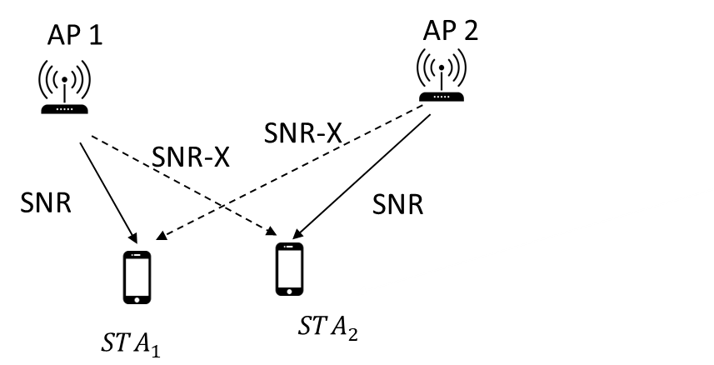
Simulation Scenario
AP Configuration
  4Tx antennas
  21dBm Tx power
  NF: 7 ~ -90dBm
  20MHz channels
  BD Beamformer
    No additional power adjustment
  1 SS
  .11ax SU PPDU format, 4xLTFs, 0.8usGI
  Fixed MCS
  X: 7dB
STA Configuration
  2 Rx antennas
  MMSE receiver
Channels:
  NLOS Model D
  NDP + Channel Estimation, Aging based on Model D with environmental speed
Within ED range

Slide 4


Overlapping Preambles
Scenarios in which the 2 APs have an offset in the transmission start can be interesting for various reasons:
    Overhead reduction – allow Sharing AP to take decision on configuration, Shared AP checks configuration in SIG fields and aligns
    NAV Status at Shared AP not allowing an aligned start
Legacy and SIG fields are currently not beamformed in most cases
  Overlap of non-beamformed preambles leads to errors in the preamble decoding on top of payload decoding
Comparison of transmission with and without beamforming applied on the preambles
$$PPDU_{oAP1→oSTA1}$$
$$PPDU_{AP1−>STA1}$$

Slide 5
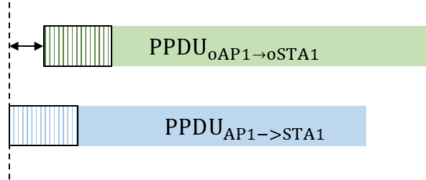
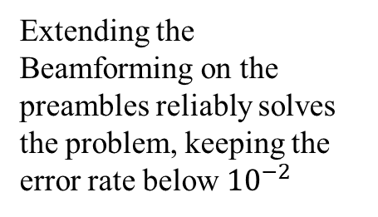
Error Rates in Preamble Decoding for Offset Transmissions
Transmission Offset of the Shared AP is within the Preamble interval
(HER) in case of non-beamformed preamble transmission can reach 40%
Extending the Beamforming on the preambles reliably solves the problem, keeping the error rate below ${10}^{−2}$

Slide 6
Error Rates in Payload Decoding for Offset Transmissions
Payload errors occur due to:
  Residual interference in the estimation fields leads to erroneous channel and noise estimation in the case of overlapped transmissions without beamformed preambles
Very good performance around synchronization, but large errors afterwards
With extended beamforming, MCS can be reliably increased

Slide 7
Residual Interference – Aligned Start
In the case of synchronized transmissions or transmissions with small offsets, even when beamforming is applied, some residual interference in the LTFs remains.
  This leads to errors in the MMSE equalizer and also to higher sensitivity to other channel impairments, in particular channel aging
A potential solution is extending the LTF fields
  to allow for interference estimation and improvement of noise estimation
  e.g., AP transmissions using different sets of orthogonal LTFs

Slide 8
Summary
In coordinated beamforming, interference levels in the legacy preambles can lead to large error rates in both header as well as payload, when a time offset between the transmissions of the 2 APs exist
  Extending the beamforming over the preamble fields can solve the problem and give robust results even under increased channel aging values
Depending on scenarios, residual interference may remain in the LTFs leading to errors in the MMSE receiver
  Extended LTFs to separate the effect of two APs in the channel and noise estimation process improve the MMSE performance
    especially for synchronized transmissions

Slide 9
References
[1] 11-19/1594r2 “Coordinated Beamforming/Null Steering Protocol in 802.11be”
[2] 11-22/1821 “System Level Simulation of Co-BF and Joint TX”
[3] 11-23/1193r1 “Nulling Performance of Coordinated Beamforming”
[4] 11-23/0776r2 “Performance of C-BF and C-SR”
[5] 11-24/0011r0 “Coordinated Spatial Nulling Simulations”
[6] 11-24/0012r0 “Coordinated Spatial Nulling Concept”
[7] 11-19/0638r0 “Nulling and Coordinated Beamforming”

