Slide 1
EHT-UHR Aggregated Sounding Design
Date: 2024-01-16
Authors:

Slide 2
Introduction
In this contribution, we propose high level designs of
UHR NDPA
EHT-UHR aggregated sounding
Assumption
To minimize design work, keep as much of the 11be design as possible.
The design of the UHR NDPA is based on the frame format of the EHT NDPA.

Slide 3
UHR NDPA (1/3)
Recap: EHT-NDPA

Slide 4
UHR NDPA (2/3)
Sounding Dialog Token
Until now, VHT/HE/EHT NDPA are distinguished by using 2 bits in the Sounding Dialogue Token (NDP Announcement Variant subfield).
However, these are no reserved bits for UHR.
Propose to set 2 bits in Sounding Dialog Token as below.
The NDP Announcement Variant subfield and a NDPA version identifier (will be shown in next slide) are jointly used to identify the UHR NDPA.
EHT and UHR can be multiplexed in a single NDPA.
This design enables EHT-UHR aggregated sounding.
NDP Announcement Variant subfield | Description
0 | VHT NDPA
1 | Ranging NDPA
2 | HE NDPA
3 | EHT NDPA, UHR NDPA

Slide 5
UHR NDPA (3/3)
STA Info subfield
Special STA Info subfield [1], [2]
The Special STA Info subfield is a STA Info subfield that does not carry STA specific information but carries extended common information not provided in the Common Info field.
E.g.) Bandwidth, Primary/Secondary160 etc.
The Special STA Info subfield is identified by an AID11 value of TBD.
The location of the Special STA Info subfield is TBD.
E.g.) Located immediately after the Common Info field.
E.g.) Located immediately before the first UHR STA Info field.
The NDPA Version Identifier subfield indicates the NDPA version [1], [3].
AID 11 | NDPA Version Identifier | Information for BW, PS160 etc.
Bits: 2 | 3 | TBD
Frame Control | Duration | RA | TA | Sounding Dialog Token | Special STA Info | EHT STA Info 1 | …. | EHT STA Info n | UHR STA Info 1 | …. | UHR STA Info m | FCS
Octets: 2 | 2 | 6 | 6 | 1 | 4 | 4 |  | 4 | 4 |  | 4 | 4

Slide 6
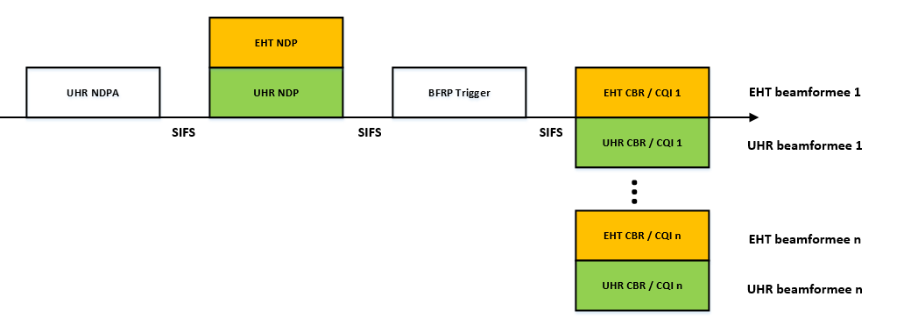
EHT-UHR Aggregated Sounding
Assumption
The UHR NDP is aligned with EHT NDP.
Advantage
Compared to two separate EHT-UHR soundings, one aggregated sounding can reduce the air-time consumption by about 2 times, leading to improved beamforming throughput.

Slide 7
Summary
We proposed the design of UHR NDPA which includes
Special STA Info. subfield
NDPA version Identifier subfield
This design can multiplex EHT and UHR into one NDPA, enabling aggregated EHT-UHR sounding.
It can also be used for UHR-only sounding without the aggregation.
Subsequent contribution will show more detailed designs with specific subfields.

Slide 8
SP #1
Do you agree to design the UHR NDPA frame based on the VHT/HE/EHT NDPA frame?
Y / N / Abstain

Slide 9
SP #2
Do you support setting the NDP Announcement Variant subfield of the Sounding Dialog Token field in the UHR NDPA as below?
Y / N / Abstain
NDP Announcement Variant subfield | Description
0 | VHT NDPA
1 | Ranging NDPA
2 | HE NDPA
3 | EHT NDPA, UHR NDPA

Slide 10
SP #3
Do you support to include special STA Info field in UHR NDPA?
Note 1: The size of the special STA Info field is 4 bytes.
Note 2: The location of the special STA Info field is TBD.
Y / N / Abstain

Slide 11
SP #4
Do you support to include NDPA version identifier subfield in the special STA Info field?
Note 1: The size of the NDPA version identifier subfield is 3 bits.
Note 2: The location of the NDPA version identifier subfield are TBD.
Y / N / Abstain

Slide 12
Reference
[1] 802.11-20/0950r3, Partial Bandwidth Feedback for Multi-RU.
[2] 802.11-20/1436r0, NDPA and MIMO Control Field Design for EHT.
[3] 802.11-21/1977r0, NDPA for Future Amendments.

