Slide 1
Enhanced HCCA for Controlled UHR Scenarios
Date: 2024-01-15
Authors:

Slide 2
Introduction
Based on current 11bn PAR [1], the scope is to add ultra reliability capability to a Wireless LAN Area Network (WLAN), where the capability is defined for both an isolated Basic Service Set (BSS) and overlapping BSSs.
  Current IEEE 802.11 standard achieves today multi-Gbps throughout, sub-10 ms latency and packet losses lower than 0.1%.
  One of the main limitation in terms of reliability is the indeterministic channel access procedure derived from the mandatory LBT procedure which impacts the transmission occurrences.
Some of the use cases envisioned for 11bn would be deployed in controlled environments, such as some of the robotics and industrial automation deployments identified for UHR.
This submission compares the EDCA procedure vs an enhanced HCCA procedure in such deployments.

Slide 3
Controlled UHR Scenarios
While the use cases targeting UHR have been discussed [2], among those some business examples related to industrial IoT, logistics and smart agriculture have been identified.
  Extended coverage areas that require multiple APs
  Secluded or indoor deployments with generally large penetration loss with outdoor
  Dedicated network with no other intra or inter-RAT technologies in proximity
For these use cases, environment is controlled while intra and inter-BSS congestion and contention exist due to the mandatory use of the LBT mechanism which leads inevitably in loss of spectral efficiency and latencies.

Slide 4
HCF Controlled Channel Access (HCCA) (1/2)
  HCCA was introduced in 802.11e [3] with no enhancements during 802.11be:
    Either AP or STAs rely on an HC, which is collocated with an AP, to obtain a TxOP.
      To access the wireless channel the HC senses during a SIFS and determine the channel idle at the TxPIFS slot boundary.
      When the channel is determined to be idle, the HC either performs the first frame TX or TX of a QoS(+)CF-Poll to set a polled TxOP.
    Within a TBTT, an HC may reclaim the channel if the wireless medium is idle at the TxPIFS slot boundary after the HCCA TxOP
      TxOP may be subject to early termination if a CAP extends across a TBTT.
beacon
beacon
beacon
CAP
HCCA TxOPs within a CAP
EDCA TxOPs and access by legacy STAs using DCF
TBTT of DTIM Beacon

Slide 5
HCF Controlled Channel Access (HCCA) (2/2)
  Advantages:
    Implements a polling system
      Guarantees a certain amount of service time for connected services
      Outperforms as is other MAC protocols, e.g. EDCA, in terms of decreasing congestion via more deterministic scheduling
    Has inherent higher priority compared to EDCA in terms of channel access acquisition
      Doesn’t require a long backoff
      Provides a more deterministic access to the channel
  Disadvantages:
    HC is the only initiating device for HCCA TxOP
      This represents a bottleneck in terms of latency for non-AP STA
      No inter-BSS coordination
    EDCA may be concurrently operated by non-AP STAs
      No coordination is possible to reduce congestion within a BSS
    No enhancements related to 802.11be are applicable (e.g., MLO, R-TWT)
      While none of 802.11be enhancements are applicable, harmonization may be straight forward with limited spec impact

Slide 6
Frame Based Equipment Framework
  By mean of regulatory requirements (i.e., ETSI BRAN [4-5]) two modes of operation may be possible:
  Load based equipment (LBE) -> both EDCA and (in principle) HCCA are based upon this framework
  Frame based equipment (FBE)
    LBT is still mandatorily required to detect the presence of other RLAN transmissions on an operating channel, but it is only done in a periodic manner based upon a fixed period.
      The fixed period can be configured between 1-10 ms and changed not less than once every 200ms.
      An idle period must be left at the end of each fixed period with minimum length of 100us or 5% of length of the period.
    Transmission can start only at the beginning of a fixed period if wireless medium is assessed to be idle.
    An AP or a STA can be concurrently both initiating or responding devices, or both.
CCA
CCA
Maximum TxOP
Idle Period
Fixed Period

Slide 7
eHCCA
  In a controlled environment the benefits of the HCCA design can be exploited, while its demerit can be mitigated with some enhancements by combining the FBE framework with the HCCA procedure, which we refer to as eHCCA:
    M-AP HC is defined to allow coordination across APs with common fixed periods non necessarily associated to the TBTT of DTIM Beacon
      Ensures a more predictable and deterministic channel access
      Congestion across BSS is mitigated while interference can be reduced by other features which are in the scope of 802.11bn (e.g., power control, beamforming, etc.)
    eHCCA can be performed (by accessing that the channel is idle after a TxPIFS) at both AP and non-AP STAs where their starting position may be different
      Mitigate bottleneck in terms of latency of current HCCA procedure
      No EDCA is necessary which reduce overall intra-BSS congestion
    802.11be features can be straight-forwardly integrated with minimum harmonization work

Slide 8
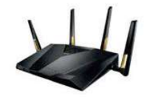
eHCCA vs EDCA – Simulations Parameters (1/2)
4 APs equally spaced
  d=40 m [15% serving links below -72 dBm]
Path loss exponent = 3.5
AWGN channel
Tx power is 23 dBm
Omnidirectional antennas at both AP and STAs
7 dB noise figure
For eHCCA, fixed period is 6 ms
d

Slide 9
eHCCA vs EDCA – Simulations Parameters (2/2)
eHCCA
CCA
TxOP
Pause
CCA
TxOP
Pause
Random backoff based on AC
Random Backoff based on AC
…
…
CCA
CCA
CCA
CCA
CCA
CCA
CCA
CCA
EDCA
TxOP
CCA
CCA
TxOP
KPIs:
  “Aggregated Spectrum Utilization” is defined as the percentage of time used for transmissions over the whole simulation time.
  “Access Delay” is defined as the interval of time between two consecutive access of the channel to perform data transmission in separate TxOP from the same device.

Slide 10
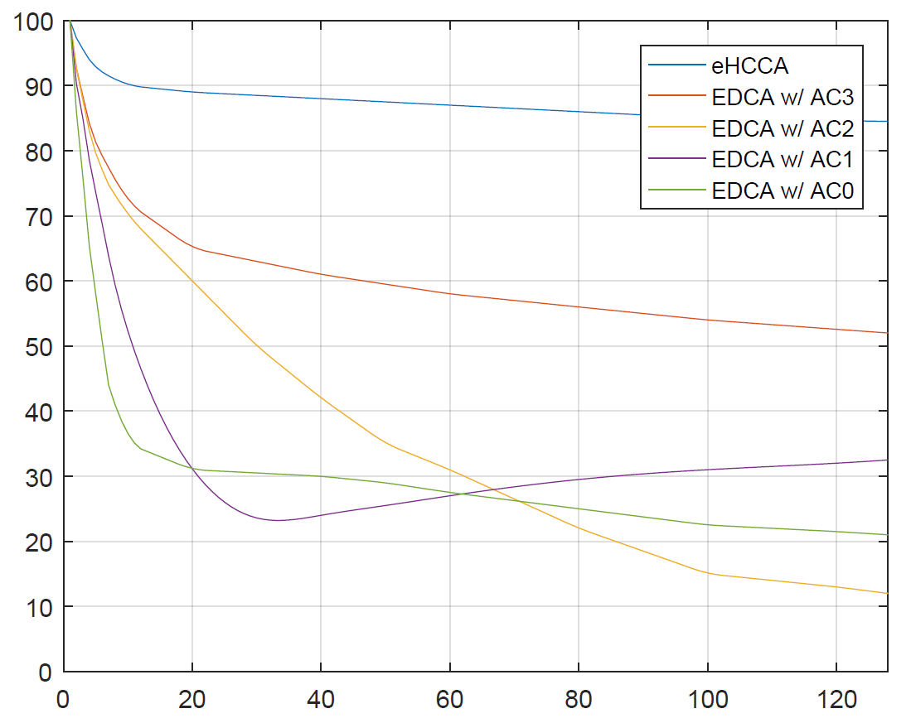
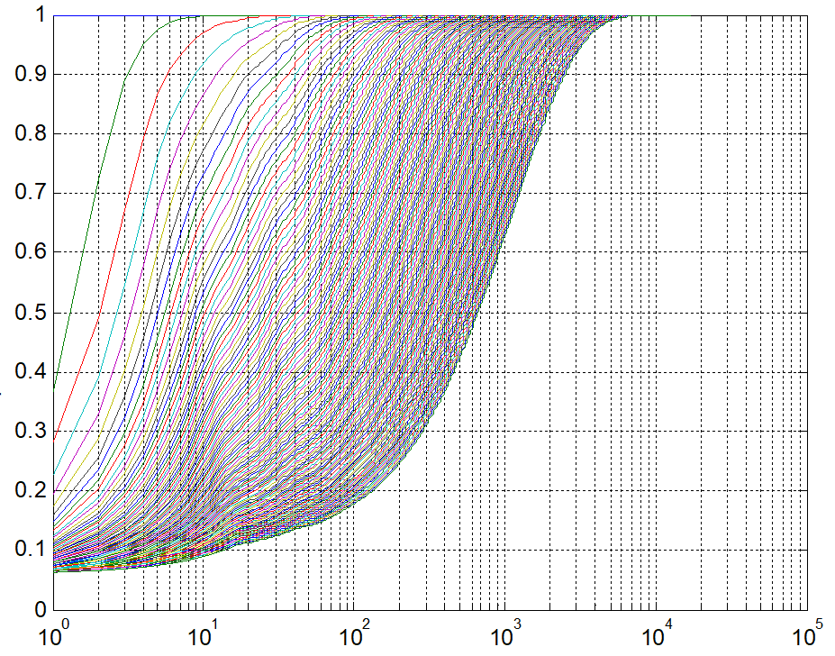
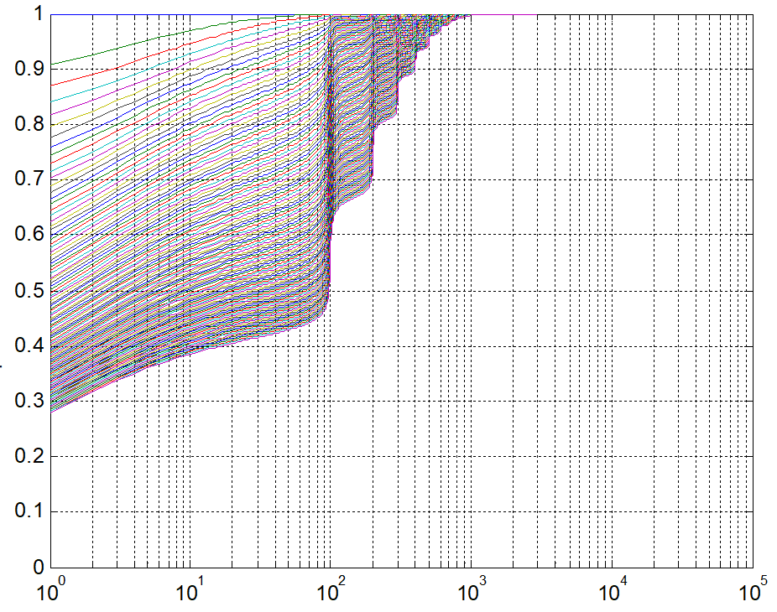
Evaluations: EDCA vs eHCCA
Aggregated Spectral Utilization:
CDFs of Access Delays:
Aggregated Spectral Utilization [%]
Access Delay for EDCA w/ AC1 [ms]
Number of STAs
Access Delay for eHCCA [ms]
Observation: eHCCA offers a much higher spectral efficiency compared to EDCA and the corresponding advantage may depend on the AC used for EDCA due to reduced congestion across inter and intra-BSSs.
Observation: eHCCA offers a large reduction in term of delays given its more deterministic channel access procedure and reduced LBT overhead.

Slide 11
Summary
An enhanced HCCA procedure for controlled UHR scenarios has been proposed
  M-AP HC is defined to allow coordination across APs with common fixed periods
  eHCCA can be performed at both AP and non-AP STAs
  802.11be features are integrated
Initial comparative simulation evaluations have been conducted to compare aggregated spectrum utilization and access delays between the legacy EDCA and the proposed eHCCA
  eHCCA offers a much higher spectral efficiency compared to EDCA and the corresponding advantage may depend on the AC used for EDCA due to reduced congestion across inter and intra-BSSs.
  eHCCA offers a significant reduction in term of delays given its more deterministic channel access procedure and reduced LBT overhead.

Slide 12
References
[1] https://mentor.ieee.org/802.11/dcn/23/11-23-0480-00-0uhr-uhr-proposed-par.pdf.
[2] https://mentor.ieee.org/802.11/dcn/22/11-22-1919-05-0uhr-considerations-on-uhr-par-and-kpis.pptx.
[3] IEEE P802.11-REVme/D4.1, “Part 11: Wireless LAN Medium Access Control (MAC) and Physical Layer (PHY) Specifications - Amendment 8: Enhancements for extremely high throughput (EHT)”, October 2023.
[4] ETSI BRAN 301.893, “5 GHz RLAN; Harmonised Standard covering the essential requirements of article 3.2 of Directive 2014/53/EU ”.
[5] ETSI BRAN 303.687, “6 GHz WAS/RLAN; Harmonised Standard for access to radio spectrum ”.

