Slide 1
PHY Layer Interference Mitigation for Improved Reliability
Date: 2024-01-01
Authors:

Slide 2
Introduction
In [1, 2] we discussed methods for improving the reliability in TGbn
In particular, we suggested two different PHY related approaches for handling interference, using Interference Mitigation (IM) approaches
– recap on those in the next two slides
Improved reliability and more efficient use of the spectrum are important goals of UHR (Ultra-High Reliability) [3]
In this contribution we share some new results, address some questions that were raised during the presentation of [2], and provide some explanations about the nature of receiver IM algorithms

Slide 3
Recap: Approach #1 for Mitigating Interference
Replicate data in frequency domain as shown in the figure below
The receiver can identify if a portion of its spectrum is interfered, and based on this decide which subcarriers (or which replica) to combine (and how to combine)
The choice of RU size to use and the replication order (number of replicas)
can be opportunistic or based on knowledge at the transmitter
side (e.g. on the interference characteristics)
Advantages:
  Simple transmit scheme
  Significantly more robust to (narrowband) interference
Disadvantages:
  Less beneficial for wideband interference
26-tone
4x replication to STA #1
26-tone
26-tone
26-tone
26-tone
52-tone
2x replication to STA #2
52-tone

Slide 4

Recap: Approach #2 for Mitigating Interference
Transmitting known pilots – interlaced with the data – will allow a (multi-antenna) receiver to track and mitigate potential interfering signals
The receiver will apply an interference mitigation (receive beamforming) scheme
  Various algorithms may be employed
Advantages:
  Can handle interference of any bandwidth
Disadvantages:
  Need ‘extra’ Rx antennas (beyond N_SS)
  to cancel the interference
Interference Mitigation Pilot
Data

Slide 5
Identifying a Random & Sudden Interfering Signal
Using either of the two schemes we presented allows a receiver to continuously monitor the received signal and apply interference mitigation (receive beamforming or selecting non-interfered subchannels), such that the receiver reacts immediately to any rising interference
In order to demonstrate this, we simulated a simple LOS scenario with a PPDU experiencing an interfering signal which rises in the 12th OFDM symbol
We use the 2nd approach with IM pilots
interspersed with the data tones
MVDR is applied in all tones (after
estimating the covariance of the noise
and interference in a frequency selective
manner)
Then we analyzed the resulting equivalent,
post-equalization gain in each direction
of arrival of the signal, for a single subcarrier (as an example)
OFDM symbols
Subcarrieres
Interference begins

Slide 6
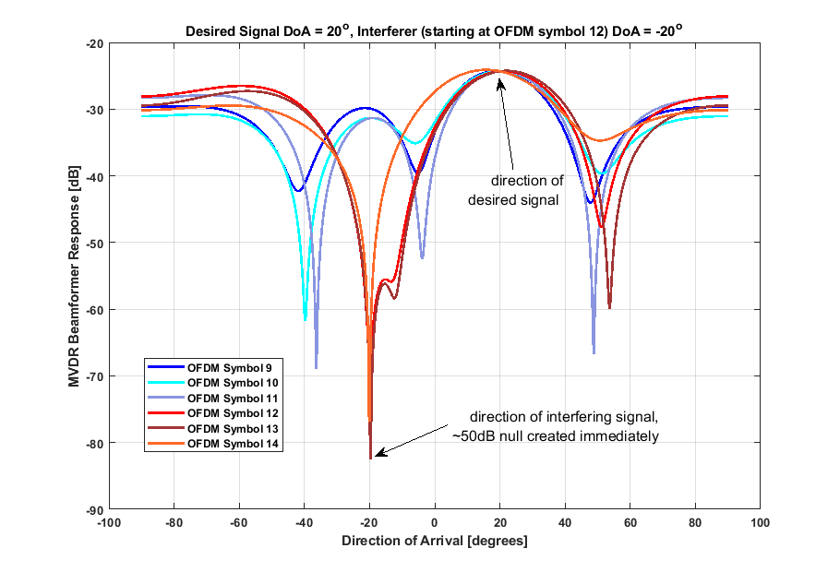
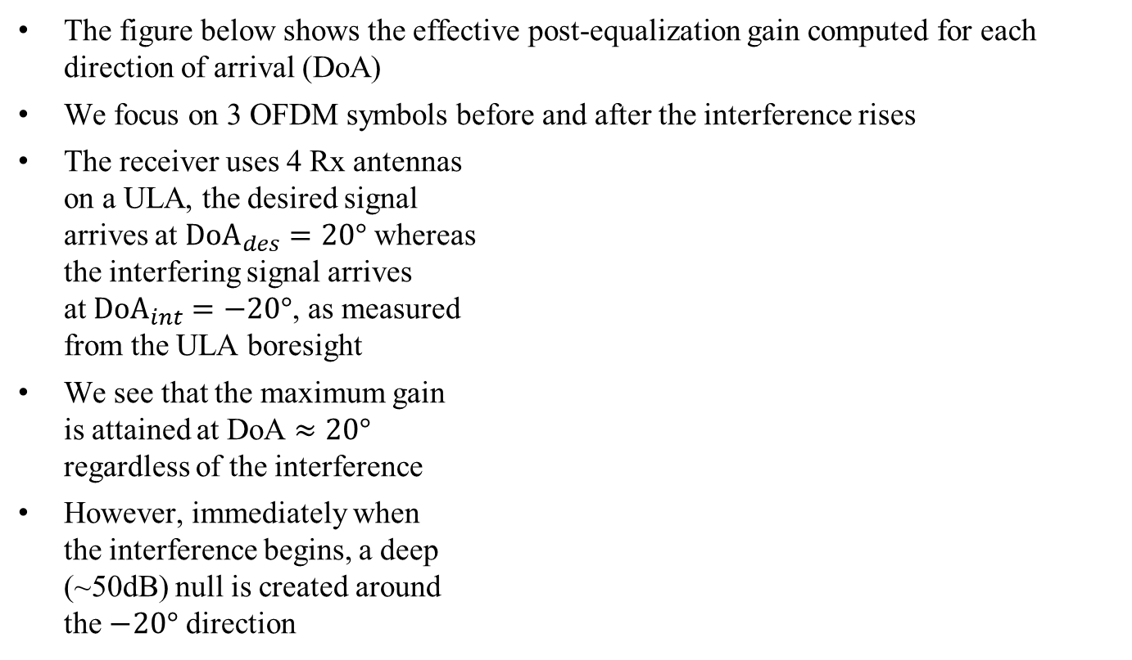
Identifying a Random & Sudden Interfering Signal – cont.
The figure below shows the effective post-equalization gain computed for each direction of arrival (DoA)
We focus on 3 OFDM symbols before and after the interference rises
The receiver uses 4 Rx antennas
on a ULA, the desired signal
arrives at ${DoA}_{des}=20°$ whereas
the interfering signal arrives
at ${DoA}_{int}=−20°$, as measured
from the ULA boresight
We see that the maximum gain
is attained at DoA $≈20°$
regardless of the interference
However, immediately when
the interference begins, a deep
(~50dB) null is created around
the $−20°$ direction

Slide 7
Number of Required IM Pilots (Approach #2)
We note that in theory, the number of measurements (i.e. IM pilots) needs to be larger than the number of Rx antennas [4]
  Otherwise, the resulting sample correlation matrix that estimates the covariance matrix is not invertible
  It is directly proportional – the larger the number of Rx antennas, the more IM pilots are needed
So this yields a lower bound on the number of IM pilots (thus CFO pilots cannot be used in many scenarios, e.g. small RUs)
Furthermore, all of these considerations should be applied within the coherence bandwidth of the interfering signal; in other words, we need to ‘sample’ the interference within its coherence bandwidth
Also, since we want to mitigate narrowband as well as wideband interference, we need to ‘sample’ the (possibly narrowband) interference densely enough
Given the above theoretical discussion, in the next slides we look at simulation results showing the practical implications

Slide 8
Number of Required IM Pilots (Approach #2) – cont.
In [2] we showed goodput results comparing various densities (%) of IM pilots
In those results, below a certain percentage (e.g. 14%) the goodput dropped abruptly to zero, and not gracefully as expected
That was due to the simplistic averaging procedure of IM pilots we used in the simulations (before covariance estimation) – same weight for all IM pilots within a fixed-size time-frequency rectangle
In order to estimate the covariance of the interference, we computed it over N OFDM symbols and K
subcarriers around the tone
to be equalized (the red
rectangle in the figure shows
a schematic example)
When the IM pilot density
was reduced (below a certain
percentage) there weren’t enough
pilots within the window

Slide 9
Number of Required IM Pilots (Approach #2) – cont.
To improve the results, we replaced the simple averaging with a weighted averaging within a wider region
This way, IM pilots are weighted according to their distance from the data tone to be equalized (i.e. IM pilots closer to the data tone have a bigger impact, whereas the impact of farther IM pilots is smaller)
  In other words, a wider window may be used such that farther pilots still contribute (albeit with smaller contribution)
Using a more flexible filter in both time and frequency significantly improves the results, as shown in the next slide

Slide 10
Number of Required IM Pilots (Approach #2) – cont.
The figure below depicts the goodput results for a receiver with 4 Rx antennas, 5dB SIR, TGn-D NLOS (both desired and interference, a different channel realization for each), comparing various percentages of IM pilots being used within a 106-tone RU, where the interference covers the entire signal BW
As shown, the case of 14% IM
pilots, though still worse than all
other cases, shows a moderate
degradation in performance
In this scenario, using ~18% IM
pilots is optimal, and the IM
receiver is not very sensitive to
deviations from this choice

Slide 11
Number of Required IM Pilots (Approach #2) – cont.
We also evaluated the performance for a receiver with 4 Rx antennas, comparing various percentages of IM pilots being used within a 106-tone RU, with a 2MHz narrowband interference whose location in frequency is randomly chosen per PPDU, with 5dB SIR (computed over the interference bandwidth only)
We see that using very few IM
pilots (e.g. black/cyan curves)
leads to performance degradation
In this scenario, using ~16% IM
pilots is optimal, and the IM
receiver is not very sensitive to
deviations from this choice

Slide 12
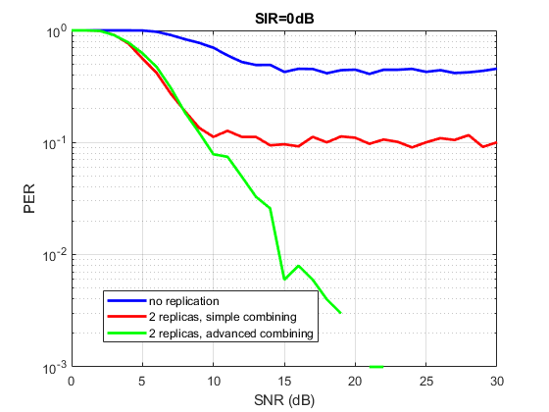
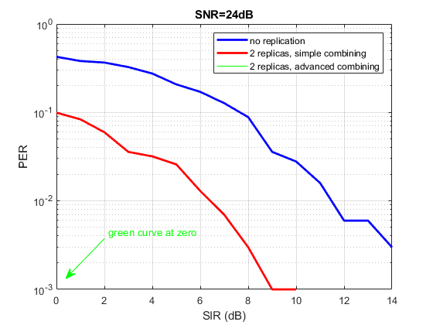
Handling 20MHz Wi-Fi interference (Approach #1)
In [1] and [2] we showed simulation results for approach #1 assuming a 20MHz signal experiencing a narrowband (~2MHz) interference
Below we show simulation results for a 40MHz signal experiencing a 20MHz Wi-Fi interfering signal (both experiencing independent TGn-D NLOS channels) rising in a random location in time; we assume MCS 4, single stream and 4Rx/2Tx antennas; as shown, this approach is very robust

Slide 13
Using Midambles as an Alternative (Approach #2)
A valid question is whether midambles (e.g. as defined in 11ax) may be used to mitigate interference
  Midambles were defined in 11ax as a periodic, replicated transmission of the HE-LTF portion, in order to cope with channel variations (Doppler) during the PPDU
  Midambles were transmitted every 10 or 20 OFDM symbols
Considering the original aim of mitigating the random interference which is quite common in the WLAN bands – and can start anytime, within any OFDM symbol, as described in [1] – we note that separation between midambles will inevitably result in unidentified interference in certain OFDM symbols and therefore in failed codewords
For example, in a 242-tone RU using 64QAM and a single stream, there are 1404 coded bits per symbol (N_CBPS) which means ~3/4 of an LDPC codeword
  So a midamble every 4 OFDM symbols means we may lose up to 3 LDPC codewords and maybe several MPDUs

Slide 14
Using Midambles as an Alternative (Approach #2) – cont.
In order to evaluate the impact of using midambles as an alternative, we simulated the following:
  SIR=5dB, MCS 6, 1Tx/4Rx antennas, ~24% IM pilots (so an IM pilot almost every 4th subcarrier in all OFDM symbols)
  Interference starts randomly anywhere
  within the PPDU (including preamble)
  Compared between two receiver
  schemes:
    Updating the interference covariance
    every OFDM symbol
    Updating the interference
    covariance every 5th OFDM symbol
As shown, there is an error floor
when we don’t update the
interference covariance often –
entire CWs are lost (error floor is
not higher because interference occasionally starts within the preamble)

Slide 15
Conclusions
In [1] we discussed how prevalent interference is in the WLAN bands, and how mitigating this interference (or the majority thereof) would lead to significantly better results, in particular lower latency
  We presented two approaches to mitigate the interference and showed, via simulation results, how we can improve the performance in the presence of random interference
In [2] we provided more simulation results and addressed some questions
In this contribution we added some explanations about the nature of interference mitigation, some new simulation results, clarifications about previously shared results and also addressed some further questions that were raised during the presentation of [2]

Slide 16
References
[1] 11-23-1490r0: Physical Layer Reliability Improvements (Shimi Shilo et al)
[2] 11-23-1943r1: Physical Layer Reliability Improvements – Follow Up (Shimi Shilo et al)
[3] 11-23/0028r6: PAR Discussion (Laurent Cariou)
[4] Jian Li, Petre Stoica: “Robust Adaptive Beamforming”, 2005, Wiley.
Notes:
at least one mode of operation capable of improved support, compared to 802.11be, for applications with stringentworst-case latency and jitter requirementscompared to 802.11be // i.e., avoid “worst-case”

