Slide 1
Seamless Roaming Consideration
Date: 2024-05-14
Authors:

Slide 2
Abstract
This presentation intends to share our experiences of seamless handover implementation on MLD.

Slide 3
Our Experiences
We have implemented WLAN make-before-break seamless handover system from 20 years ago.
We would like to share our experiences.
We have implemented:
  Use 2 wireless physical interfaces
  Use multiple logical interfaces on a single wireless physical interface.
    This implementation has a restriction that all APs have to be operated on the same channel.
  Use multiple logical interfaces on multiple wireless physical interfaces
We used
  MISP (base idea of IEEE 802.11ai. please refer 11-05/0859r0) / IEEE 802.11ai for fast authentication and IP layer setup.
    It is not necessary but better to be used.
  Mobile IP for IP layer transparency
    Our system had to support inter-LAN handover for large scale network.
    Non-AP MLD used home address (a fixed IP address) instead of MLD MAC address.
    It is not required for roaming in a LAN.

Slide 4
Multiple Interfaces Seamless Handover Implementation
A non-AP MLD communicates through AP1 with the non-AP STA1 (STA1). Non-AP STA2 (STA2) performs channel scan.
The non-AP MLD finds AP2 on the non-AP STA2 and associates to it by the STA2. At this point, the non-AP MLD has two links, STA1-AP1 and STA2-AP2. The non-AP MLD still uses AP1 link on the STA1 for communication.
In certain condition, the non-AP MLD decides to use STA2-AP2 link.
(implementation dependent)
The non-AP MLD notifies its location to the network.
The non-AP MLD transmits packets to AP2 while the non-AP MLD can receive packets from both AP1 and AP2. This means the non-AP MLD can receive buffered packets from AP1. (No packet losses)
In certain condition, the non-AP MLD decides to disconnect from AP1.
(implementation dependent)
Seamless roaming from AP1 to AP2 completes.
AP1
AP2
STA1
STA2
Non-AP MLD
This system was used for V2I communication
of train surveillance in some places.

Slide 5
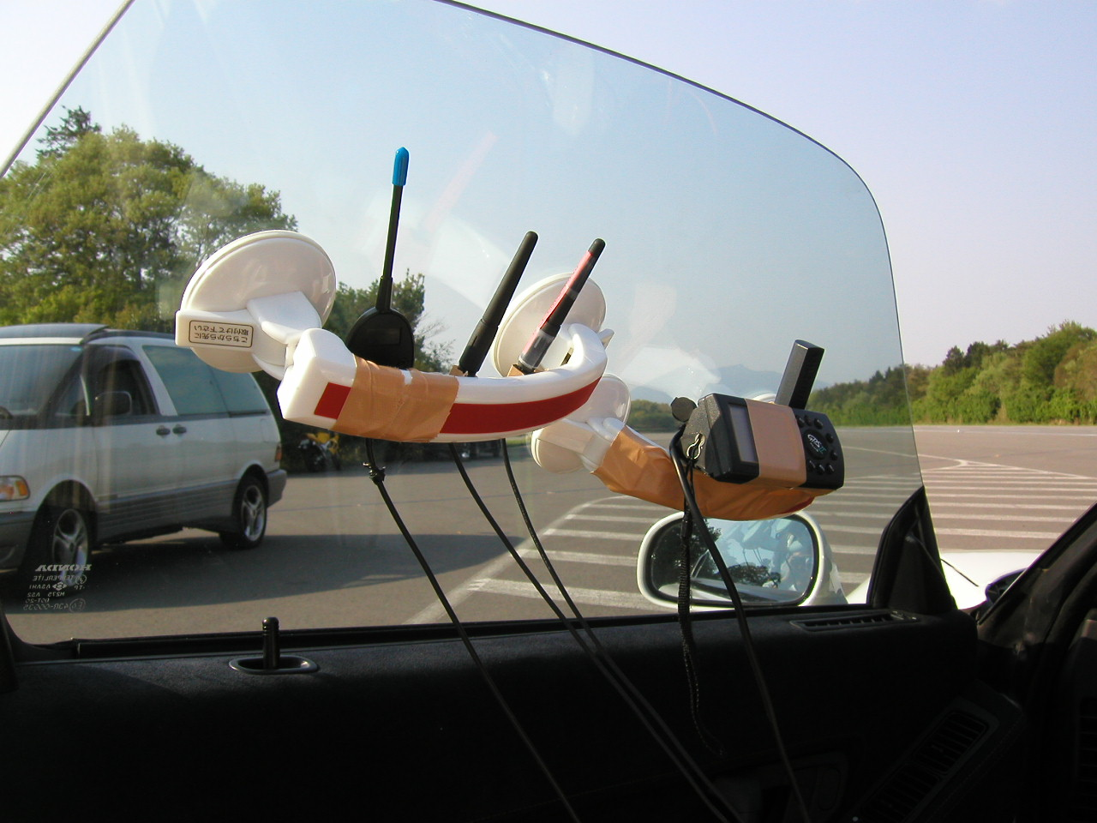
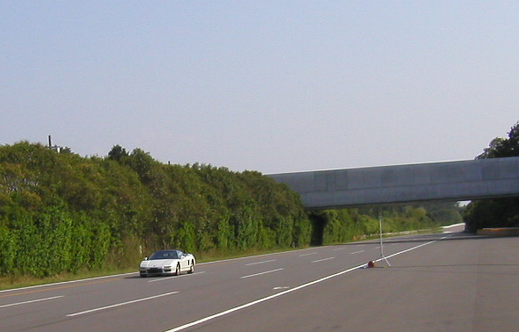
Our Trial in 2003
Antennas of the
non-AP MLD
We tested seamless handover on a test course for automobile in 2003.
We installed 4 APs along the course. The distance of each AP was 300m.
The non-AP MLD had 2 non-AP STAs.
Realtime video transfer (DVTS) was tested.
Seamless video transfer was observed up to 260km/h (speed limit of the vehicle).
We have also tested in a laboratory.
We got the results that indicated no packet losses for 1ms interval UDP TX/RX.
Non-AP MLD
In this vehicle
AP

Slide 6
MLD Roaming Consideration
Key points of seamless roaming:
  UL is simple. Just use the preferred link.
  DL needs
    To change routing in the LAN
    To prevent dropping buffered packets
How to change routing in the LAN
  Non-AP MLD can notify its location by transmitting a broadcast frame to the LAN with the MLD MAC address as the source address. (e.g Gratuitous ARP/NDP)
  After receiving the broadcast frame, IEEE 802.1Q compliant devices will update the routing table and forward the frames correctly. (IEEE 802.1Q-2022 8.7 The Learning Process)
How to prevent buffered packets from dropping
  Keep link connected until it is considered that no buffered packets are remaining.
Seamless roaming can be realized by existing IEEE 802.11.
  Just a non-AP MLD implementation issue.

Slide 7
What should be standardized?
We should consider standardization issue and implementation issue separately.
Standardization is required if interactions with other STAs are required.
MLD seamless roaming can be realized only by non-AP MLD implementation, without any changes on AP side.
  In other words, we can implement seamless roaming without any changes / violations of the existing standards.
Although I am open to make a new standard for seamless roaming, I wonder if it is really required.

Slide 8
References
H. Morioka, M. Ohmori, M. Ohta, H. Mano, “Development of a Seamless Handover Method Using Two Wireless LAN Devices on a Mobile Node”, The 10th IPSJ DPS Workshop, 2002 (Japanese)
H. Morioka, H. Mano, M. Ohmori, M. Ohta, M. Hirabaru, M. Hasegawa, M. Inoue, "Seamless Handover with Wireless LAN, Mobile IP, MISP and PDMA", The 9th International Symposium on Wireless Personal Multimedia Communications, 2006

