Slide 1
MLD Roaming scenarios
Date: 2024-01-12
Authors:

Slide 2
Abstract
This contribution discusses MLD roaming scenarios with enabling seamless roaming for non-AP MLD STAs
Make before break
Eliminate the packet loss
STA assists in the roaming to reduce packet loss and latency

Slide 3
Scenario 1. “Intra V-MLD” Roaming
DS
ETH switch
Purpose:
Extend the EHT architecture to allow APs/MLDs to be not co-located
Optimize data path to DS to reduce latency
Provide lossless roaming
Each MLD may consist of one or more Affiliated APs
Data path
Virtual MLD
Virtual MLD
Management path (proprietary)
MLD1
MLD2
Roaming/Virtual MLD:
Non-Link specific management frame endpoint
STA MLD associates with V-MLD MAC address
Reordering buffer is in the MLDs only (no buffer in the V-MLD)
V-MLD does not have access to the DS
STA MLD

Slide 4
Initial phase:
Router
DL Data
DL Ethernet frame
Ethernet Switch
UL Data
UL Ethernet frame
2.4GHz
5GHz
AP MLD1
AP MLD2
5GHz
2.4GHz
DL Data & UL DATA
STA MLD

Slide 5
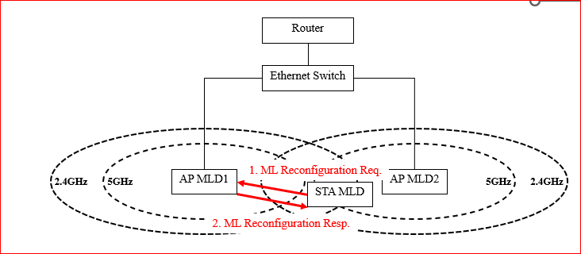
Transition step 1
V-MLD
Add link to MLD2
STA sends ML reconfig to MLD1 to set up link(s) with MLD2. This step can be
STA initiated
MLD triggered

Slide 6
Transition Step 2a
Router
Ethernet Switch
1. MLD Roaming Indication
2.4GHz
5GHz
AP MLD1
AP MLD2
5GHz
2.4GHz
STA MLD
STA initiates roaming by sending a Roaming Indication frame to MLD1

Slide 7
Transition Step 2b
Router
Ethernet Switch
UL Data
UL Ethernet frame
2a. Flush UL Data frames received from STA MLD
2b. V-MLD coordination (context sync)
2.4GHz
5GHz
AP MLD1
AP MLD2
5GHz
2.4GHz
STA MLD
MLD1 flushes UL data to DS

Slide 8
Transition Step 3
STA Requests DS Map Update to MLD2 (DS stops sending DL data through MLD1)
STA sending UL data (if any) through MLD2 does DS Map update automatically
STA may request MLD2 to buffer its DL data until ready to receive
Router
Ethernet Switch
DS Mapping update
DS Map update Req
2.4GHz
5GHz
AP MLD1
AP MLD2
5GHz
2.4GHz
DL data for STA MLD
STA MLD

Slide 9
During transition
Depending on STA capabilities, DL data is retrieved by the STA either sequentially or in parallel from the MLDs
If sequential, STA requests MLD2 to buffer DL data for STA until STA receives all DL from MLD1
Router
DL Data
Ethernet Switch
DL Ethernet frame
UL Data
UL Ethernet frame
MLD2 to buffer DL Data frames until STA ready to receive DL from MLD2
2.4GHz
5GHz
AP MLD1
AP MLD2
5GHz
2.4GHz
DL Data
STA MLD
UL Data

Slide 10
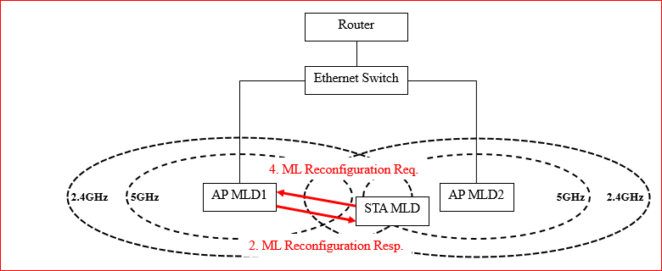
Transition Step 4a
STA releases its links with MLD1
Requests the DL data from MLD2

Slide 11
Transition Step 4b
STA request for DL Data (if buffering was requested)
Router
Ethernet Switch
2.4GHz
5GHz
AP MLD1
AP MLD2
5GHz
2.4GHz
STA MLD
UL/DL data with MLD2

Slide 12
Roaming complete
Router
DL Data
Ethernet Switch
DL Ethernet frame
UL Data
Pack
UL Ethernet frame
STA MLD
DL Data & UL DATA
2.4GHz
5GHz
AP MLD1
AP MLD2
5GHz
2.4GHz

Slide 13
What is proposed to enable this roaming scenario
Define procedures which allows
MLDs to indicate they belong to a V-MLD
STA to indicate roaming intent and MLD buffer flush request
STA to request DS Map Update
STA to request DL data buffering for the roaming transition period

Slide 14
Submissions on roaming topic
11-23-1884
11-23-1897
11-23-1907
11-23-1908
11-23-1937
11-23-1971
11-23-1976
11-23-1996
11-23-2157
. . .

Slide 15
3 distinct characteristics for the proposals
Require context transfer directly between MLDs
Require context sync through a V-MLD
Reuse and extend the existing FT architecture

Slide 16
Main differences between proposals 1/2
Context Sync/Transfer on the backend
Only for control msgs vs control msgs & buffered data forwarding
Buffered data forwarding only practical when source and target APs can have a direct connection
Reuse the FT architecture vs sharing the PTK among APs
STAs use 2 keys and DL from 2 APs during the roaming period
STAs use only one key at a time and forward buffered data from source MLD to target MLD
Sync/transfer happens between AP MLDs or between AP MLDs and a V-MLD

Slide 17
Main differences between proposals 2/2
Frontend:
Reusing FT architecture requires STA to re-associate
2 PTKs for a temporary period
Complicates STA implementations
1 PTK and data forwarding
delay and data loss impact
Sharing the PTK among APs (either directly between APs or through a V-MLD) removes the requirement from the STA to reassociate
Is the aspect of requiring STA to re-associate important/crucial in the 11bn seamless roaming design?
Crucial part is the 2 keys vs 1 key usage at the STA during the roaming transition period

Slide 18
Context Sync/Transfer between MLDs
Directly between AP MLDs
Requires APs to create a mesh among themselves (n(n-1)/2 connections)
Through a V-MLD
Each AP requires only one connection to the V-MLD
V-MLD would not require any inter-AP communication definition in the spec

Slide 19
Way forward
Decide on the roaming architecture
transfer the context (SN, PN, SCS, rTWT, BA …) between the AP MLDs vs. reuse of the FT architecture
transfer PTK between AP MLDs (to enable reuse of the same key) vs. reuse of FT architecture and require STAs to use 2 keys during the roaming transition
If former, then rekey after roaming
enable data forwarding for MSDU transfer between source and target AP, when practical:
AP MLDs have direct connection
‘raw’ MSDU transfer possible
context sync/transfer done directly or through a V-MLD

Slide 20
SP
To enable seamless roaming, do you agree to:
transfer the context (SN, PN, SCS, rTWT, BA …) between the AP MLDs instead of reusing the FT architecture
transfer PTK between AP MLDs instead of reusing the FT architecture and require STAs to use 2 keys during the roaming transition
enable data forwarding for MSDU transfer between source and target AP, for deployments when practical
define a framework for V-MLD

