Slide 1
Handling of TXOP for R-TWT in Presence of Beacon Transmission
Date: 2024-01-15
Authors:

Slide 2
Introduction
In current 11be specification, a conflicting behavior has been identified:
  In Clause 11.1.3.2 no limitation is set on transmitting a beacon at the start of the quiet time for R-TWT SP.
  In Clause 35.8.4.1 the specification grants the R-TWT SP the highest priority and prevents a beacon to be transmitted.
How to handle the overlap between a beacon transmission and the start of an R-TWT SP is currently not addressed, and behavior is contradicting along the specification.

Slide 3
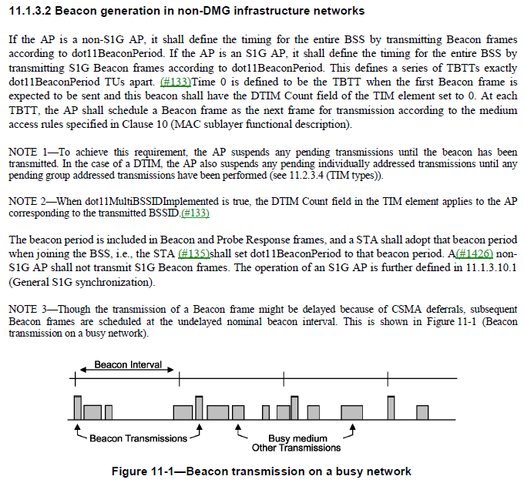
Legacy Specification Language for Beacon Generation
For 11be no specification changes have been applied so far.
Based on Clause 11.1.3.2, AP transmits a Beacon regardless on when this overlaps with the start point of R-TWT SP.

Slide 4
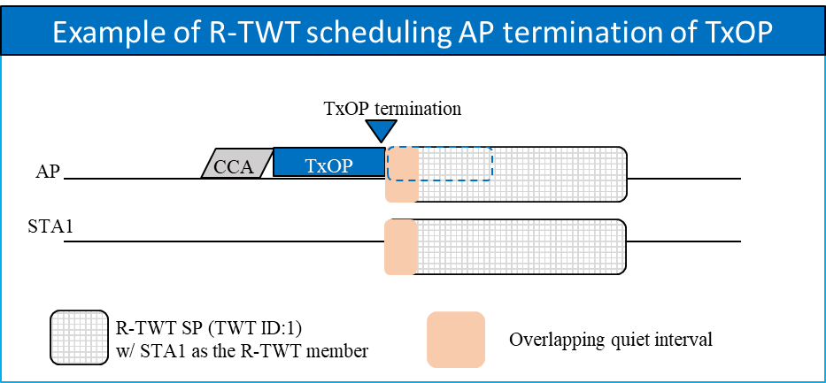
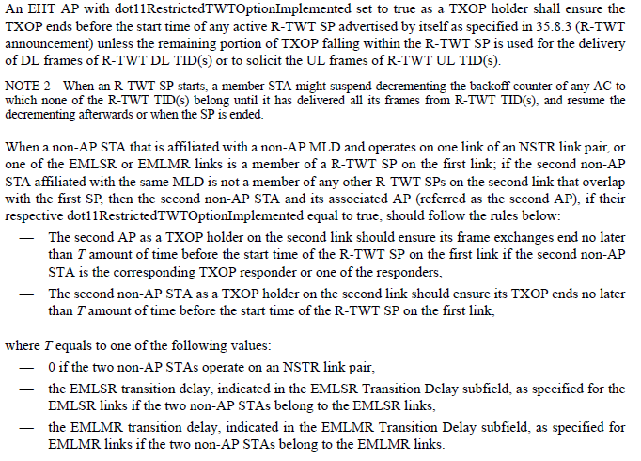
TxOP Termination Rule at the start of R-TWT SP (1/2)
In Clause 35.8.4.1 TXOP and backoff procedures rules for R-TWT SPs :
TxOP is terminated before the quiet time starts, unless TXOP is used for DL frames of R-TWT DL TID(s) or solicit the UL frames of R-TWT UL TID(s) (no Beacon transmission).
Notice that there is no issue in B-TWT as no related protection/prioritize scheme was introduced.

Slide 5
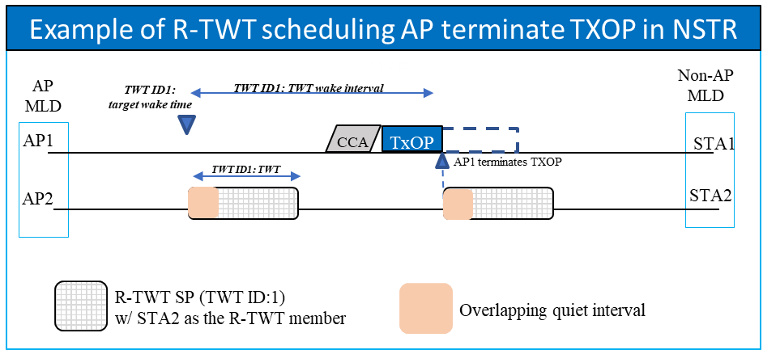
TxOP Termination Rule at the start of R-TWT SP (2/2)
In Clause 35.8.4.1 TXOP and backoff procedures rules for R-TWT SPs :
For NSTR, a Beacon is sent on the primary link only.
  If R-TWT SP is transmitted on the primary link, same issue as single link issue arises;
  If R-TWT SP is on the non-primary link, termination of the TxOP would occur along the whole channel BW (no beacon transmission).

Slide 6
Proposals
Given the current inconsistency, how to handle the overlap between a beacon transmission and the start of an R-TWT should be addressed.
If you agree on the identified issue, then the specification should be modified so that Beacon transmission priority > 11be R-TWT rule.

Slide 7
Summary
The AP behavior is not clearly indicated for the case when a beacon transmission and the start of an R-TWT SP are overlapping.
This contribution proposes to solve this ambiguity. In this matter, we propose to update the specification so that to give higher priority to a Beacon frame when this overlaps with the starting point of an R-TWT SP.

Slide 8
References
[1] Draft P802.11REVme_D4.1, “Part 11: Wireless LAN Medium Access Control (MAC) and Physical Layer (PHY) Specifications”, October 2023.
[2] Draft P802.11be_D5.0, “Part 11: Wireless LAN Medium Access Control (MAC) and Physical Layer (PHY) Specifications - Amendment 8: Enhancements for extremely high throughput (EHT)”, November 2023.

Slide 9
Straw Poll 1
Do you agree to address that the handling of TXOP for R-TWT in presence of Beacon transmission should be addressed?

Slide 10
Straw Poll 2
If you agree to address the identified issue, do you agree to give higher priority to a Beacon frame when this overlaps with the starting point of an R-TWT SP?

