Slide 1
Numerologies to include Optical Bands
Date: 2024-01-15
Authors:

Slide 2
Abstract
This contribution considers numerologies to include optical bands into the IMMW scope. Both, the original numerology from sub-7GHz and the up-clocked numerology for mm-wave bands may be supported in optical bands.

Slide 3
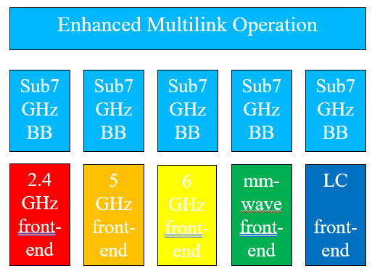
Previous work and this contribution
Recent contributions in IMMW SG show significant interest in use of higher bands
  [1-4] proposed to reuse existing sub-7GHz baseband waveforms
  [5, 6] proposed a limited scope to minimize effort in general
  [7] discussed beacon issues
  [8] proposed to extend the scope and include optical bands
  [9, 10] provide background on 11bb in optical bands
  this approach can only work if parts of the standard are reused
Numerology is critical issue
  definitions for optical bands to be proposed

Slide 4
RMS delay spread
Most application scenarios are inside buildings
  light propagation is via dominant line-of-sight (LOS)
  minor diffuse reflections at walls and objects
  NLOS is 20…30dB_{el} below LOS signals [11]
  light propagation is limited to a single room, walls are opaque
11bb channel models
  longest path delay is 100 ns in industrial scenario
  RMS delay spreads are below 20 ns [12]
Cyclic prefix can be very short
  100 ns as proposed for mm-wave may work very well
  impact on performance to be evaluated
Source: https://ieeexplore.ieee.org/abstract/document/8864131 [11]
Source: 11-18/1582r4, „IEEE 802.11bb Reference Channel Models for Indoor Environments [12]

Slide 5
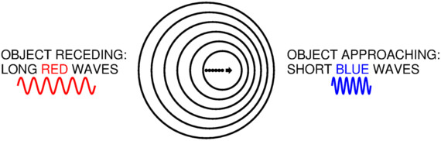
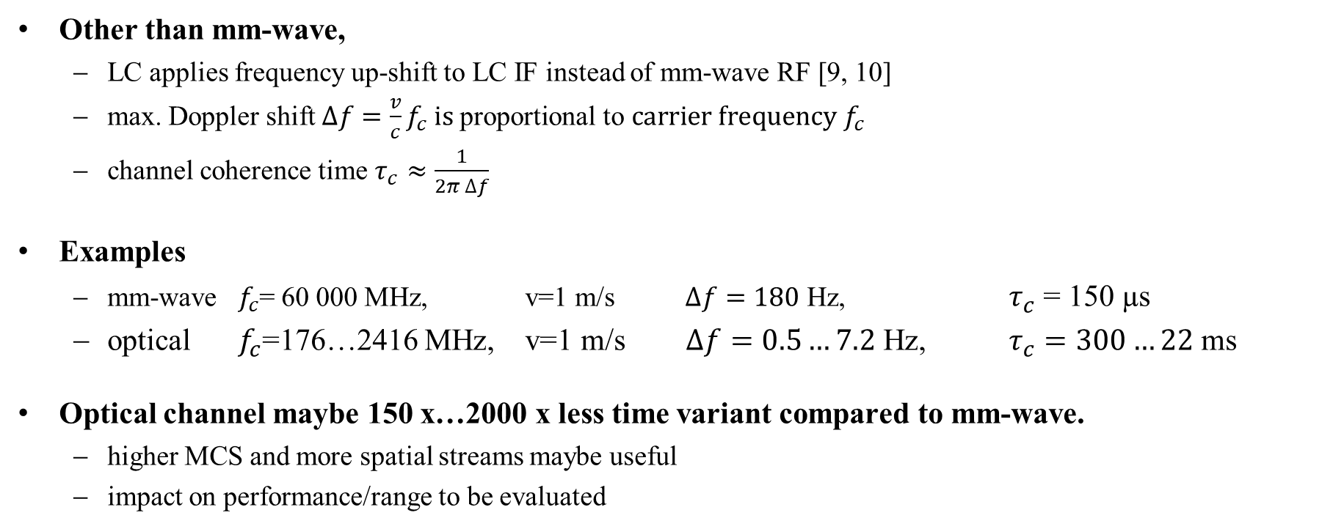
Channel coherence time
Other than mm-wave,
  LC applies frequency up-shift to LC IF instead of mm-wave RF [9, 10]
  max. Doppler shift $∆f=\frac{v}{c}f_{c} is \text{proportional} \text{to} carrier frequency$ $f_{c}$
  channel coherence time $τ_{c}≈\frac{1}{2π ∆f}$
Examples
  mm-wave $f_{c}$= 60 000 MHz, v=1 m/s $∆f=180$ Hz, $τ_{c}$ = 150 µs
  optical $f_{c}$=176…2416 MHz, v=1 m/s $∆f=0.5…7.2$ Hz, $τ_{c}=300…22$ms
Optical channel maybe 150 x…2000 x less time variant compared to mm-wave.
  higher MCS and more spatial streams maybe useful
  impact on performance/range to be evaluated
Source: https://astro.ucla.edu/~wright/doppler.htm

Slide 6
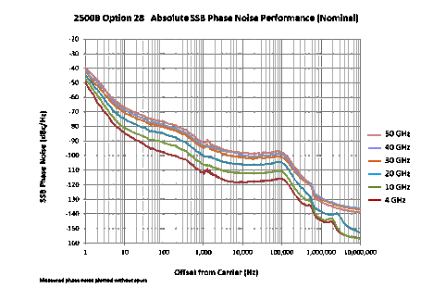
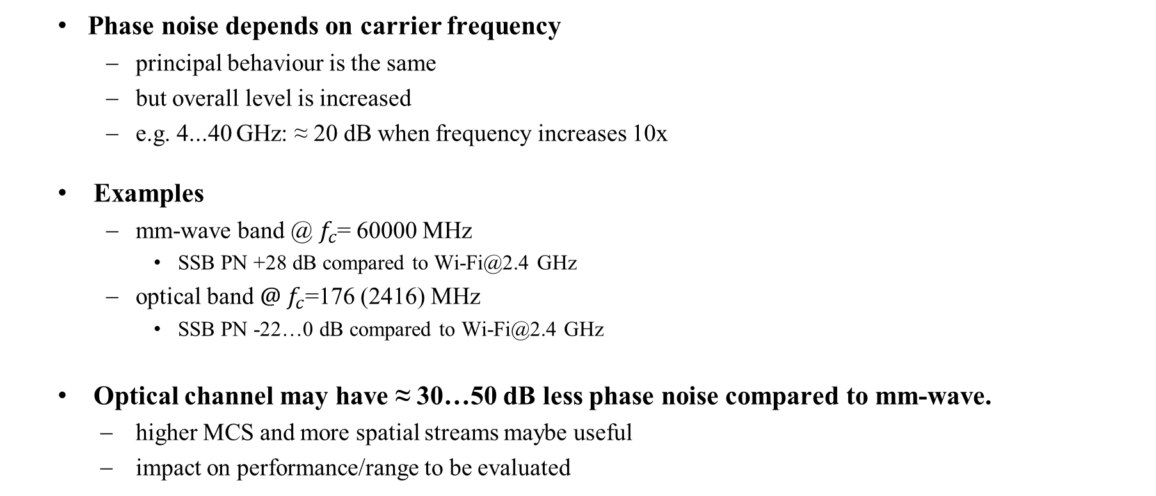
Phase noise
  Phase noise depends on carrier frequency
    principal behaviour is the same
    but overall level is increased
    e.g. 4...40 GHz: ≈ 20 dB when frequency increases 10x
  Examples
    mm-wave band @ $f_{c}$= 60000 MHz
      SSB PN +28 dB compared to Wi-Fi@2.4 GHz
    optical band ${@ f}_{c}$=176 (2416) MHz
      SSB PN -22…0 dB compared to Wi-Fi@2.4 GHz
  Optical channel may have ≈ 30…50 dB less phase noise compared to mm-wave.
    higher MCS and more spatial streams maybe useful
    impact on performance/range to be evaluated
Source: https://www.edn.com/impact-of-phase-noise-in-signal-generators/

Slide 7
Implications on numerology
  Optical bands can use the same cyclic prefix like mm-wave.
    delay spread is small enough
  Optical bands do not necessarily need to increase carrier spacing.
    significantly lower Doppler frequencies and phase noise
    higher MCS and more spatial streams maybe useful
  Optical bands can be considered “transparent”.
    i.e., both, the original numerology from sub-7GHz and the up-clocked numerology derived from sub-7GHz for mm-wave bands can be supported in optical bands

Slide 8
Summary
In order to maximize reuse of HW/SW, numerologies should be aligned with mm-wave when including optical bands.
Both, the original numerology from sub-7GHz and the up-clocked numerology derived from sub-7GHz for mm-wave bands can be supported in optical bands.

Slide 9
References
[1] Integrated mmWave Design Considerations, doc. 11-23/1819r1 https://mentor.ieee.org/802.11/dcn/23/11-23-1819-01-immw-integrated-mmwave-design-considerations.pptx
[2] High-Level Design Considerations of IMMW, 11-23/1878r1, https://mentor.ieee.org/802.11/dcn/23/11-23-1878-01-immw-high-level-design-considerations-of-immw.pptx
[3] Requirements Analysis for IMMW Use Cases, 11-23/1977r1, https://mentor.ieee.org/802.11/dcn/23/11-23-1977-01-immw-requirements-analysis-for-immw-use-cases.pptx
[4] Discussion on Enabling MIMO in IMMW, 11-23/1991r, https://mentor.ieee.org/802.11/dcn/23/11-23-1991-00-immw-discussion-on-enabling-mimo-in-immw.pptx
[5] Technical scope proposal, 11-23/2004r0, https://mentor.ieee.org/802.11/dcn/23/11-23-2004-00-immw-technical-scope-proposal.pptx
[6] High-level thoughts on IMMW, 11-23/1905r0, https://mentor.ieee.org/802.11/dcn/23/11-23-1905-00-immw-high-level-thoughts-on-immw.pptx
[7] mmWave operation without mmWave Beacon, 11-23/2152r0, https://mentor.ieee.org/802.11/dcn/23/11-23-2052-00-immw-mmwave-operation-without-mmwave-beacon.pptx
[8] Extend IMMW scope to include optical bands, 11-23/2016r2, https://mentor.ieee.org/802.11/dcn/23/11-23-2016-02-immw-extend-immw-scope-to-include-optical-bands.pptx
[9] IEEE Std 802.11bb-2023, https://standards.ieee.org/ieee/802.11bb/10823/
[10] IEEE 802 Tutorial “IEEE 802 Standards on Light Communication” at March 2023 Plenary Meeting https://mentor.ieee.org/802.11/dcn/23/11-23-0277-01-0000-ieee-802-standards-on-light-communication.pdf
[11] Sreelal M. Mana et al., "Experiments in Non-Line-of-Sight Li-Fi Channels," 2019 Global LIFI Congress (GLC), Paris, France, 2019, https://ieeexplore.ieee.org/document/8864131
[12] 11-18/1582r4, „IEEE 802.11bb Reference Channel Models for Indoor Environments”, https://mentor.ieee.org/802.11/dcn/18/11-18-1582-04-00bb-ieee-802-11bb-reference-channel-models-for-indoor-environments.pdf
[13] 11-23/0221r1 “Hybrid LC and RF in UHR” https://mentor.ieee.org/802.11/dcn/23/11-23-0221-01-0uhr-hybrid-lc-and-rf-in-uhr.pptx
[14] 11-23/0091 “New Light Communication Features” https://mentor.ieee.org/802.11/dcn/23/11-23-0091-00-0wng-light-communication-for-uhr.pptx

Slide 10
For discussion only
Parameter | 11n | 11ac | 11ax | 11be | IMMW [2] | IMMW [5] | IMMW [4] | IMMW [6] | ILC_1 | ILC_2
 | HT | VHT | HE | EHT
Upclocking scheme |  |  |  |  | 78.125*2^n, n=4,5 | 312,5Khz*8 | 312,5Khz*8 |  | EHT*1 | IMMW
Channel BW | 20, 40 | 20, 40, 80, 160 | 20, 40, 80, 160 | 20, 40, 80, 160, 320 | 320, 640, 1280, 2560 | 160, 320, 640, 1280 | 320, 640, 1280, 2560 | 320, 640 | 320 | 640, 1280, 2560
Subcarrier spacing (kHz) | 312.5 | 312.5 | 78.125 | 78.125 | 1.25, 2.5 MHz | 2.5 MHz | 2.5 MHz |  | 78.125 | 2.5 MHz
Cyclic prefix (µs) | 0.8 | 0.8 | 3.2 | 3.2 | 0.1 | 0.1 | 0.1 |  | 3.2 | 0.1
Spatial streams | 1..2 (max. 4) , SU-MIMO | 1…4 (max. 8), SU-MIMO, MU-MIMO (DL) | 1...8, SUMIMO, MUMIMO | 1...8, SUMIMO, MUMIMO | 2 or 4 | SUMIMO | SUMIMO, MUMIMO: FFS | 1, (2 FFS) | mobile apps 1...8, SUMIMO, MUMIMO | nomadic apps 1 or 2 (PolMux)
Constellation | BPSK, QPSK, 16QAM | BPSK, QPSK, 16QAM, 256QAM | BPSK, QPSK, 16QAM, 256QAM, 1024QAM | BPSK, QPSK, 16QAM, 256QAM, 1024QAM, 4096QAM | BPSK, QPSK, 16QAM, 256QAM | simple beamforming |  | BPSK, QPSK, 16QAM | BPSK, QPSK, 16QAM, 256QAM, 1024QAM, 4096QAM | BPSK, QPSK, 16QAM, 256QAM

