Slide 1
Comparison of OFDM and EDMG SC Waveform
Date: 2024-01-12
Authors:
Name | Affiliations | Address | Phone | email
Thomas Handte | Sony Group Corporation |  |  | Thomas.Handte@sony.com
Yusuke Tanaka |  |  |  | Yusuke.YT.Tanaka@sony.com
Salvatore Talarico |  |  |  | Salvatore.Talarico@sony.com
Dana Ciochina
Daniel Verenzuela
Ken Tanaka
Kosuke Aio
Ryuichi Hirata
Qing Xia

Slide 2
Introduction
Goals of integrated mmWave [1,2] are to …
… combine mmWave and sub-7 GHz via MLO framework
… reuse sub-7GHz OFDM waveform for application in mmWave
Studies have been done which compare parameters of upclocked 11ac waveform with EDMG OFDM waveform [3,4]
However, EDMG OFDM waveform is optional
Performance of any new waveform should be compared to EDMG single carrier (SC) which is the only mandatory PHY mode
IMMW should not compromise its performance vs. EDMG SC
This submission compares OFDM with SC waveform and provides some design considerations
Particularly, we analyze the output power backoff of the power amplifier (PA)
We derive the bandwidth (BW) at which the OFDM waveform is expected to achieve same link budget/ range as EDMG SC

Slide 3
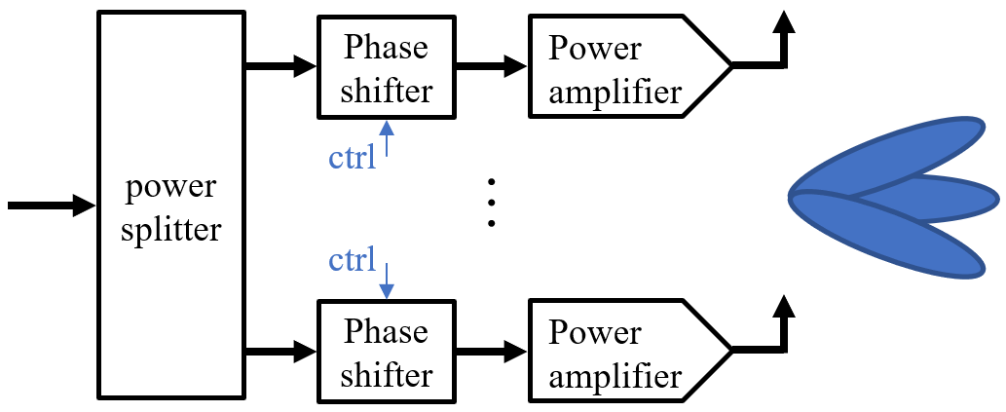
RF frontend in mmWave
A mmWave RF frontend is challenging to implement
Need for power splitters, switches, and phase shifting circuitries to implement analog beamforming
Those components have non-zero loss
RF power is scarce resource
A power amplifier (PA) for 60 GHz has typ. 10dBm output power
=> various PAs reside in an RF frontend
It is difficult to do digital predistortion (DPD) for all [5]
Thus, consideration of PA characteristic is very important
For our analysis, we use the PA model of EDMG evaluation methodology [6]
PA backoff parameter is defined as $BO=−10\log_{10}\left({P_{avg}}/{P_{sat}}\right)$
$P_{avg}$ average transmit power
$P_{sat}$ maximum transmit power

Slide 4
PA backoff (BO) considerations
PA BO depends on waveform
SC requires
BO ≈ 0.5dB for BPSK/QPSK
BO ≈ 3dB for 16-QAM
OFDM requires
BO ≈ 8dB for BPSK/QPSK/16-QAM
BO numbers are designed …
… to meet spectral mask
… to achieve about -20dB EVM
Higher order modulation (>16-QAM) may require higher backoff
E.g. EDMG 64-QAM has -27dB as EVM requirement
… for EDMG SC and EDMG OFDM PHY
IMMW waveform may require slightly different BO because of
Higher robustness due to LDPC with longer CWs
having different guard bands
BO numbers correlate with recommendation of [6]

Slide 5
PA Backoff and Bandwidth implications
A PA achieves lower average transmit power with increasing BO
SC achieves 7.5dB (QPSK) or 5.5dB (16-QAM) more average transmit power compared to OFDM
A lower bandwidth increases power spectral density [dBm/MHz]
IMMW targets lower bandwidth compared to EDMG
Limits to power spectral density may apply for lower bandwidths in some countries
E.g. EIRP ≤ 40dBm and ≤ 23dBm/MHz (ETSI)
BW ≥ 50 MHz
Both effects need to be studied to estimate link budget/ range of the new waveform

Slide 6
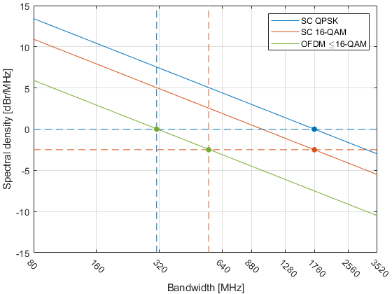
Achievable Spectral Density
Upper bound of spectral density depending on waveform type
Reflecting BO requirements
SC has an advantage over OFDM of at least 5dB
OFDM achieves same spectral density as SC waveform…
… for a BW of 310 MHz (QPSK)
… for a BW of 550 MHz (16-QAM)
320 MHz seems to be reasonable choice for IMMW waveform
160 / 640 MHz would result in 3dB more / less link budget compared to SC QPSK which could be acceptable
Better than EDMG SC QPSK
Worse than EDMG SC QPSK

Slide 7
Conclusion
IMMW OFDM waveform needs to be compared to EDMG SC
OFDM and SC waveform have different requirements for PA BO
Different bandwidths are discussed for IMMW compared to EDMG
IMMW should not compromise its performance vs. EDMG
Comparison shows that an OFDM waveform with a bandwidth of 320 MHz achieves roughly same link budget/ range as EDMG SC
Slightly higher bandwidth may be feasible and acceptable from QoE perspective
Significantly higher bandwidth comes with link budget/ range reduction
unless compensated by appropriate means (e.g. PAPR reduction, higher beamforming gain)
A reasonable operating bandwidth of IMMW seems to be 160 – 640 MHz
Especially in the light that a “simple PHY” is desired for IMMW

Slide 8
References
[1] 11-23/1819r1 “Integrated mmWave Design Considerations”
[2] 11-23/1905r0 “High Level Thoughts on IMMW”
[3] 11-22/1395r0 “ Thoughts on high frequency band”
[4] 11-22/1872r0 “Considerations on PHY designs for mmWave band”
[5] Why Millimeter Wave Requires a Different Approach to DPD and How to Quantify Its Value | Analog Devices
[6] 11-15/0866r4 “11ay evaluation methodology”

